Slide 1
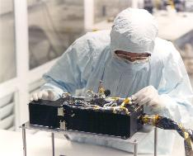
R-Alice Lutetia PDS/PSA Data Review
Kurt Retherford

Slide 2
Datasets Reviewed
RO-A/CAL-ALICE-2-AST2-V1.0
RO-A/CAL-ALICE-3-AST2-V1.0
RO-A/CAL-ALICE-4-AST2-V1.0
Review Conclusions
Data are ready to be released after minor RIDs are addressed (no delta-review needed)
RIDs submitted: 279, 291, 292, 293

Slide 3
R-Alice Spec’s
Spectral Range 700 - 2050 Angstroms
Spectral Resolution 12.5 - 9.8 Angstroms for extended sources
Spatial Resolution 0.6 degrees
Projected Entrance Slit 0.1 by 6 degrees
Nominal Effective Area 0.03cm² (at 1900 Angstroms), to 0.53cm² (at 1150 Angstroms)
Very similar to the New Horizons Alice and LRO LAMP instruments I work with.

Slide 4
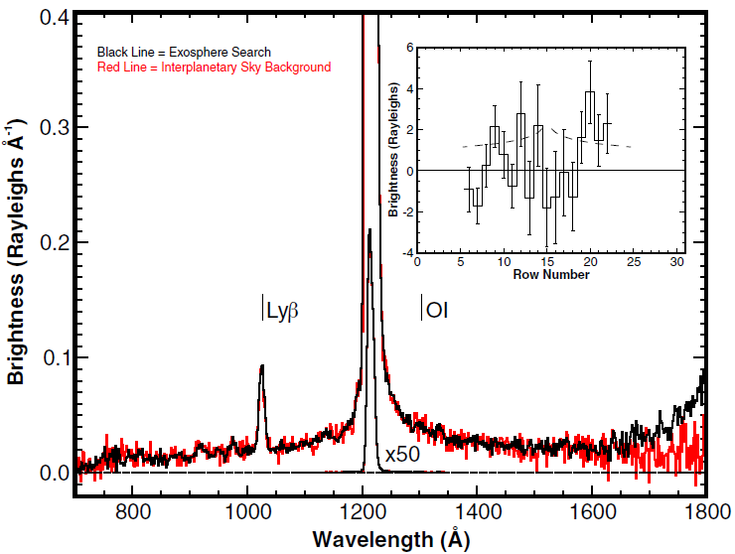
R-Alice Lutetia Results
Stern et al., “Ultraviolet Discoveries at Asteriod (21) Lutetia by the Rosetta Alice Ultraviolet Spectrograph,” AJ, 2011.
Notes:
Figure 1. Alice spectrum (rows 14–16) observed on approach to Lutetia (black). Also shown (red) is the IPM background observed following closest approach. The inset shows the difference in the Lyα spatial profile, corrected for temporal variability in solar Lyα. Error bars are 1σ in the counting statistics. At the mean distance of the observations, 1 row is ∼10,000 km and the asteroid is centered in row 15. The dashed line is a Haser model with Q(H2O) = 1.0×1026 molecules s−1. The rise in signal longward of 1650Åis from Lutetia’s reflectance seen even at this distance.

Slide 5
R-Alice Lutetia Observations
Beginning on approach to Lutetia on 2010 July 8 at 14:30 UT,
at a distance of 2.7×106 km,
we obtained 22 separate spectra of the region around the asteroid;
these observations totaled 20.2 hr of integration,
ending on 2010 July 9 at 18:15 UT
at a distance of 1.2×10⁶ km from the asteroid.
Rows 14-16 extracted.

Slide 6
Evaluation Tools
Lenovo Thinkpad Running via VMWare SuSE 11.4x64
Desktop PC running SuSE – data installed just fine
IDL 8.0
Readpds v4.5
Astron library

Slide 7
RO-A/CAL-ALICE-2/3/4-AST2-V1.0
AAREADME.TXT, VOLDESC.CAT, and ERRATA.TXT: good

Slide 8
RO-A/CAL-ALICE-2/3/4-AST2-V1.0
CALIB/CALINFO.TXT: good
CALIB/RA_AEFF_008
RA_CR2_PC10_CORRECTION
RA_CVP2_PC10_CORRECTION
RA_ESB2_PC10_CORRECTION
RA_ESB3_PC10_CORRECTION
RA_MARS_PC10_CORRECTION
RA_PC4_PC10_CORRECTION
RA_PC6_PC10_CORRECTION
RA_PC8_PC10_CORRECTION
RA_STEINS_PC10_CORRECTION
CALIB/RA_PC12_AEFF_001
RA_LUTETIA_PC12_CORRECTION
CALIB/Flat, Dark, and Wave (2,3,4): good
Flats not recommended for use (~5% effect)

Slide 9
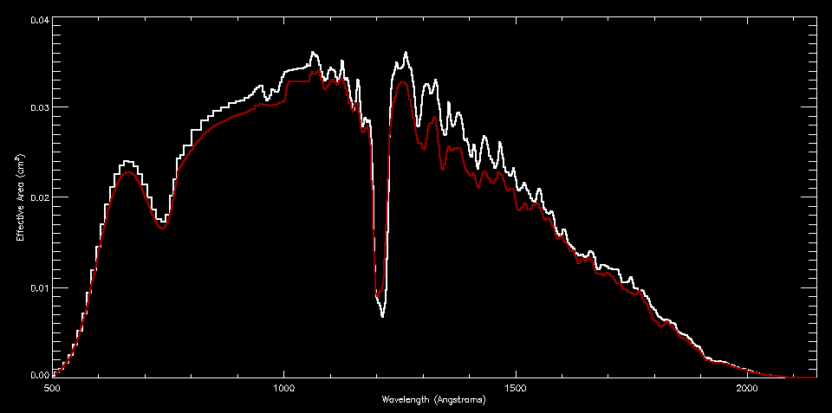
Effective Area Calibration Data
Before and After Correction

Slide 10
Effective Area Calibration Data
Trouble reading RA_PC12_LUTETIA_CORR.TAB
Probably my environment variables (new setup), rather than the file
Readcol brings in the .TAB ascii file (2 columns) just fine

Slide 11
CATALOG, DOCUMENT, & INDEX
CATALOG/ALICE_RO.CAT through SOFTWARE.CAT (2,3,4): good
DOCUMENT/* (2,3,4): good
DOCUMENT/ALICE_DATA_TO_RAYLEIGHS.ASC is especially nice to have.
Note that conversion from flux photons/cm²/sec to differential flux (i.e., specific intensity) photons/cm²/sec/A by dividing by Δλ/pix is described here with an idl code example.
RID: The table listing solid angle per row is so useful that it should be provided as an additional calibration data product in the archive
DOCUMENT/CODE/* (2,3,4), Entire “MIKE” calibration pipeline code: good
Didn’t get around to running myself (most users won’t ever need this)
INDEX/ (2,3,4): good
2 is ENG, uncalibrated
3 is SCI, flux calibrated
4 is LIN, extracted calibrated spectra
(1 is raw datastream from spacecraft, not useable – not archived)

Slide 12
GEOMETRY
GEOMETRY/GEOMINFO.TXT: editorial change
RID
“one of the following 4-character values” =>
“one of the following 3-character values”
Missing the version number following the first three characters PIX#, HIS#, CNT#.
# might not be needed, unless related to SPICE info updates
GEOMETRY/
One for each data file
Plot of target on sky and background stars with the GeoVis (GV) software
RID: Add a reference to Throop et al. DPS 2008 poster for GV details.
These are a nice addition to the delivery

Slide 13
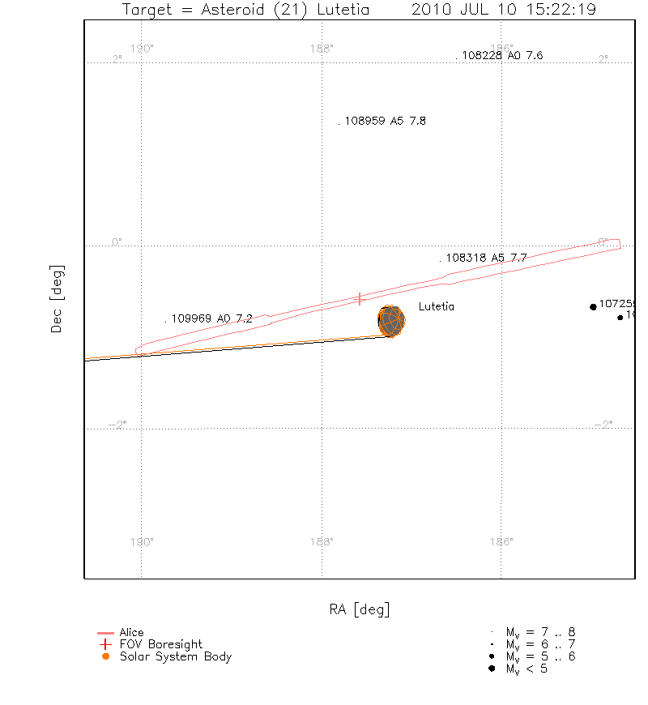
Geometry Plots

Slide 14
DATA
RA_YYMMDDhhmmss_<type>_<lev>_<v>,
where type is PIX# (pixel list), HIS# (histogram), CNT# (count rate)
and where # is the 1-digit version number to distinguish different dumps from the same observation;
where lev is ENG, SCI, or LIN level (2, 3, 4, respectively);
And where <v> is the running version number of the calibration
Why isn’t <v> always 1 here? Instead it is absent. Not a problem though.

Slide 15
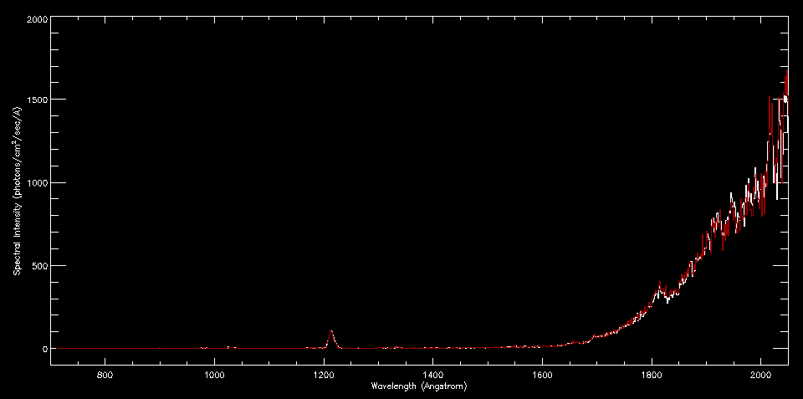
DATA
Successfully plotted SCI and LIN versions of one of the Lutetia targeted spectra

Slide 16
Summary
Data are ready to be released
Four minor RIDs
279, 291, 292, 293

