Slide 1
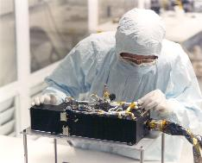
R-Alice Lutetia PDS/PSA Data Review
Kurt Retherford

Slide 2
Datasets Reviewed
RO-A/CAL-ALICE-2-AST2-V1.0
RO-A/CAL-ALICE-3-AST2-V1.0
RO-A/CAL-ALICE-4-AST2-V1.0
Review Conclusions
Data are ready to be released after minor RIDs are addressed (no delta-review needed)
RIDs submitted: 279, 291, 292, 293

Slide 3
R-Alice Spec’s
Spectral Range 700 - 2050 Angstroms
Spectral Resolution 12.5 - 9.8 Angstroms for extended sources
Spatial Resolution 0.6°
Projected Entrance Slit 0.1° by 6°
Nominal Effective Area 0.03cm² (at 1900 Angstroms), to 0.53cm² (at 1150 Angstroms)
Very similar to the New Horizons Alice and LRO LAMP instruments I work with.

Slide 4
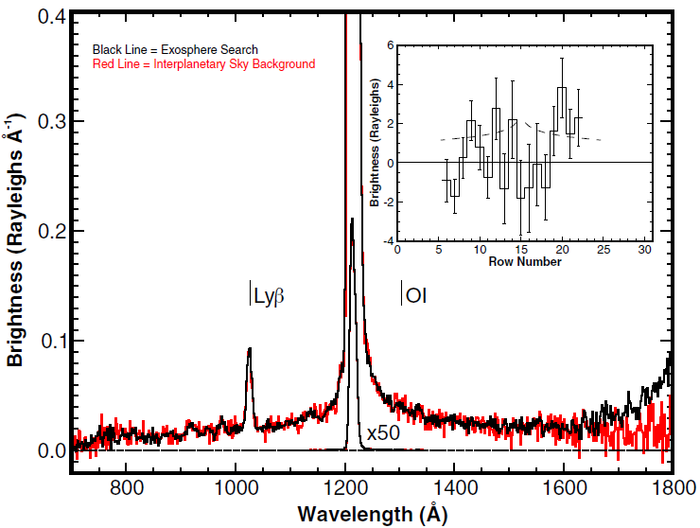
R-Alice Lutetia Results
Stern et al., “Ultraviolet Discoveries at Asteriod (21) Lutetia by the Rosetta Alice Ultraviolet Spectrograph,” AJ, 2011.
Notes:
Figure 1. Alice spectrum (rows 14–16) observed on approach to Lutetia (black). Also shown (red) is the IPM background observed following closest approach. The inset shows the difference in the Lyα spatial profile, corrected for temporal variability in solar Lyα. Error bars are 1σ in the counting statistics. At the mean distance of the observations, 1 row is ∼10,000 km and the asteroid is centered in row 15. The dashed line is a Haser model with Q(H2O) = 1.0×1026 molecules s−1. The rise in signal longward of 1650Åis from Lutetia’s reflectance seen even at this distance.

Slide 5
R-Alice Lutetia Observations
Beginning on approach to Lutetia on 2010 July 8 at 14:30 UT,
at a distance of 2.7×106 km,
we obtained 22 separate spectra of the region around the asteroid;
these observations totaled 20.2 hr of integration,
ending on 2010 July 9 at 18:15 UT
at a distance of 1.2×10⁶ km from the asteroid.
Rows 14-16 extracted.

Slide 6
Evaluation Tools
Lenovo Thinkpad Running via VMWare SuSE 11.4x64
Desktop PC running SuSE – data installed just fine
IDL 8.0
Readpds v4.5
Astron library

Slide 7
RO-A/CAL-ALICE-2/3/4-AST2-V1.0
AAREADME.TXT, VOLDESC.CAT, and ERRATA.TXT: good

Slide 8
RO-A/CAL-ALICE-2/3/4-AST2-V1.0
CALIB/CALINFO.TXT: good
CALIB/RA_AEFF_008
RA_CR2_PC10_CORRECTION
RA_CVP2_PC10_CORRECTION
RA_ESB2_PC10_CORRECTION
RA_ESB3_PC10_CORRECTION
RA_MARS_PC10_CORRECTION
RA_PC4_PC10_CORRECTION
RA_PC6_PC10_CORRECTION
RA_PC8_PC10_CORRECTION
RA_STEINS_PC10_CORRECTION
CALIB/RA_PC12_AEFF_001
RA_LUTETIA_PC12_CORRECTION
CALIB/Flat, Dark, and Wave (2,3,4): good
Flats not recommended for use (~5% effect)

Slide 9
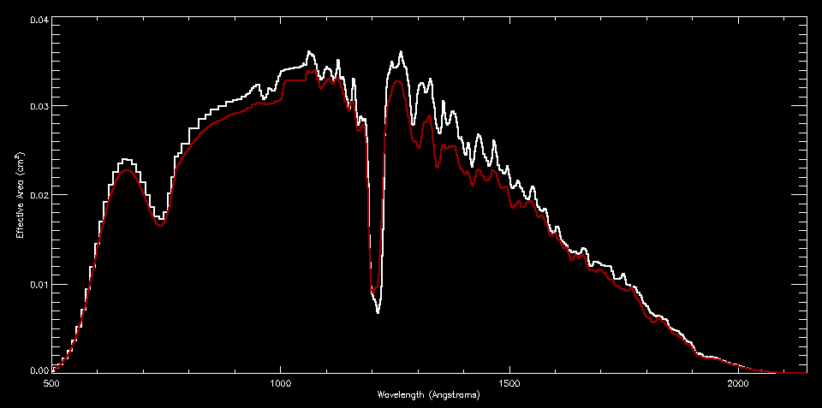
Effective Area Calibration Data
RA_AEFF_008 (white), RA_PC12_AEFF_001 (red)

Slide 10
Effective Area Calibration Data
Trouble reading with readpds the RA_LUTETIA_PC12_CORR file
“Error: File either corrupted or bad PDS Label”
Could be my environment variables (new setup), rather than the file
Readcol brings in the .TAB ascii file (2 columns) just fine
I read in the similar RA_STEINS_PC10_CORR file with readpds without error
A “diff” between the .LBLs for these two seems fine

Slide 11
CATALOG, DOCUMENT, & INDEX
CATALOG/ALICE_RO.CAT through SOFTWARE.CAT (2,3,4): good
DOCUMENT/* (2,3,4): good
DOCUMENT/ALICE_DATA_TO_RAYLEIGHS.ASC is especially nice to have.
Note that conversion from flux photons/cm²/sec to differential flux (i.e., specific intensity) photons/cm²/sec/A by dividing by Δλ/pix is described here with an idl code example.
RID: The table listing solid angle per row is so useful that it should be provided as an additional calibration data product in the archive
DOCUMENT/CODE/* (2,3,4), Entire “MIKE” calibration pipeline code: good
Didn’t get around to running myself, but this is a nice addition (most users won’t ever need this).
INDEX/ (2,3,4): good
2 is ENG, uncalibrated
3 is SCI, flux calibrated
4 is LIN, extracted calibrated spectra
(1 is raw datastream from spacecraft, not archived/archivable)

Slide 12
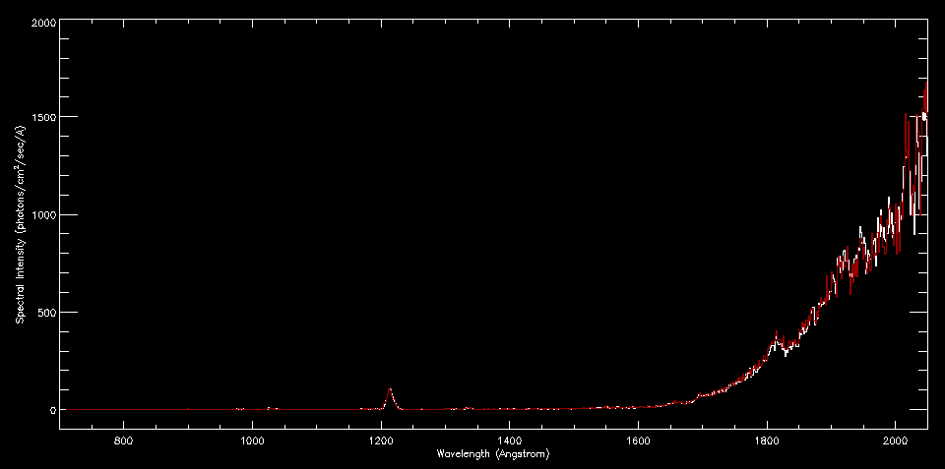
DATA
Successfully plotted SCI and LIN versions of one of the near-Lutetia targeted spectra

Slide 13
GEOMETRY
GEOMETRY/GEOMINFO.TXT: editorial change
RID
“one of the following 4-character values” =>
“one of the following 3-character values”
Missing the version number following the first three characters PIX#, HIS#, CNT#.
# might not be needed, unless related to SPICE info updates
GEOMETRY/
One for each data file
Plot of target on sky and background stars with the GeoVis (GV) software
RID: Add a reference to Throop et al. DPS 2008 poster for GV details.
These are a nice addition to the delivery

Slide 14
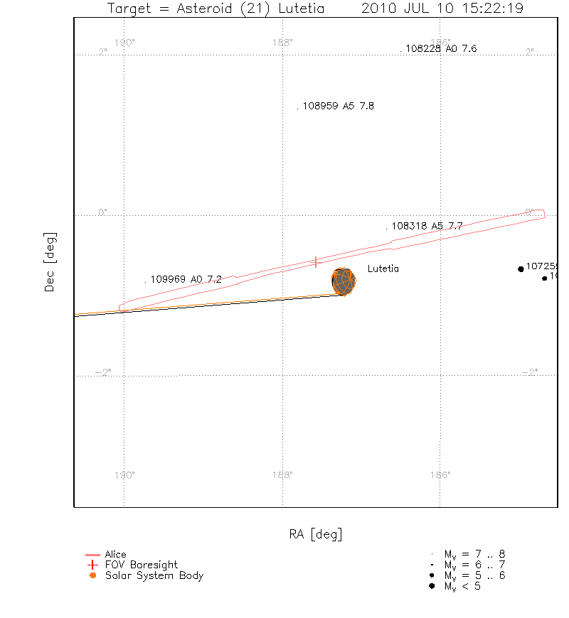
Geometry Plots

Slide 15
DATA
RA_YYMMDDhhmmss_<type>_<lev>_<v>,
where type is PIX# (pixel list), HIS# (histogram), CNT# (count rate)
and where # is the 1-digit version number to distinguish different dumps from the same observation;
where lev is ENG, SCI, or LIN level (2, 3, 4, respectively);
And where <v> is the running version number of the calibration
Why isn’t <v> always 1 here? Instead it is absent. Not a problem though.

Slide 16
Summary
Data are ready to be released
Four minor RIDs
279, 291, 292, 293
Listed on the next four slides

Slide 17
RID 279
RID Classification: Editorial
Location: Document
Location Details: DOCUMENT
Title: Spectrograph vs Spectrometer
Description: It is more common to refer to instruments with instantaneous coverage of all wavelengths as "spectrographs" and instruments that scan the frequency domain with time as "spectrometers". (Very minor.)
Recommended Solution: Replace everywhere "Spectrometer" with "Spectrograph" in future PSA/PDS deliveries and publications, at the discretion of the team.

Slide 18
RID 291
RID Classification: Minor
Location: Data Product
Location Details: DOCUMENT/ALICE_DATA_TO_RAYLEIGHS.ASC
Title: Slit Aperture FOV Solid Angle per Row Table
Description: The table within DOCUMENT/ALICE_DATA_TO_RAYLEIGHS.ASC listing solid angle per row is so useful that it should be provided as an additional calibration data product in the archive. The complicated slit shape makes this information an important component of any extended source analysis (e.g., such as the upper limits to H and O emissions reported in Stern et al., AJ, 2011).
Recommended Solution: Add a file listing the FOV of the aperture in steradians for each detector row to the CALIB/ directory. This could wait until the next delivery; the information in the ALICE_DATA_TO_RAYLEIGHS.ASC file in the current delivery is sufficient.

Slide 19
RID 292
RID Classification: Editorial
Location: Document
Location Details: GEOMETRY/GEOINFO.TXT
Title: Clarification of filename format
Description: The GEOINFO.TXT file describes the geometry .png file data filename format as including “one of the following 4-character values”, but unlike the DATA files these geometry data are missing the version number following the first three characters PIX#, HIS#, CNT#. The # might not even be needed in this case, unless it were updated along with the SPICE info updates or something.
Recommended Solution: Replace the text in question with “one of the following 3-character values”, or add the corresponding number element of the DATA filenames to the corresponding GEOMETRY filenames.

Slide 20
RID 293
RID Classification: Editorial
Location: Document
Location Details: GEOMETRY/GEOINFO.TXT
Title: Reference to GEOMETRY Plot Tool
Description: It would be appropriate to add a reference to the GV (GeoVis) plotting tool program used to create the .PNG file GEOMETRY products. Throop et al., "Introducing GV: The Spacecraft Geometry Visualizer," AAS/DPS Meeting, 2009. The plots are a nice contribution to the archive, and the reference would let any users of these plots attribute the plotting program with a reference.
Recommended Solution: Add reference.

