Slide 1
Rosetta Lutetia ALICE PDS Review
Jeff Morgenthaler

Slide 2
Major Nits
PDS labels for level 4 spectro-imaging pixels are not consistent with FITS headers or data
Not PDS labeled as “per Angstrom”
Referred to as level 3 product
No reference for coordinate system of asteroid given (how are SUB_SPACECRAFT_LON/LAT determined)?
maybe this is my ignorance

Slide 3
Cudos
GEOMETRY directory is nice (at least for stars)
Checked consistency with one of the stellar calibrations
Star not centered in slit image in GEOMETRY image
Stellar spectrum not centered in ALICE image
Makes sense
DOCUMENTATION is extensive (but could use a dictionary, see next page)
Very nice to have pipeline reduction code

Slide 4
Minor Nits
What is OBT? (not in a dictionary of terms), in another world I have heard this called mission elapse time (MET). But is it different?
What is AST2?
What is LIN
Found answer in DOCUMENT/ALICE_DATA_TO_RAYLEIGHS.ASC but a dictionary would be a nicer place to collect all of this stuff
CATALOG/CATINFO.TXT
IMHOST.CAT ← RO.CAT
MISSION.CAT ← ROSETTA.CAT
ALICE_RO.CAT ← INST.CAT

Slide 5
PDS questions
No systematic overview of directory naming structure
e.g. explaining all acronyms in mission_inst_level_???_ver in, say, CATINFO.TXT
Is this normal for PDS?
Connection to higher meta-level is always nice, so you don’t have to start in exactly the “right place” at the top level
What if PDS software goes missing?

Slide 6
In ALICE_RO.CAT
The detector has a 1024x32 pixel format (wavelength x spatial) with two side-by-side, solar-blind cathodes separated by a small gap.
Suggest:
The detector has a 1024x32 pixel format (wavelength x spatial) with two side-by-side, solar-blind cathodes separated by a small wavelength gap.

Slide 7
DOCUMENT/DOCINFO.TXT
[DOCUMENT] Directory containgin supplemental documentation for Alice data.
typo
[DOCUMENT] Directory containing supplemental documentation for Alice data.
Very nice to have the code.

Slide 8
CALIB/RA_FLAT_002.FIT
header explains flat problem, which is almost visible in ds9
Is this something that could be fixed numerically (e.g. smoothed using a combination of cross-dispersion and dispersion direction data)?
Talk to me if this is not intuitive

Slide 9
Asteroid image
A little disappointed asteroid was stellar
CATALOG/DATASET.CAT:
SUB_SPACECRAFT_LATITUDE, SUB_SPACECRAFT_LONGITUDE are given in the PLANETOGRAPHIC coordinate system
No reference for this coordinate system is given (that I could find)

Slide 10
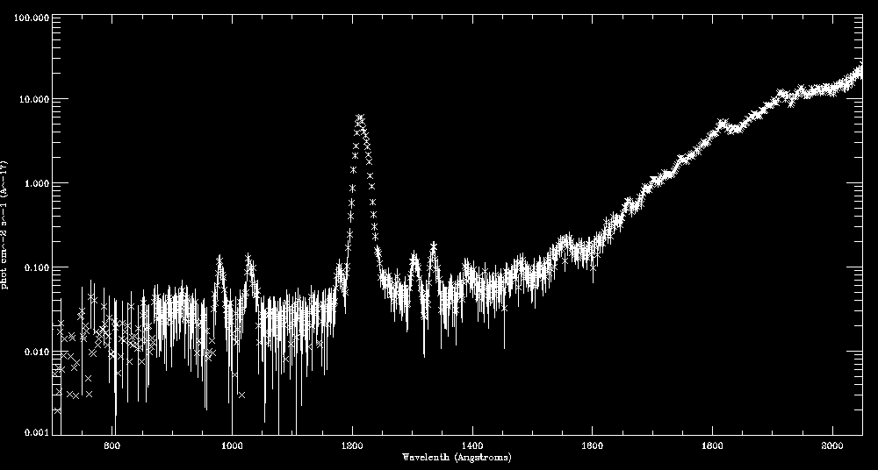
RA_100710150716_HIS3_LIN.FIT actual science spectrum in nice units

Slide 11
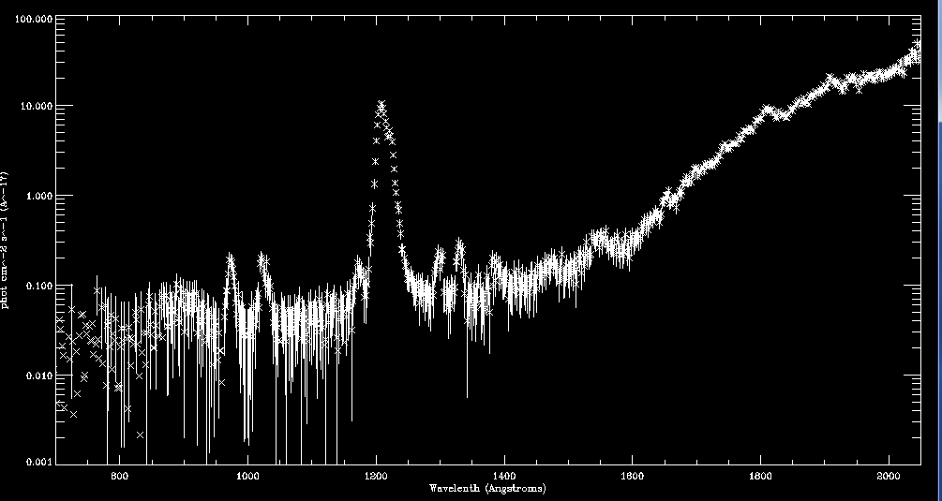
RA_100710150716_HIS3_SCI.FIT Not the best science units

Slide 12
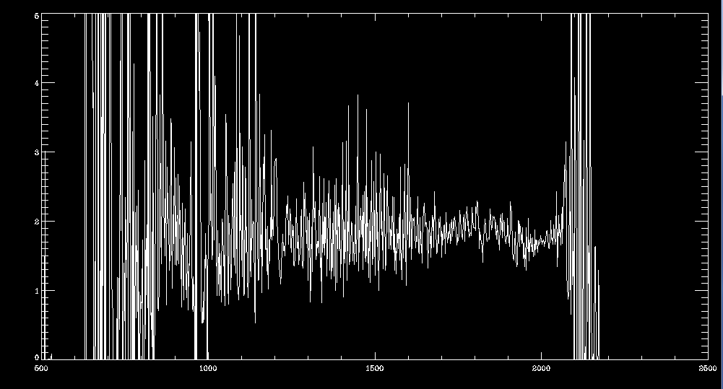
sci_spec/lin_spec level 4 pixels are per angstrom

