Slide 1
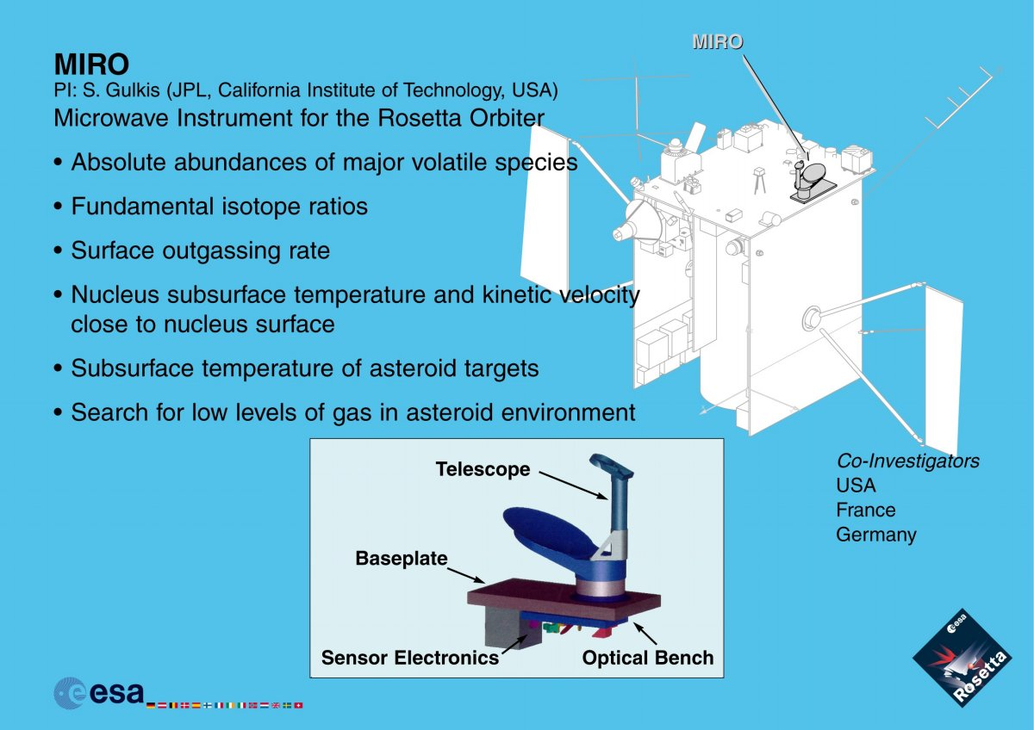
MIRO

Slide 2
MIRO
The method for calculating brightness temperature, the mapping fromspectral channel number to sky frequency, and details on geometry are all either clearly outlined in the user manual or contained in the data release itself. This is refreshing given their lack at the time of the Steins review. There is still a small confusion about the transition between bands 7 & 8, however.

Slide 3
MIRO
The ICD (RO_MIR_IF_0001.PDF) says that software is supposed to be in the SOFTWARE directory, but the only supplied software is actually in the DOCUMENT directory. There is the following (in that PDF file):
  3.4.3.9 Software Directory
  It is intended that the software used to calibrate the data will be included in this directory for level-3 products. Currently, this software is in an early stage of development and is tied to the local database used by the processing, hence is not suitable for delivery to the archive at this time. The description of the algorithms in section 2.3.3.2 fulfills this function, for now. Therefore, this directory was omitted in the current deliveries.
but, some of that software is delivered, in the DOCUMENT directory. This is further described in Appendix 3 of the ICD.

Slide 4
MIRO
The supplied software was very hard to run sensibly; it didn't supply meaningful defaults for hardly any of the inputs, seemingly one has to know quite a bit about the data to make it return what you want. For instance, it asks you to "enter 1 if UTC field is present, 0 otherwise:". I have no idea whether the UTC field is present or not in each of the datasets, or what it means if it is or isn't. In addition, more comments in the code would be extremely useful. On the other hand, this software was extremely useful - it was a quick way to gain access to the data. During the steins review Amy had tried to use the readpds function of IDL to read this data and had failed - I'm not familiar with that so couldn't test it (and didn’t have an IDL license on my laptop either), but for me this FORTRAN program was great.

Slide 5
MIRO
There is a column in the continuum data that is supposed to indicate that a calibration is occurring. From the format file for the continuum data:
  OBJECT = COLUMN
  NAME = CALMODE
  COLUMN_NUMBER = 12
  DATA_TYPE = MSB_UNSIGNED_INTEGER
  FORMAT = I1
  START_BYTE = 60
  BYTES = 2
  DESCRIPTION = "0: Calibration in progress, 1: No calibration in
  progress"
  END_OBJECT = COLUMN
but in the actual data, there are many entries in that column that are 256, not 0 or 1. What does 256 mean?

Slide 6
MIRO – Continuum mm – Level 2

Slide 7
MIRO – Continuum mm – Level 2

Slide 8
MIRO – Continuum mm – Level 3

Slide 9
MIRO – Continuum mm
There are some discontinuities in the mm data - what are they (previous plots)? Note that at least one of them seems to have been introduced in the calibration, since it doesn't exist in the level 2 data.

Slide 10
MIRO – Continuum submm – Level 2

Slide 11
MIRO – Continuum submm – Level 3

Slide 12
MIRO – Continuum submm
There are some discontinuities in the submm data - what are they (previous plots)? Very odd things happening in the early pre-encounter period. This isn’t particularly important because the pre-encounter baseline can still be established, but it’s a bit disconcerting.

Slide 13
MIRO – CTS (spectra) – Level 3

Slide 14
MIRO – CTS (spectra) – Level 3
band edges

Slide 15
MIRO – spectra
There are large discontinuities between the seven "bands" (see previous plots). I would have expected this to have been removed in level 3 data? The overall level is also quite variable (overall and between bands) – I can’t judge whether that is real or not (see movie). There seem to be ~150 pure 0 values at the beginning of each spectrum.

