Slide 1
PDS Review of EPOXI observations of Earth
Calibrated HRIV and MRI images
dif-e-hriv-3/4-epoxi-earth-v2.0
dif-e-mri-3/4-epoxi-earth-v2.0
Michael Smith
5 March 2013

Slide 2
HRIV DOCUMENTATION
Spacecraft Mission and Instrument:
Narrow-band filter images (350-950 nm) of Earth taken by Deep Impact High Resolution Visible CCD (HRIV)
Observation Sequence:
Images taken in March, May, June 2008 and March, October 2009
Each observing period lasted for 24 hours
Images taken hourly at 350, 750 and 950 nm
Images taken every 15 minutes at 450, 550, 650 and 850 nm
Geometry (May 2008):
In image labels, target listed as “EARTH”, but derived geometry listed as “UNK” (PHASE_ANGLE, TARGET_CENTER_DISTANCE, SUB_SPACECRAFT_LONGITUDE, I/F scaling, etc.)
Geocentric distance given as 0.3315 AU = 49.59 million km in “document/epoch_earth_geom_2008may.asc”
Pixel 2 microradians, so pixel = 99 km for HRIV
Diameter of Earth is 127 pixels and Moon is 35 pixels on the 512x512 sub-frame
Calibration:
Calibrated data in units of W/m²/ster/µm with conversion to I/F provided

Slide 3
HRIV DIRECTORY STRUCTURE
Main Directory:
calib/
catalog/
data/
document/
DOWNLOAD/
index/
aareadme.txt <- Nice that this is shown on directory page
dataset.html <- Not explained, somewhat cryptic name
voldesc.dat
data/ Directory:
rad/
radrev/
Data further organized by year/doy/
Other than “dataset.html”, directory structure was as expected for a PDS archive. All necessary files and directories were present. Organization of data was easy to understand and navigate, especially with aareadme.txt shown. HTML homepage very helpful as well.

Slide 4
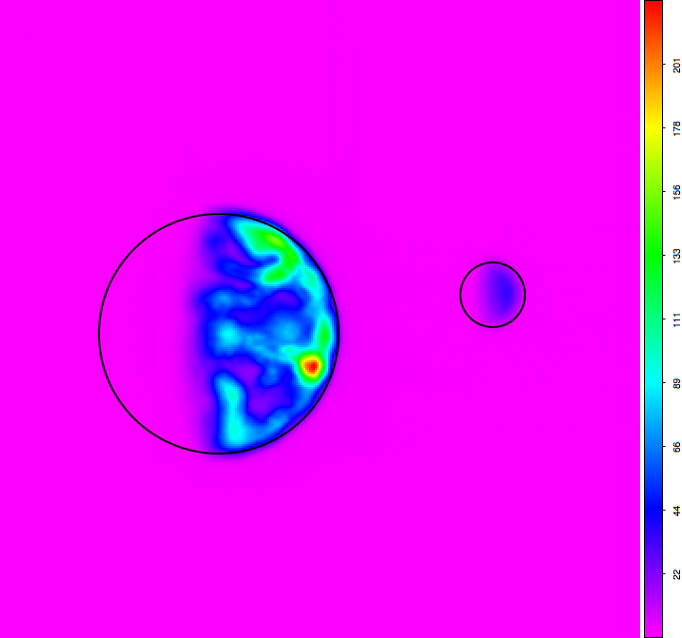
Sanity Checks
Maximum I/F ~ 0.55
650 nm
Size of Earth Disk
Size of Moon Disk
W/m²/ster/µm
Sky = zero radiance
I was able to read, display and manipulate the HRIV images without problem.
Basic parameters of image appear reasonable.

Slide 5
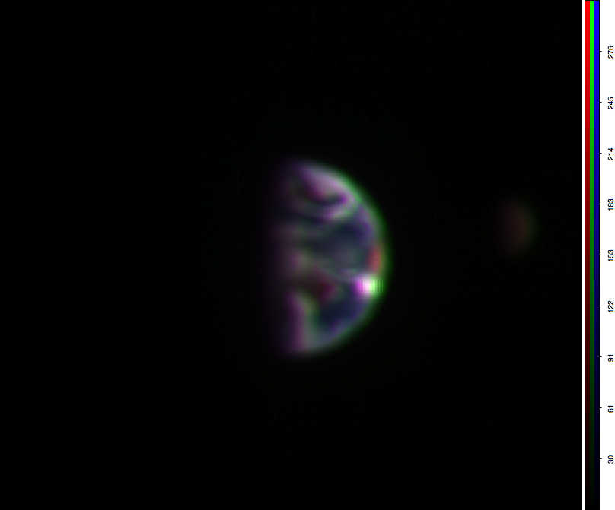
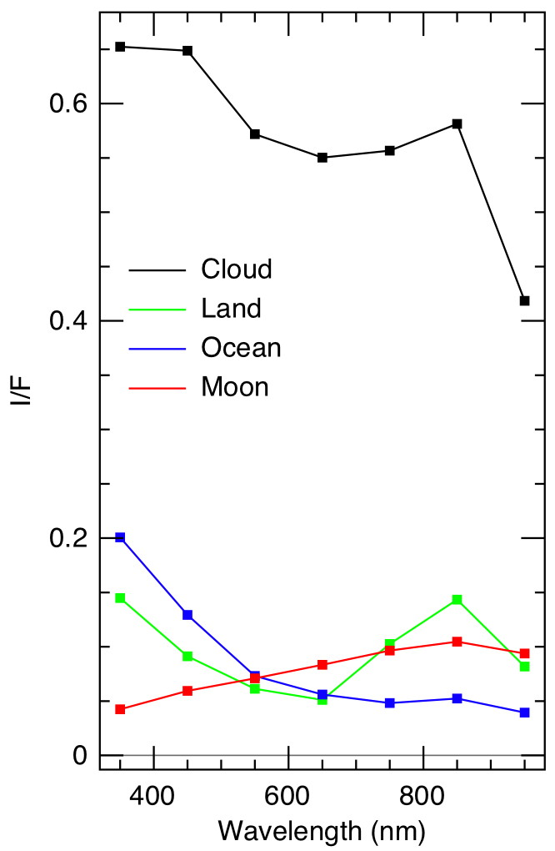
Wavelength Dependence
As expected, clouds bright and white, Moon dark and red, oceans blue.

Slide 6
MRI DOCUMENTATION
Spacecraft Mission and Instrument:
Calibrated 750-nm filter images of Earth taken by Deep Impact Medium Resolution Visible CCD (MRI)
Observation Sequence:
Images taken in March 2008 and October 2009
Each observing period lasted for 24 hours
Images taken every 30 minutes as context for HRI IR spectrometer observations
Geometry (March 2008):
Target listed as “EARTH”, but derived geometry listed as “UNK” (PHASE_ANGLE, TARGET_CENTER_DISTANCE, SUB_SPACECRAFT_LONGITUDE, I/F scaling, etc.)
Geocentric distance given as 0.182 AU = 27.23 million km in “document/epoch_earth_geom_2008mar.asc”
Pixel 10 microradians, so pixel = 272 km for HRIV
Diameter of Earth is 47 pixels on the 512x512 (sub-framed) image
Calibration:
Calibrated data in units of W/m²/ster/µm with conversion to I/F provided

Slide 7
MRI DIRECTORY STRUCTURE
Main Directory:
calib/
catalog/
data/
document/
DOWNLOAD/
index/
aareadme.txt <- Nice that this is shown on directory page
dataset.html <- Not explained, somewhat cryptic name
voldesc.dat
data/ Directory:
rad/
radrev/
Data further organized by year/doy/
Other than “dataset.html”, directory structure was as expected for a PDS archive. All necessary files and directories were present. Organization of data was easy to understand and navigate, especially with aareadme.txt shown. HTML homepage very helpful as well.

Slide 8
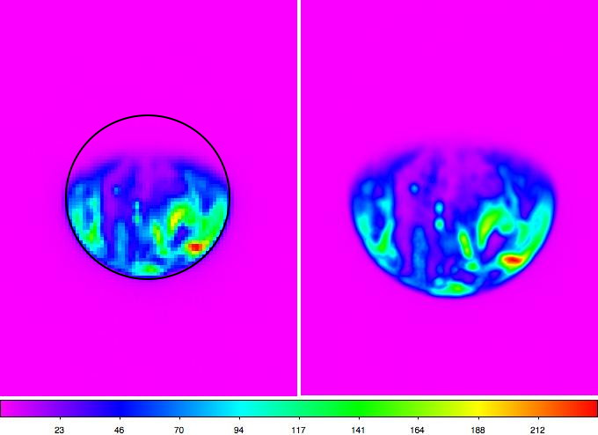
Comparison of MRI with HRIV
MRI
HRIV (750 nm)
A “gibbous Earth”
Size of Earth Disk
Sky = zero radiance
Maximum I/F ~ 0.55
W/m²/ster/µm
I was able to read, display and manipulate the MRI images without problem.
MRI and HRIV images look very similar given different pixel size.

Slide 9
CONCLUSIONS
File Structure:
All files appear to be in place
Data structure easy to understand and navigate
Documentation:
Sufficient documentation for scientific work
Data:
Calibrated (reversible), and calibrated versions of image data available
Necessary calibration images and data available
Support files available
Target information (i.e., identification of Earth) MISSING from FITS files and associated label files. This makes all derived quantities “Unknown”.
Image Quality:
Calibrated image data pass sanity checks
Calibrated radiance appears to follow expected wavelength trends
Submitted PDS archive of EPOXI HRIV images of Mars in good shape and ready for acceptance after correction of target information and derived quantities.

