Slide 1
PDS Review of EPOXI observations of Mars
Calibrated HRIV and MRI images
dif-m-hriv-3/4-epoxi-mars-v2.0
dif-m-mri-3/4-epoxi-mars-v2.0
Michael Smith
5 March 2013

Slide 2
HRIV DOCUMENTATION
Spacecraft Mission and Instrument:
Narrow-band filter images (350-950 nm) of Mars taken by Deep Impact High Resolution Visible CCD (HRIV)
Observation Sequence:
Images taken on 20-21 November 2009 over a 24-hour period
Images taken hourly at 350, 750 and 950 nm
Images taken every 15 minutes at 450, 550, 650 and 850 nm
Geometry:
Range was 1.04 AU
Phase Angle of 37°
Scale of 310 km/pixel
Diameter of Mars is 22 pixels on the 512x512 sub-framed image
Calibration:
Calibrated data in units of W/m²/ster/µm with conversion to I/F provided
Background and supporting data complete and sufficient to perform scientific work.

Slide 3
HRIV DIRECTORY STRUCTURE
Main Directory:
calib/
catalog/
data/
document/
DOWNLOAD/
index/
aareadme.txt <- Nice that this is shown on directory page
dataset.html <- Not explained, somewhat cryptic name
voldesc.dat
data/ Directory:
rad/
radrev/
Data further organized by year/doy/
Other than “dataset.html”, directory structure was as expected for a PDS archive. All necessary files and directories were present. Organization of data was easy to understand and navigate, especially with aareadme.txt shown. HTML homepage very helpful as well.

Slide 4
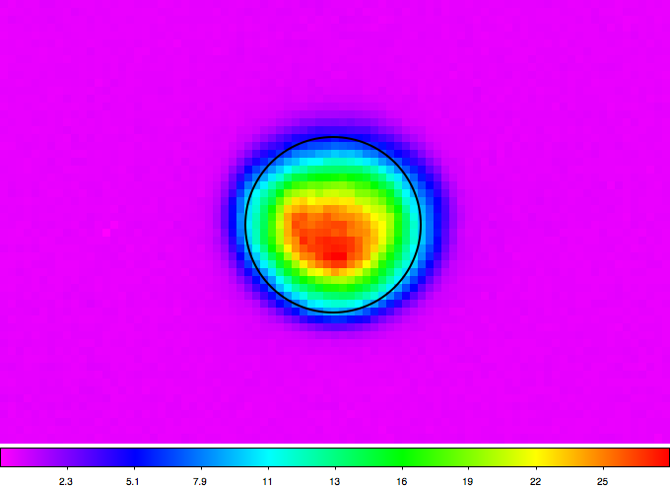
Sanity Checks
Not quite “full Mars”
Size of Mars Disk
Sky = zero radiance
Disk average I/F ~ 0.13
W/m²/ster/µm
I was able to read, display and manipulate the HRIV images without problem.
Basic parameters of image appear reasonable.

Slide 5
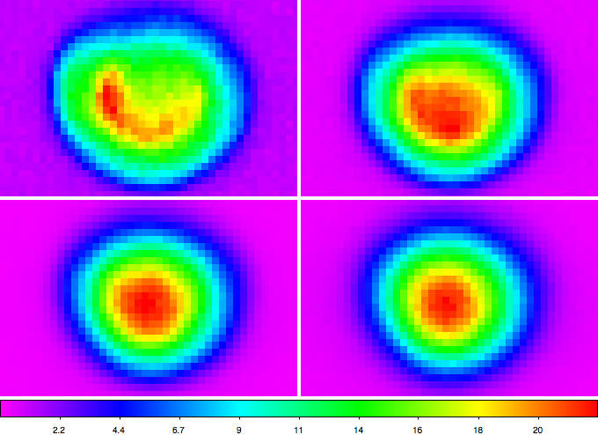
Wavelength Dependence
350 nm
550 nm
750 nm
950 nm
As expected, more structure at shorter wavelengths (especially violet)

Slide 6
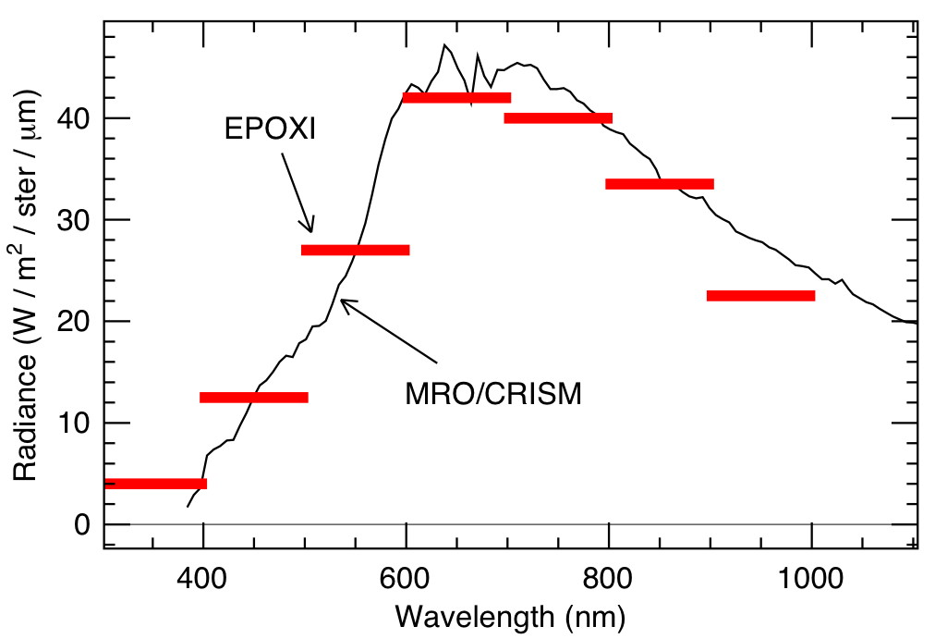
Check against Spacecraft Observation
Wavelength dependence and absolute radiance consistent with observation from MRO/CRISM Vis/near-IR spectrometer

Slide 7
MRI DOCUMENTATION
Spacecraft Mission and Instrument:
Calibrated 750-nm filter images of Mars taken by Deep Impact Medium Resolution Visible CCD (MRI)
Observation Sequence:
Images taken on 20-21 November 2009 for a 24-hour period
Images taken every 30 minutes as context for HRI IR spectrometer observations
Geometry:
Range was 1.04 AU
Phase Angle of 37°
Scale of 1557 km/pixel
Diameter of Mars is 4+ pixels on the 512x512 sub-framed image
Calibration:
Calibrated data in units of W/m²/ster/µm with conversion to I/F provided
Background and supporting data complete and sufficient to perform scientific work.

Slide 8
MRI DIRECTORY STRUCTURE
Main Directory:
calib/
catalog/
data/
document/
DOWNLOAD/
index/
aareadme.txt <- Nice that this is shown on directory page
dataset.html <- Not explained, somewhat cryptic name
voldesc.dat
data/ Directory:
rad/
radrev/
Data further organized by year/doy/
Other than “dataset.html”, directory structure was as expected for a PDS archive. All necessary files and directories were present. Organization of data was easy to understand and navigate, especially with aareadme.txt shown. HTML homepage very helpful as well.

Slide 9
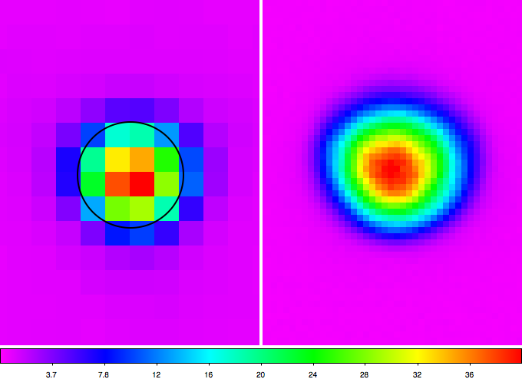
Comparison of MRI with HRIV
MRI
HRIV (750 nm)
Size of Mars Disk
Sky = zero radiance
Maximum I/F ~ 0.25
W/m²/ster/µm
I was able to read, display and manipulate the MRI images without problem.
MRI and HRIV images look similar given different pixel size.

Slide 10
CONCLUSIONS
File Structure:
All files appear to be in place
Data structure easy to understand and navigate
Documentation:
Sufficient documentation for scientific work
Data:
Calibrated (reversible), and calibrated versions of image data available
Necessary calibration images and data available
Support files available
Image Quality:
Calibrated image data pass sanity checks
Calibrated radiance is consistent with spacecraft observations of Mars
Submitted PDS archive of EPOXI HRIV images of Mars in excellent shape and ready for acceptance.

