Slide 1
dif-c-hrii-3 4-epoxi-hartley2-v2.0
M. DiSanti, lead

Slide 2
Straightforward to extract spectra (centered ~row 55)
Not clear what “central” rows represent
Spectral curvature to emissions, even though lambda-cal is uniform along slit (?) (specmap)

Slide 3
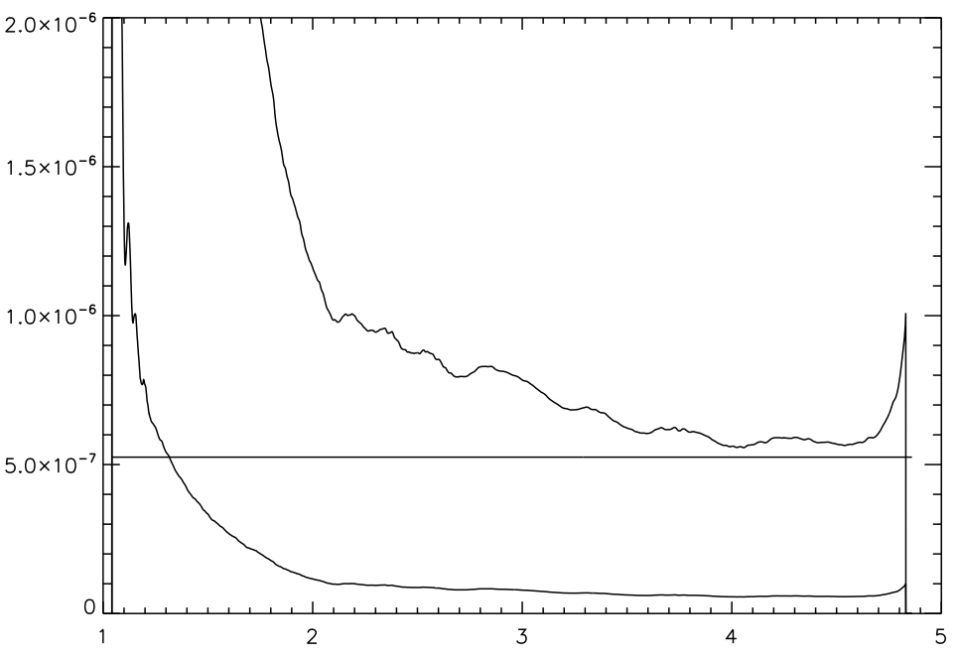
Radiance Conversion (W/m^2/sr/um) vs (RAW DN/s)

Slide 4
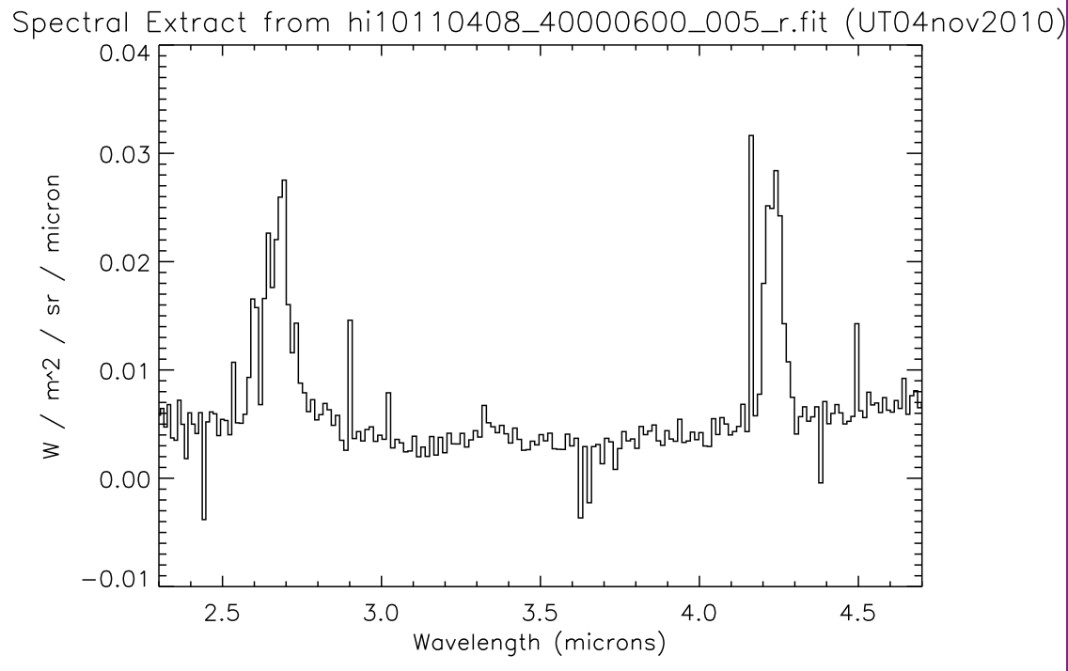

Slide 5
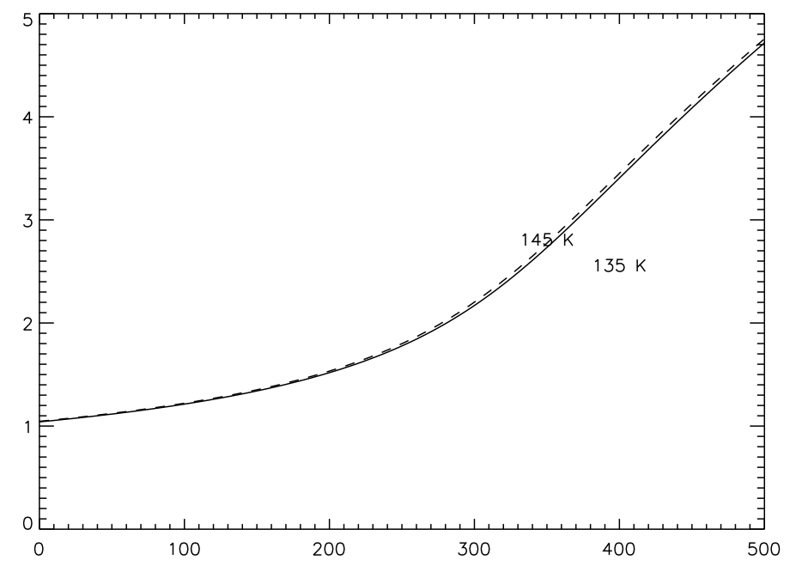

Slide 6
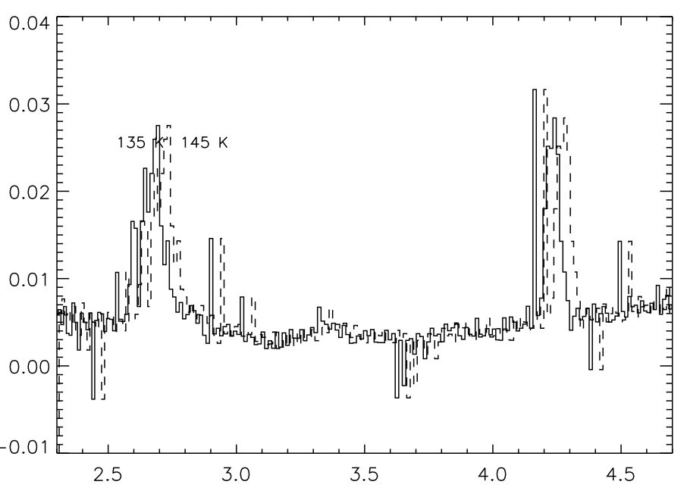
What Temp is relevent? prism, primary T’s are very close (lines ~67,68 in lbl file);
TEMPSIM keyword (line 295);
Temp string in filename.
Can this be made clearer?

