Slide 1
EPOXI HRIV Hartley 2 Deconvolved Images
Hartley 2 HRIV Deconvolved images within ±1 hr of close encounter
With Richardson-Lucy method for 25, 50, 100, 200, 400 iterations
Original images and PSFs used are all documented
Images can be loaded and displayed in correct orientation with both SAOImage and IDL. FITS extensions loaded well.
Generally a good dataset, with minor suggestions

Slide 2
Review Summary
Several questions should be addressed in the dataset description or documentation:
Why this deconvolution algorithm?
What are the pros and cons?
Is photometry generally preserved?
How to judge what images are the best for various purposes?
What should users be cautious about when using the deconvolved images
Suggest including Lindler’s paper in the dataset, if not substantially expand the dataset description
Some other documentation issues
In deconv_image_parameters.tab: columns 27-30 are intended for sub-s/c and sub-solar coordinates, but all -88.88. The values are easy to cause confusions. Suggested either remove, or replace with meaningless values such as -999.
Column 33, the meaning of “partial saturated pixel” is not clear
aareadme.txt:
Line 72: Duplicated section of /DATA/ directory

Slide 3
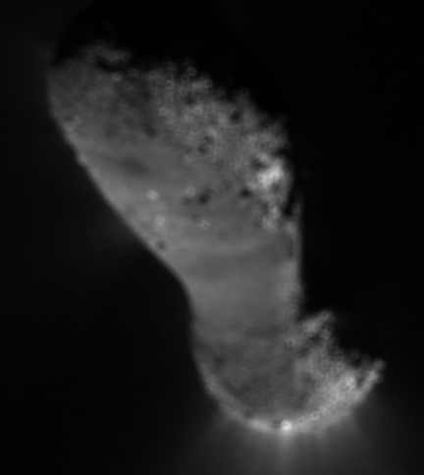
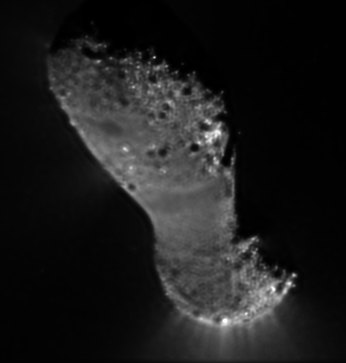
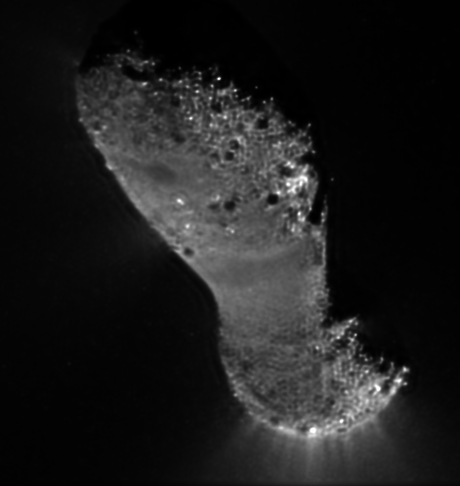
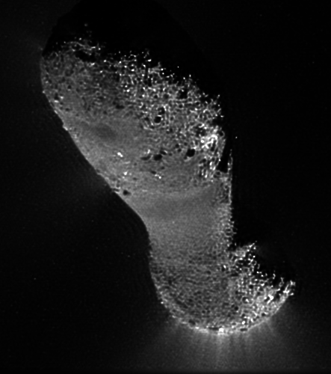
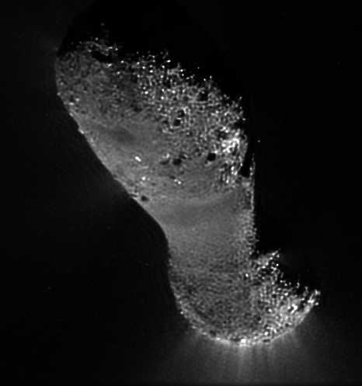
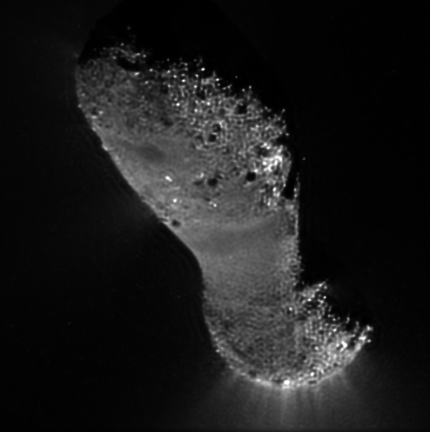
hv10110413_5004008_001

Slide 4
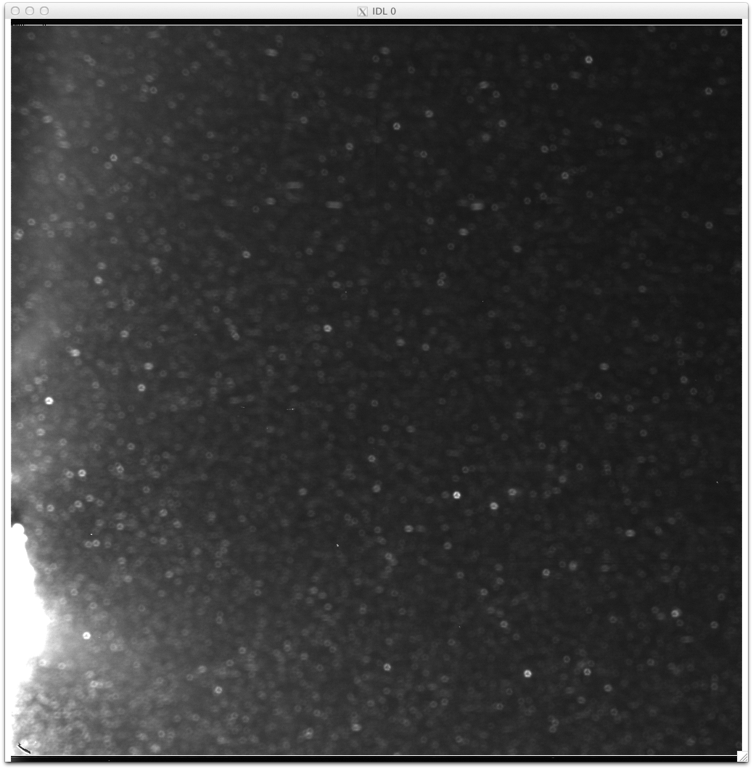
hv10110413_5004024_001

Slide 5
Review Recommendation
Certified, but revisions are required to resolve the minor liens
No need to review the revision again

Slide 6
Tempel 1 Shape Model
Shape model of Tempel 1 as derived from DI data and NExT data
Overall the documentation is fine, with some minor suggestions to improve
All references in the NExT/EPOXI special issue needs to be updated
The consistency of numbers in documents needs to be checked
Some peculiarity in the shape model needs to be either resolved of documented
Pixelization in the VRML format
Flags appear to be suspicious in some places

Slide 7
Tempel 1 Shape Model
catalog/dataset.cat:
Line 83: Center of figure not coincident with the origin...to be corrected in future version?
Needs to define A/B/C
Check numbers in dataset.cat
Area 108 vs 108.5
Volume: 95.2 vs 95.2
Mean Radius: 2.83 vs 2.68
Radius range: 2.10-3.97 vs 2.10-3.97
Line 141: Not diameter range but radius range
Generaly good agreements between the listed values in the file (first) and my calculation (second)
But some discrepancies exist, especially for mean radius

Slide 8
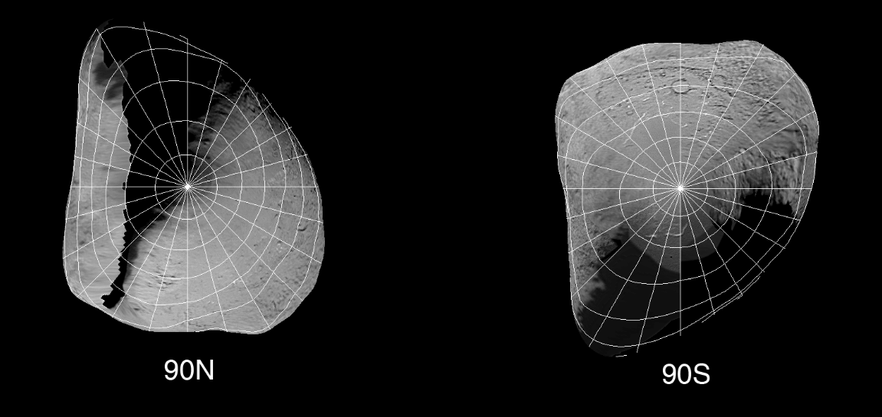
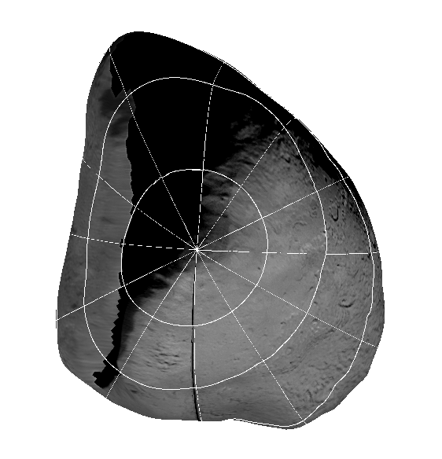
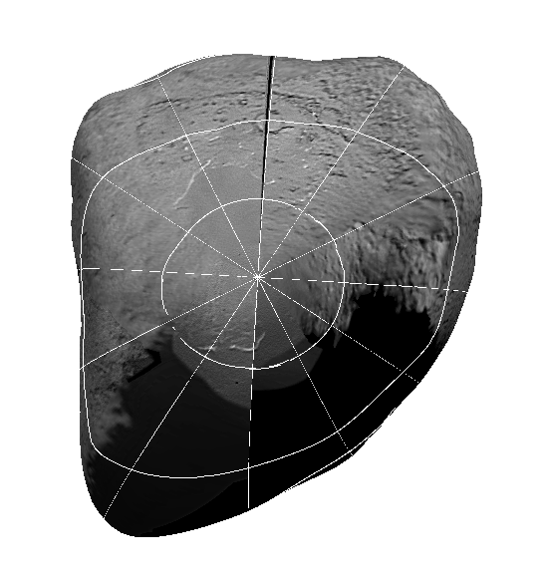
Visualization of shape model:
From document
From shape model

Slide 9
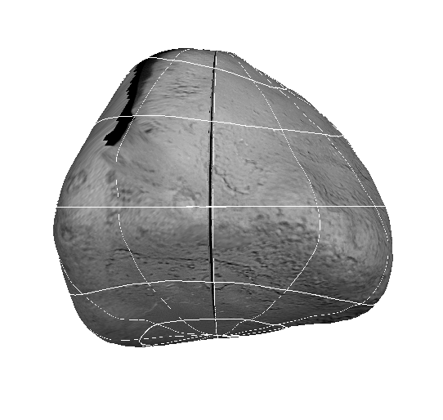
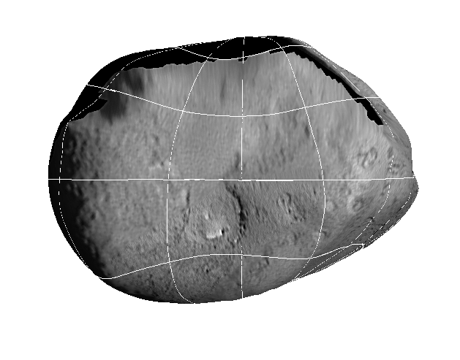
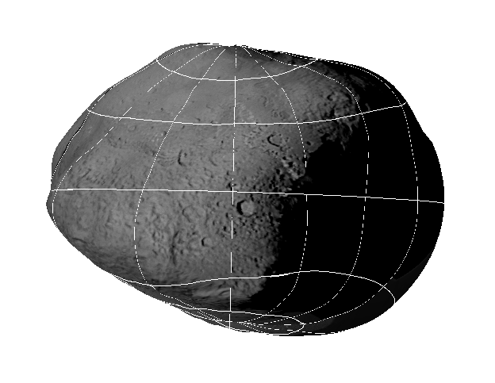
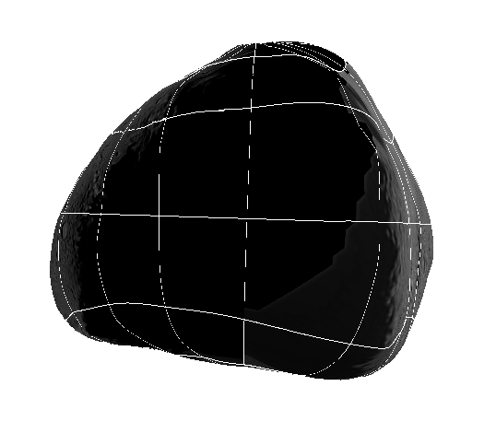
Visualization of shape model:
From document
From shape model

Slide 10
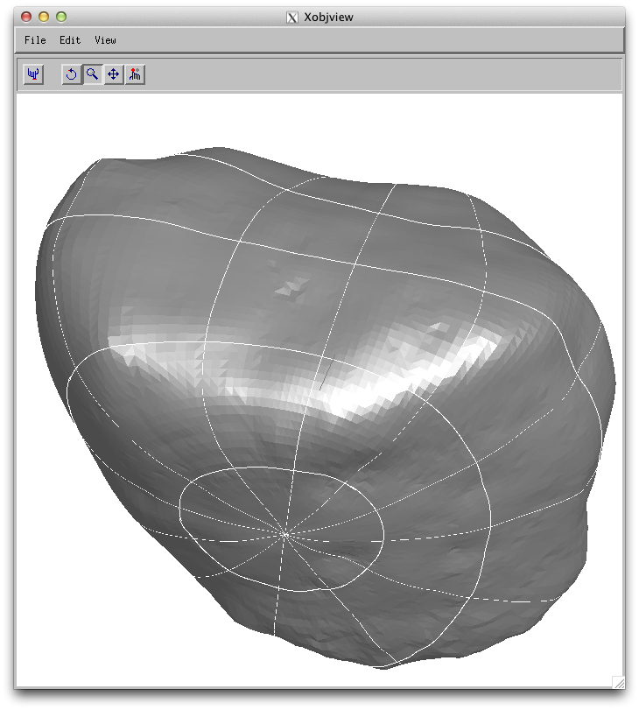
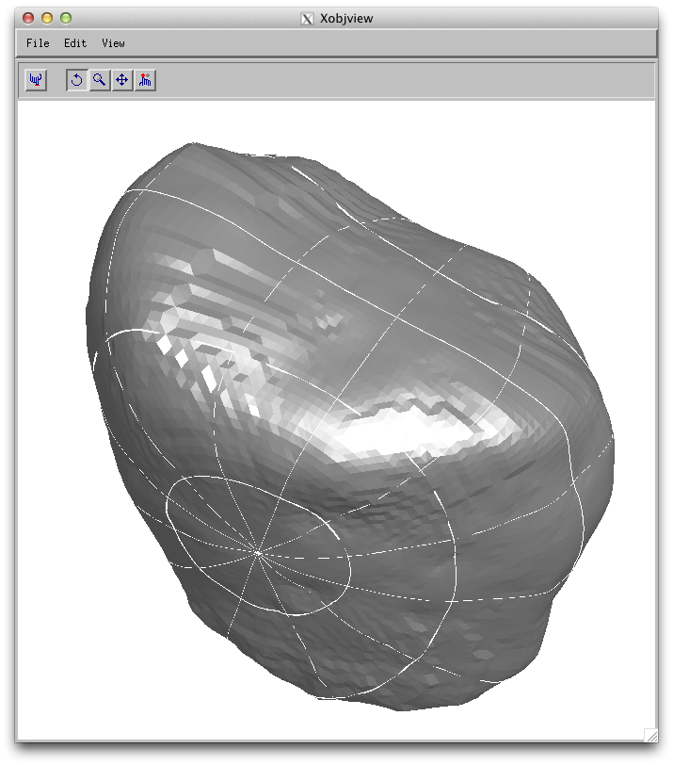
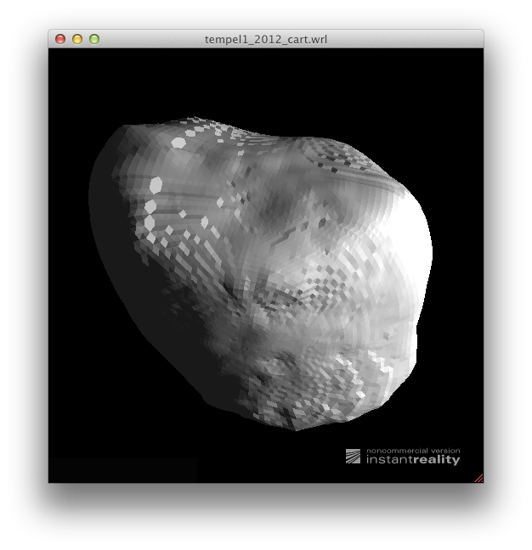
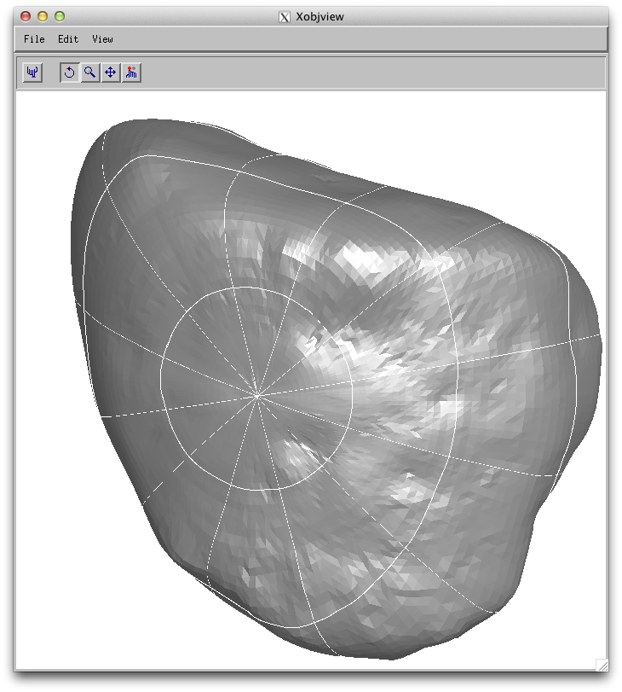
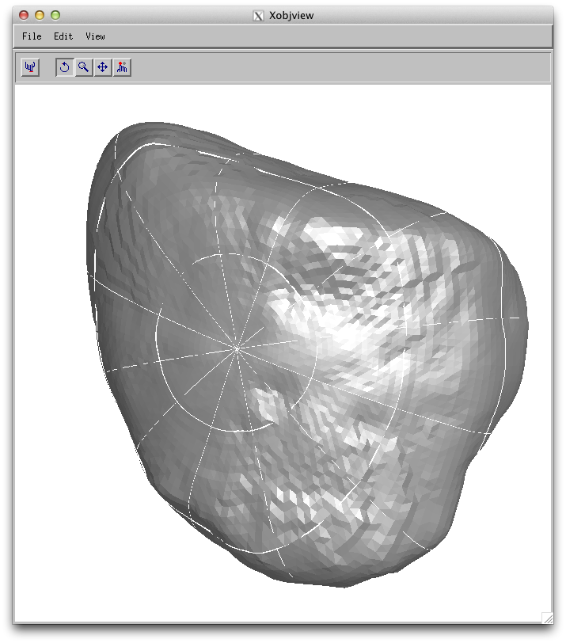
VRML Format:
Pixelization
Degradation of resolution
Planetocentric version
Cartesian version
VRML view

Slide 11
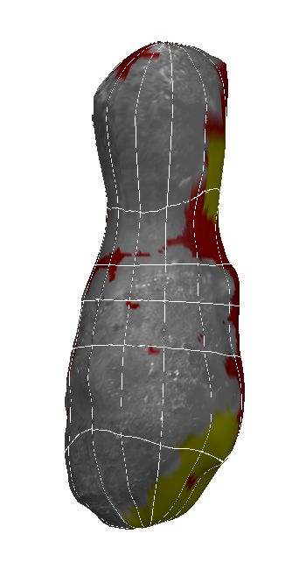
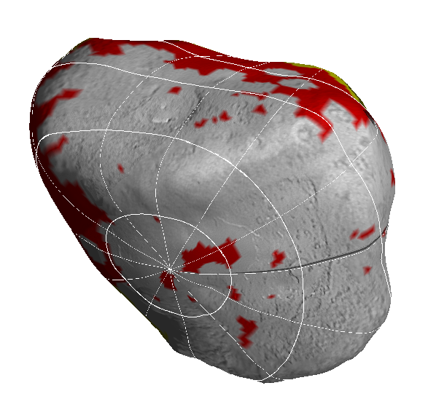
Some flag 3 may not be correct
Yellow – flag=2
Red – flag=3
When flag=3, it is 0.4 km away from flag=1 or 2 for Tempel 1, 0.11 km away for Hartley 2
But there exist some very small areas with flag=3

Slide 12
Minor Suggestions
aareadme.txt
Lines 62, 63: Suggest replace "refs" by full spelling "references”
catalog/catinfo.txt:
Line 89: PERSONNEL.CAT is not in the directory, despite that this file says it is. The description of PERSONNEL.CAT should probably also mention DI mission.
Line 42: REFERENCE.CAT is mentioned, but it should be ref_next.cat and ref_di_epoxi.cat

Slide 13
Minor Suggestions
catalog/dif.cat:
Line 30: Revise the sentence: not "presently being used”
Last paragraph in "Instrument Host Overview": Should it be moved up because the previous contents are all in chronological order?
Section about "Safe Mode and Telecom Anomaly": What is the purpose of this section? There must be other safes but why only these two were discussed here?
Last paragraph should be removed as the mission ends.
catalog/hriv.cat, its.cat, mri.cat:
Discussions about the 1/3 pixel gap: is it also worth to reference to the photometric dataset that contains the documentations on the photometric correction as an example?
catalog/next.cat:
Is formal mission name "Stardust-NExT" or "NEXT".

Slide 14
Minor Suggestions
document/tempel1_shape_description.asc:
Line 19: Numbers of vertices and plates are not consistent with those in the actual model
Coincidence of center of figure and coordinate origin
Line 33: Add uncertainty for flag 2 (~100 m as in dataset.cat)
Line 66: Mention the downsampling of vertices for high latitude areas in cart version from plan version
Line 110: The image file format is PNG as in the dataset, not TIF as in this document. Also need to check the consistency of file names, e.g., tempelviews_gridded.tif vs tempel1views_gridded.png

Slide 15
Review Recommendation
Can be certified
The shape model data file in planetocentric coordinates is good to use
Documentation contains sufficient information for scientific use under support from producer
Include a note in the certification that the VRML format needs some more tweak
Revision has to be taken
The discrepancy between planetocentric version and VRML version has to be resolved
The documentation of flags has to be updated
Documents needs to be improved

Slide 16
Hartley 2 Shape Model
Shape model of Hartley 2 as derived from EPOXI data
Overall the documentation is fine, with some minor suggestions, similar to Tempel 1 shape model, to improve
All references in the NExT/EPOXI special issue needs to be updated
The consistency of numbers in documents needs to be checked
Similar peculiarity in the shape model as for Tempel 1 dataset
Pixelization in the VRML format
Flags appear to be suspicious in some places

Slide 17
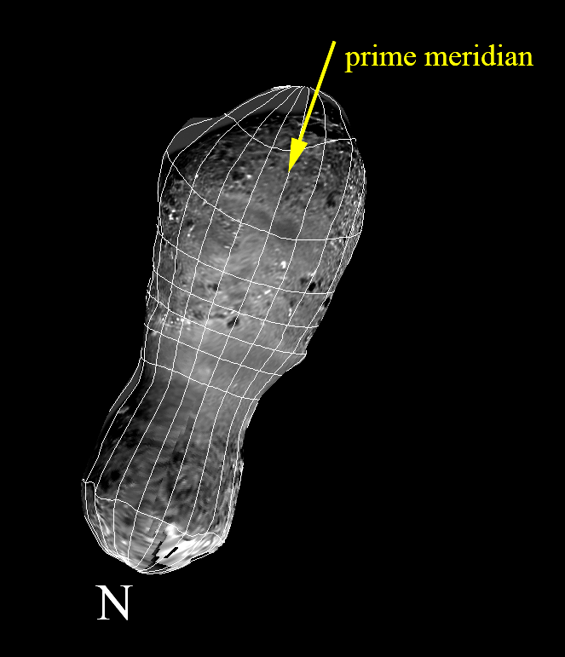
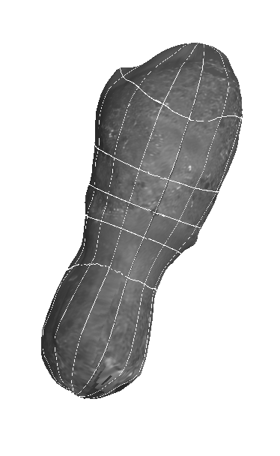
From document
From shape model

Slide 18
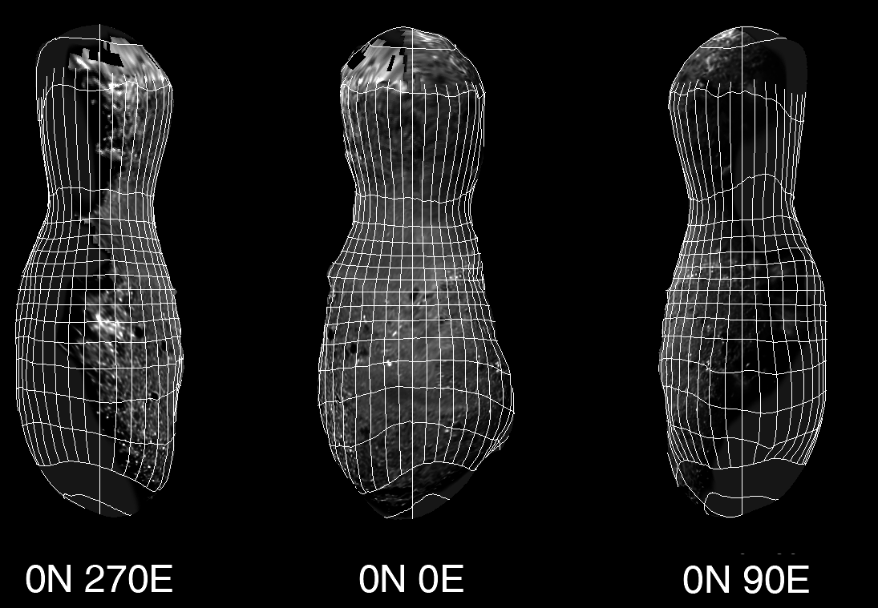
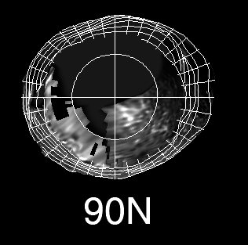
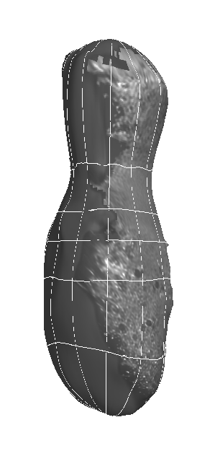
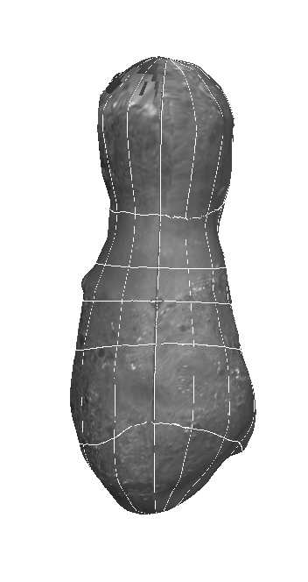
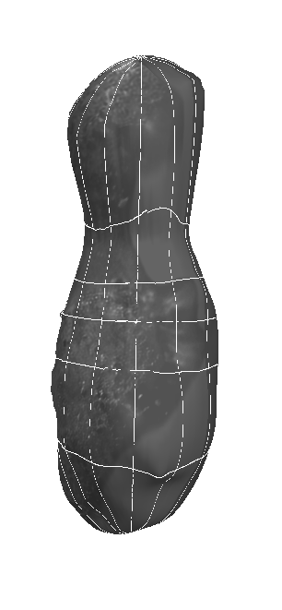
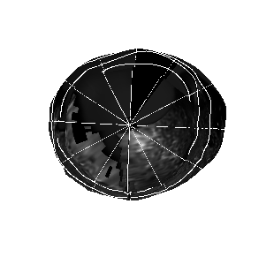
From document
From shape model

Slide 19
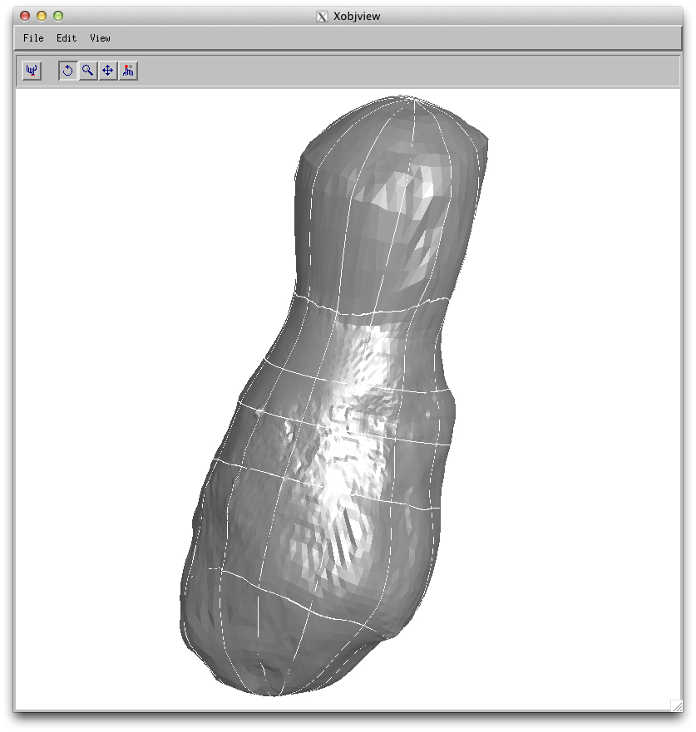
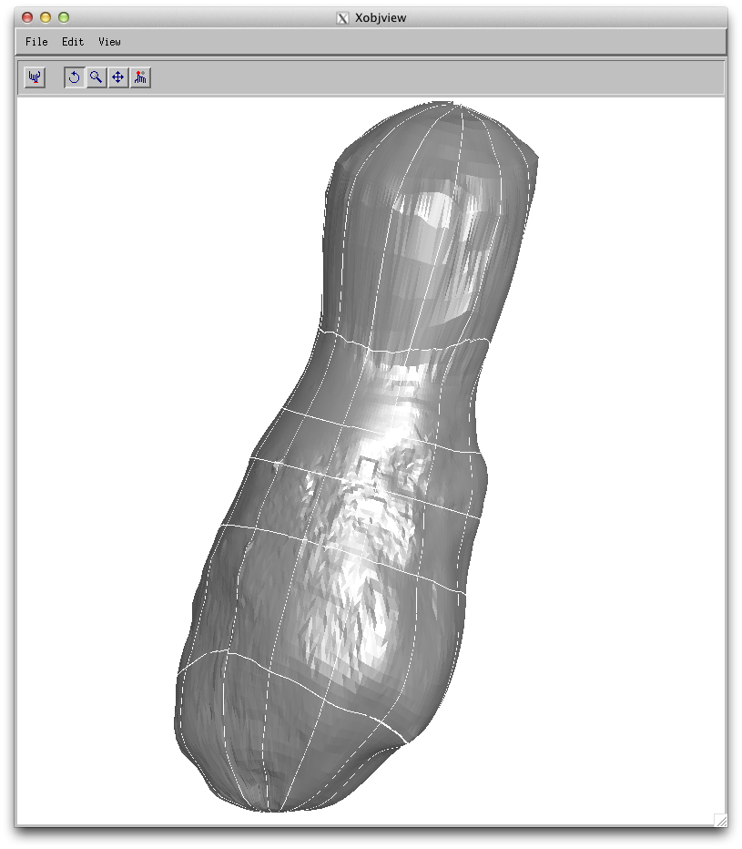
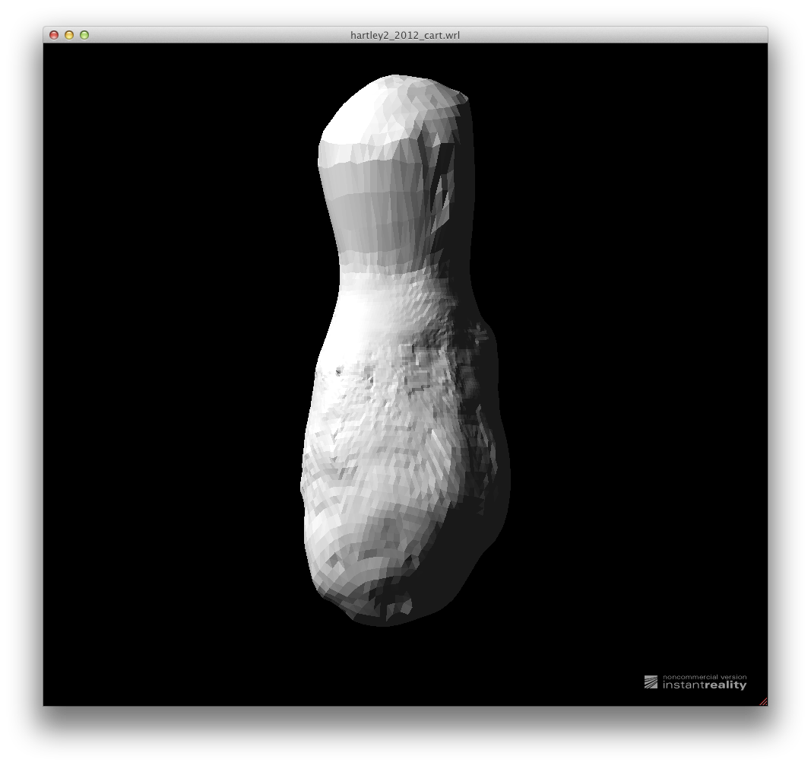
VRML Format:
Pixelization
Degradation of resolution
From VRML
format
From planetocentric coordinates
VRML View

Slide 20
Minor Suggestions
catalog/catinfo.txt:
Line 36 and 69: PERSONNEL.CAT is not included in the directory, but mentioned in this file. The description is wrong
Line 36: REFERENCE.CAT is mentioned, but it should be ref_epoxi.cat.
catalog/dataset.cat:
Line 43: Update reference Thomas et al., 2013
Line 65: Any reasons why the center of figure is offset from the coordinate origin?
Line 71: Reference to Belton et al., 2013 needs to be updated
Define A/B/C
Check numbers:
Area: 5.24 vs 5.24
Volume: 0.809 vs 0.810
Mean radius: 0.58 vs 0.62
Diameter range: ... Radius range 0.31 - 1.26
document/hartley2_shape_description.asc:
Line 72: Make the file name consistent

Slide 21
Review Recommendation
Can be certified
The shape model data file in planetocentric coordinates is good to use
Documentation contains sufficient information for scientific use under support from producer
Include a note in the certification that the VRML format needs some more tweak
Revision has to be taken
The discrepancy between planetocentric version and VRML version has to be resolved
The documentation of flags has to be updated
Documents needs to be improved

Slide 22
Lutetia Shape Model
catalog/catinfo.txt
Line 37, check consistency of file names: REFERENCE.CAT as in this file and references.cat (extra s) as in the directory
Line 38: No personnel.cat file found in the directory
catalog/dataset.cat:
The dimensions are obviously wrong. My calculation has A=111.3, B=121.1, C=84.8
Discrepancy in area: 33331 in dataset.cat, and 33318 by myself
Documents
Recommend expanding the documents to include 1) views from s/c at various times during the flyby and 2) standard view point with lat-lon grid overlain
Data:
An obvious seam as Tony noticed. Need documentation on it.
Related to the seam and "two methods used" mentioned in the dataset, it will be userful to document what method was used for what areas

Slide 23
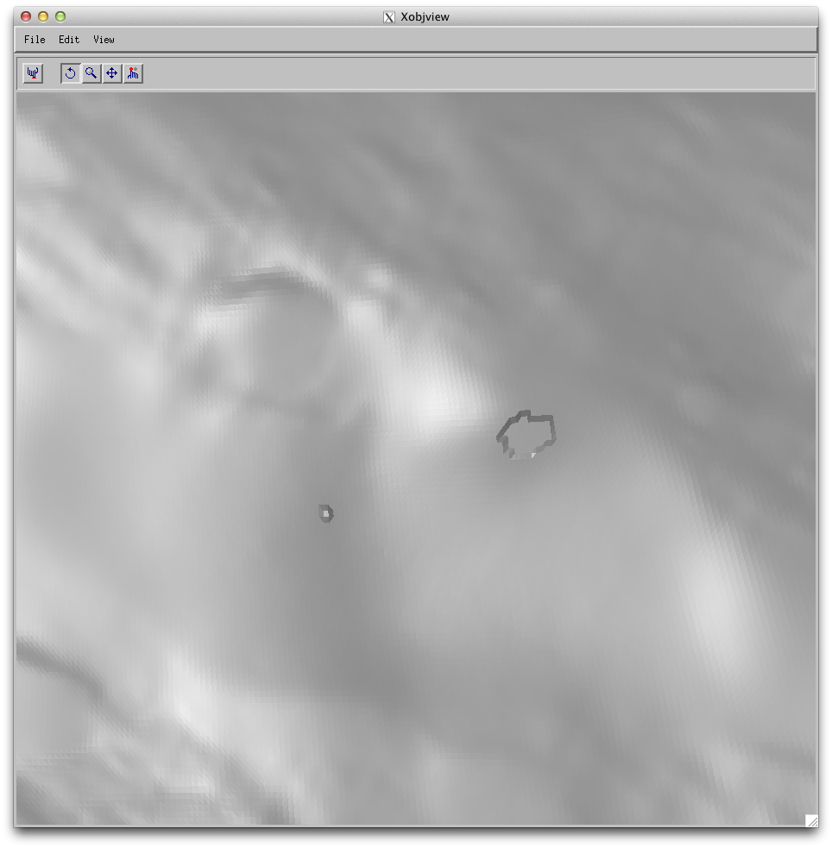
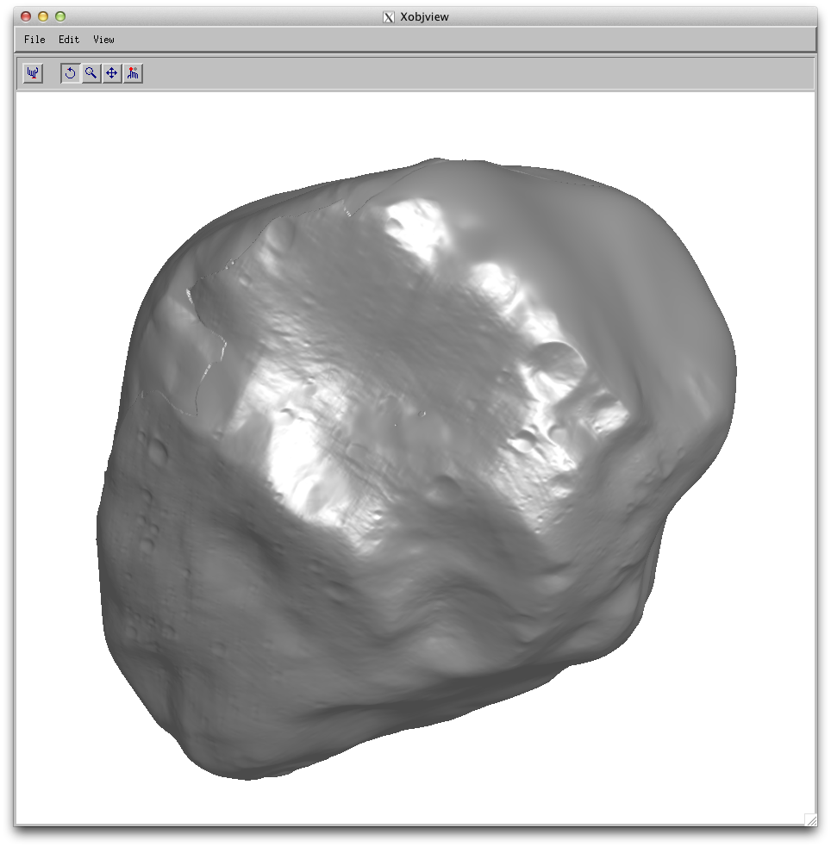
Seam
Holes?
Peculiarity in the data

Slide 24
Steins Shape Model
catalog/catinfo.txt:
Line 37: Check consistency of file name: REFERENCE.CAT vs references.cat (extra s)
Line 38: No personnel.cat file fund in the directory
Numbers in catalog/dataset.cat:
Area 92 vs 92.5
Mean rad 2.70 vs 2.59
Dimensions: 6.83x5.70x4.42 vs 6.81x5.62x4.20
Need a reference for rotational period
Documents
Recommend expanding the documents to include 1) views from s/c at various times during the flyby and 2) standard view point with lat-lon grid overlain
Data:
An obvious seam as Tony noticed. Need documentation on it.
Related to the seam and "two methods used" mentioned in the dataset, it will be userful to document what method was used for what areas

Slide 25
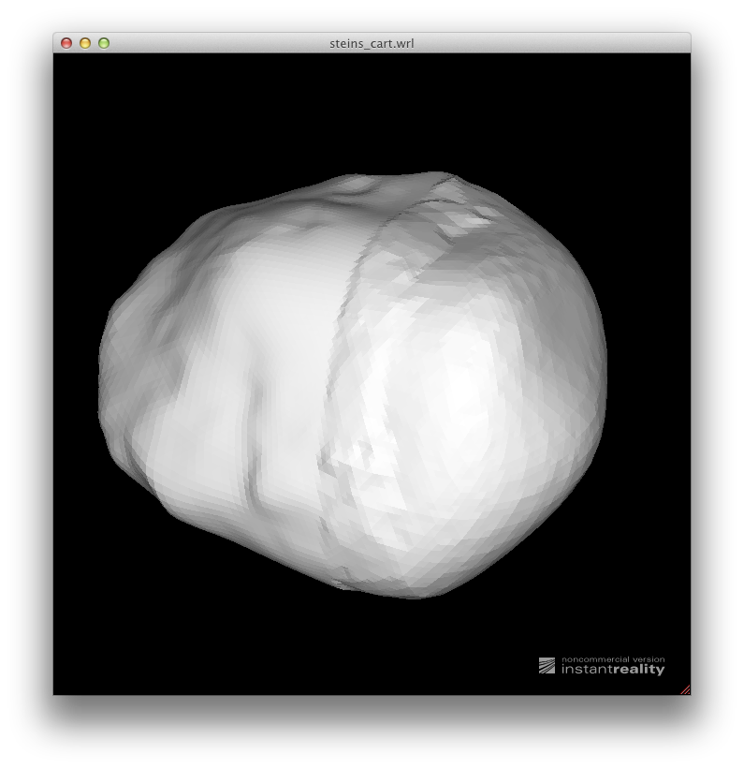
Seams between two halves

