Slide 1
ALICE PLUTOCRUISE PDS Review, January 2014
Jeff Morgenthaler
Planetary Science Institute

Slide 2
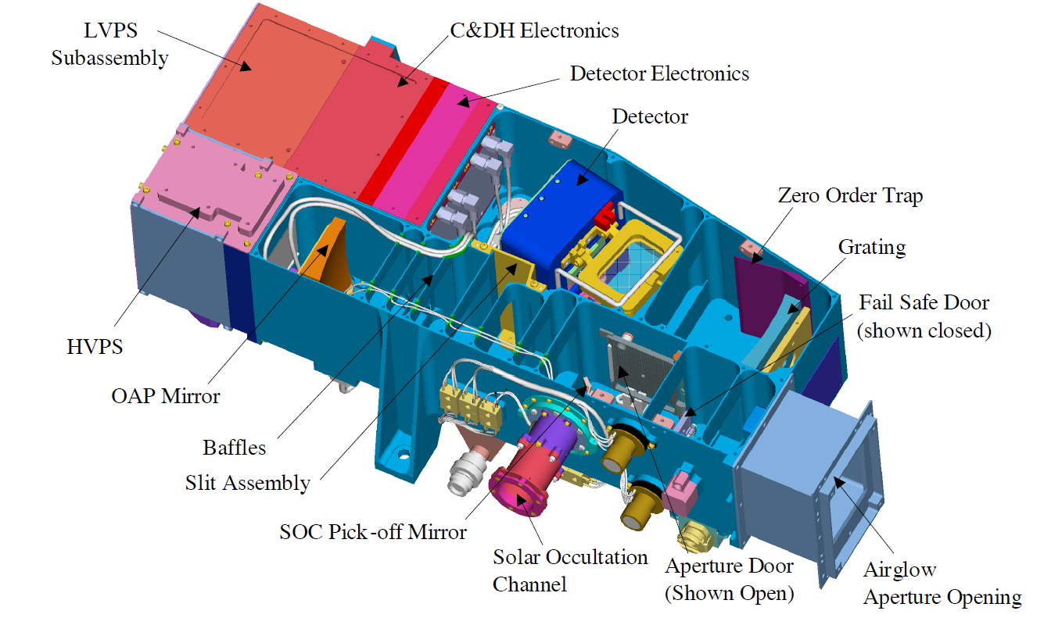
ALICE Basics alice_ssr.pdf (STERNETAL2007)
(SOC)

Slide 3
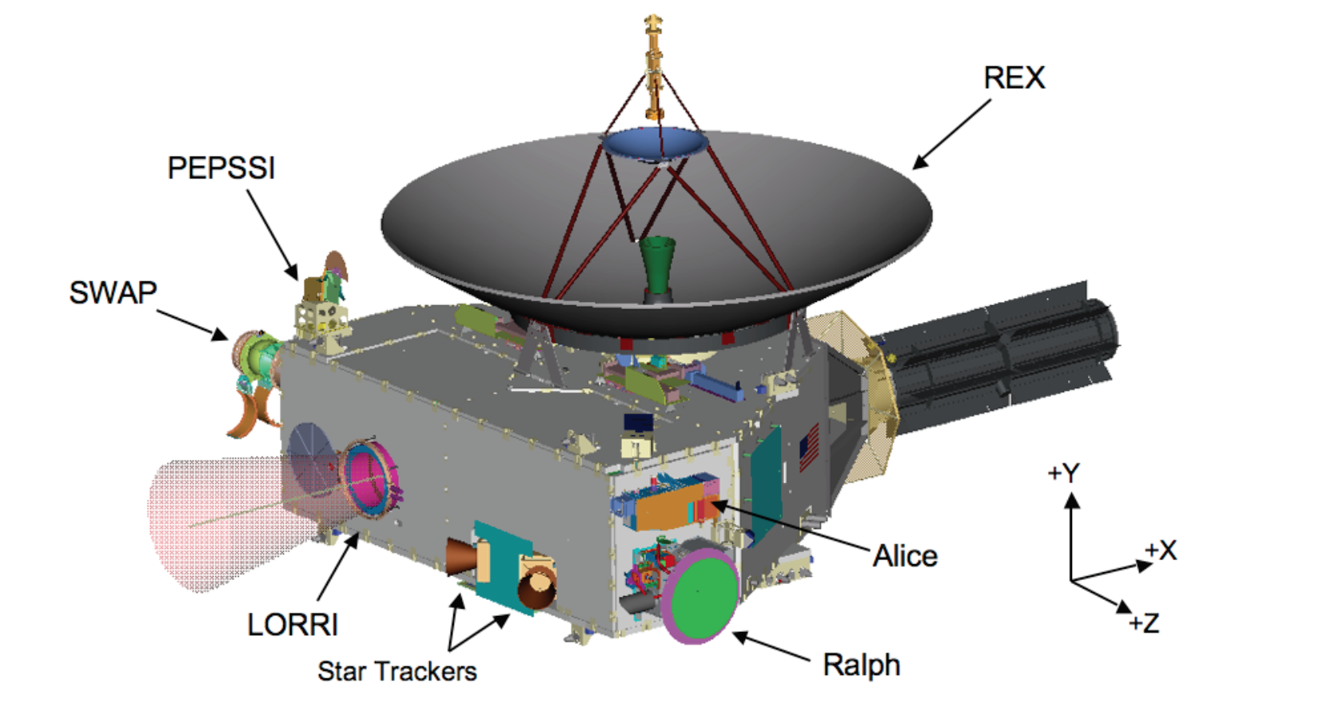
Alice on New Horizons – two FOVs payload_ssr.pdf (WEAVERETAL2007)

Slide 4
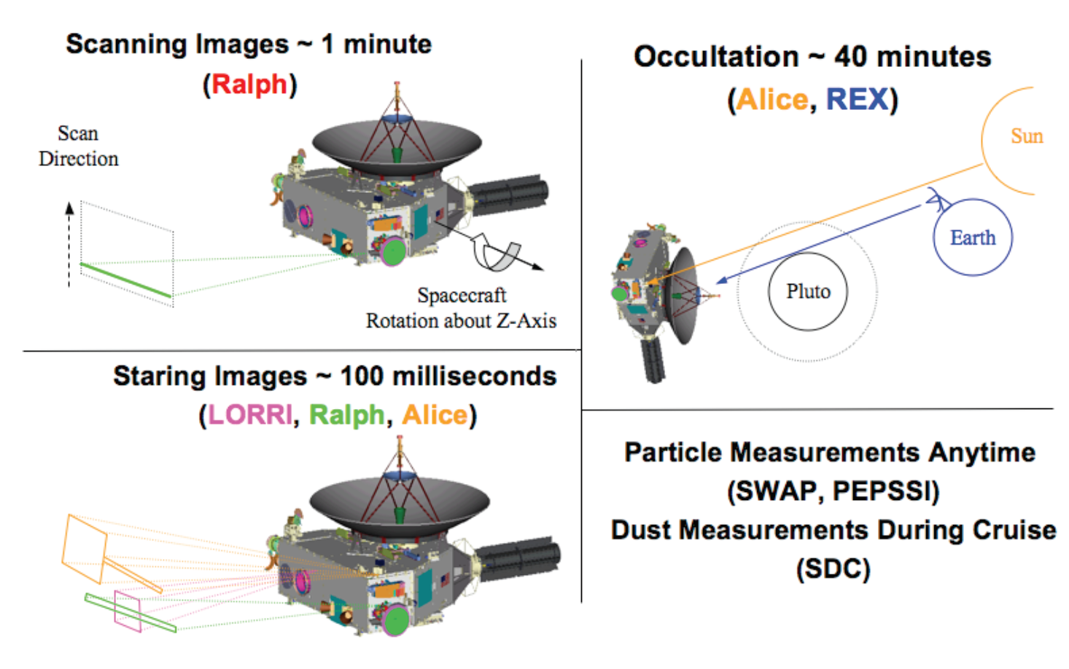
ALICE two FOVs payload_ssr.pdf (WEAVERETAL2007)

Slide 5
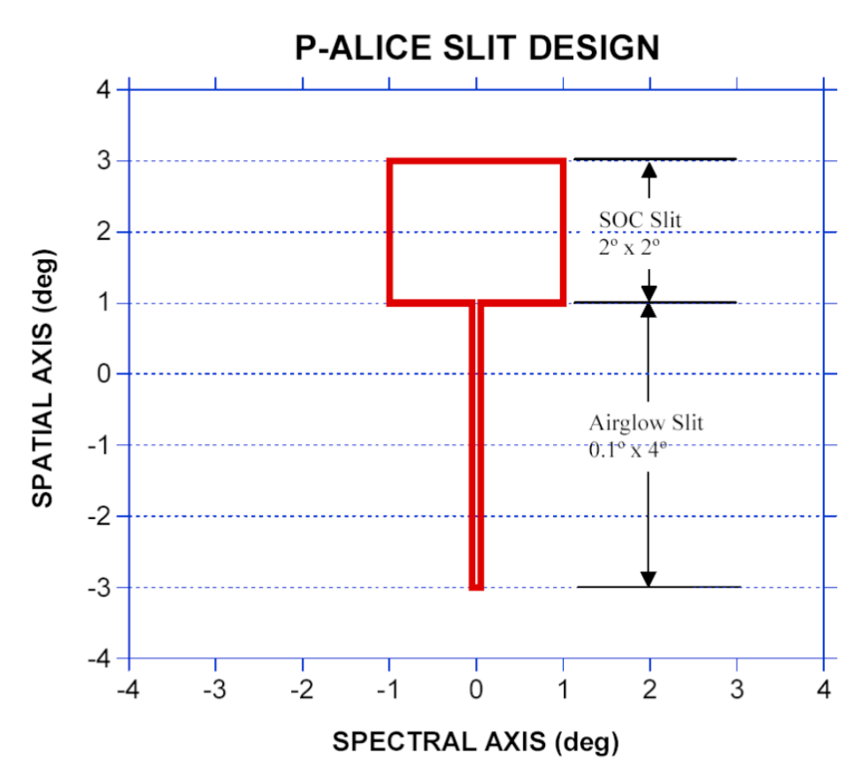
ALICE two FOVs
SOC slit big, slit filled resolution is 172 Å
Atmosphere may not fill slit – better resolution possible 2 – 3 Å
Airglow filled-slit resolution is 9 Å

Slide 6
Data directory structure
Example: 20070715_004679
Intelligible date
First 6 of 10 digit MET (a little abstract, but OK)
10 digit MET good for 317 years
File example: ali_0046791576_0x4b1_eng_1.fit
Inst; full MET; ApID; eng=raw; sci=cal; SOC ver

Slide 7
ALICE spectra
REQDESC = 'Calibration on rho Leo histogram observations (1.5 hr sec, ~6.3 kHz)
ρ Leo stretch: asinh (top), linear (bottom)

Slide 8
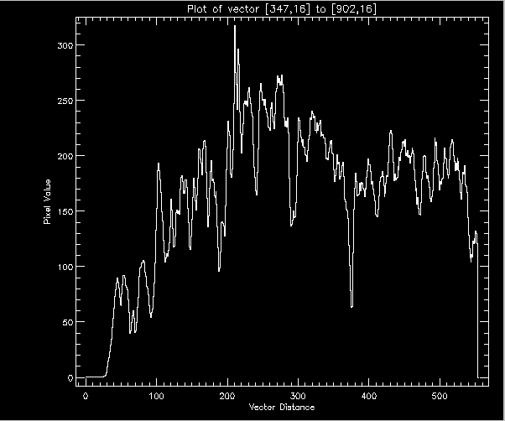
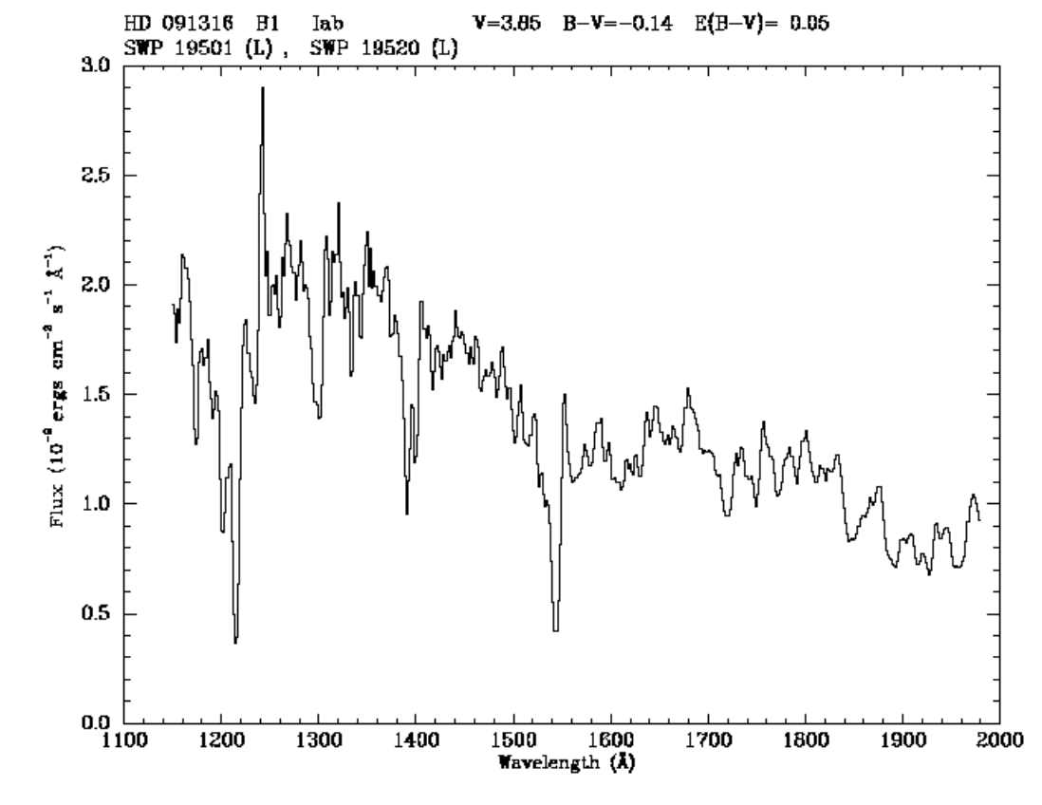
ALICE calibration on ρ Leo
IUE Standard Stars Atlas
(NEWSIPS)
http://www-int.stsci.edu/~jinger/iweb/B/hd091316.html

Slide 9
Rating of ALICE PLUTOCRUISE
Completeness
Stuff is there – aareadme.txt could be improved
Intelligibility
FITS and ASCII file formats well documented
Good
Interpretability
Could be improved with more notes in SEQ file or a cookbook of how to piece multiple files together (meta-meta data)
Archive quality
Inflight calibration of P-ALICE is important.
A bit of an internal brain dump (see Interpretability), so currently tough for a Future Analyst to get into the brain of the P-ALICE team

Slide 10
Suggested improvements
AAREADME.TXT:
Required Reading → Required Reading (see also Details) (cleans up SSR confusion)
Add seq_alice_plutocruise.tab to Required Reading list
nh_trajectory is in document, not catalog (correct place?)
ICD:
needs an acronym list
Are APIDs the same as ApIDs?
Table 7-3 is confusing because ApIDs are used that are not defined (11 and 14)

