Slide 1
Laboratory Ices PDS Review, January 2014
Jeff Morgenthaler
Planetary Science Institute

Slide 2
Documentation = *.cat
Simple explanation of setup looks good
No pretty pictures
Refer to Icarus article
(SOC)

Slide 3
Data directory structure
Example: ch3d_in_ch4
Self-explanatory
File: a_ch3d_2_5_40k.tab
Not sure what the 2_5 refers to
Important, since there is 2_9 and 4_5 for same temperatures
Couldn’t figure it out from quotes from the paper

Slide 4
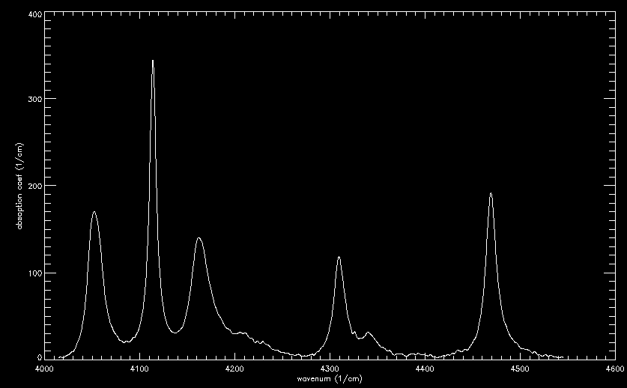
Sample measurement

Slide 5
Rating of laboratory ices
Completeness
Stuff is there, but as to file names, I am not sure what I am looking at (interpretability)
Intelligibility
ASCII file format well documented
Files names not well documented
Interpretability
If file names documented, would be perfect
Archive quality
Lab data on ices is worthy of inclusion in PDS
Data S/N look excellent

Slide 6
Suggested improvements
AAREADME.TXT:
Required Reading → Required Reading (see also Details) (cleans up SSR confusion)
Add seq_leisa_plutocruise.tab to Required Reading list
nh_trajectory is in document, not catalog (correct place?)
ICD:
needs an acronym list
Are APIDs the same as ApIDs?
Table 7-3 is confusing because ApIDs are used that are not defined (11 and 14)

