Slide 1
Ralph/LEISA PLUTOCRUISE PDS Review, January 2014
Jeff Morgenthaler
Planetary Science Institute

Slide 2
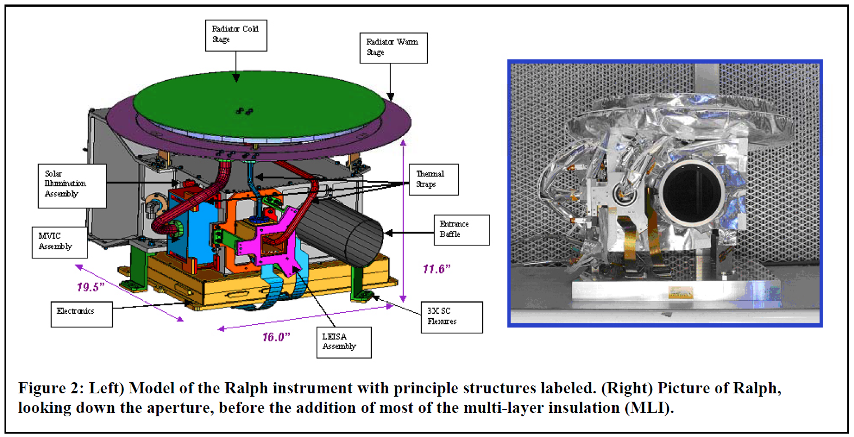
Ralph Basics ralph_ssr.pdf (REUTERETAL2007)
(SOC)

Slide 3
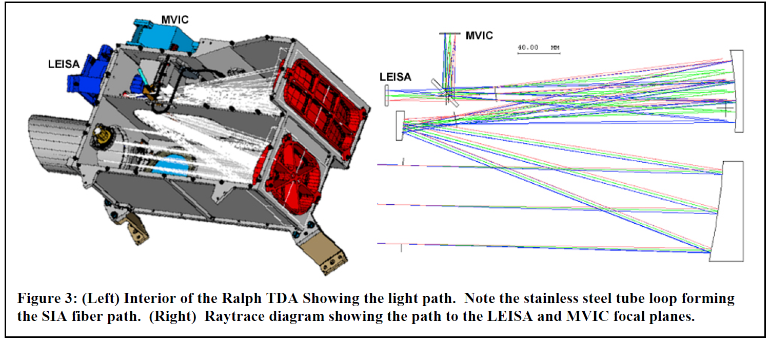
Ralph/LEISA internals

Slide 4
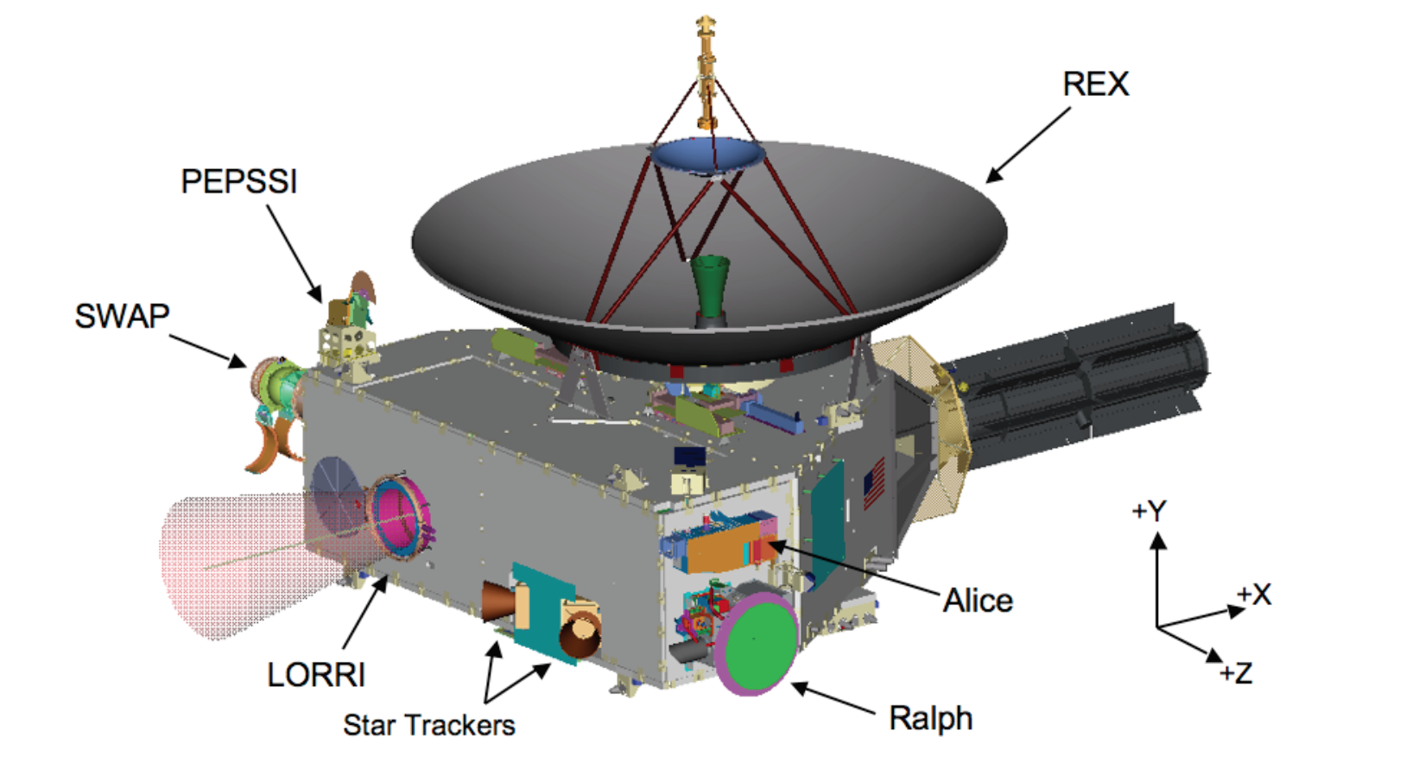
Ralph on New Horizons payload_ssr.pdf (WEAVERETAL2007)

Slide 5
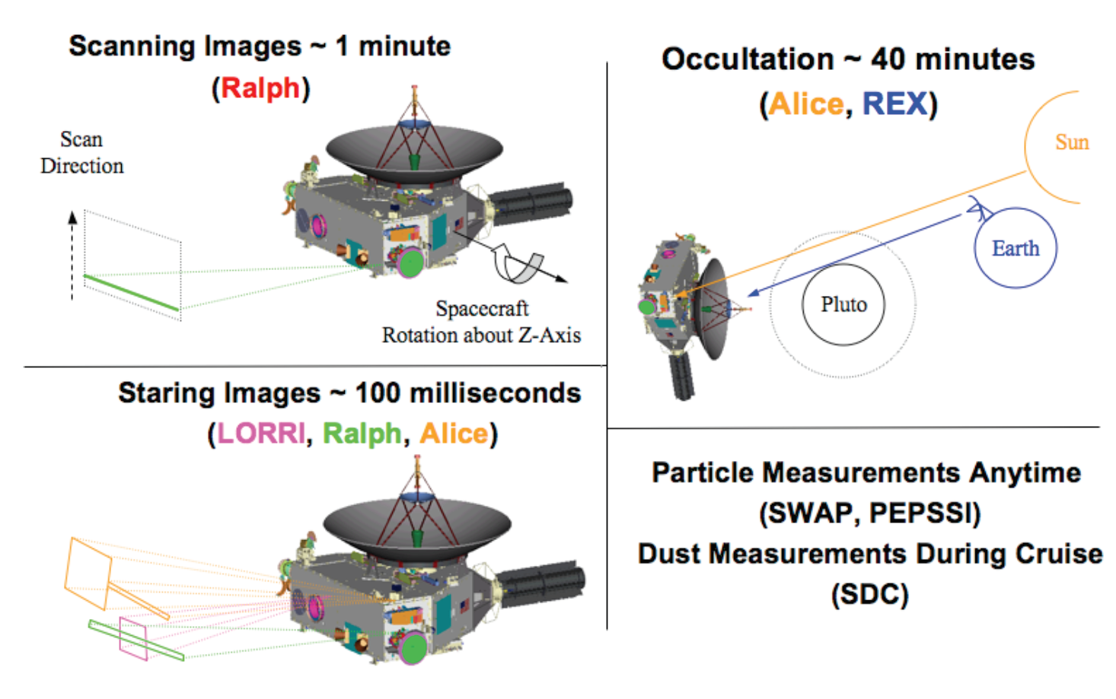
Leisa pushbroom spectrometry payload_ssr.pdf (WEAVERETAL2007)

Slide 6
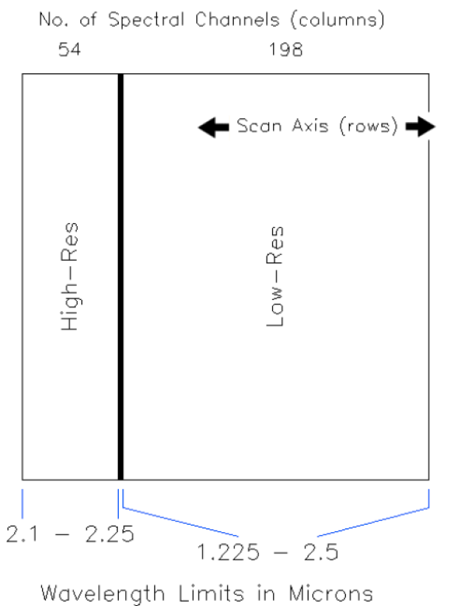
LEISA detector
Note overlap in wavelength
Images get flip-flopped when stored

Slide 7
Data directory structure
Example: 20100623_013964
Intelligible date
First 6 of 10 digit MET (a little abstract, but OK)
10 digit MET good for 317 years
File example:
lsb_0139647719_0x53c_sci_2.fit
Inst; full MET; ApID; eng=raw; sci=cal; SOC ver

Slide 8
LEISA cube slice of Vega
Wavelength vertical
Sunlight leak
Lots of data taken to characterize sunlight leak

Slide 9
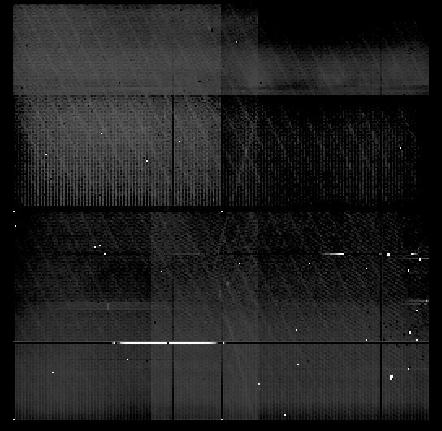
Vega co-added data cube
Doesn’t look too useful
Doesn’t look like instrument artifacts are taken out of individual slices
This is not according to ICD specifications

Slide 10
Rating of LEISA PLUTOCRUISE
Completeness
Stuff is there – aareadme.txt could be improved
Intelligibility
FITS and ASCII file formats well documented
Good
Interpretability
Data not properly flatfielded?
Could be improved with more notes in SEQ file or a cookbook of how to piece multiple files together (meta-meta data)
Archive quality
Inflight calibration of LEISA is important
A bit of an internal brain dump (see Interpretability), so currently tough for a Future Analyst to get into the brain of the LEISA team

Slide 11
Suggested improvements
AAREADME.TXT:
Required Reading → Required Reading (see also Details) (cleans up SSR confusion)
Add seq_leisa_plutocruise.tab to Required Reading list
nh_trajectory is in document, not catalog (correct place?)
ICD:
needs an acronym list
Are APIDs the same as ApIDs?
Table 7-3 is confusing because ApIDs are used that are not defined (11 and 14)

