Slide 1
New Horizon PDS Data Peer Review, January 13-14,2014
Thanasis ECONOMOU
University of Chicago

Slide 2
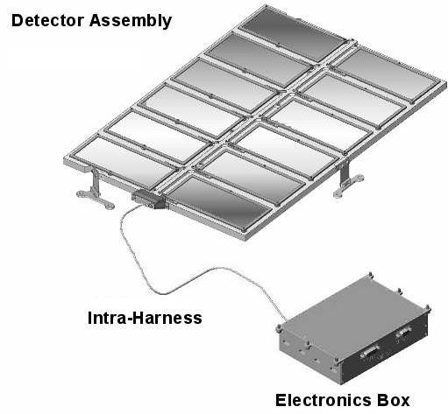
The NH SDC instrument Mihaly Horanyi – Principal Investigator

Slide 3
EVALUATION OF STUDENT DUST COUNTER (SDC) PDS DATA
nh-x-sdc-2-launch-v3.0 | NH SDC Launch Raw data | Economou/Poppe
nh-x-sdc-3-launch-v3.0 | NH SDC Launch Calibrated data | Economou/Poppe
nh-j-sdc-2-jupiter-v3.0 | NH SDC Jupiter Encounter Raw data | Economou/Poppe
nh-j-sdc-3-jupiter-v3.0 | NH SDC Jupiter Encounter Calibrated data | Economou/Poppe
nh-x-sdc-2-plutocruise-v1.0 | NH SDC Pluto Cruise Raw data | Poppe/Economou
nh-x-sdc-3-plutocruise-v1.0 | NH SDC Pluto Cruise Calibrated data | Poppe/Economou

Slide 4
SUMMARY EVALUATION ALL THE DOCUMENTS IASSOCIATED WITH THE SDC IN THE PDS ARE IN VERY GOOD SHAPE AND IF SOMEONE READS THE RECOMMENDED MATERIAL CAN UNDERSTAND THE INSTRUMENT, THE DATA STRUCTURE AND SUCCESSFULLY USE THE SDC DATA CONTAINED IN THE PDS DATA BASE FOR A MEANINGFUL ANALYSIS

Slide 5
nh-x-sdc-2-launch-v3.0 NH SDC Launch Raw data
This data set contains Level 2 Raw data taken by the New Horizons Student Dust Counter instrument during the post-launch checkout mission phase. In the first 6 months there were weeks to months periods that the SDC was OFF due to mission restriction.
It also contains all the preflight calibration data needed for proper data interpretation and other important documentation. Very helpful are the recommended reading of the NH_ICD and HORANYIETAL2007 documents that are included in the PDS Data Base.
It would be nice if the 2nd recommended reference "WEAVERETAL2007“ ( In addition to “HORANYIETAL2007“ for the SDC was also included in the PDS data base.
Note: Sometimes these references are given as HORANYIETAL2008“ and "WEAVERETAL2008“ ??
VERY GOOD

Slide 6
nh-x-sdc-3-launch-v3.0 NH SDC Launch Calibrated Data
This data set contains Level 3 Raw data taken by the New Horizons Student Dust Counter instrument during the post-launch checkout mission phase.
It also contains all the preflight calibration data needed for proper data interpretation and other important documentation.
GOOD

Slide 7
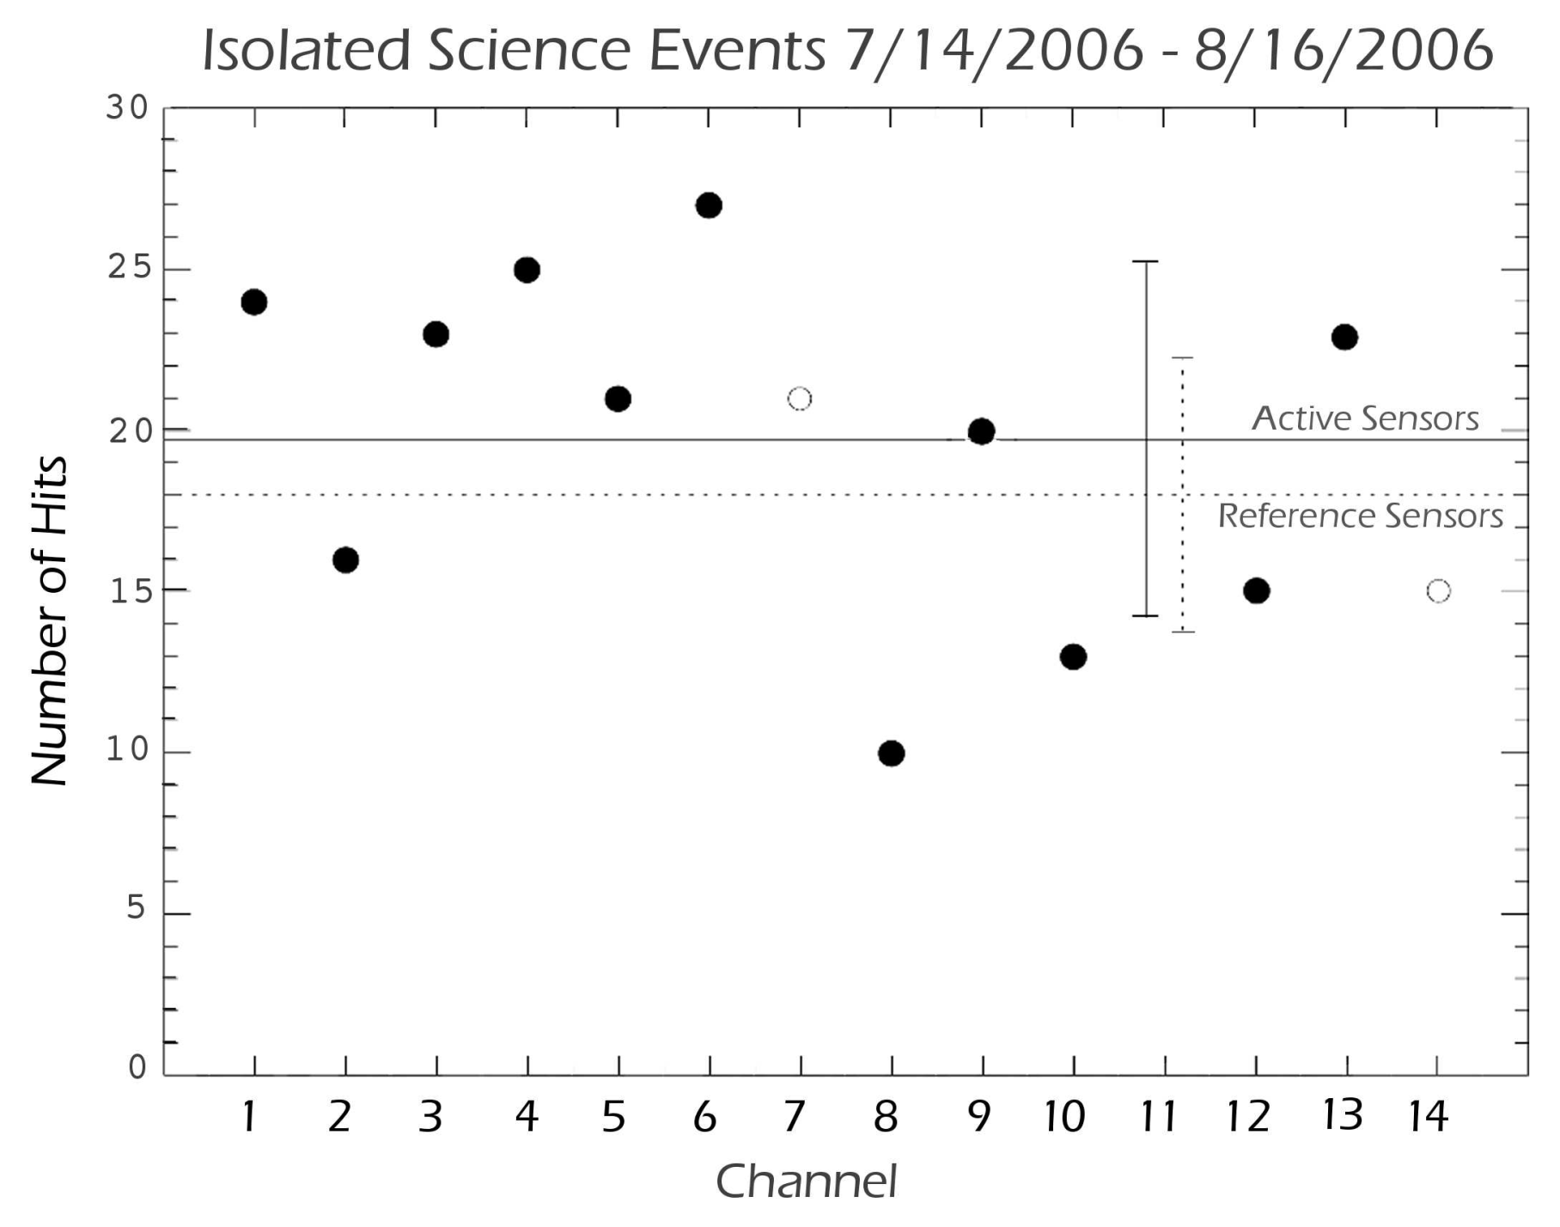
Fig. 10

Slide 8
Some confusing data
I tried to duplicate the Figure 10 above from M. Horanyi et al.,2007 SSR paper and had some problems until I realized that file sdc_0016861919_0x700_sci_1.fit has both, real events and flight internal calibration data.
This is at least confusing. They should not be
in the same file. Probably, this occurs in other
files as well.

Slide 9
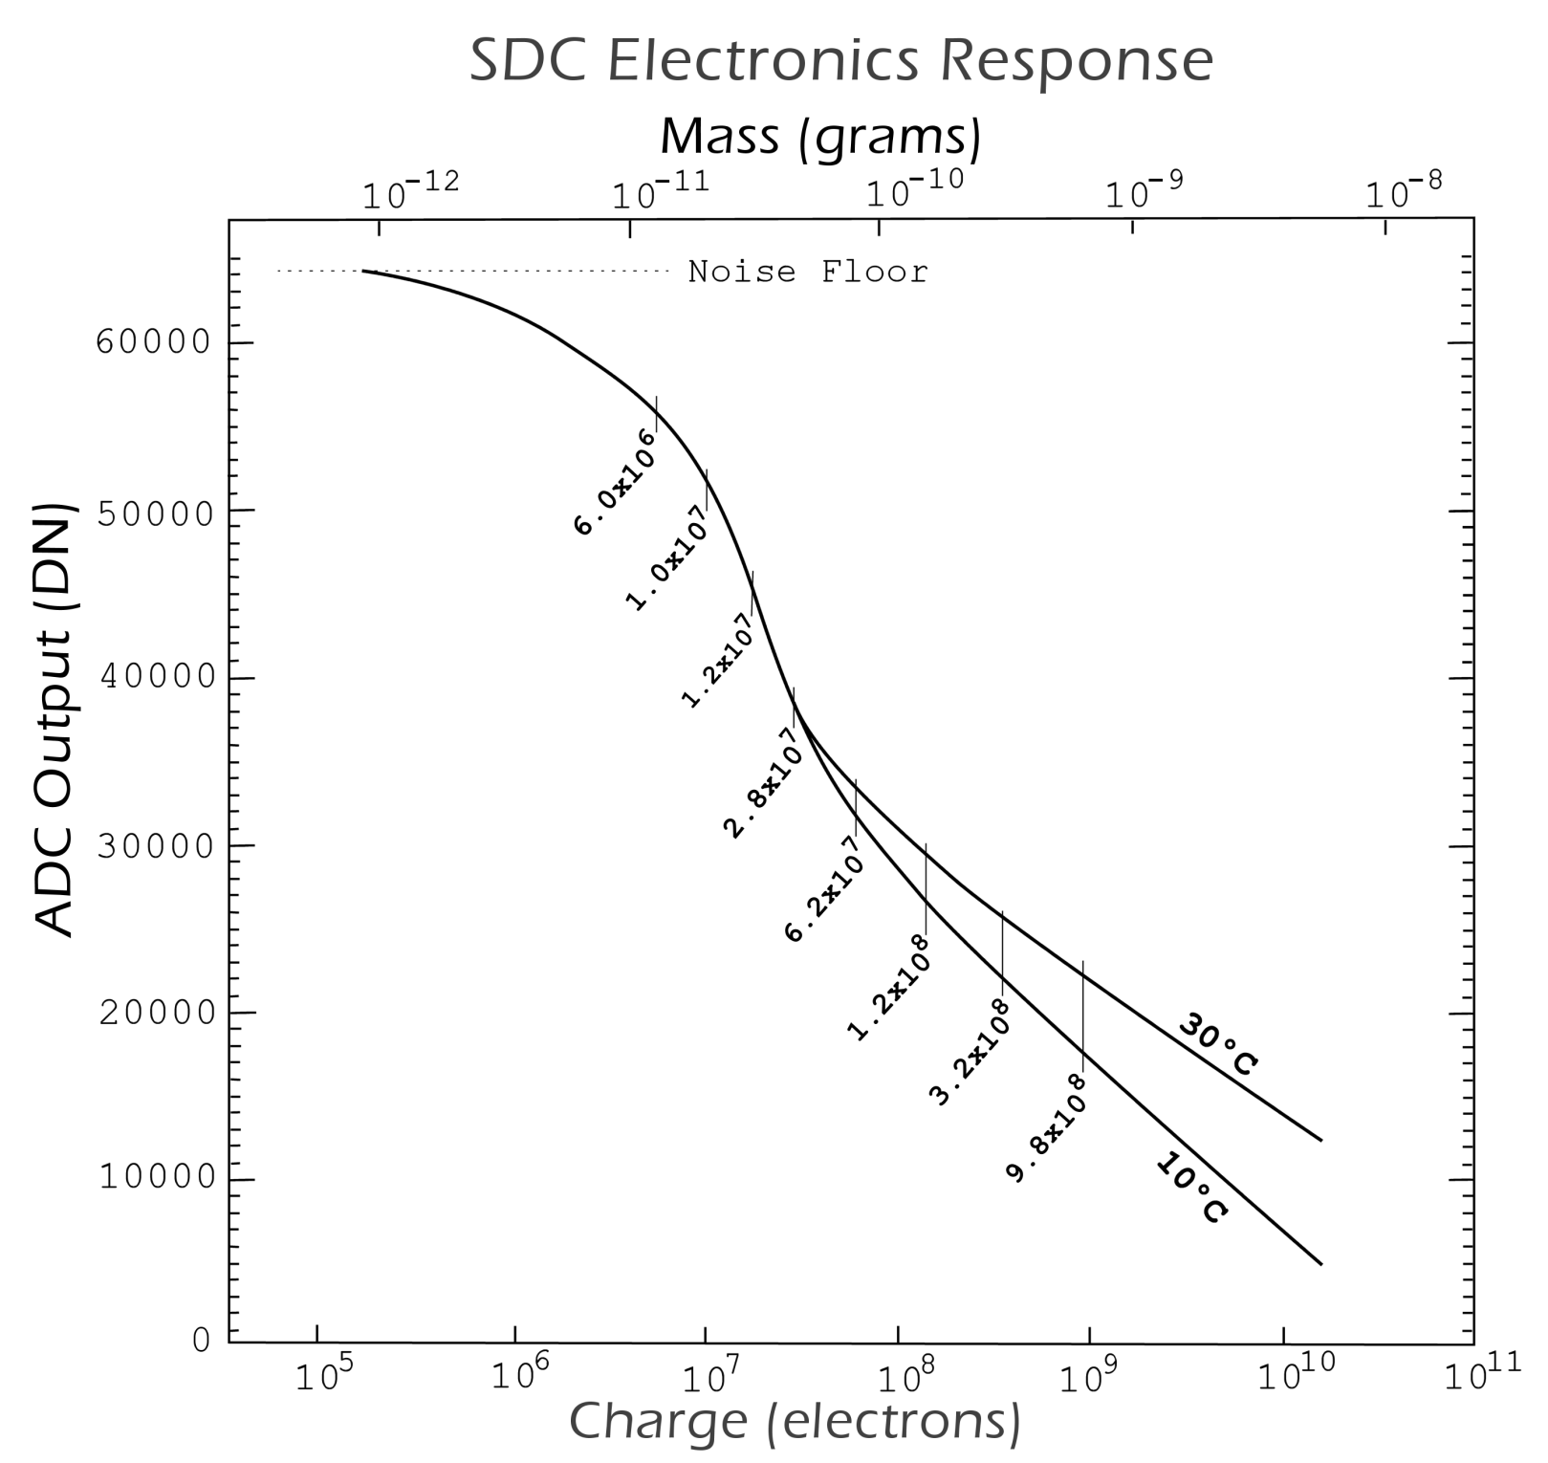

Slide 10
According to the specification, the SDC determines the masses of dust particles in the range between 10⁻¹²
and 10⁻⁹ . Yet, lot of masses found in SDC flight data files show masses as low as 7.0*10^{-13.} . That would indicate that the SDC has lower threshold in space that in the lab. (This is not a fault – just stating the facts). I also have noticed that I have not seen any large particle masses (>10⁻¹¹ ), real or from flight calibration.

Slide 11
nh-j-sdc-2-jupiter-v3.0 NH SDC Jupiter Encounter Raw data
This data set contains Raw data taken by the New Horizons Student Dust Counter instrument during the Jupiter encounter mission phase. For the Jupiter encounter mission phase, SDC collected no science data during the Jupiter flyby, as the requisite spacecraft configuration prevented SDC from operating. Most of the data are between April 2007 and June 2007.
GOOD

Slide 12
nh-j-sdc-3-jupiter-v3.0 NH SDC Jupiter Encounter Raw data
This data set contains Raw data taken by the New Horizons Student Dust Counter instrument during the Jupiter encounter mission phase. For the Jupiter encounter mission phase, SDC collected no science data during the Jupiter flyby, as the requisite spacecraft configuration prevented SDC from operating. Most of the data are between April 2007 and June 2007.
The data and documentation are archived
GOOD

Slide 13
Suggested Improvements
ICD wrpct SDC
Two different name (VSDC &SDV) is confusing to a non insider .
Need for an acronym list
The definition of “Threshold “ in 13.2.1. section needs some expansion. Why is that hits below threshold should be recorded “due to the way software works”?
In Documents
The sdc_on_off_times_v0077.tab and sdc_on_off_times_v0077_alt.tab ON/OFF SDC files are too long and not very useful for science considerations. A shorter version with only science data would be much more useful.
In order to derive final validated IDP impact rates as a function of dust mass, one still has to proceed with level 4 analysis , as defined in HORANYI ETAL2007, in order to remove any suspected noisy events. This is not discussed at all in DPS data base.

