Slide 1
New Horizons SPICE Review NH-J/P/SS-SPICE-6-V1.0
Tony Farnham

Slide 2
SPICE Data
Data set NH-J/P/SS-SPICE-6-V1.0
Accumulating data set
Kernel set created by the SOC for use in scientific data analysis
Not always compatible with the kernels used for Mission Ops.
Current release includes latest instrument alignment data
Differ from image data values?

Slide 3
Documentation
Catalog files
Typically well done, no major issues
Much info taken from other sources
Some typos (separate file)
PERSON.CAT file has A’Hearn as first contact
Correct/intentional/desired?
Labels
No significant issues
TARGET_NAME in all cases is “Jupiter, Pluto, Solar System”. Should this be more focused?

Slide 4
Documentation
Data files
Extensively documented, as usual
Tried to check to make sure text agrees with kernels
Assuming values are correct
Comments in some files are not correct/relevant
Came from individual files merged into one
Not particularly important (e.g. how to invoke CKBRIEF)
Some typos (separate file)

Slide 5
Reading Data
Read all kernels with no problems
Used FURNSH list provided in the metadata
Some kernels differ from those used in NH datasets
Assume that this dataset is most up-to-date or that the archive uses merged files

Slide 6
Testing the Data
Adapted my general geometry routine for NH data
Randomly sampled data at various times throughout the dataset to test temporal calculations
Seem to be valid for times when the s/c was not in hibernation
Calculations for s/c and planets
State vectors, rates, etc.
Seems robust and complete
Tried to test some aspects of all data, instruments, etc. at some level
Not familiar with some instruments so not sure how to fully exercise them

Slide 7
Instruments
Able to read instrument files, grab instrument FOV properties and compute various dependencies
Boresight pointing, corner positions, etc
Exception is Ralph, addressed in errata file
Instruments are body-mounted to the s/c, so they should be simple coordinate transformations relative to the spacecraft frame
Compared boresight pointing for various instruments, and it seems consistent
Assume if some instruments are correct, all will be
Test some instruments extensively (LORRI, REX)

Slide 8
Testing Against Data
Used LORRI and REX data sets as comparative test
My values generally match header and label values in a random sampling of those files
LORRI boresight often differed by a few tenths of a degree
Old alignment information in image data files?
More extensive tests with LORRI data
How would I use the data?
Looked at pointing throughout Jupiter encounter in Feb 2007

Slide 9
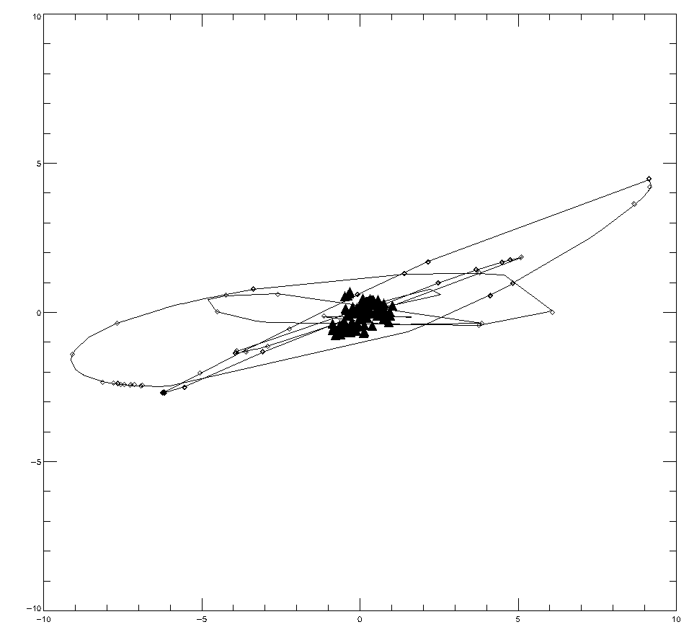
Jupiter Encounter Pointing
Jupiter and Io
Position of boresight, relative to Jupiter
Triangles – Jupiter images
Diamonds – Io images
Tracks are computed position of Io
LORRI seems to be self consistent

Slide 10
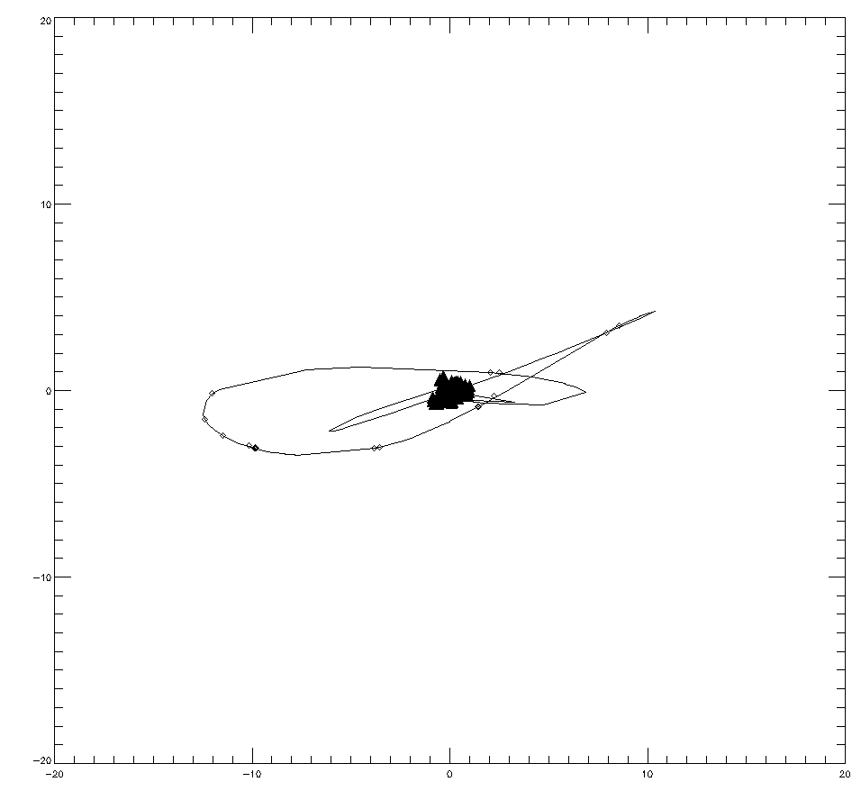
Jupiter Encounter Pointing
Jupiter and Europa
Position of boresight, relative to Jupiter
Triangles – Jupiter images
Diamonds – Europa images
Tracks are computed position of Europa
LORRI seems to be self consistent

Slide 11
Summary
Files are readable and well-documented
Few typos
LORRI calculations seem to be self-consistent and correct
REX calculations seem to be self-consistent
Other instruments are consistent with LORRI and REX
By extension, they should be correct as well
Temporal coverage seems to be complete
Data set is in good shape

