Slide 1
LORRI PDS Review
December 12, 2014
Carolyn Ernst

Slide 2
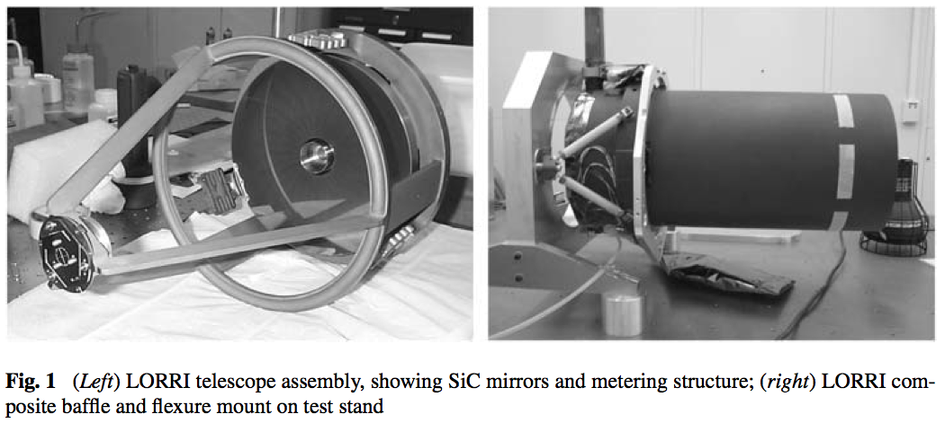
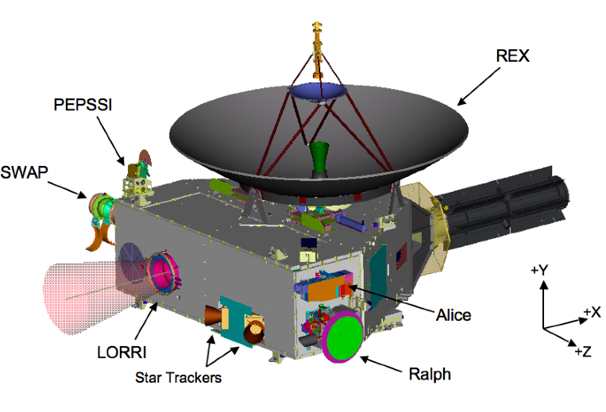
LOng-Range Reconnaissance Imager
SPECIFICATIONS (from lorri.cat)
--------------
NAME: LORRI (Long-Range Reconnaissance Imager)
DESCRIPTION: High-resolution telescope
PRINCIPAL INVESTIGATOR: Andy Cheng, APL
WAVELENGTH RANGE: 350 - 850nm
FIELD OF VIEW: 5.06 x 5.06 milliradians (0.29 x 0.29 degrees)
ANGULAR RESOLUTION: 0.00494 milliradians, unbinned
PRIMARY DATA FORMAT(S): 1) 1024x1024 2-D pixel array (unbinned)
2) 256x256 2-D pixel array (4x4 binned)
PRIMARY MEASURED QUANTITIES:
1) Raw data: per-pixel brightnesses as Data Numbers (DNs)
2) Calibrated data: per-pixel brightnesses as radiances

Slide 3
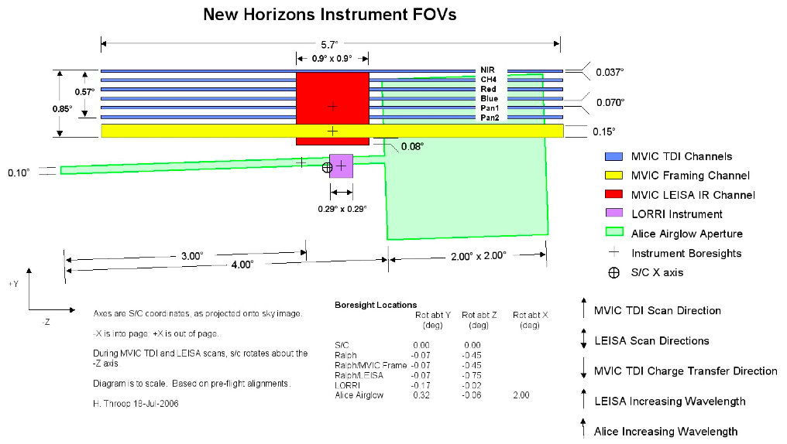

Slide 4
Datasets to Review
Launch Phase
nh-x-lorri-2-launch-v2.0
nh-x-lorri-3-launch-v2.0
Jupiter Phase
nh-j-lorri-2-jupiter-v2.0
nh-j-lorri-3-jupiter-v2.0
Pluto Cruise Phase
nh-x-lorri-2-plutocruise-v1.0
nh-x-lorri-3-plutocruise-v1.0

Slide 5
Data Checking

Slide 6
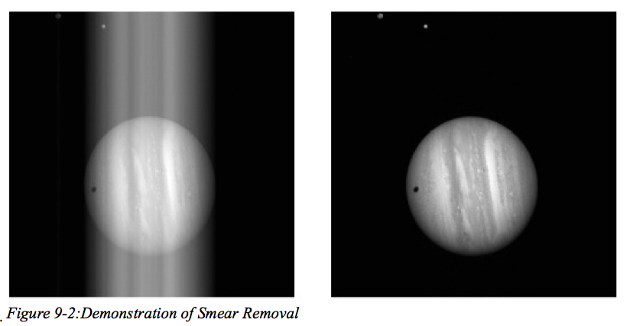
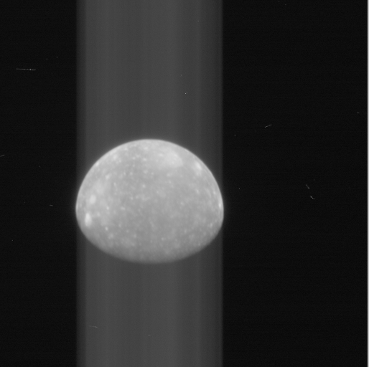
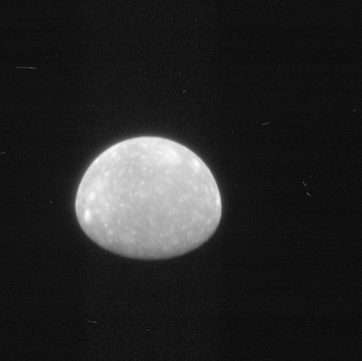
Smear Removal
←From ICD
lor_0034858514_0x630_eng_1.fit
lor_0034858514_0x630_sci_1.fit
Callisto from archive ->

Slide 7
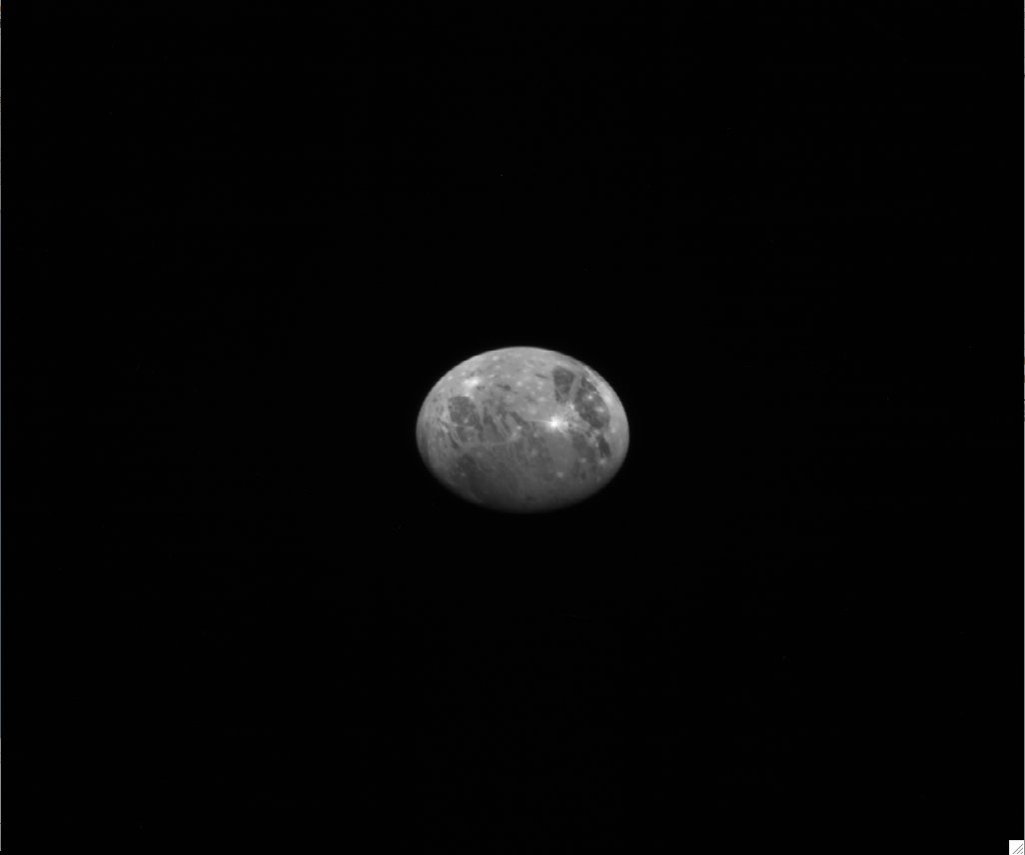
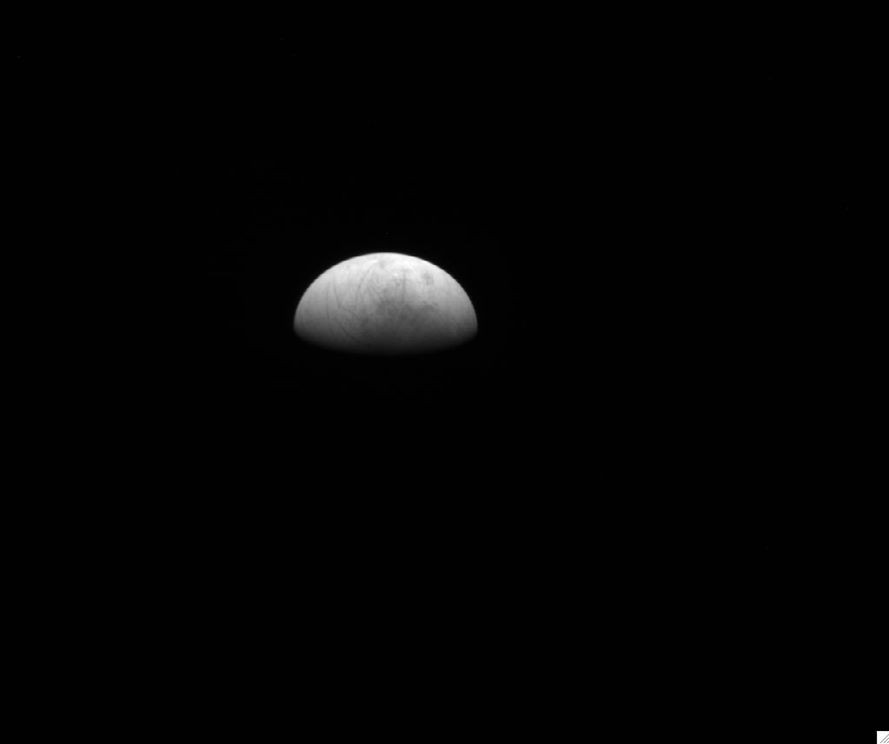
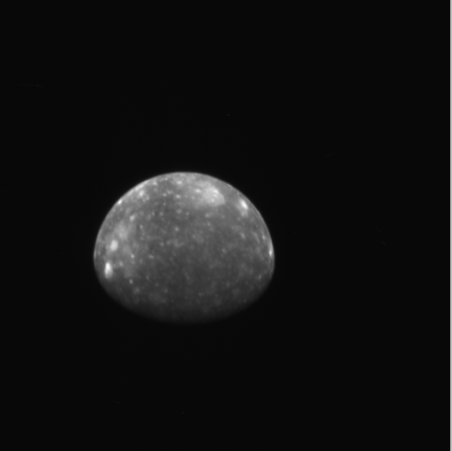

Slide 8
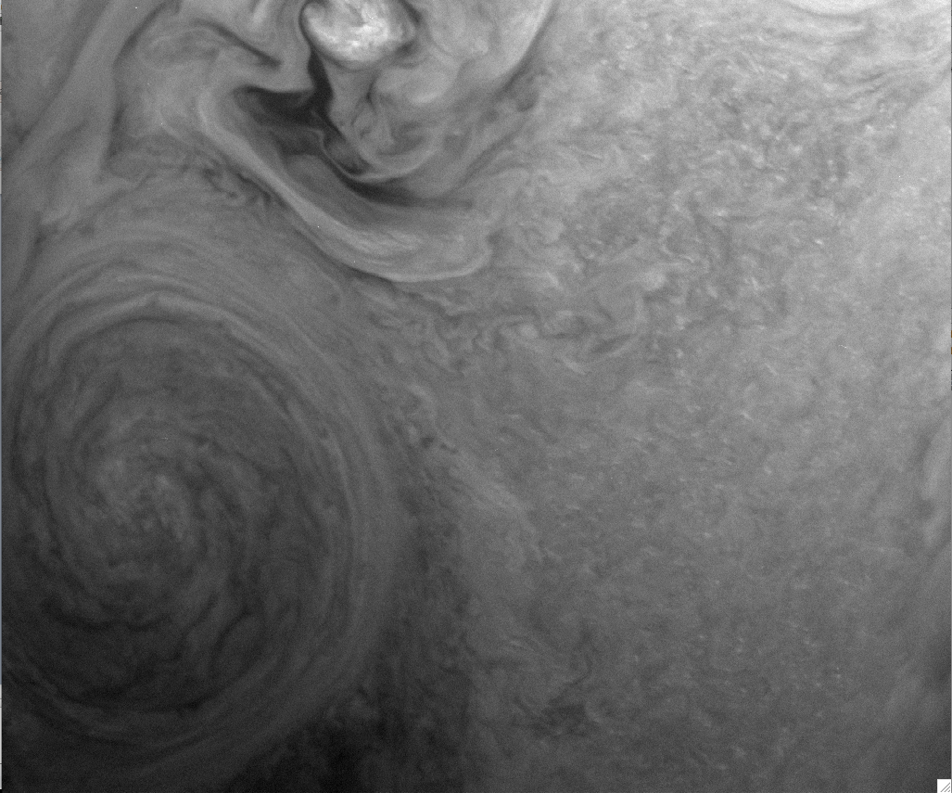
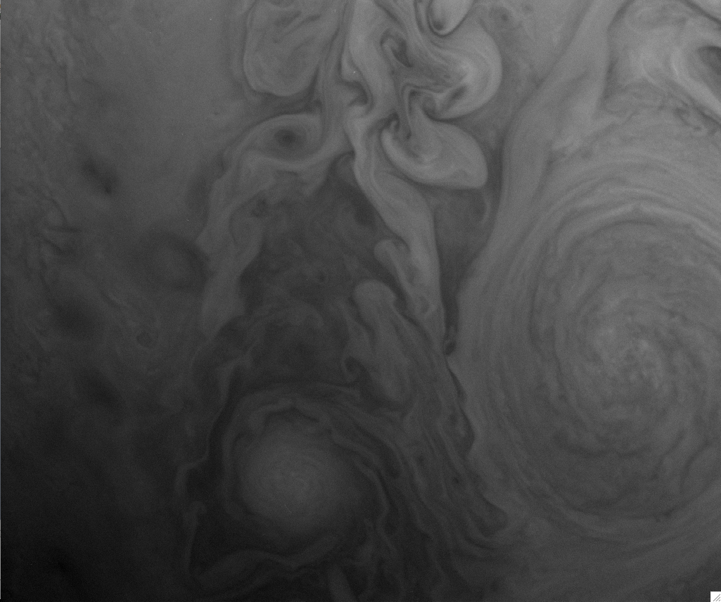

Slide 9
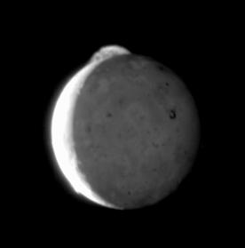
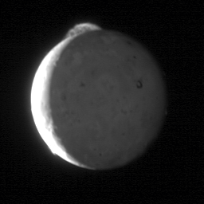
Recreate Io Plume Movie
Created for this review:
20070301_003509/lor_0035098949_0x630_sci_1.fit
20070301_003509/lor_0035099069_0x630_sci_1.fit
20070301_003509/lor_0035099189_0x630_sci_1.fit
20070301_003509/lor_0035099309_0x630_sci_1.fit
20070301_003509/lor_0035099429_0x630_sci_1.fit
http://photojournal.jpl.nasa.gov/catalog/PIA09665
Image Credit: NASA/JHUAPL/SwRI

Slide 10
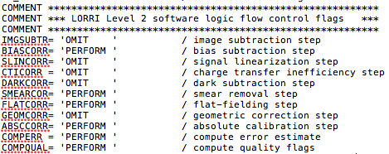
Calibration (1/3)
The data are calibrated into ‘DN’s, not absolute calibration. This needs to be made clear in several places, including:
-dataset.cat
Under the Calibration header, the pipeline steps are described, but nowhere is it clear that the calibration is into DN and that the listed ‘absolute calibration’ step is not occurring.
-.lbl:
-.fit header:

Slide 11
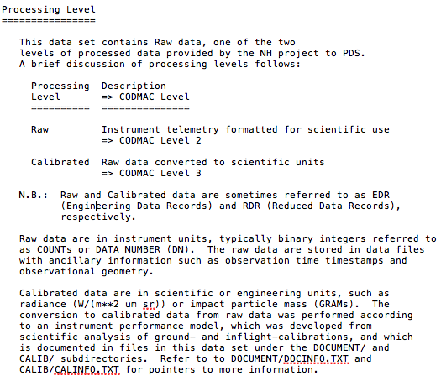
Calibration (2/3)
-lorri.cat
PRIMARY MEASURED QUANTITIES:
1) Raw data: per-pixel brightnesses as Data Numbers (DNs)
2) Calibrated data: per-pixel brightnesses as radiances
-aareadme.txt; aareadme_bu.txt

Slide 12
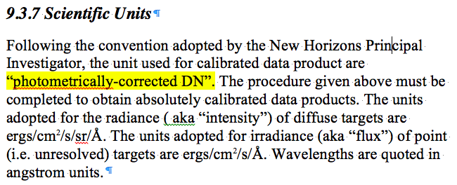
Calibration (3/3)
-ICD (seems correct in here)

Slide 13
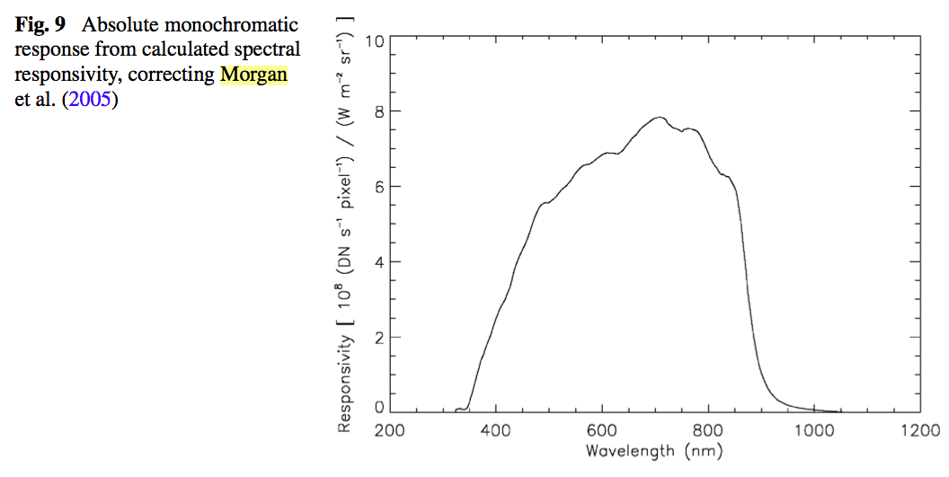
Responsitivity Graph (1/4)
In the published version (not the submitted version that is archived) of the LORRI SSR Cheng et al. paper, the Figure 9 y-axis has units of W m-2 sr-1 in the denominator. The caption cites a correction form the Morgan LORRI paper.

Slide 14
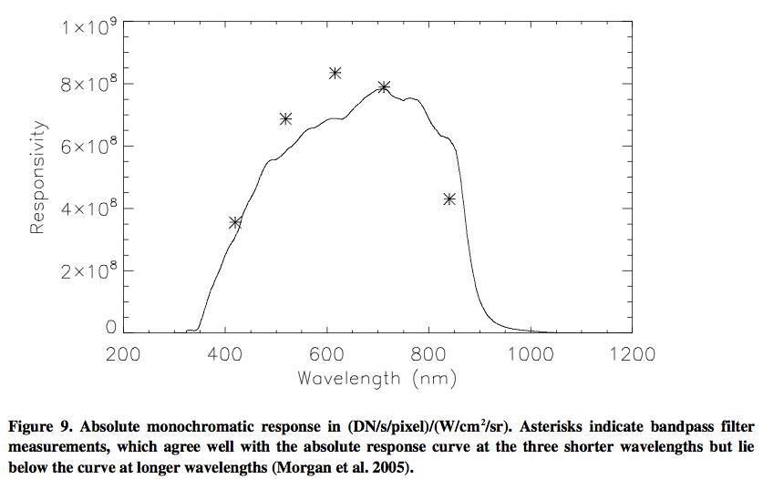
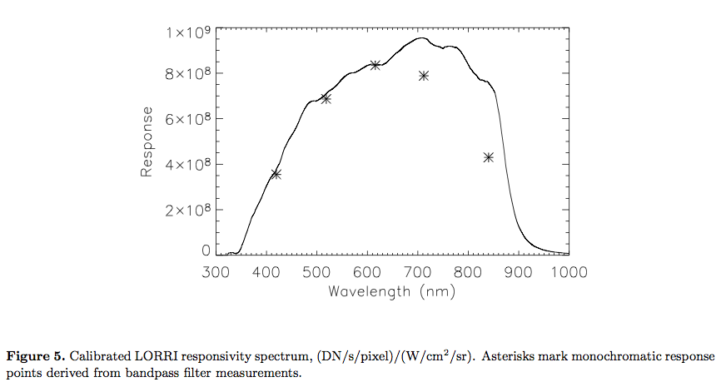
Responsitivity Graph (2/4)
In the archived submitted version of the LORRI SSR Cheng et al. paper, figure 9 is identical to the Morgan LORRI paper figure 5 (and has units of W cm-2 sr-1)

Slide 15
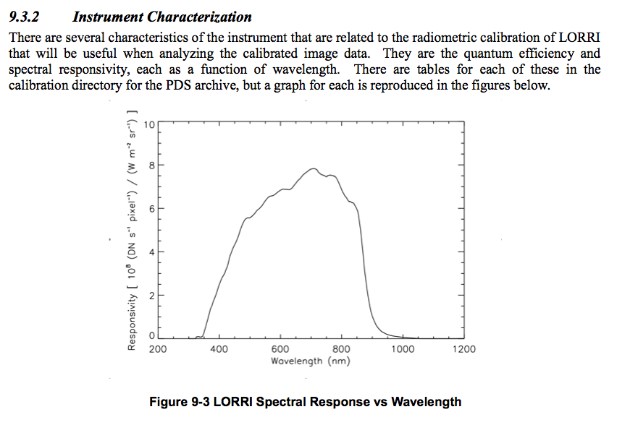
Responsitivity Graph (3/4)
Figure 9.3 in the ICD matches the published version of the graph

Slide 16
Responsitivity Graph (4/4)
The lorri_responsivity_plot.png file in the archive matches the published version of the Cheng et al. figure 9.
The preprint Cheng paper and this .png are inconsistent with one another
Despite citing an error in the Morgan et al. paper, later work seems to indicate that the original units of W cm-2 sr-1 were correct after all.
This is based on personal communication with Frank Morgan, as well as inconsistencies discovered between the Cheng numbers and LORRI operational spreadsheets (personal comm. Brett Denevi)
This is clearly an issue – but I’m uncertain as to the solution
If the Cheng units are correct: It needs to be noted somewhere that there was an important change to figure 9 between the submitted and final versions.
If the Morgan units are correct: It should be noted somewhere that in the final version of the Cheng paper the units are not correct. Additionally, the file lorri_responsivity_plot.png should be made to match the Morgan numbers.
If the correct version of the graph is unknown, this is may be a project issue to solve?
Does the absolute calibration step discussed in the documentation (e.g., the discussion of specific targets and the translation from DN to absolute units in the ICD) yield correct numbers?

Slide 17
Keywords
There are no unit labels in either the level 2 or level 3 files
Both should be noted as “DN”
PRODUCT_TYPE = "EDR” for both
For level 3 files, this should be “RDR”
Note: These keyword comments are true for all three datasets – labels should be checked for other instrument datasets that are already in the PDS and certified (e.g., MVIC launch and Jupiter phases)

Slide 18
Typos in level3 .lbl files

Slide 19
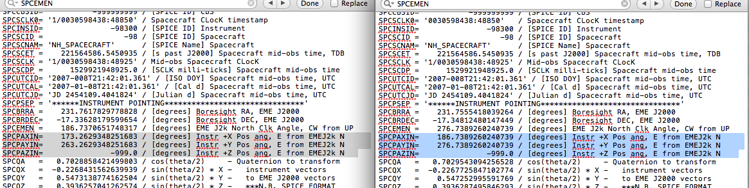
Changes between V1.0 and V2.0
The data pipeline corrected some FITS header keywords
(SPCEMEN, SPCPAXIN, SPCPAYIN, PA_XINST, PA_YINST) that were
in error by 90 degrees and that express the orientation of the
LORRI FOV around the boresight; the correction did not affect
the quaternion, which was and is correct.

Slide 20
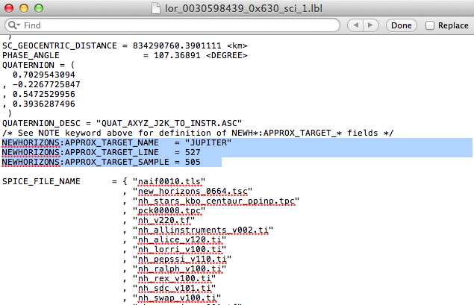
Changes between V1.0 and V2.0
Approximate target and target location in line and sample have
been added in PDS mission-specific keywords
NEWHORIZONS:APPROX_TARGET_NAME
NEWHORIZONS:APPROX_TARGET_LINE
NEWHORIZONS:APPROX_TARGET_SAMP
“SAMP” in dataset.cat, but actual keyword is “SAMPLE”

Slide 21
lor_0268688039_0x630_sci_1.fit

Slide 22
lor_0268688039_0x630_sci_1.fit

Slide 23
Pluto
Charon
lor_0268688039_0x630_sci_1.fit

