Slide 1
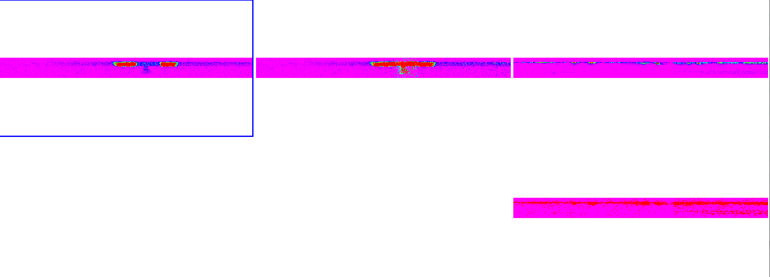
New Horizons – Alice Data (L. Feaga Report 12/11/14)
Some data with ENG values are NAN’s when converted to Level 3 data!
AI: Check where Level 3 files are NAN’s for entire file
ali_0235930840_0x4b1_eng_1
EARTH - ENG
ali_0235930840_0x4b1_sci_1
EARTH - SCI
ali_0140158550_0x4b1_eng_1
SUN - ENG
ali_0140158550_0x4b1_sci_1
SUN – SCI
NAN’s
ali_0140158552_0x4b1_sci_1
SUN - SCI
NAN’s
ali_0140158549_0x4b1_sci_1
SUN - SCI

Slide 2
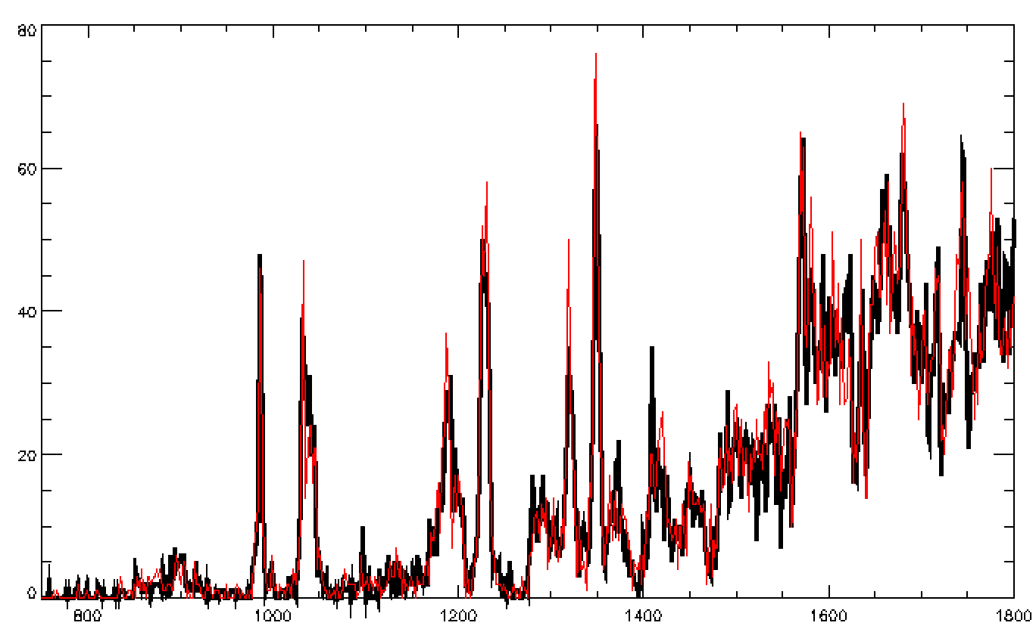
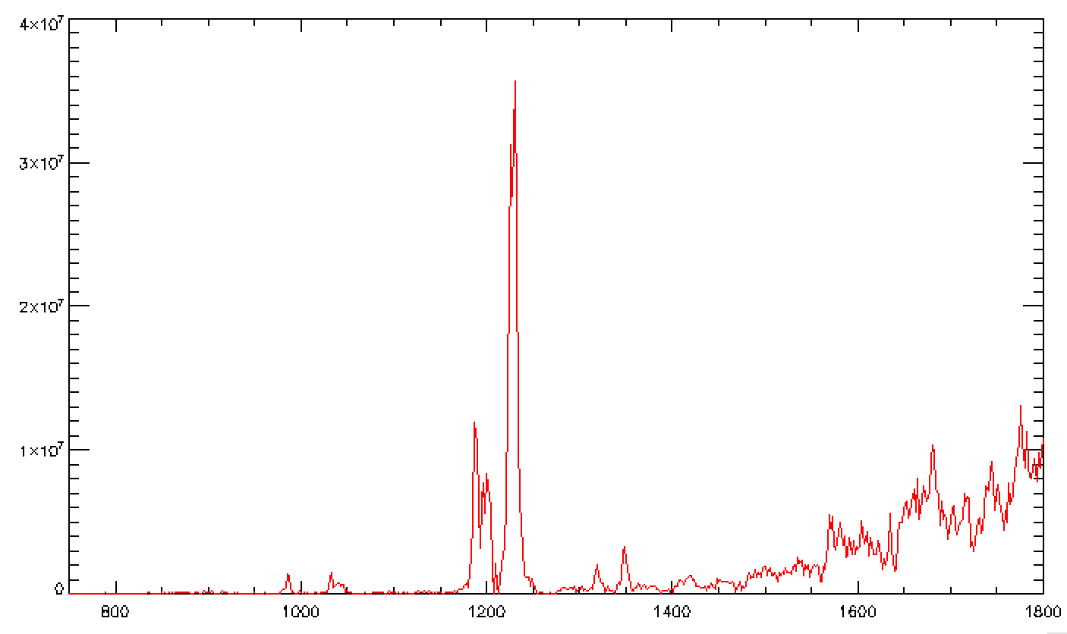
Plotting the ENG and SCI examples
ENG Files ~ Similar w/ non-NAN data
SCI Files ~ one is all NAN’s one has data
Looks like a UV solar spectrum
when data are present

Slide 3
NH Alice Data PDS Labels
For SUN as target data, should have these distances and would want them for most:
TARGET_SUN_POSITION_VECTOR = ( 0.00000 <km> , 0.00000 <km> , 0.00000 <km> )
SOLAR_DISTANCE = 0.00000 <km>
AI: for data with real Solar System targets (Earth, Sun), make sure position & velocity vectors are non-zero in PDS labels

Slide 4
calib/calinfo.txt
Multiple dark files don’t have dates of applicability, whereas the multiple aeff files do.
AI: Add dates of applicability for all calibration files

