Slide 1
NH/REX Review
Dick Simpson
11-12 December 2014

Slide 2
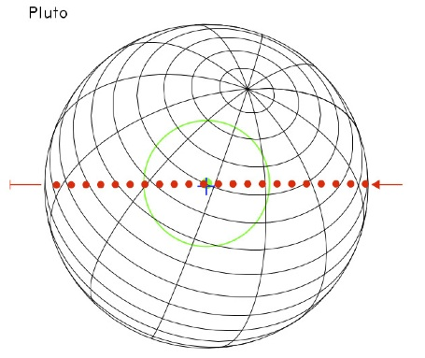
HGA Beam on Pluto for Radiometry
(Charon is similar, but not resolved)
radio tracking
radio tracking
radiometry
occultation
occultation
For quantitative work, tabulated antenna pattern is needed

Slide 3
Objectives
Radio occultation — needs 1 kHz samples for extraction of atmospheric temperature and pressure profile from phase changes in uplink radio signal (Pluto and Charon)
Radio occultation — needs 1 kHz samples to determine length of occultation chord (Pluto and Charon)
Radiometry — needs radio power measurements to estimate Pluto and Charon emission —> surface temperatures
Radio Tracking — needs Doppler (and range?) measurements from close approach to estimate mass (and higher order coefficients) of gravity field (Pluto and maybe Charon) ... may not be part of REX?

Slide 4
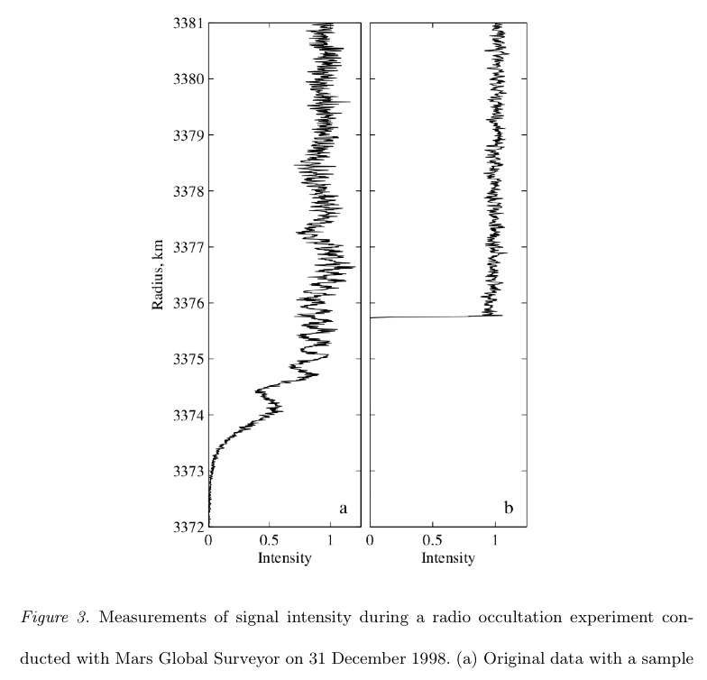
Example Occultation (profiles derived from high-rate voltage samples)
original data
after diffraction correction

Slide 5
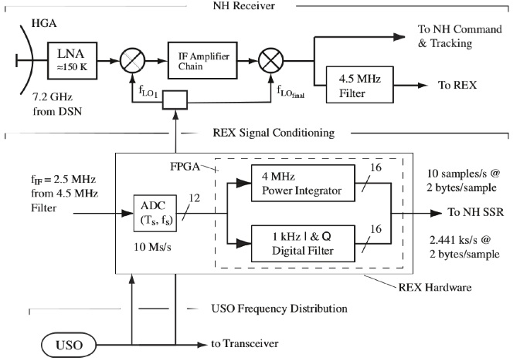
Spacecraft Radio System

Slide 6
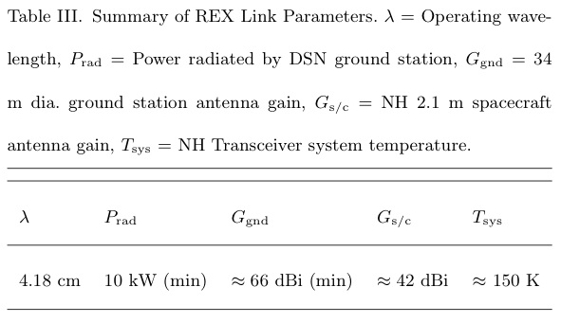
REX Performance

Slide 7
HGA Beam on Pluto for Radiometry
For quantitative work, tabulated antenna pattern is needed

Slide 8
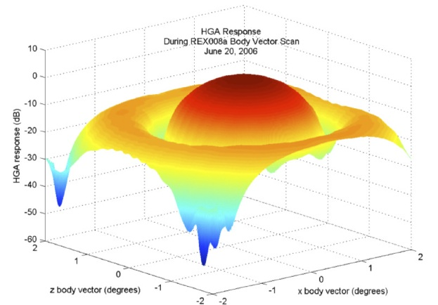
HGA Pattern from June 20, 2006, Test
Needs tabulated pattern

Slide 9
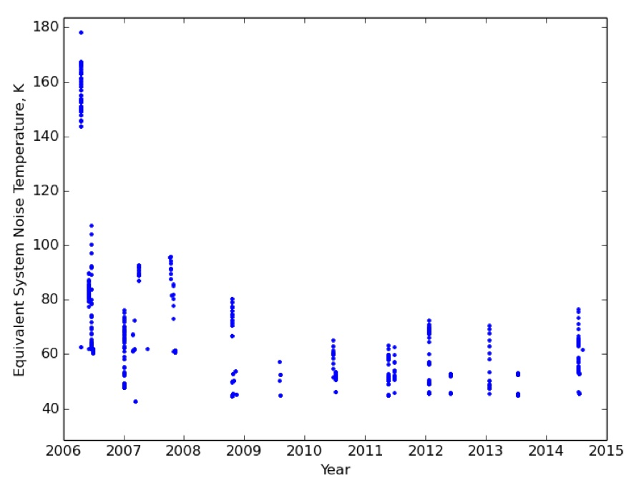
Inferred Temperature from Radiometry Tests Since Launch
“The standard deviation of the 10-s averages indicates that the NH transceiver is radiometrically stable at a level of approximately 5 parts in 10,000, and thus adequate for measuring radiometric temperature to a precision of 0.1 K, or about 1 part in 1000.” — from REX_SSR.
Why so much variation at each time?
Why decrease from ~150K to ~50K

Slide 10
Radiometry from 2006-06-29 First Test (part 2)
Peak to baseline difference is ~0.2%

Slide 11
Radiometry from Test 2006-06-29 First Test (part 1)

Slide 12
Radiometry from 2006-06-29 Third Text (all)

Slide 13
REX Sequences on 2006-06-29
"REX","CORX_003B_3AXIS ","2006-06-29T00:00:00 ","1/0013845117:31760","Three axis attitude. HGA beam pattern & radiometry calibration"
Appears to be calibration using natural radio sources; no HGA calibration.
No information about which sources (and no SPICE files).
"REX","06180:CORX01a_01_TstPatt ","2006-06-29T11:49:48 ","1/0013887705:31750","REX Test Patterns (SSR [TYLERETAL2008] Section 6.2) "
Test patterns
"REX","06180:CORX07a_11acoldrad ","2006-06-29T11:56:43 ","1/0013888120:31749","Cold Sky Cal"
Appears to be calibration using natural radio sources, not cold sky.
No information about which sources (and no SPICE files).

Slide 14
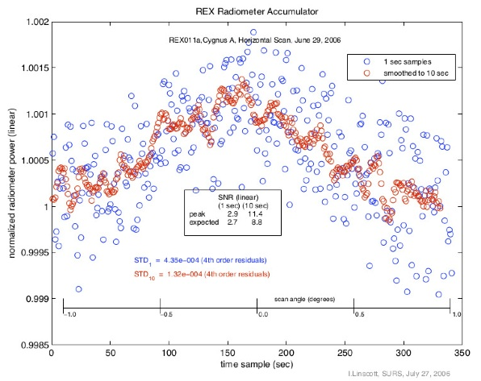
Published Radiometry Calibration Data
Source increases power ~0.15%
How was baseline determined?

Slide 15
Community Issues
FITS is common in astronomy, but not radio science.
IDL is not common in radio science
Radio scientists are used to unpacking dense (and perverse) binary files
All data (including both from REX hardware and tracking) are different.

