Slide 1
MVIC Review
Carolyn Ernst
12/11/14

Slide 2
Some of the things that I checked
Read through much of the documentation
Checked seq_mvic_plutocruise.lbl(.tab) against the observations
Checked image that appears windowed when displayed says windowed in label
Read in data with readfits in IDL
0x530 mode is a 2d strip
0x539 mode is a cube

Slide 3
Windowed Example: mc0_0086351808_0x536_eng_6.fit
NEWHORIZONS:OBSERVATION_DESC = "
CALIBRATION OBSERVATIONS OF M6 AND M7
TARGET_NAME = "STAR"

Slide 4
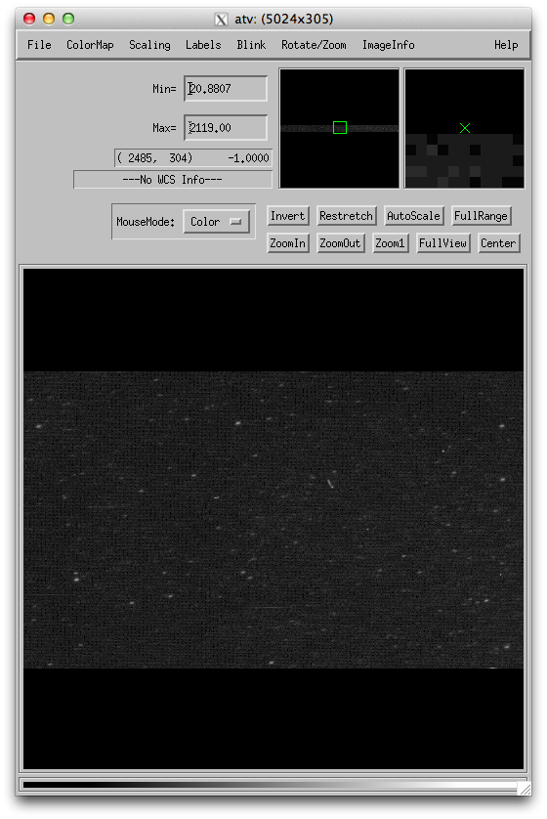
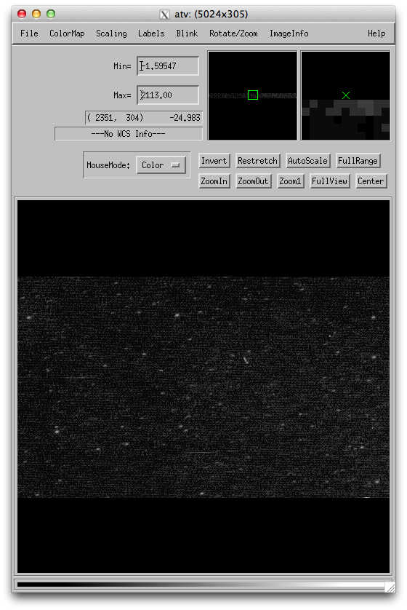
mp1_0086352708_0x530_eng_1.fit
mp1_0086352708_0x530_sci_1.fit
Noticed the data values were nearly the same – realized that the conversion to radiance was not made. This is reflected correctly in the labels, but incorrectly in multiple places in the documentation (e.g., dataset.cat; ICD).

Slide 5
Comparing Level 2 and 3 Labels: Errors?
Comparing label files for
MP2_0086352228_0X530_ENG_1.FIT
MP2_0086352228_0X530_SCI_1.FIT
PRODUCT_TYPE = “EDR” for both files
Should be “RDR” for the level 3 files (applicable to all files)
Level 2: “This image may be windowed”
Opened product, appears windowed
Level 3: “This image is not windowed”
Opened product, is not windowed
This may be an issue with windowed products – I spot checked mp2_0111027708_0x530 also, and these labels did not change start/stop time, geometry, etc.

Slide 6
Minor errors
Typos in the nhsc.cat:
LORRI - capitalize the O in LOng?
-----
The instrument that provides the highest spatial resolution on New
Horizons is LORRI - short for LOng Range Reconnaissance Imager -
which comprises a telescope with a 20.8cm aperture that focuses
visible light onto a charge coupled device (CCD). LORRI has a very
simple design; there are no filters or moving parts. Near the time
of closest approach, LORRI takes images of the Pluto surface at 100m
resolution.
PEPSSI - name of instrument missing “Science”
------
Another plasma-sensing instrument, the Pluto Energetic Particle
Spectrometer Science Investigation (PEPSSI), searches for neutral atoms that
escape the Pluto atmosphere and subsequently become charged by their
interaction with the solar wind.
Typos in the ref.cat: (same typo occurs multiple times) – Should be PEPSSI
/**********************************************************************/
/**************************** PEPPSI **********************************/
/**********************************************************************/
Typos in dataset.cat for MVIC 2:
Line 3 “horizons” – the H should be capitalized.

