Slide 1
SDC PDS Review Cruise Data: June 2007 to August 2014
A. R. Poppe
UC Berkeley

Slide 2
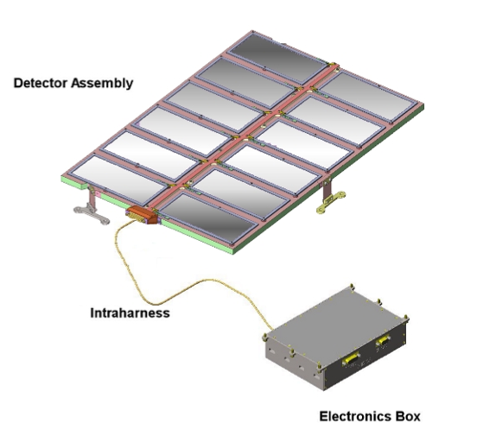
SDC Instrument
SDC instrument:
- 14 detectors: 12 science (with 1 defunct), 2 reference
- electronics box for signal processing, telemetry/commands

Slide 3
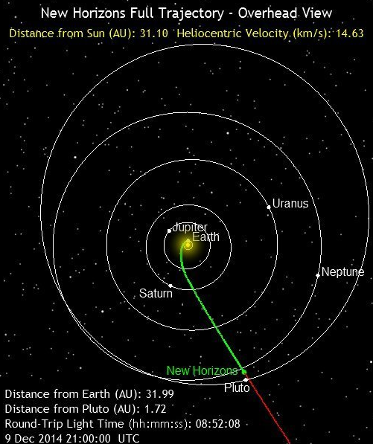
Three main data periods released by SDC:
Launch: March 2006 – Dec 2006, mainly testing and checkout of instrument
Jupiter: Dec 2006 – June 2007, small chunk of data taken post-Jupiter fly-by (note SDC was not on during close approach of Jupiter)
Pluto-cruise: June 2007 – July 2014, main period of scientific data collection by SDC between the orbits of Jupiter and Pluto
SDC launch, jupiter, and cruise datasets cover 1/2006 to 7/2014, Earth to approximately the orbit of Neptune

Slide 4
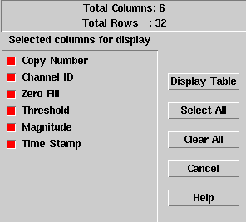
SDC Raw Data
Includes SDC raw scientific data, SDC housekeeping (engineering telemetry), New Horizons spacecraft housekeeping (0x004, 0x00D, 0x00A), and New Horizons thruster firing fata
The SDC raw scientific data includes channel (detector) number, data threshold, data magnitude, and time stamp

Slide 5
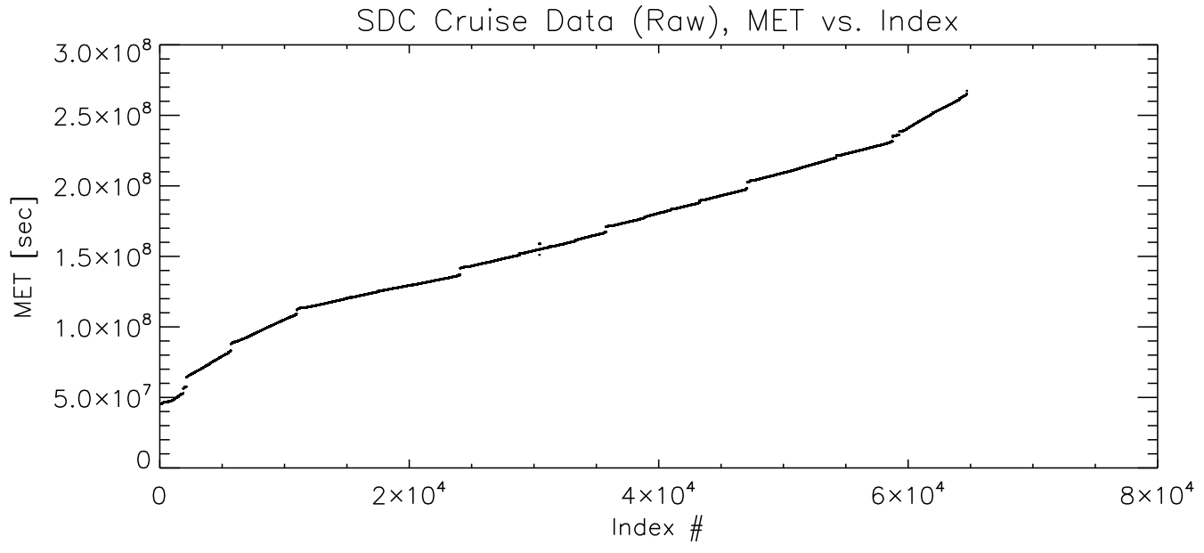
Plot of Mission Elapsed Time vs entry looks good
Rate increase noted at about event #58,000 but that could be actual “science”

Slide 6
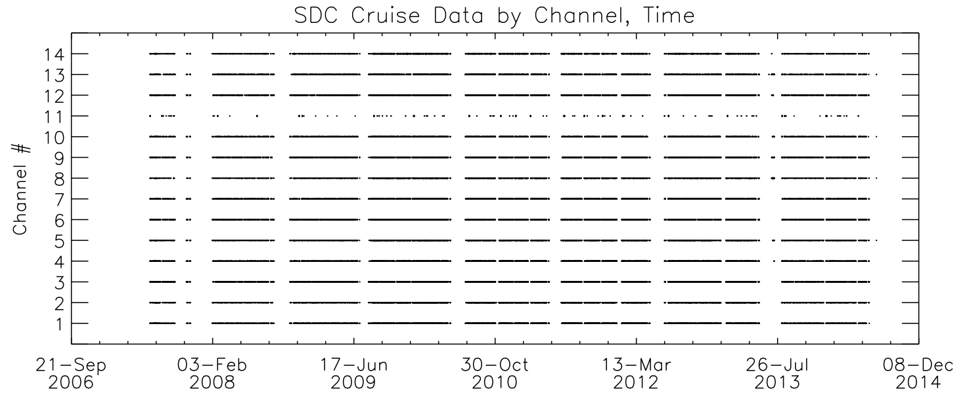
SDC cruise data taken in large chunks (9-11 months) each year
Note the failure of channel #11

Slide 7
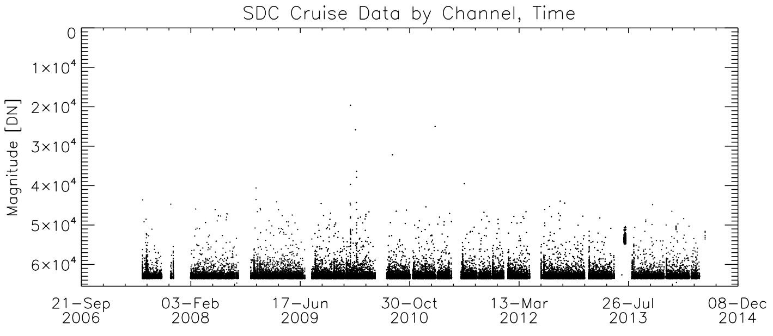
Note that the SDC magnitude scale is inversely proportional to the size of the impact (ranges from 65535 – 0 DN)
July 2013 event? Correlates with a Stimulus calibration

Slide 8
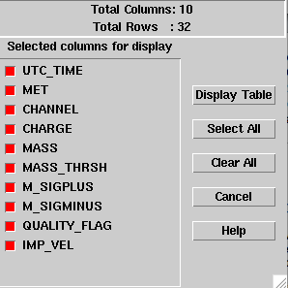
SDC Calibrated Data
Includes SDC calibrated scientific data
The SDC calibrated scientific data includes time, channel, charge, mass, mass threshold, error bars, quality flag, and theoretical SDC-dust relative impact velocity

Slide 9
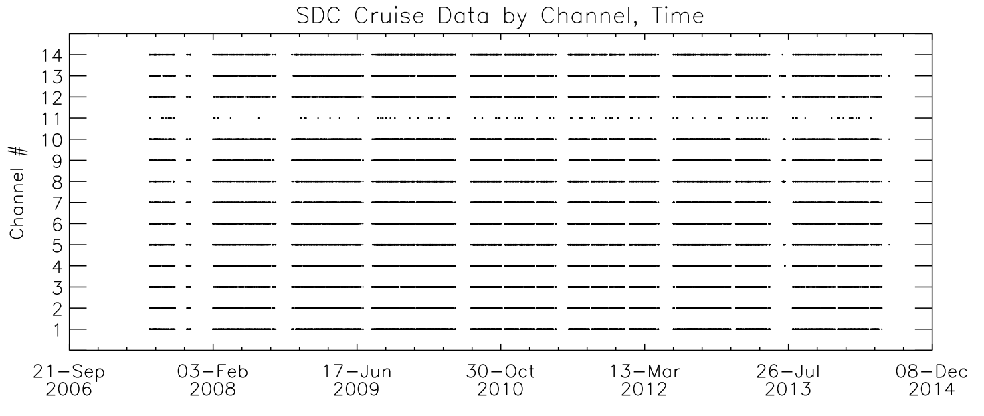
Plot of Mission Elapsed Time vs entry looks good
Again, note failure of Channel 11 (described in documentation)

Slide 10
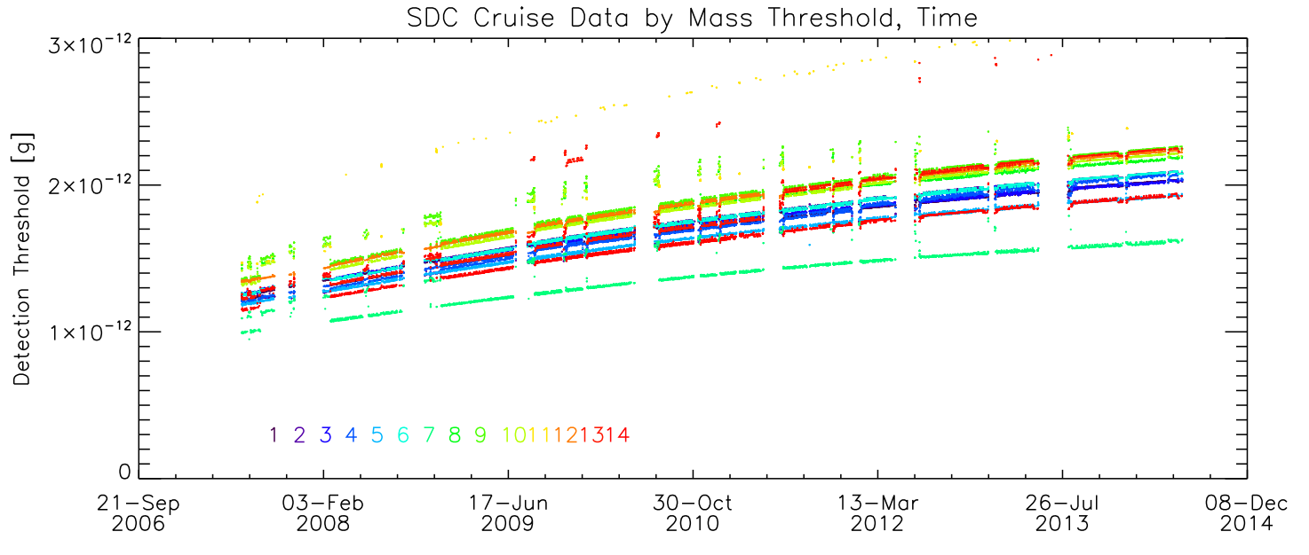
Plot of Detector Threshold versus Time looks good

Slide 11
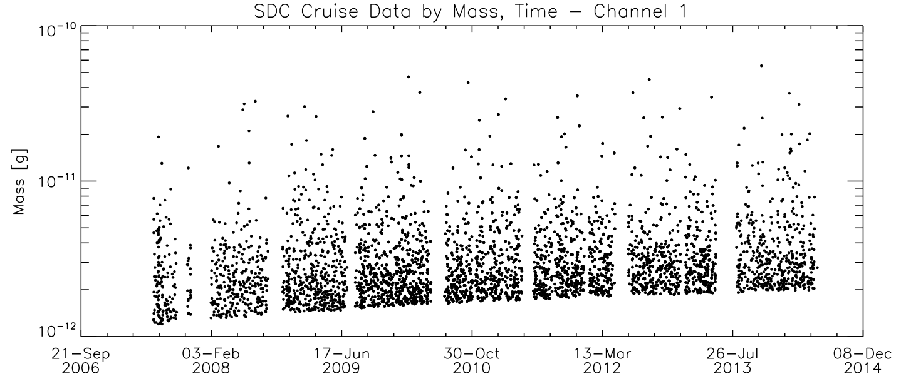
Plot of Channel 1 Event Magnitude versus Time looks good – although as noted in the previous review (January 2014) the dynamic range of the data seems limited to a small range (the instrument can detect from 10⁻¹² to 10⁻⁹ g. The team noted this in the revised ‘sdc.cat’ file, but did not provide a specific explanation.

Slide 12
Completeness:
Each time period (launch, jupiter, plutocruise) has a complete set of files and documentation (all comments from Jan 2014 review were adequately addressed)
Adequate completeness of each data record (i.e., one dust hit)
Intelligibility:
Documentation is adequate and straightforward
SDC data are intelligibly formatted through FITS files, both raw and calibrated
Metadata are straightforward through ASCII implementation
Interpretability:
Given the relatively simple nature of SDC operations, the data are straightforwardly interpretable; no issues noted here

