Slide 1
Review of Rosetta model
Olivier Barnouin
Jan 29, 2016
Focused on wrl and obj.
Found no issue with my use of dsks last time- but my analysis was not as rigorous as members of the SPICE group who are also reviewers. I leave it to them to re-review those.

Slide 2
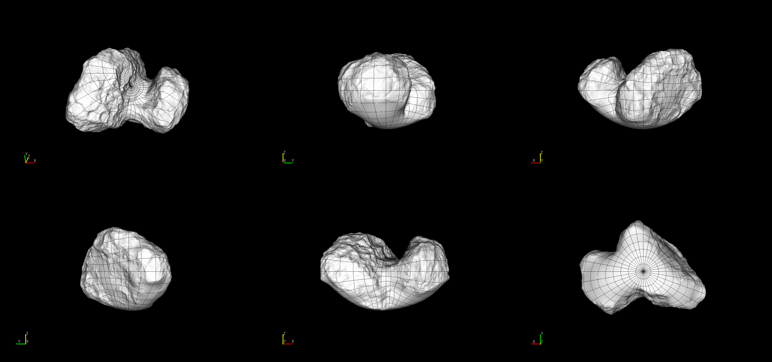
Checked basic functionality of triplate models
SPC_LAM_PSI
Able to read wrl files in meshlab and paraview
  Was able to convert them to obj file format – identical to the more common *.tab files SBN PDS usually has.
  Made this six view figure in Small Body Mapping Tool.
Lables were fine
No issues or problems
399k model

Slide 3
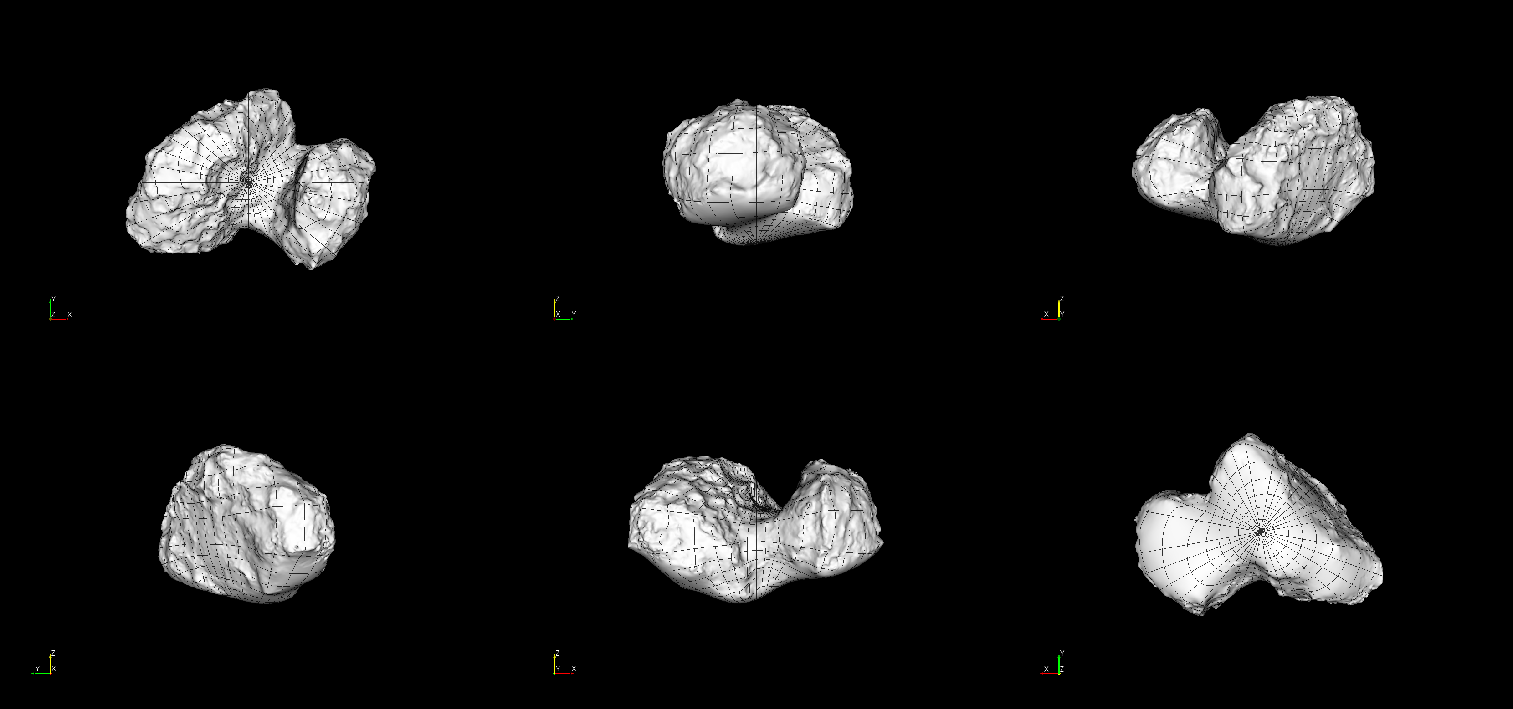
Checked basic functionality of triplate models
mspcd_lam
Able to read wrl files in meshlab and paraview
  Was able to convert them to obj file format – identical to the more common *.tab files SBN PDS usually has.
  Made this six view figure in Small Body Mapping Tool.
No issues or problems (prime meridian line up with previous model – toggle slides)
399k model

Slide 4
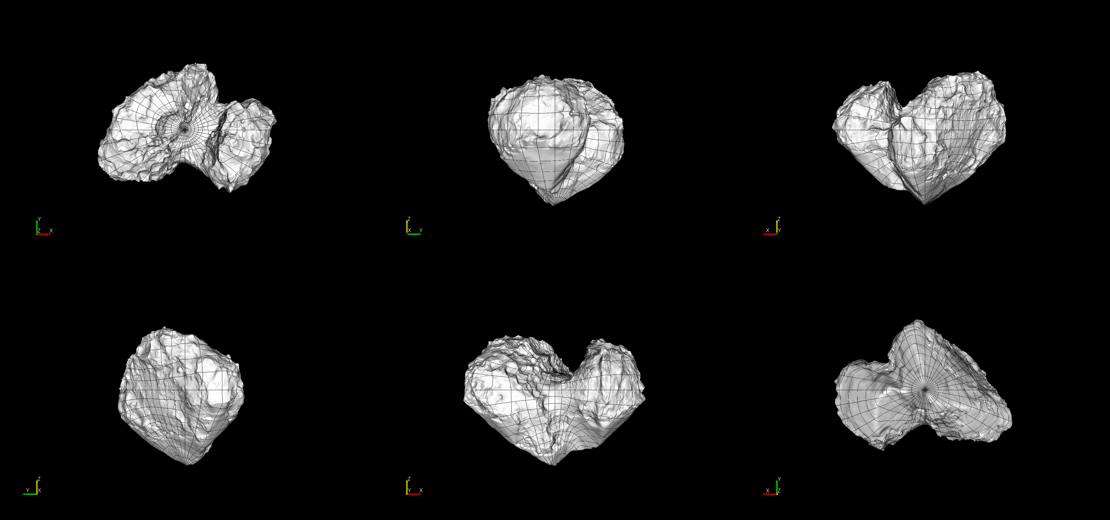
Checked basic functionality of triplate models
spc_esa
Able to read wrl files in meshlab and paraview
Able to work with obj file provided.
  Made this six view figure in Small Body Mapping Tool.
No issues or problems (prime meridian line up with previous model – toggle slides)
399k model

Slide 5
Shape models look really good
I had no issues
Documentation was sufficient for their use
These are suitable for use in the PDS

