Slide 1
What the dataset contains
What the instrument does
7 micro-cameras with 1024x1024 CCD (VIS) for 360° observations at landing site. 2 cameras are co-aligned for stereo DTM derivation.
Level 2 (raw), level 3 (calib. by SONC) and level 3a (calib. by IAS):
PHC, level 2: CIVA-M, IR (1 cube), VIS (9 cubes)
PHC, level 2, level 3: CIVA-P, 4 sets (“panoramas”)
PDCS, level 2, level 3: CIVA-P, 10 sets
Camera 1 shows comet, camera 3 leg, camera 5,6 the SC.
FFS, level 2 , level 3a: CIVA-P, 1 set

Slide 2
Calibrations
For PHC and PDCS: from level 2 to level 3 the following is applied:
Geometric correction, with geom_coeff in calib folder
Non-linearity correction, with table
Photometric correction, with coeff_photo in calib folder
Instantaneous line of sight, with tables.
Coeff_geom_ext_stereo is present in Calib folder but not described in documents.
For FFS, unclear processes for level 3a
In level 2 and 3a the document civa_calibration_desc.asc describes what is done to level 1 data. Description of what is done to produced level 3a is not clear.

Slide 3
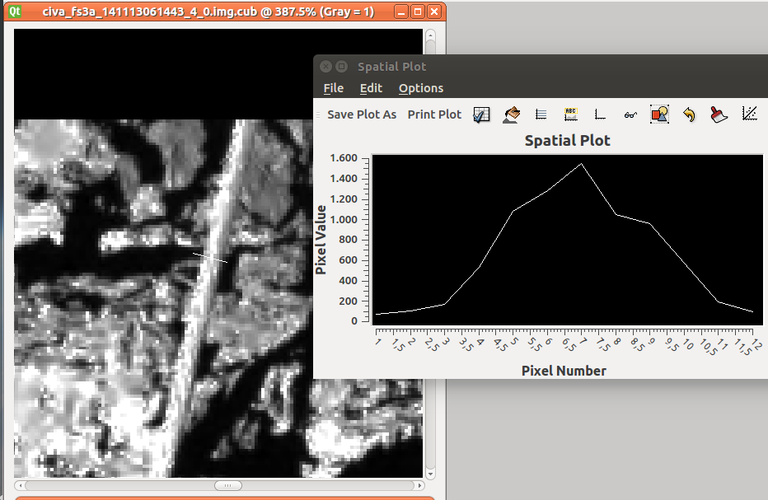
Working with the data
Opened with USGS/ISIS and IDL.
Camera 5,6,7 have very low DN, Camera 2 points to open sky: ->not nominal position of philae, balcony side of Philae toward the ground.
Camera 3, FFS level 3a. Grain near leg is 56 px ~ 56 mm large (Fig. upper right).
IFOV 1.1 mrad (eaicd_civa.pdf)
Calibration check: “CONSERT antenna reflectance 1200 DN” Bibring et al., 2015
Approximately 1200 in level 3a image (Fig. lower right).

Slide 4
Minor notes/questions on image labels:
Image labels:
of level 3 of FFS and PDCS: Spacecraft clock start and stop count/times are identical.
Some focal planes have temperature of 999.9 K (FFS).

