Slide 1
Rosetta Comet Nucleus Sounding Experiment by Radiowave Transmission (CONSERT) Comet Data Review Summary
Dick Simpson
18 February 2016
V2.0

Slide 2
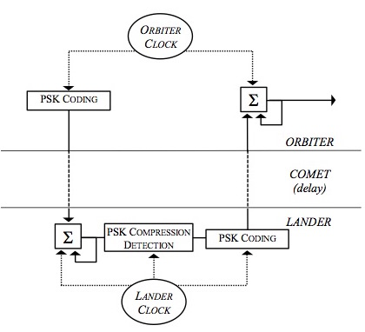
Instrument Block Diagram
Coded signal is emitted from orbiter.
Lander uses correlator to detect signal, synchronizing clocks.
Lander transmits coded signal with observed delay.
Orbiter correlates echo signal, and sends I/Q samples to Earth to:
estimate ε from material time delay and
infer interior structure from tomography
PING
PONG

Slide 3
Example Data (cn_o_2_141112t185640.dat)
Sample values appear reasonable (upper figure)
But not seeing peaks in correlator output (lower figure)
Associated L0 headers appear to be OK
Cause of problem is unknown
Similar results for other records (tested records 1 and 500)
Sample Number

Slide 4
Conclusions
Inability to see peak in I/Q samples is puzzling
Timing and geometry are critical to measuring dielectric constant of the comet; but timing information has been hard to locate in data records.
EAICD is the best description of the instrument, its operation, and the data; but it is short on details.
Spacing of correlator samples should be given in data product labels.
There should be a clear statement in documentation about which timing parameters are needed to determine the ping-pong timing and how they are to be assembled.

Slide 5
Conclusions
INST.CAT is too brief to be useful. What are the major components of the instrument on both Rosetta and Philae, what are their specifications, and how do they work?
How long is the modulating code and how has synchronization been tested to verify that it performs as expected.

Slide 6
Conclusions
From one data set to another, AAREADME.TXT and DATASET.CAT change very little
This makes DATASET.CAT, which users will find in searches, to be of very little help in distinguishing among the four data sets.
Explain what makes each data set distinct from the others
Abbreviations for mission phases (FSS, SDL, PDCS, and PHC) should be expanded in these files.
“Processing” should be described rather than saying that data are all at CODMAC Level 2.

Slide 7
Conclusions
Do not include URL links to external references; many are not stable. The URL for MIL_STD-1750A in AOCS labels fails today.
AOCS and data sample products are both described by PRODUCT_TYPE=EDR, which does not distinguish them.
AOCS labels include FILE_NAME, which points to a non-existent file (change extension *.DAT to *.TAB).
L0_PARAMETER_DEF.FMT is probably OK for labels; but is there a reference where users can find more information about the parameters?
Some AOCS columns do not appear to have valid values (34-39)
AOCS temperatures are suspect (columns 40, 87, and 88)

