Slide 1
Rosetta MIDAS PDS Review
A Steele

Slide 2
Issues
Biggest issue is the use of BCR-STM format to view 3-D images. Relies on Commercial software interface – SIPS.
This was an issue brought up in the preliminary review.
Cannot open the data files to accurately assess the data product in 3-D.
All other aspects of the posted data seem OK.
All references to data product mention BCR file formats including .lbl files associated with each product

Slide 3
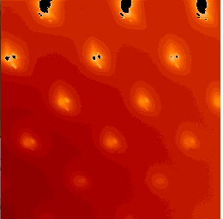
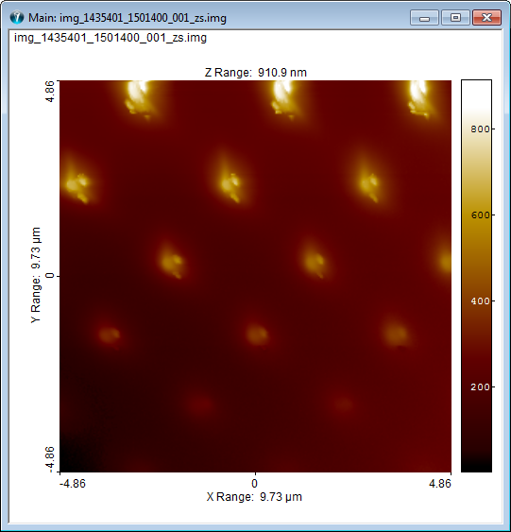
Tested two ways of viewing a file
NASA View Software
SPIP format reading BCR-file
A lot more information available to the viewer in the BCR format

Slide 4
Information in formats
NASA View format limited read of the information available in the image. However image is available in the labels
All information immediately loaded up in BCR format

Slide 5
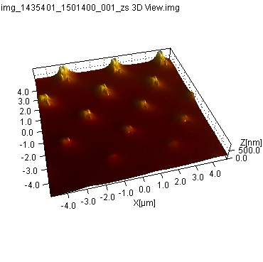
3D only in BCR format

Slide 6
Mitigation
Add a different file format to the files.
Work with open source developer to enable NASA view software to process files.

