Slide 1
MUPUS : PDS Review
Kevin Walsh
15-Feb-2016

Slide 2
MUPUS TM
infrared radiometer (TM)
MUPUS PEN (penetrator)
Penetrator (PEN) is equipped with 16 thermal sensors,
MUPUS ANC (anchor)
ANC-T (temperature)
ANC-M (accelerometer)
accelerometer sensors /ANC-M) located in the Philae harpoons.

Slide 3
penel map & hammer
penel –
16 temperature sensors down the length of the penetrator + housekeeping/calibration sensors
map -
4 channel infrared radiometer with thermopile detectors and a blackbody calibration unit and the two anchor temp sensors
hammer/
Does the PEN insertion – records hammer strokes

Slide 4
Timeline
Notes:
The Lander timeline gives an overall picture of the Lander operation
over a given period (mission phase).
It is an ASCII file containing synthetic information on the
operation of the experiments and which reflects the sequencing of
the operations, the energy consumption in Wh and the data production
(number of telemetry packets) for each ON/OFF session of an
experiment.
The periods of operation of the experiments are deduced from the
science and housekeeping data in the SONC database.
The following general information is displayed for each experiment:
- Start and stop times (corresponding to the time span of the data
set)
- Energy consumption (between start and stop times).
- Number of science and housekeeping telemetry packets (between
start and stop times).
In addition specific information is displayed for each experiment.
SD2
===
- drill translation (PME1, mm)
- carrousel rotation (PME2, arcmin)
- carousel rotation direction (clockwise or counter clockwise)
- carousel status
- oven number (deduced from carousel rotation)
- oven type (MTO or HTO)
- status: empty or full (from volume checker)
- sample volume
- experiment served (CIVA-M/V, CIVA-M/I, COSAC, PTOLEMY)
- drill depth (mm), available for the Comet phase only.
CIVA-P
======
- the cameras which functioned (CH-1 to CH-7)
- on board time
- exposition duration
CONSERT (Orbiter and Lander)
========
- scanning sequence number
For each scanning sequence
- start and stop times of data
- sounding count
COSAC
======
- TPST report from science telemetry (potentiometer value and oven
temperature)
- Tapping station position from housekeeping telemetry
PTOLEMY
========
- docking station position
ROLIS
=====
- Lander on board time
- ISB LED status
- ISB exposure time
- ISB infinity lens position
Auxiliary data
==========
Distances:
- Sun, Rosetta
- Earth, Rosetta
- Mars, Rosetta
- Comet, Rosetta
Attitude on slew manoeuvres (Roll, pitch, yaw)

Slide 5
Data

Slide 6
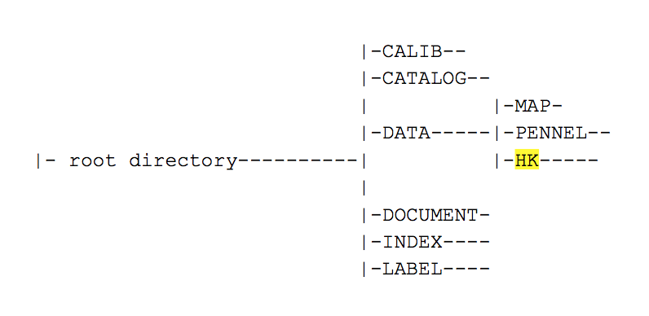
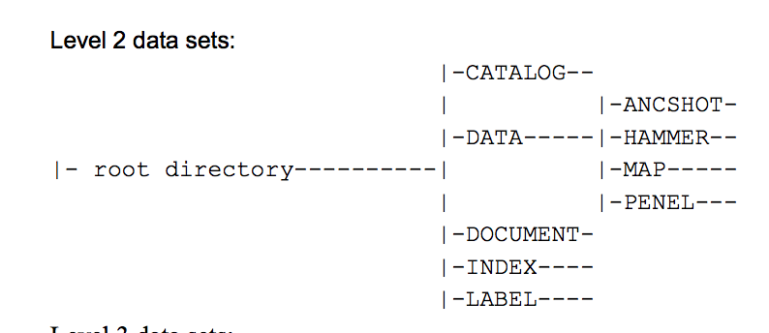
Hibernation Commissioning Raw+Processed
Rosetta-Lander MUPUS Post Hibernation Commissioning Raw Data
RL-CAL-MUPUS-2-PHC-V1.0
Data is Hex values of raw measured voltage
data/
map/
penel/
Rosetta-Lander MUPUS Post Hibernation Commissioning Calibrated Data
RL-CAL-MUPUS-3-PHC-V1.0
Data is decimal, converted values of raw voltage
data/
map/
penel/
hk/
Notes:
~2Hr chunks of data for Penel in calibrated in April 2014, 14th 16th 21st and 23rd
MUPUS On Board Time represented as a
32-bit integer (in hexadecimal format)
with 1 millisecond resolution.
It counts the time since the MUPUS boot and
overruns after 49.7 days (2^32 milliseconds)
MAP.FMT - Calibrated SC data before PEN deployment (Level 2 SONC)
PEN.FMT - Calibrated SC data after PEN deployment (Level 2 SONC)
MAP.FMT - Calibrated SC data before PEN deployment (Level 2 SONC)
PEN.FMT - Calibrated SC data after PEN deployment (Level 2 SONC)
The Calib directory further contains the file "Tau_FM.txt" which provides
the 4 filter transmission curves and infrared absorber emittance as
a function of wavelength.
This auxiliary data is required to derive brightness temperatures from digital
values.

Slide 7
Spot Check for penel – Looks good
Converting Raw to measured voltage
Hex to Decimal
Formula from MUPUS User Manual page 100
U=DN*4/(2^16-1)
Compared to Calibrated data is good
Followed calibration description (page 100/101) using table in calib/ directory
Got reasonable looking Temps -95K for PEN16

Slide 8
Separation Descent Landing (SDL) Raw+Calibrated
Only map/ data
7 hour dataset
Quick spot check of map/ data
Converted Raw voltages
Hex to Decimal
Formula from MUPUS Manual page 103
U=DN*6/(2^14-1)
Comparison is fine – Decimal, converted raw voltages
Calibration requires lots of constant values and lots of math
7 step process defined
I got a not-crazy value for one spot check

Slide 9
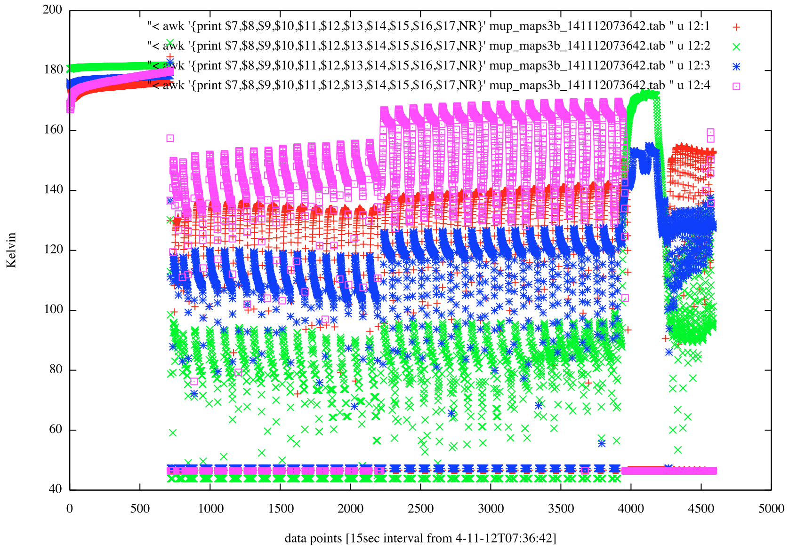
Four IR channels

Slide 10
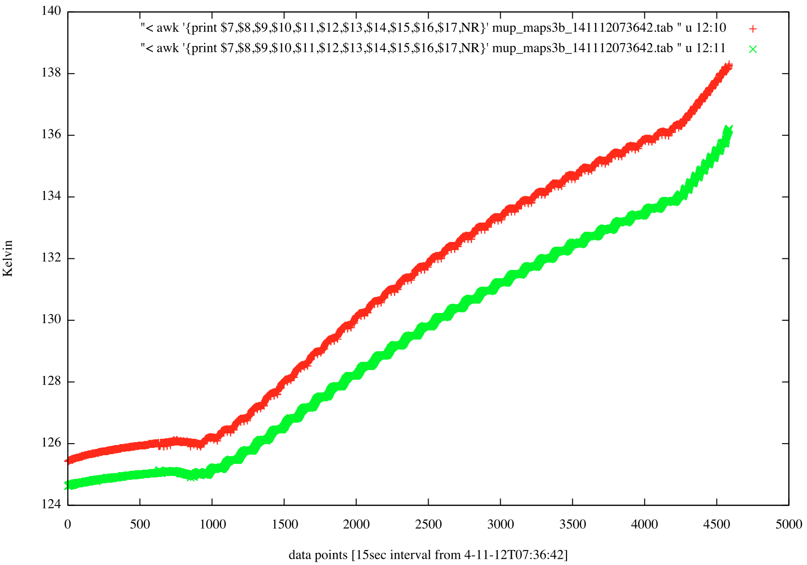
Two Anchor Temp sensors

Slide 11
Rebounds Raw+Calibrated
Just TM mapper data
2 hours of data
Temperatures vary widely….

Slide 12
First Science Sequence (FSS) Raw+ Calibrated
Hammer (1 table)
Map (5 tables)
Penel (2 tables)
Hammer in Raw but not Calibrated
Nothing in calib/ directories
Nothing in MUPUS manual to calibrate/interpret Hammer data

Slide 13
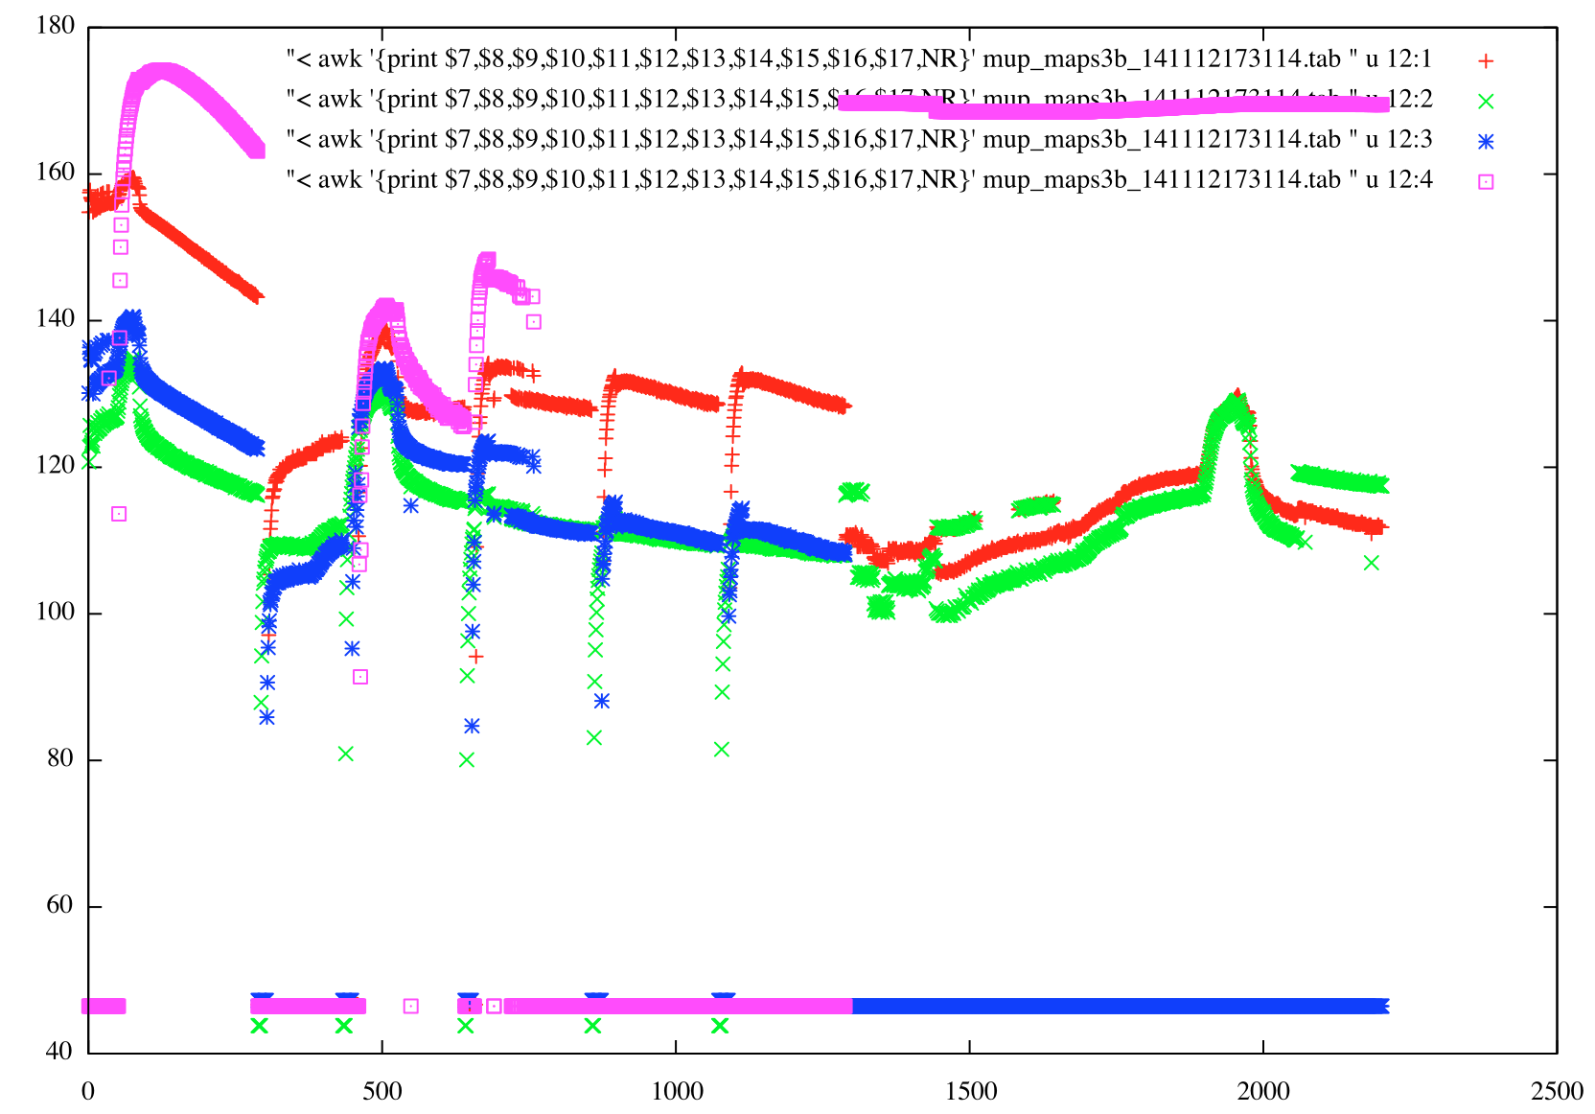

Slide 14
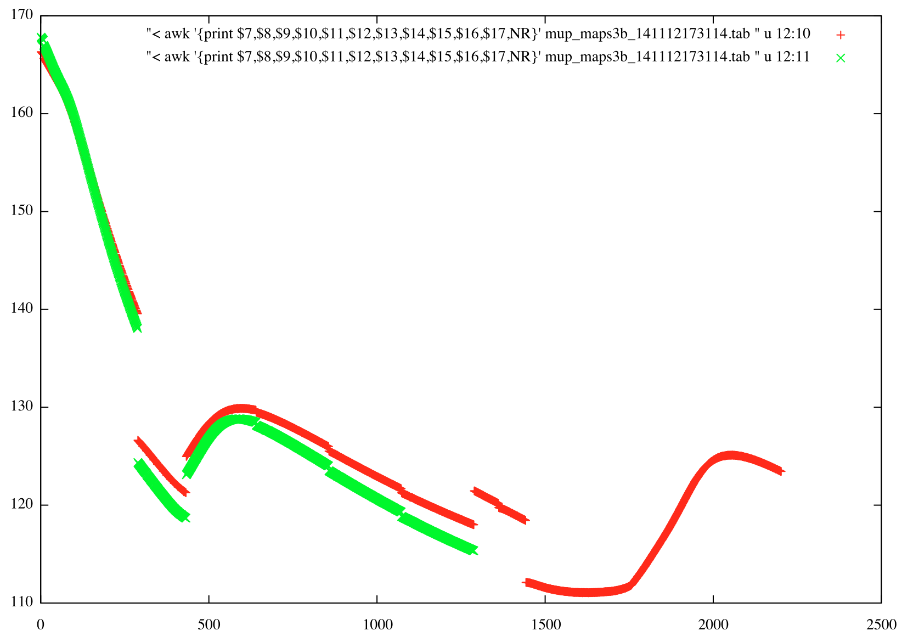

Slide 15
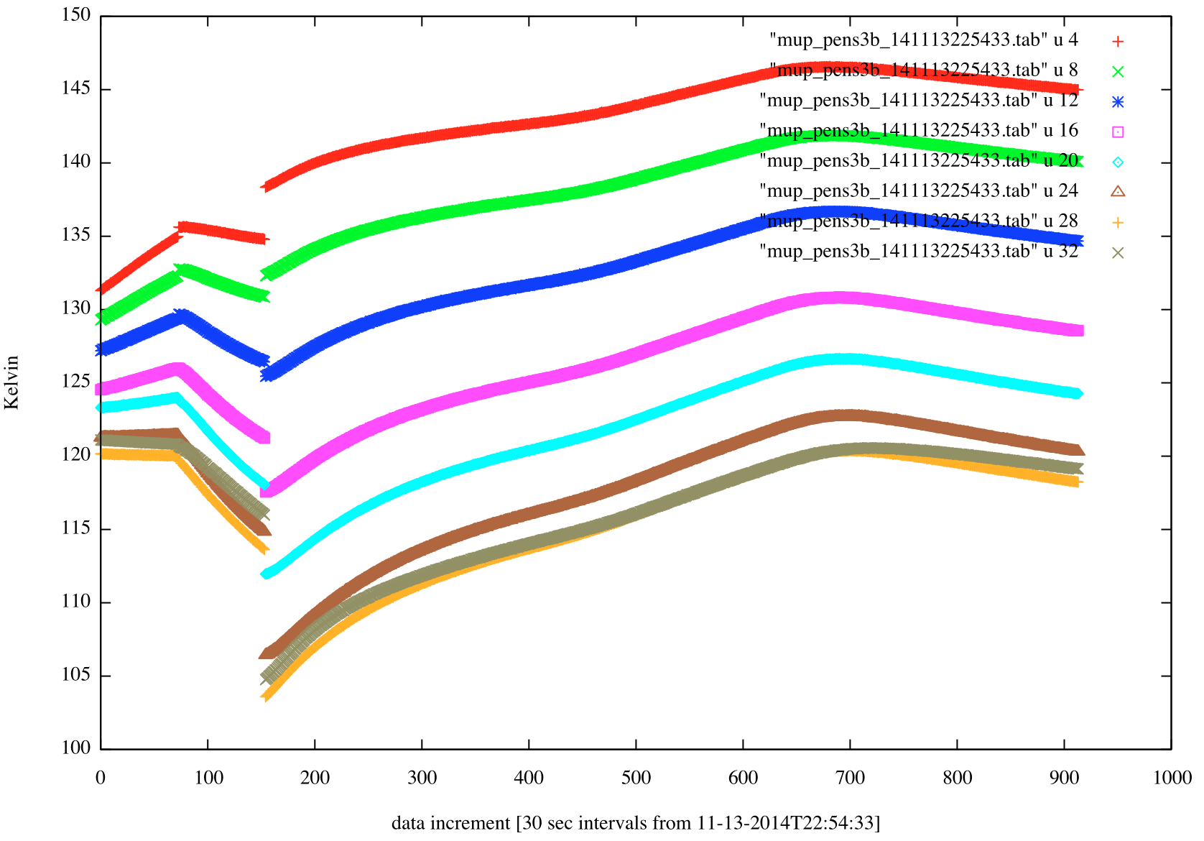
Every other PENEL temperature sensor

Slide 16
Question/Issues/Problems?
Typos in section 10.1 of MUPUS User Manual
Eq(2) R_{il} should be R_{i,l}
Eq(3) is awkward with no space between formula and indices…
T₀ is updated in the calib/ directory from the value listed in the Manual
Typos is section 10.2 of MUPUS User Manual
References to Eq 1 should be Eq 6
TM calibration steps – 5. incorrect Table Reference (51 should be 52 on page 104)
(I think) typo in step 5. of TM calibration steps – I think Ucal should be Uth,i . I think.
Hammer/ in Raw (rl-c-mupus-2-fss-v1.0/) but not Calibrated (rl-c-mupus-3-fss-v1.0/) for FSS
Nothing in calib/ directories in rl-c-mupus-3-fss-v1.0/ relating to hammer/
Nothing in MUPUS manual to calibrate/interpret hammer data

