Slide 1
NAVCAM
Dennis Bodewits

Slide 2
Comments
No documentation is provided that allows for a quantitative assessment of the data. Listed references in the PSA document (user manual, design documents) are not available. Even basic information such as QE and transmission curves are not provided.
It is not specified what processing is done on the data. Is any bias subtracted? What is the bias? Are bad pixels removed? The numeric value of the gain is not given. This value is needed to assess the signal to noise.
The data provided has been geometrically corrected. The documentation does not explain what is done and this is therefore an irreversible calibration. The expected geometrical accuracy is not listed; inspection suggests it is no better than ~1 arscec.
The saturation is given as a magnitude; it would be more helpful when given in units of counts (as it is in the headers)
data_valid key word is often not-ok. It is unclear to me what this means RA & DEC are given in header but it is not specified where the boresight is.
What is the apparent vertical coherent noise? What is its typical value?
FITS and IMG are identical

Slide 3
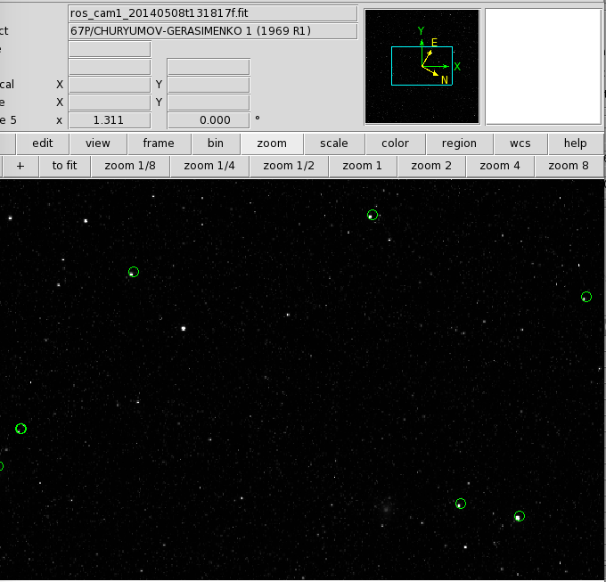

Slide 4
