Slide 1
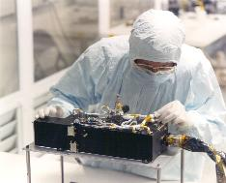
R-Alice PDS/PSA Data Review PRL & ESC1 phases
Cesare Grava

Slide 2
Datasets Reviewed
RO-C/CAL-ALICE-2-PRL-V1.0
RO-C/CAL-ALICE-3-PRL-V1.0
RO-C/CAL-ALICE-4-PRL-V1.0
RO-C/CAL-ALICE-2-ESC1-V1.0
RO-C/CAL-ALICE-3-ESC1-V1.0
RO-C/CAL-ALICE-4-ESC1-V1.0
Review Conclusions
Data are ready to be released after some RIDs are addressed
RIDs submitted: 101,102,103,104,105

Slide 3
R-Alice Spec’s
Spectral Range 700 - 2050 Angstroms
Spectral Resolution 12.5 - 9.8 Angstroms for extended sources
Spatial Resolution 0.6°
Projected Entrance Slit 0.1° by 6°
Nominal Effective Area 0.03cm² (at 1900 Angstroms), to 0.53cm² (at 1150 Angstroms)
Very similar to the LRO/LAMP UV spectrograph I work with.

Slide 4
Evaluation Tools
Laptop Lenovo Thinkpad:
Virtual Machine Oracle Fedora 17x86_64
Windows 7
Data installed just fine with tar; had to download multiple times the huge tgz files though…
IDL 8.4
Readpds v4.8
Astron library

Slide 5
RO-C/CAL-ALICE-2/3/4-PRL/ESC1-V1.0
VOLDESC.CAT, and ERRATA.TXT: good
AAREADME.TXT: see RID 103

Slide 6
RO-C/CAL-ALICE-2/3/4-PREL/ESC1-V1.0
CALIB/CALINFO.TXT: good
CALIB/RA_AEFF_008 and its corrections (see RIDs # 101, 102):
RA_CR2_PC10_CORRECTION
RA_CVP2_PC10_CORRECTION
RA_ESB2_PC10_CORRECTION
RA_ESB3_PC10_CORRECTION
RA_MARS_PC10_CORRECTION
RA_PC4_PC10_CORRECTION
RA_PC6_PC10_CORRECTION
RA_PC8_PC10_CORRECTION
RA_STEINS_PC10_CORRECTION
CALIB/RA_PC12_AEFF_001 and its correction:
RA_LUTETIA_PC12_CORRECTION
CALIB/Flat, Dark, and Wave (2,3,4): good

Slide 7
RO-C/CAL-ALICE-2/3/4-PREL/ESC1-V1.0
CALIB/RA_DARK_3900V_V003.FIT

Slide 8
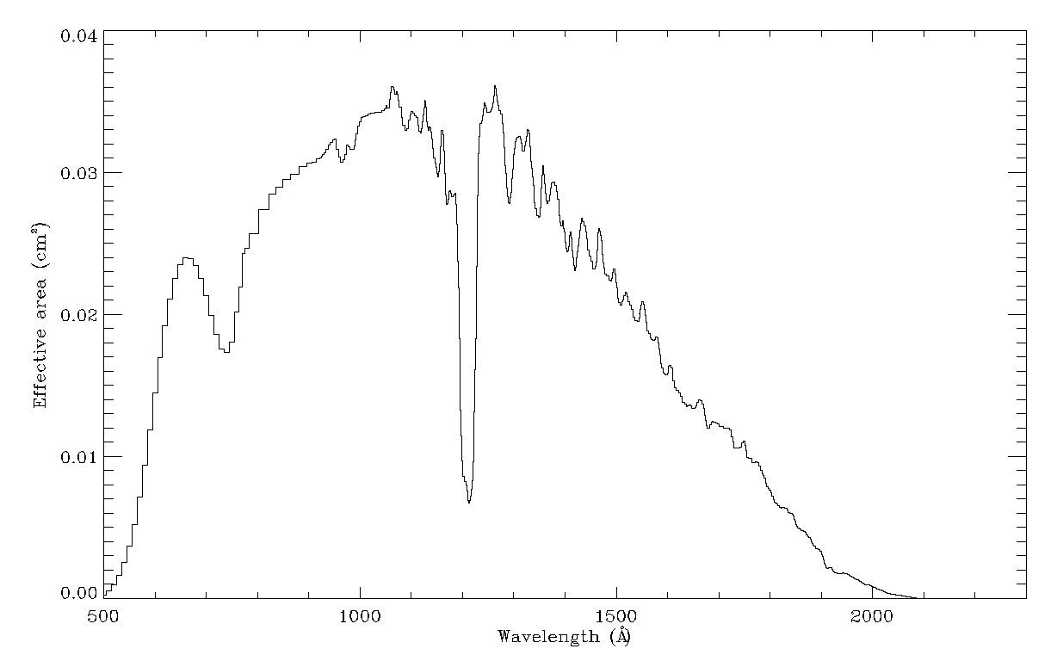
Effective Area Calibration Data
CALIB/RA_AEFF_008: read with readcol.pro, no problem

Slide 9
CATALOG
CATALOG/ALICE_RO.CAT → SOFTWARE.CAT (2,3,4): good
CATALOG/REF.CAT: good. RID 105: Could add some more references (Stern et al. 2015; Feldman et al. 2015; Feaga et al. 2015)

Slide 10
DOCUMENT & INDEX
DOCUMENT/* (2,3,4): good
RID 104: change name of ALICE_L3_TO_RAYLEIGHS.ASC
DOCUMENT/ALICE_DATA_TO_RAYLEIGHS.ASC is especially nice to have.
Note that conversion from flux photons/cm²/sec to differential flux (i.e., specific intensity) photons/cm²/sec/A by dividing by Δλ/pix is described here with an idl code example. I tested it and it did work!
DOCUMENT/CODE/* (2,3,4), Entire “MIKE” calibration pipeline code: good
Didn’t get around to running myself, but this is a nice addition since it explains how the calibration is done (most users won’t ever need this).
INDEX/ (2,3,4): good
2 is ENG, uncalibrated
3 is SCI, flux-calibrated
4 is LIN, extracted calibrated spectra

Slide 11
DATA
Naming convention:
<TYPE> is PIX# (pixel list), HIS# (histogram mode), CNT# (count rate)
and where # is the 1-digit version number to distinguish different processing runs of the data (i.e. different improved calibrations);
<STD> is ENG, SCI, or LIN level (CODMAC 2, 3, or 4, respectively);
Read data both with rdfits_struct.pro (for .fit) and readpds.pro (for .lbl): no problem.
RA_<YYMMDDhhmmss>_<TYPE>_<STD>.<EXT>

Slide 12
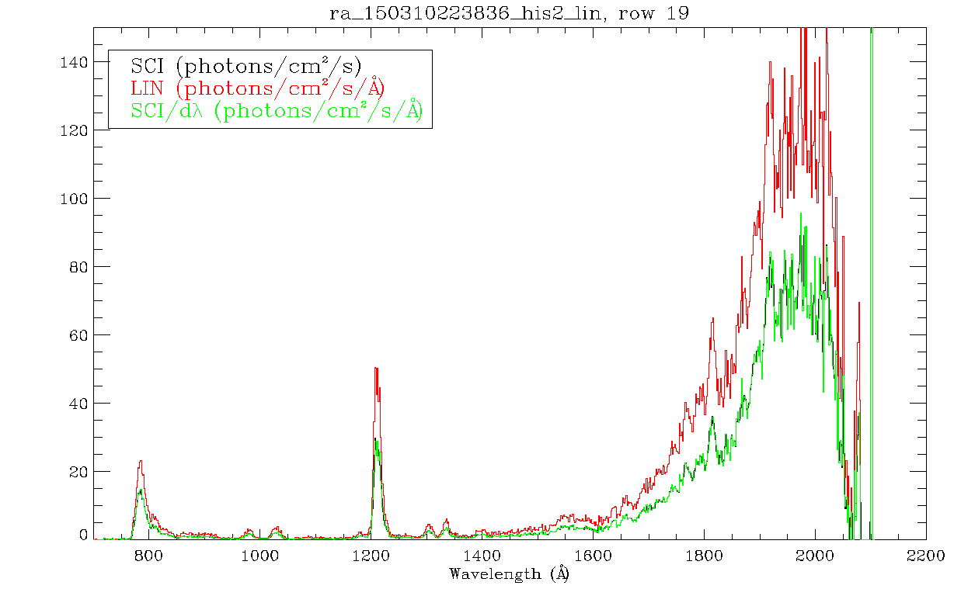
DATA
Successfully plotted SCI and LIN versions of one ESC1 spectrum of 67/P. I applied the instructions (from alice_data_to_rayleighs.asc) for converting SCI to LIN and I got (correctly) the LIN spectrum

Slide 13
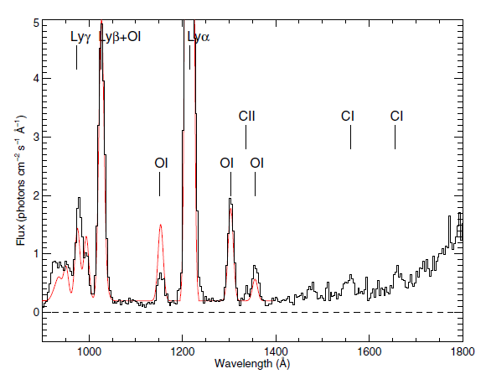
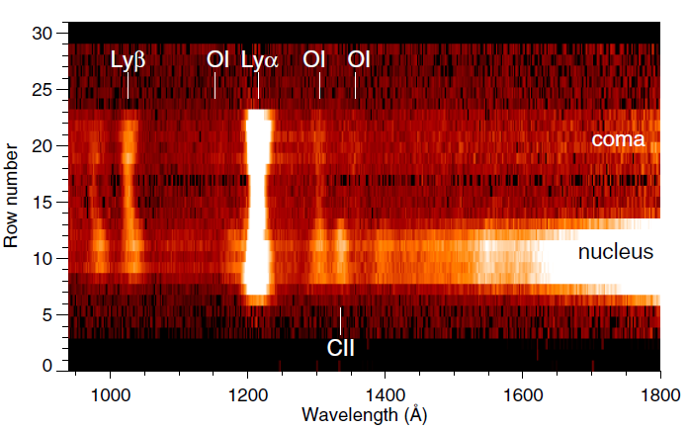
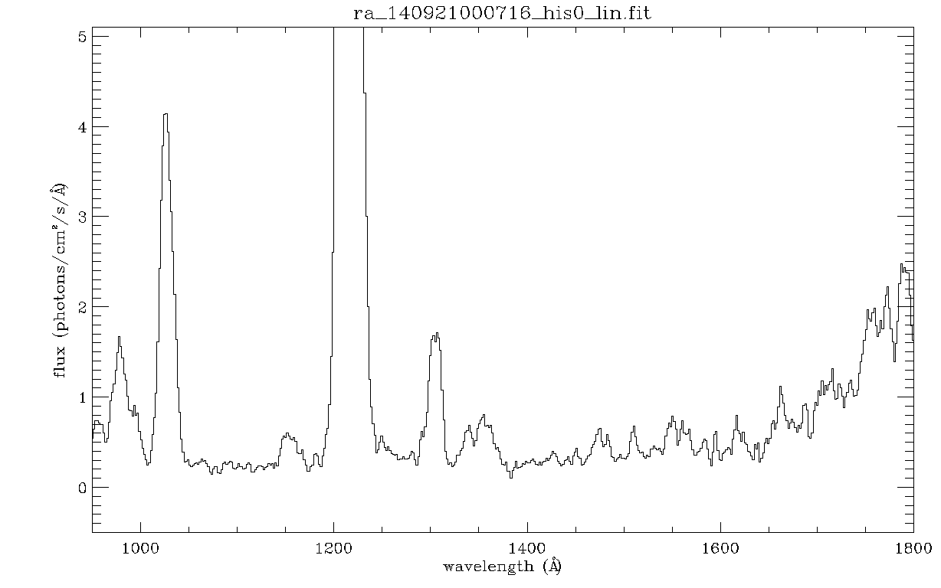
DATA
Reproduced Fig. 2 (right) and fig. 3 (left) of Feldman et al. 2015
DATA

Slide 14
Summary
Data are complete, intelligible, interpretable, and of archival quality
RIDs: two major, one minor, two editorial
101,102,103,104,105
Listed on the next five slides

Slide 15
RID 101
RID Classification: Major
Location: calibration/
Dataset : ALL
Title: number of elements in Effective Area file
Description: The effective area, with 668 elements, does not correspond in size with the number of used columns in the EDR/SCI/LIN files (1024 – 100 = 924, as explained in the EAICD). There are obviously other columns that are unused.
Recommended Solution: It should be described somewhere (perhaps in the EAICD) the exact range of the effective columns of the illuminated detector.

Slide 16
RID 102
RID Classification: Major
Location: calibration/
Dataset: ALL
Title: number of elements in Effective Area correction files
Description: The effective area file, with 668 elements, does not correspond in size with the series of “effective area corrections” files, which have 1024 elements.
Recommended Solution: It should be described somewhere (perhaps in the EAICD) how these “effective area corrections” are applied.

Slide 17
RID 103
RID Classification: Minor
Location: AAREADME.TXT
Dataset: ALL
Title: Missing mention of LIN dataset
Description: in the file aaareadme.txt there is no mention of the third data product of Alice, probably the most used one (LIN): the “linearized”, resampled, calibrated data (CODMAC level 4).
Recommended Solution: Add the description of the LIN data products after SCI data products.

Slide 18
RID 104
RID Classification: Editorial
Location: docinfo.txt
Dataset: ALL
Title: change name of ALICE_L3_TO_RAYLEIGHS.ASC
Description: In docinfo.txt, the document referred to as ALICE_L3_TO_RAYLEIGHS.ASC is in reality ALICE_DATA_TO_RAYLEIGHS.ASC
Recommended Solution: Replace in every /Document/docinfo.txt ALICE_L3_TO_RAYLEIGHS.ASC with ALICE_DATA_TO_RAYLEIGHS.ASC.

Slide 19
RID 105
RID Classification: Editorial
Location: ref.cat
Dataset: ALL
Title: update reference list
Description: three recent references could be added to the list
Recommended Solution: Stern et al. 2015, Feldman et al. 2015, Feaga et al. 2015 can be added to the list.

