Slide 1
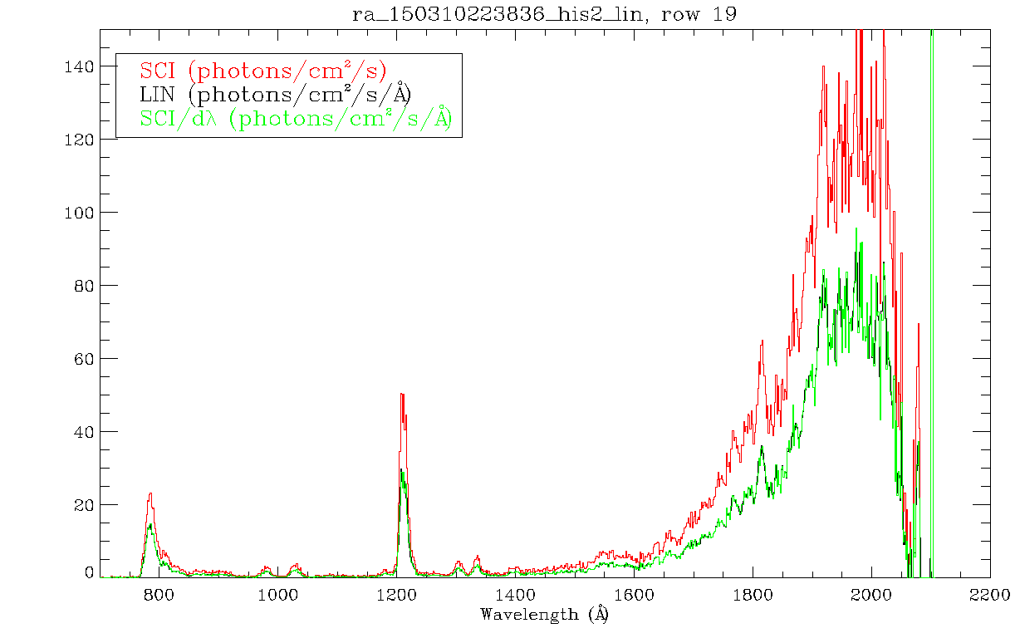
DATA
Successfully plotted SCI and LIN versions of one ESC1 spectrum of 67/P. I applied the instructions (from alice_data_to_rayleighs.asc) for converting SCI to LIN and I got (correctly) the LIN spectrum

