Slide 1
Rosetta – Miro PDS/PSA Review
Bryan Butler
National Radio Astronomy Observatory

Slide 2
MIRO

Slide 3
MIRO
Essentially three separate spectrometers:
Broadband radiometer @ 190 GHz,
Broadband radiometer @ 562 GHz,
High resolution spectrometer @ 562 GHz (Δν/ν ≈ 10⁷).

Slide 4
MIRO
4 Data sets , covering Pre-landing (PRL – April-November 2014) and Escort (ESC – November 2014-March 2015) phases, Levels 2 and 3:
ro-c-miro-2-prl-67p-v1.0
ro-c-miro-3-prl-67p-v1.0
ro-c-miro-2-esc1-67p-v1.0
ro-c-miro-3-esc1-67p-v1.0

Slide 5
MIRO
Each dataset has the proper overall directory structure, including an aareadme.txt file, document/ directory, etc., though see RIDs for capitalization, and the aareadme.txt files don’t describe the dataset fully.
Each dataset also has a data/ directory
PRL_2 – continuum/ engineering/ spectroscopic/
PRL_3 – continuum/ spectroscopic/
ESC1_2 – continuum/ engineering/ spectroscopic/
ESC1_3 – continuum/ geometry/ spectroscopic/

Slide 6
MIRO
I have my own software (Fortran), inherited originally from the MIRO team and then modified extensively (and in various different ways) for the Steins and Lutetia PDS reviews. I used this software again for this review, though it needed some updating.

Slide 7
MIRO
Confirm the completeness and scientific integrity of the Rosetta data sets in the PSA
Data quality (e.g. signal-to-noise ratio, radiance level, instrument artifacts).
Data quality is high; radiance levels are appropriate; but there are many artifacts remaining and some issues with continuum zero level and spectral baselines/offsets (next slides).
Data processing levels.
Level 2 (raw) and Level 3 (calibrated) data were provided. No level 4 data were provided.
Usage of proper units.
Proper units are used in the calibrated datasets.
Whether the needs of the scientific community are met.
Not yet.

Slide 8
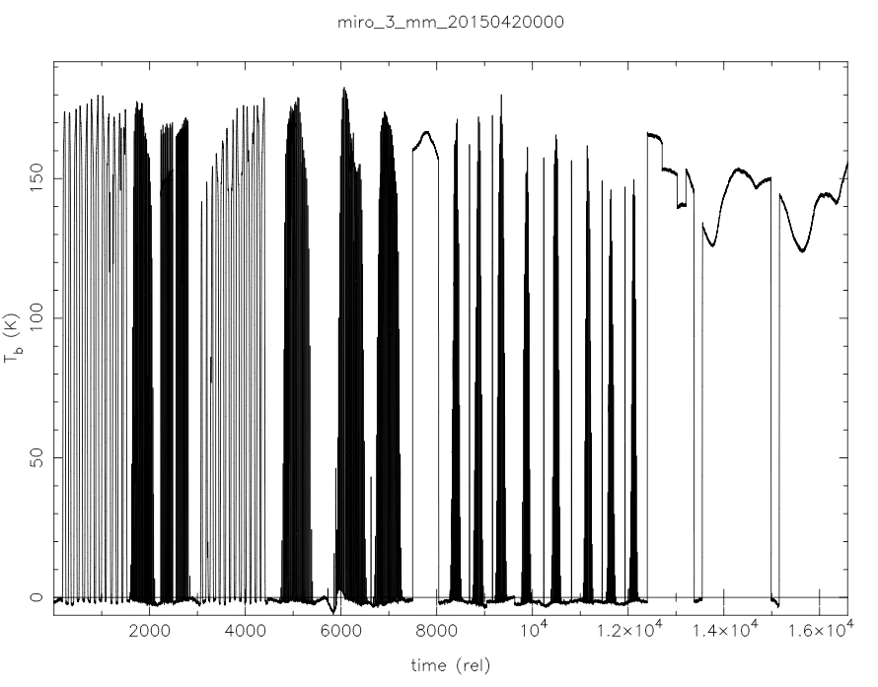
MIRO – Continuum mm – Level 3

Slide 9
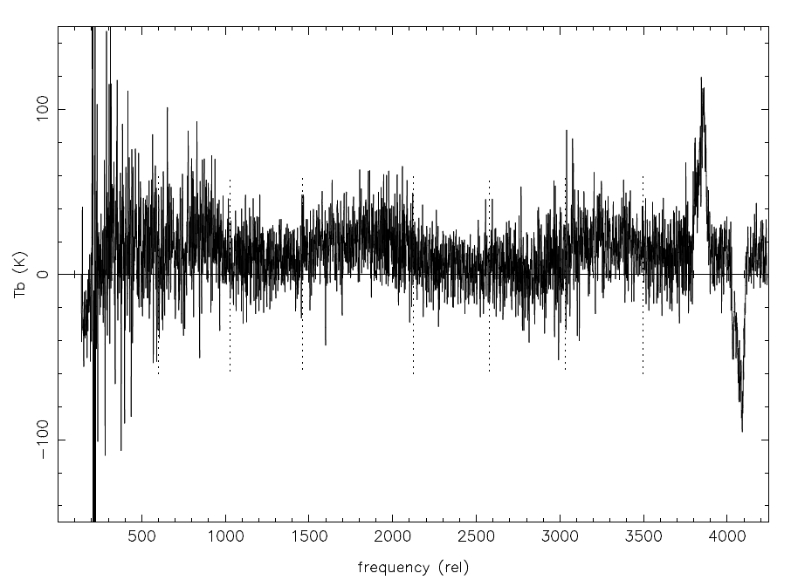
MIRO – CTS (spectra) – Level 3
band edges

Slide 10
MIRO
Confirm that the datasets contain the necessary instrument science, instrument housekeeping, spacecraft housekeeping and science operations information necessary to execute instrument, cross-instrument and cross-mission data analysis.

Slide 11
MIRO
Verify that the set of documentation is complete and sufficient for data processing and analysis.
The documentation is not complete enough to reproduce the calibration into Level 3 data (or published data). Note the following at the first of Chapter 9 of the User’s Manual: “This chapter is intended to be a reference for users of MIRO science data. It is being introduced in Version 4.5 of the Users Manual with just a few monographs addressing topics of interest. It is expected to grow rapidly in later versions, and eventually will present a summary of the following topics:
Science data products
Beam pattern
Pointing
Radiometric calibration
Spectral calibration
Spatial calibration ("geolocation”)
Pipeline data processing
Special data processing
Data quality flags.”
Some of this is present, but much is missing; i.e., the “growth” hasn’t happened yet.

Slide 12
MIRO
Confirm that calibration information provided is complete, making the calibration reversible (if applicable).
In principle everything is there, as there are engineering/ directories under data/ for the Level 2 datasets. But the recipe for calibration is only described in pretty general terms (in Chapter 9 of the User Manual), so I expect this to be difficult. I did not try though.

Slide 13
MIRO
As an example, given the documentation in the user manual, I think that given a number of source counts D, the antenna temperature of the source is:
Given warm and cold load counts D_{w} and D_{c}, and warm and cold load temperatures T_{w} and T_{c}. But there are some caveats given about when to use which load, when the sky is used as a load, and there are two temperatures for each load in the housekeeping data and it’s not specified which is used. And, are values interpolated? Nearest neighbor?

Slide 14
MIRO
Confirm the long-term scientific usability of the data, e.g. against already existing planetary archives.
I found this difficult to assess. Without a particular objective it’s difficult to know. The data is definitely of use long-term, though they need to improve the calibration (see note in catalog/dataset.cat: “CONFIDENCE_LEVEL_NOTE The calibration algorithms used to generate these data are still under development, so the current values must be regarded as preliminary, with uncertainties of order 10%”).

Slide 15
MIRO
Confirm the usefulness of the provided data sets for analysis by the science community e.g. by attempting to read/manipulate the data (without team-provided software) to produce or reproduce scientifically published results (if feasible).
As noted above, I could read and manipulate the data with my own software, but I couldn’t reproduce scientifically published results (though, admittedly, this is difficult and I didn’t spend much time on it). I also could not find the data corresponding to a recent publication (Chroukom et al. 2015) at all.

Slide 16
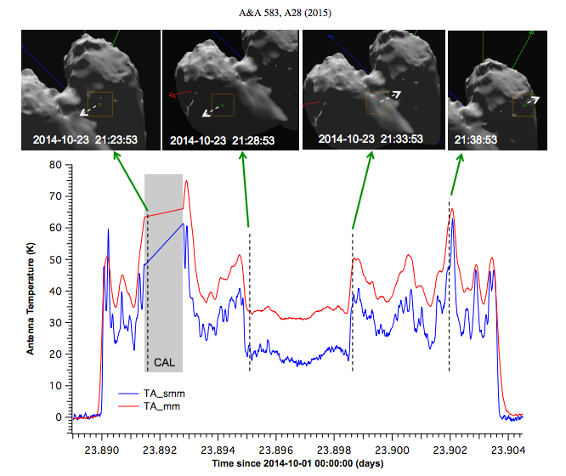
MIRO
Chroukom et al. 2015:
Times: 2014-10-23T21:21:36 to
2014-10-23T21:41:46
In ro-c-miro-3-prl-67p-v1.0/data/continuum
miro_3_mm_20142790000.dat - 2014-10-06T00:00:11 to 2014-10-12T23:59:34
miro_3_mm_20142860000.dat - 2014-10-13T00:01:38 to 2014-10-19T23:59:52
miro_3_mm_20142930000.dat – missing!?
miro_3_mm_20143000000.dat - 2014-10-27T00:00:01 to 2014-11-02T23:00:15
miro_3_mm_20143070000.dat - 2014-11-03T05:32:40 to 2014-11-09T23:59:49

Slide 17
MIRO
Despite some of the shortcomings noted above, the method for calculating brightness temperature, antenna temperature, the mapping from spectral channel number to sky frequency, and details on geometry are all either clearly outlined in the user manual or contained in the data release itself. The data is in pretty good shape, just needs a few fix-ups to get it into PDS-ready form.

Slide 18
MIRO
RIDs:
1 – Capitalization (Minor)
2 – Supplied software (Minor)
3 – aareadme.txt not right (Minor)
4 – Documentation on calibration (Major)
5 – Artifacts in Level 3 data (Major)
6 – Zero level in continuum data (Major)
7 – Baselines in spectroscopic data (Major)
8 – Missing data? (Major)
9 – ref.cat needs an update (Schloerb et al. 2015, Choukron et al. 2015, etc.) (Trivial)

