Slide 1
Rosetta Radio Science Investigations (RSI) Comet Data Review
Dick Simpson
17 February 2016
V1.0

Slide 2
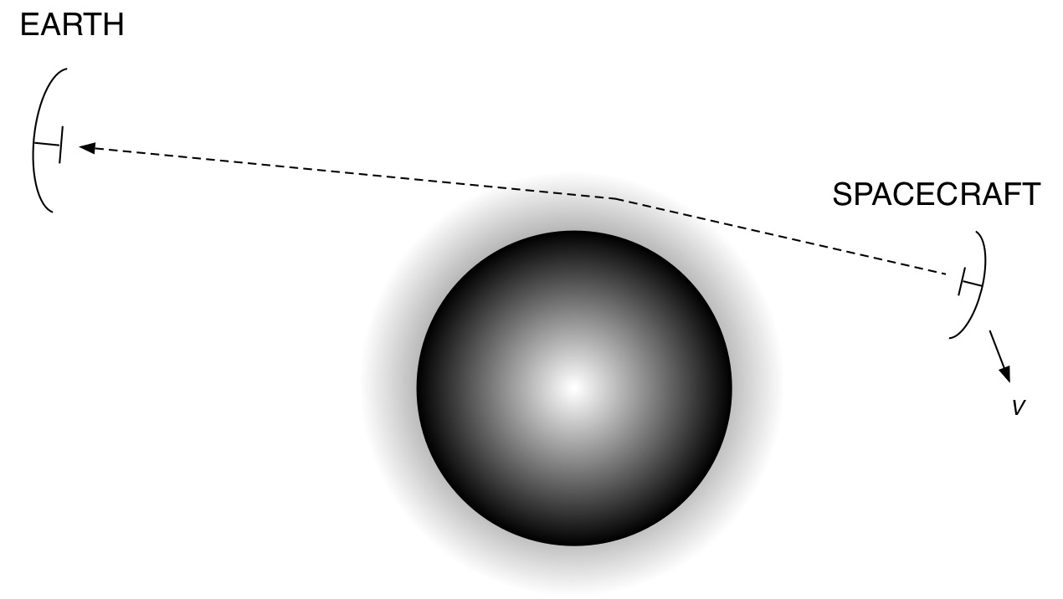
Generic Radio Science Observation Geometry
Spacecraft to Earth = One-Way Downlink Earth to Spacecraft = One-Way Uplink
If both and if downlink is coherent with uplink, then ‘two-way’

Slide 3
Generic Radio Science Observation Geometry
Downlink can be S-Band (λ=13 cm) or X-Band (3.6 cm) or both.
Uplink can be S- or X-Band.
ESA New Norcia,
ESA Malargue, or any of
several DSN antennas

Slide 4
Generic Radio Science Observation Geometry
MEX
VEX
ROSETTA
ESA New Norcia,
ESA Malargue, or any of
several DSN antennas
RSI shares analysis software, archiving tools, and documentation among three missions, realizing some efficiencies but also leading to ambiguities and errors that will be noted in future slides and annotated documents.

Slide 5
Generic Radio Science Observation Geometry
If two-way, the uplink can be modulated. The modulation can be used to measure round-trip time, and Earth-to-spacecraft distance can be derived. Navigation!

Slide 6
Generic Radio Science Observation Geometry
GRAVITY
Small Doppler changes in received frequency can be used to estimate spacecraft velocity v and then GM of the target. Two-way Doppler plus ranging yields the best GM (and higher order field coefficients).

Slide 7
Generic Radio Science Observation Geometry
COMA
As the ray path begins to pass through the coma, photons will be refracted and or scattered by plasma, neutrals, or particles causing Doppler shifts and/or spreading. Inversion of Doppler measurements can yield density of the media.

Slide 8
Generic Radio Science Observation Geometry
NUCLEUS
When the raypath grazes the nucleus, reflections may provide information about surface roughness and dielectric constant. Duration of an occultation may be interpreted in terms of an occultation chord length.

Slide 9
Generic Radio Science Observation Geometry
SOLAR CORONA
When the target is the Sun, perturbations of the received signal may be interpreted as coronal structure and turbulence.

Slide 10
Radio Science Observations (ESA)
Commands
Predicts
IFMS
ROSETTA
ANTENNA
TARGET
Range
Doppler
There are 3 Intermediate Frequency and Modem System (IFMS) units at each ground station. IFMS-1 (prime) usually receives X-Band and controls uplink, IFMS-2 (backup) usually receives X-Band, and IFMS-3 (when available) is for radio science (often used to receive S-Band). Each IFMS has 2 Doppler and 2 AGC outputs.

Slide 11
RSI Observations (from 2014 RSI ops log)
MTP | Date(s) | Obs Kind | Achievement | Archive Status
1 | 089 | COM | partial | PSA; in review
1 | 095 | COM | cancelled | N/A
2 | 103 | COM | successful | PSA; in review
2 | 109 | COM | successful | PSA
2 | 119 | COM | successful | PSA
3 | 138 | COM | successful | PSA
3 | 151 | COM | performed | PSA
4 | 151 | COM | performed | PSA
4 | 165 | COM | successful | PSA
4 | 179 | COM | successful
5 | 187-212 | 38 COM | 2 successful, 2 partial, 34 performed
6(?) | 213-365 | 1 GRV 350 COM | successful 294 successful, 2 partial, 54 performed

Slide 12
RSI 2014 Ops Log
Appears to be useful and reasonably up to date:
Label PRODUCT_CREATION_TIME = 2015-11-18T16:02:52
But, LABEL_REVISION_NOTE = "2004-03-05"
Only 1 of 498 observations is listed as science (GRV); all others are COM, which is not described anywhere
All listed observations have L1a, L1b, and L2 outputs
Eight of 498 have been delivered to PSA
Two of those eight (the earliest, when Rosetta was farthest from C-G) are available for review
Six bistatic radar observations at DSN stations are not listed (9/28, 10/10, 10/11. 11/22, 11/29, and 12/13)

Slide 13
Review Strategy
Examine IFMS carrier strength measurements for consistency
AG1 should equal AG2 for each IFMS
There may be instances where IFMS1 = IFMS2 (depends on inputs)
Doppler will be more useful for science (RSI gravity at C-G)
In hindsight, choosing to look at AG1 and AG2 (rather than DP1 and DP2) may have been easy but not scientifically helpful; there are no L02 AG1 and AG2 data on 2014/089 or 103, and L1B data are simply reformatted L1A data
Don’t expect science to pop out; this is just after hibernation
Don’t expect to find explanations of results

Slide 14
IFMS1 (ICL1)
AG1
L1A
2014/089
X-Band?
Telemetry OFF?
IFMS1 (ICL1)
AG2

Slide 15
IFMS2 (ICL2)
AG1
L1A
2014/089
20 dB difference
IFMS2 (ICL2)
AG2
X-Band?
S-Band?

Slide 16
IFMS3 (ICL3)
AG1
L1A
2014/089
15 dB difference
IFMS3 (ICL3)
AG2
S-Band?

Slide 17
Conclusions — 1
It is difficult to understand what was being tested and how in the submitted data. There is no general documentation about the ‘COM’ activity and no specific information about the two tests on days 089 and 103. There were 495 other RSI ‘COM’ activities conducted during 2014 for which there is also no information. DATASET.CAT refers to the RSI User’s Guide and INST.CAT for more information. The User’s Guide only refers to other documents for results of tests in 2004; the User’s Guide has not been updated since January 2006. INST.CAT describes hardware and science objectives but is silent on ‘COM’.

Slide 18
Conclusions — 2
The set of RSI Ops Logbooks provides the best overview of this and other RSI data sets.
Each RSI Ops Logbook could be expanded to provide some of the missing information (previous slide).
Status granularity — ‘partially performed’, ‘performed’, and ‘successfully performed’ — is neither sufficient nor descriptive.
The 2014 Ops Logbook is missing entries for six bistatic radar experiments, which are both important observations and very different in character from the majority of activities, which are focused on gravity.

Slide 19
Conclusions — 3
Label specifications do not match actual data object parameters; correct errors.
For example r32icl1l1b_ag1_140891743_00.lbl says r32icl1l1b_ag1_140891743_00.cfg has one record of 17377 bytes; in fact, the configuration file has 17444 bytes. The same label says r32icl1l1b_ag1_140891743_00.tab has 2481 records of 118 bytes (total 292758 bytes); in fact, the table has 3600 records of 118 bytes (total 424800 bytes).
The corresponding D1X label is also wrong for both *.cfg and *.tab objects (r32icl1l1b_d1x_140891743_00.lbl)
I did not check many labels; the ones I did check had a lot of errors. However, INDEX/index.lbl has the right description of index.tab

Slide 20
Conclusions — 4
The document list in DOCUMENT/DOCINFO.TXT needs to be scrubbed and updated.
For example, many of the ESA documents describing data delivery interfaces and procedures are not likely to be of use to anyone (and of only passing interest to RSI Team members) in the future. They represent ‘clutter’ to a new person trying to establishing footing in the archive.
The 2014 RSI Ops Logbook is included in the archive but is not shown in DOCINFO.TXT.
Are there range calibrations and group delay stability specifications and measurements at Malargue?
If there will be separate lists of documents elsewhere (as there is in DATASET.CAT), make it consistent.

Slide 21
Conclusions — 5
Update all documentation (including *.CAT files and labels) so that information is correct and appropriate for 2014.
Change references to MEX and VEX so that they make sense in the RSI context (without requiring readers to chase down documentation from other missions); remove references that are not appropriate for RSI.
Repair the following where indicated by annotations (AAREADME.TXT, DATASET.CAT, and INST.CAT)
Stanford (Simpson, Tyler, and/or Hinson) is mentioned in several places as being integral to RSI data processing and archiving. None of that is true.
Spacecraft High-Gain Antenna patterns are listed in DATASET.CAT as DSN documents; they should be ESA documents, but they are not listed anywhere else. They are important for bistatic radar calibration.

Slide 22
Conclusions — 6
L02 AG1 Sample Number is left-adjusted in a 21-byte ASCII_INTEGER column and Carrier Level is left-adjusted in a 20-byte ASCII_REAL column. Both have variable numbers of digits within the file.
Other numerical values are also left-adjusted in their fields also; but they are displayed with fixed numbers of digits.
Several documents appear only as PDF; the PDS3-required human-readable text version is not included.
L1A labels only describe a few of the columns in the data file; the IFMS SIS describes a few more, but there seems to be no explanation of the entire table. Some of the mystery values might be useful.

