Slide 1
OSIRIS Prelanding Datasets
Jian-Yang Li
Planetary Science Institute

Slide 2
Datasets
OSIRIS prelanding data
From 2014-03-18 to 2014-09-16, separated to 8 datasets (M01, M02, M03, M04, M04b, M05, M06, M07)
WAC + NAC
Raw + Cal
Total 8x2x2 = 32 datasets
The Raw datasets for both NAC and WAC in M01-M04 are v1.1 (8 of the 32 are updated from v1.0)
Comparative approach
Compare the catalog files in v1.0 and v1.1
Compare Raw and Cal datasets
Compare NAC and WAC datasets

Slide 3
dataset.cat
The dataset.cat in various datasets only differ in dataset specific information, such as names, times, and etc. Descriptions are all the same.
"CCD Images" section, first paragraph: The first sentence is problematic. Also need to revise the text for level-3 datasets.
"Target Name..." section, 3: It's not clear which column in the table is used as target name in the header.
Should also explain the subdirectory organization of data files.
"Data Units" needs to be updated for all level-3 datasets. Right now it’s DN.
Coordinate System" section: what is "earth-observer-to-target”?
"Confidence level" section: please separate the paragraphs for NAC and WAC to their corresponding datasets. Also, need to at least provide references for the quality assessment of compression, calibration, etc.
Need to have a description or reference to the SIS for how data files are organized with the segments, IMAGE, QUALITY_MAP_IMAGE, SIGMA_MAP_IMAGE.

Slide 4
Compare with Previous Version (M01-04 Raw)
It seems that the previous versions, although labeled level 2, actually contain calibrated data?
The description of update doesn’t include all changes, and is therefore incomplete.
All image names correspond to each other
Everything else are the same
The only different text other than names and version number change in dataset.cat:

Slide 5
Inter-Comparison Between Datasets
Number of images in level-2 and level-3 are inconsistent, and no explanations found
NAC Raw: 4835, Cal: 4480 (355 images less)
WAC Raw: 3784, Cal: 3297 (487 images less)
Someone should verify my count to avoid the potential “lost-in-packaging-downloading” problem
All images have TARGET_NAME = 67P, therefore it’s either the TARGET_NAME problem or image problem
I didn’t have time to track down the different files

Slide 6
Data Files
Read in all images with readpds
But all of them don’t have the same structure, and the same segments. Had to determine structure dynamically, affecting automated processing
Extracted labels: time, target_name
All images have TARGET_NAME = 67P

Slide 7
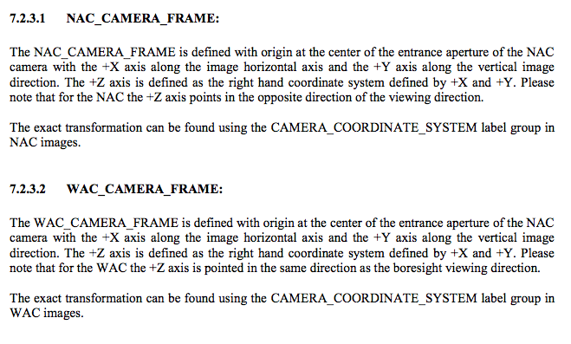
Camera Frame (SIS)

Slide 8
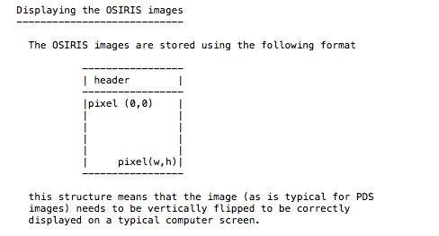
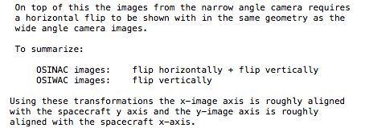
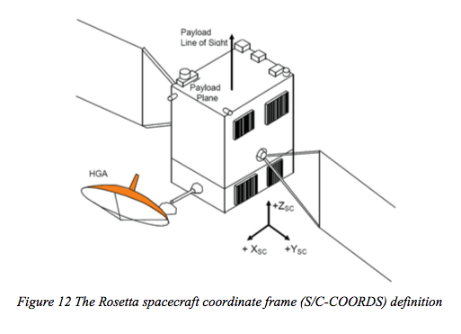
Image Orientation
NAC:
SAMPLE_DISPLAY_DIRECTION=RIGHT
LINE_DISPLAY_DIRECTION=DOWN
WAC
SAMPLE_DISPLAY_DIRECTION=RIGHT
LINE_DISPLAY_DIRECTION=DOWN
The relative flip along horizontal direction between NAC and WAC are not reflected in these keywords.

Slide 9
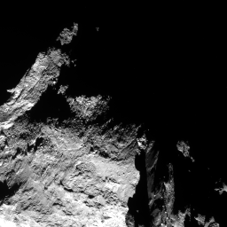
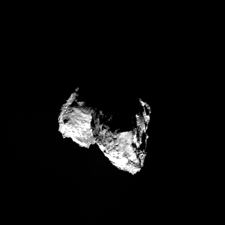
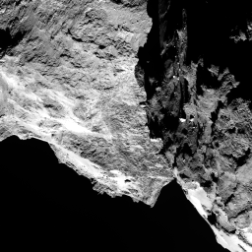
WAC straight from IDL readpds return
NAC flipped from IDL readpds return
n20140905t040224548id30f71
w20140905t035413805id30f18
Relative orientation between WAC&NAC is good
n20140905t040555555id30f22

Slide 10
Image Frame Definition
ROS_OSIRIS_NAC & ROS_OSIRIS_WAC (from ROS_V25.TF):
+Z axis points along the camera boresight;
+X axis is parallel to the apparent image columns; it is nominally co-aligned with the s/c +X axis;
+Y axis completes the right hand frame; it is nominally parallel the to the apparent image lines and co-aligned with the s/c +Y axis;
the origin of the frame is located at the camera focal point
Pointing up or down?
+x
+y
+y
+z
CCD
Contradict with the definition in SIS
+x

Slide 11
Simulated Images
Use mid-imaging time from labels
Illumination and S/C viewing geometries, camera FOV orientation, and boresight are calculated from NAIF SPICE
Use shape model spc_lam_psi/cg_spc_shap2_786k_cart.wrl
Assume an arbitrary set of Hapke parameters
Simulate 4 NAC images and 4 WAC images arbitrarily selected in M06 and M07
Self-developed software widely used in all of my past work over ten imaging datasets from missions and HST
Shadowing turned off to speed up calculation
Compare with images from IDL readpds return

Slide 12
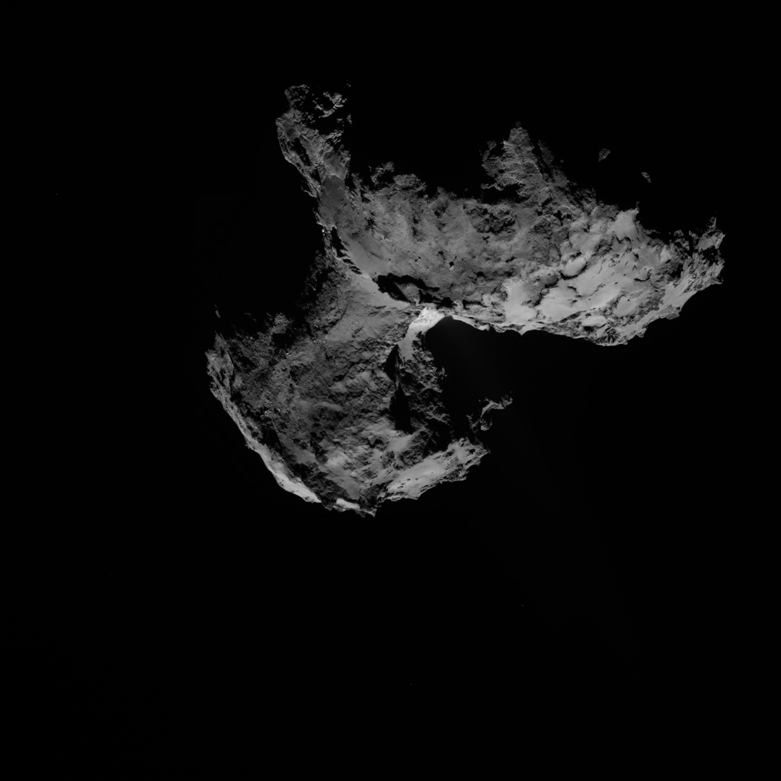
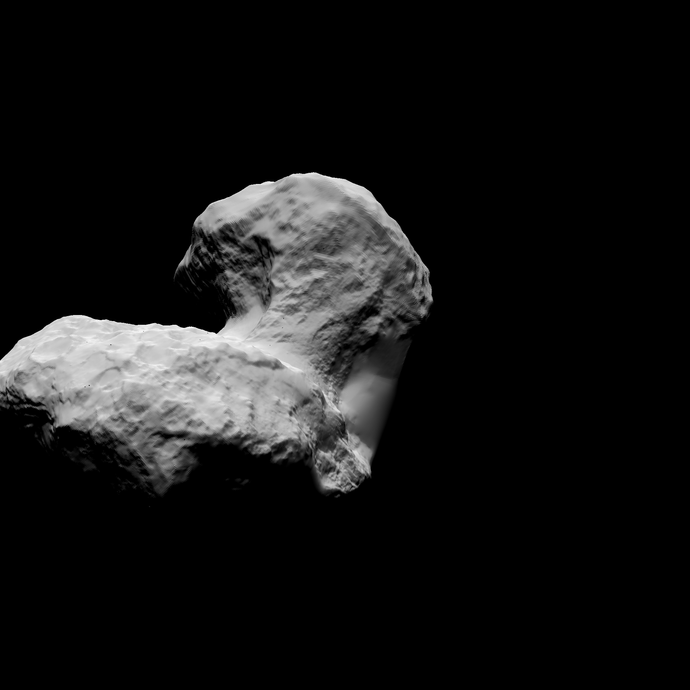
WAC
w20140914t205850753id30f18
Need to rotate by 180º to match

Slide 13
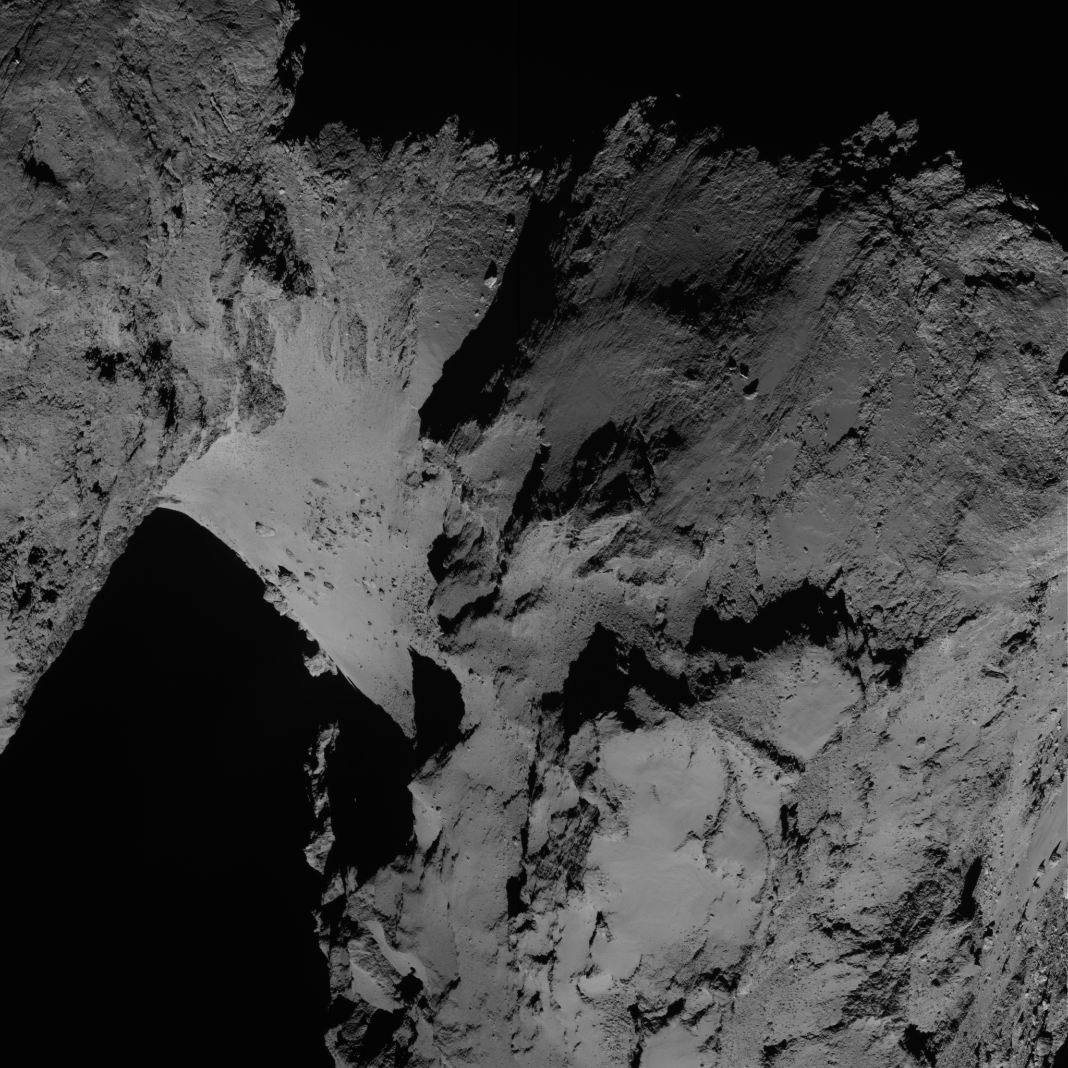
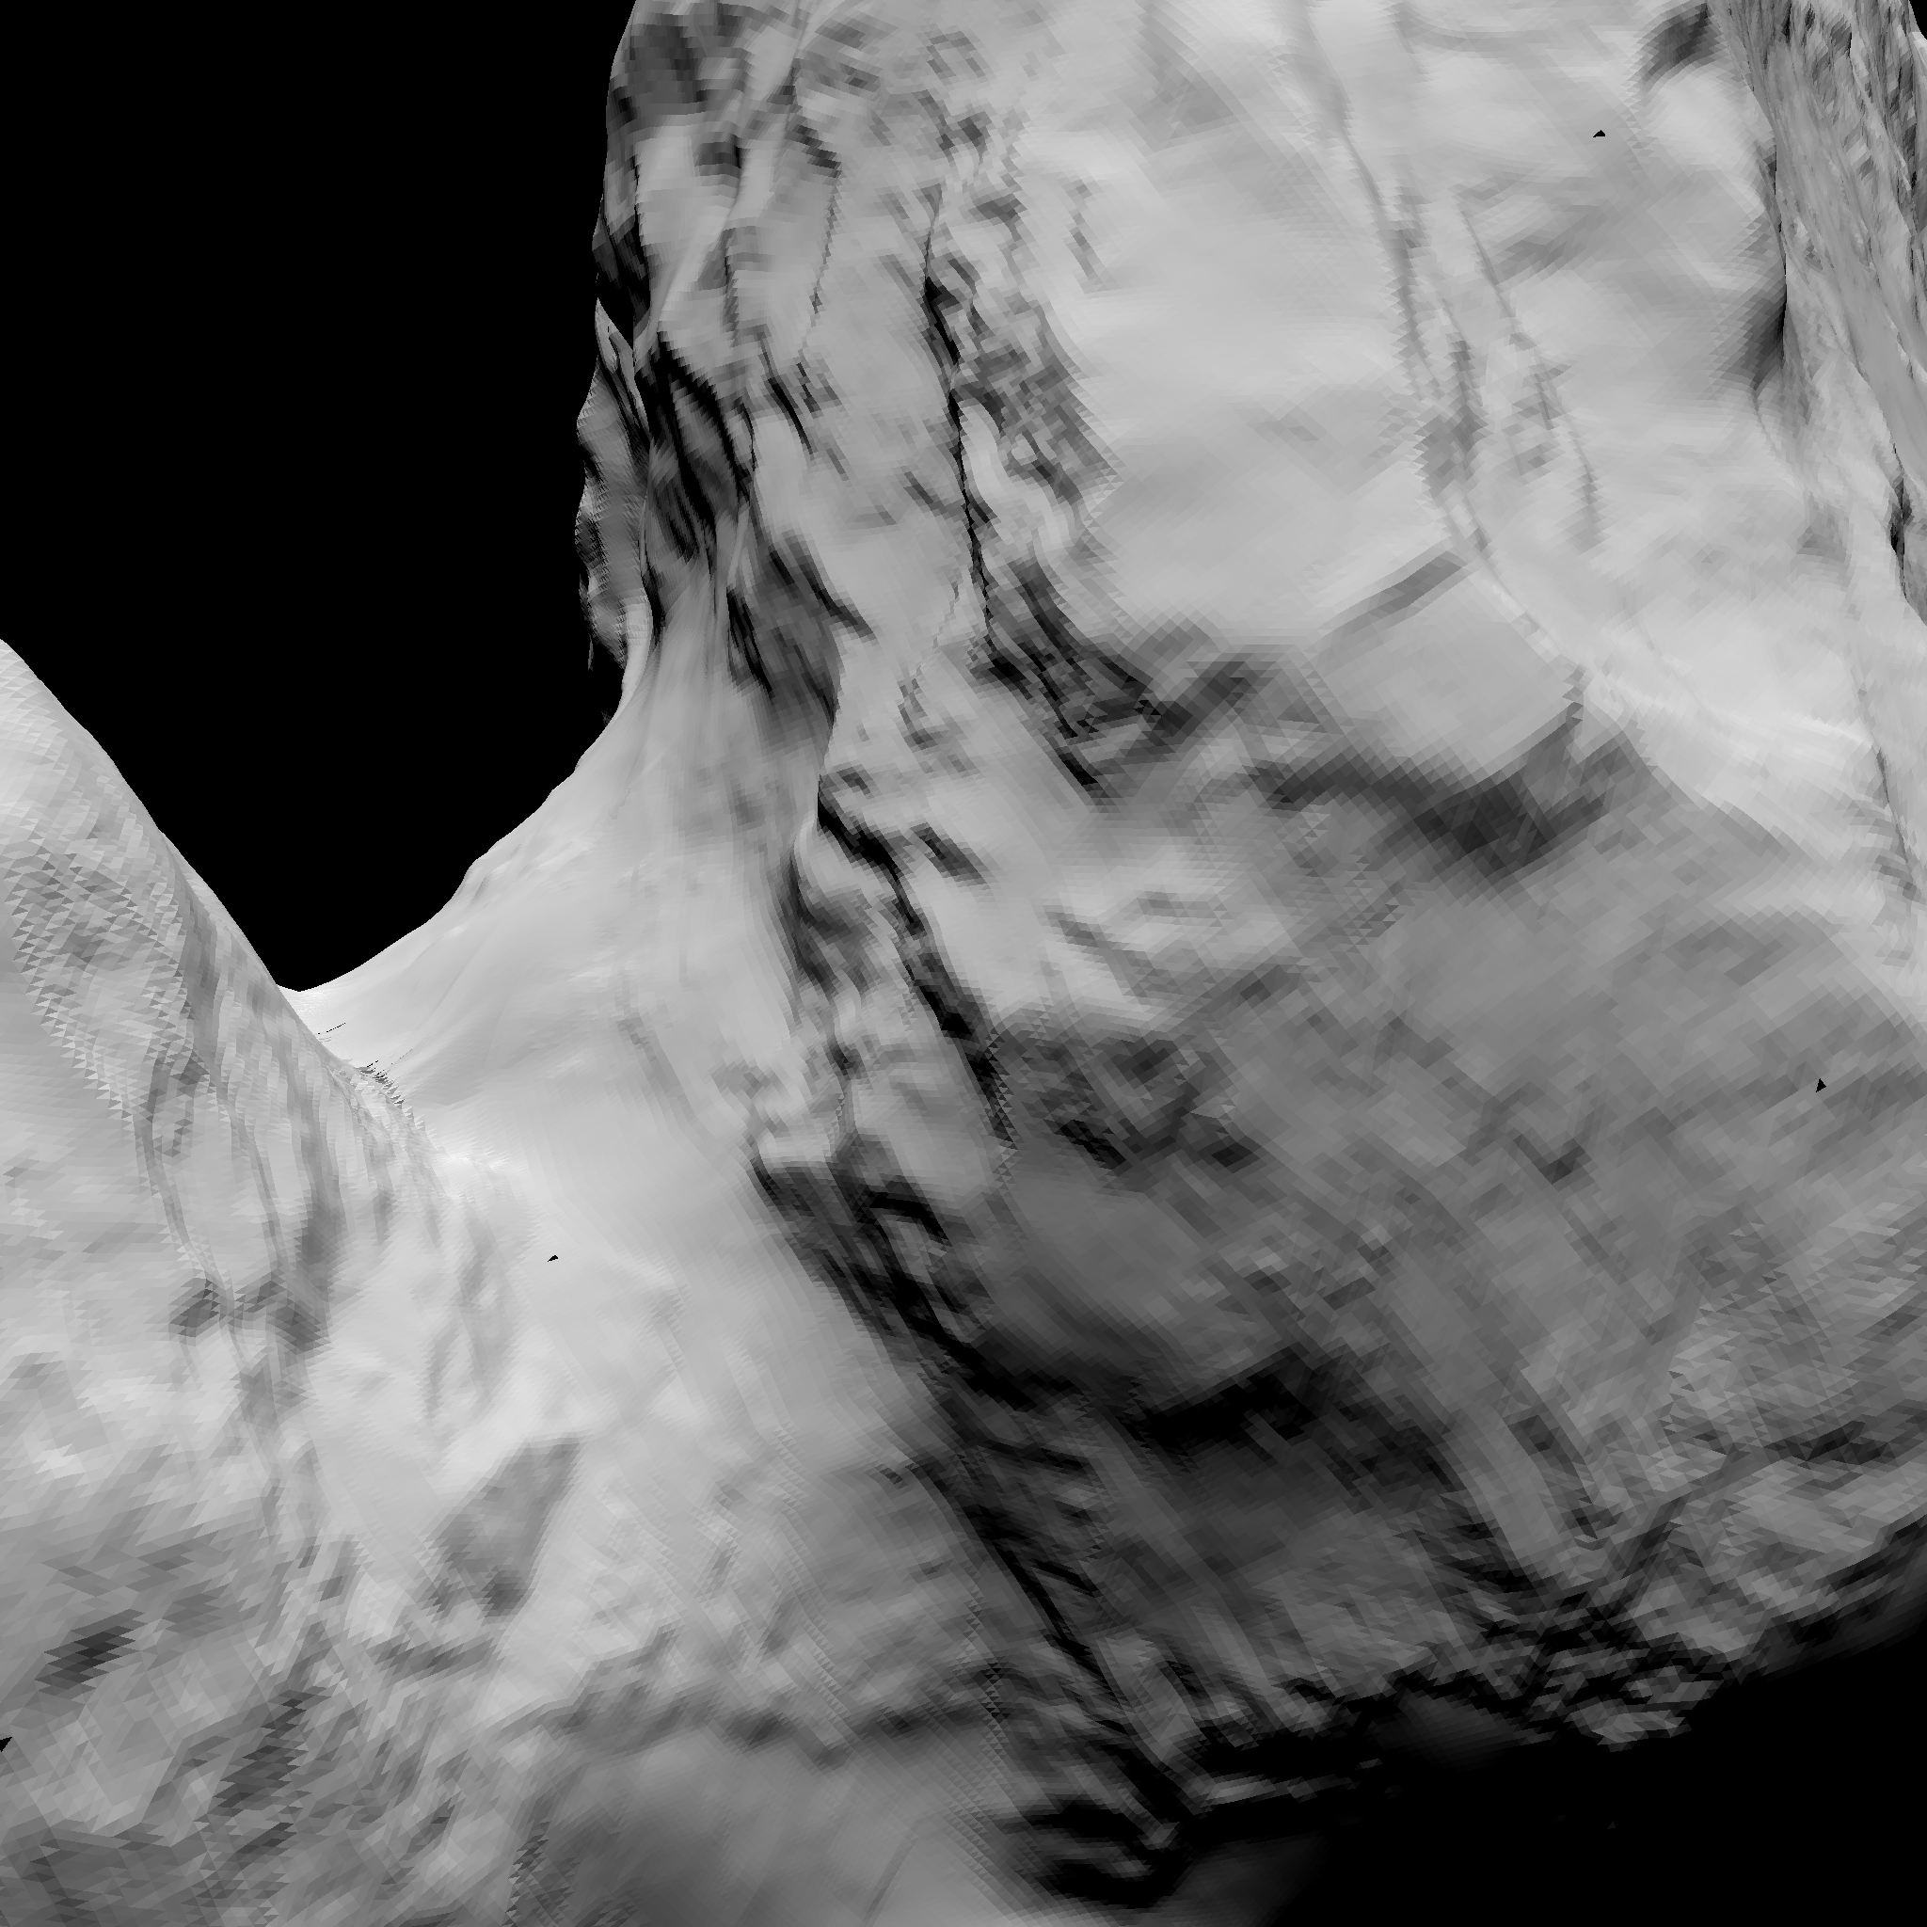
NAC
n20140902t174357308id30f41
Need to rotate by 180º and flip horizontally to match

Slide 14
NAC
n20140902t174357308id30f41

Slide 15
Orientation from Simulation
WAC: rotate 180º
NAC: rotate 180º + horizontal flip
→ Maybe the +x axis actually points down?
My calculation of image orientation should be rotated by 180º
If this is the case, then the orientation of OSIRIS images are correctly defined for both WAC and NAC
One question: Should they modify the SAMPLE_DISPLAY_DIRECTION from RIGHT to LEFT?
So it’s easy to describe in the dataset catalog file
Comply with PDS standard
IDL readpds can load the image in correct orientation automatically
+y
CCD
+x

Slide 16
What’s not Done
Test the calibration software provided in extras/ subdirectory
Verify the completeness of the calibration data provided in calib/ subdirectory
Test whether calibration is performed as described in osiris_cal.pdf
Verify calibration by comparing with literature
Verify the calculation of geometry keyword values in PDS labels with SPICE kernels
Careful proofread of all documents in document/ subdirectory

