Slide 1
ROLIS Data Review
Jian-Yang Li
Planetary Science Institute

Slide 2
Datasets
Post-hibernation checkout, level 2
2014 Apr 9 – Apr 24
13 images, 2 strips
Separation, descend, and landing, level 2 & 3
2014 Nov 12 8:35:02 – 15:34:04
9 images
First science sequence, level 2
2014 Nov 12 15:34:05 – 17:30:20
6 images, 1 strip

Slide 3
Catalog Files
The dataset.cat files in all four datasets only differ in mission phase specific and level specific text
No major problem identified
Some points should be mentioned or reiterated, see following slides

Slide 4
Data
Browse facility (subdirectory) is provided with the png images of all data – very good!
But why some png images have blue tone in phc dataset
Data provided in FITS format with customized extensions: .rim (raw), .cim (calibrated)
Separated PDS label files supplied
FITS format is stated in the EAICD, but should also be mentioned in the dataset.cat
No PDS display direction keywords found. IDL readpds does complain. Is the implicit definition through FITS standard acceptable?
All essential time and geometric information provided in PDS labels
All information in FITS headers are not transferred to PDS labels, some essential: LED, temperatures. Need to mention this somewhere at least, if not adding them to PDS labels
All data can be loaded by IDL readpds or DS9
The three imaging mode are not sufficiently described. Specifically, what is FULL-FRAME IMAGE STRIPE (inst.cat)?

Slide 5
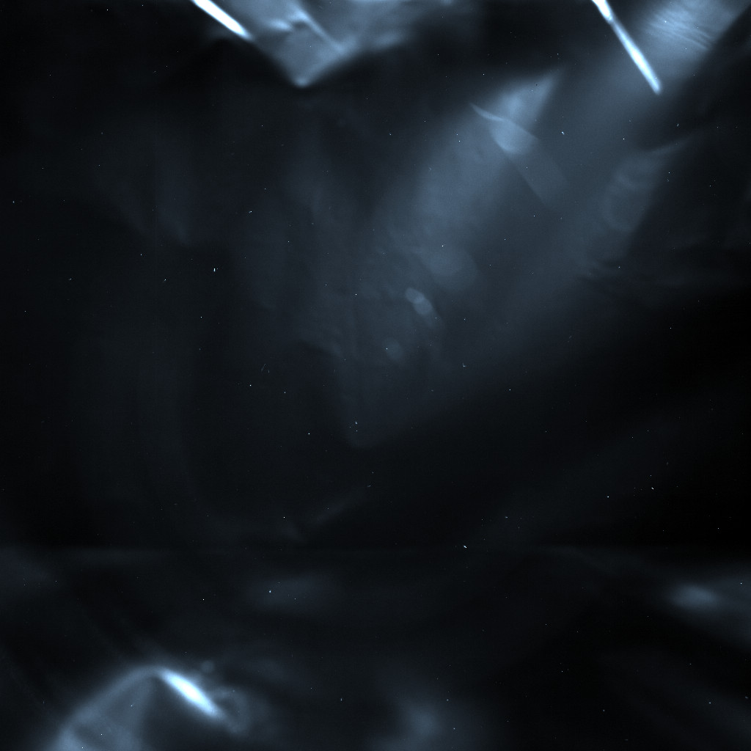
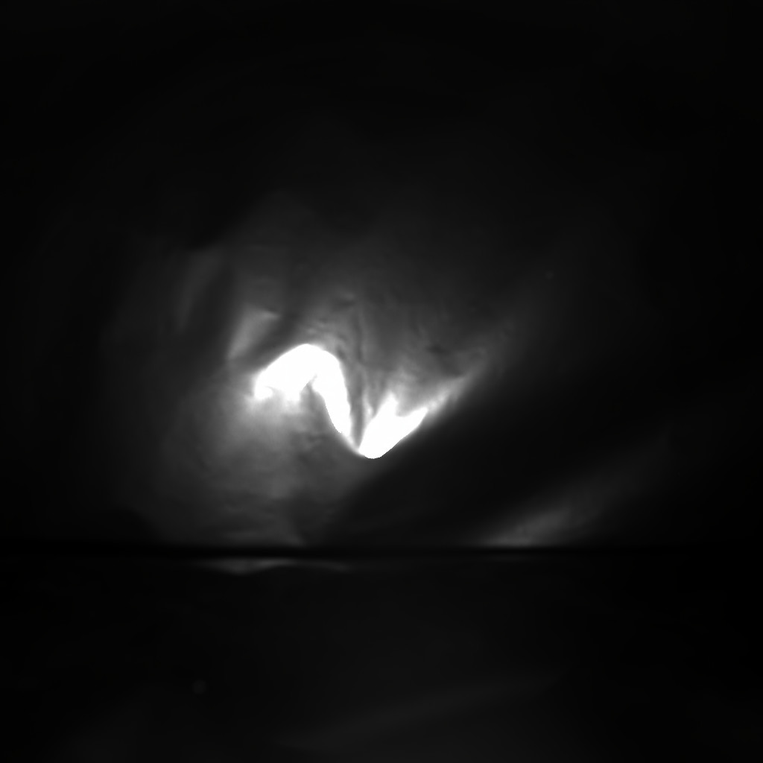
Blue-tone PNG in Browse
rol_fsp_140417055623_336_00
rol_fsp_140417055700_336_01

Slide 6
Calibration
Calibrated to arbitrary units that are proportional to radiance
Bias and dark subtraction
De-smearing
Flatfield
Procedure clearly described in document/rolis_calibration_desc.txt
Flatfield is provided in calib/rolis_ifl_flat_clear.fits
No problems identified
Didn’t verify the calibration process

Slide 7
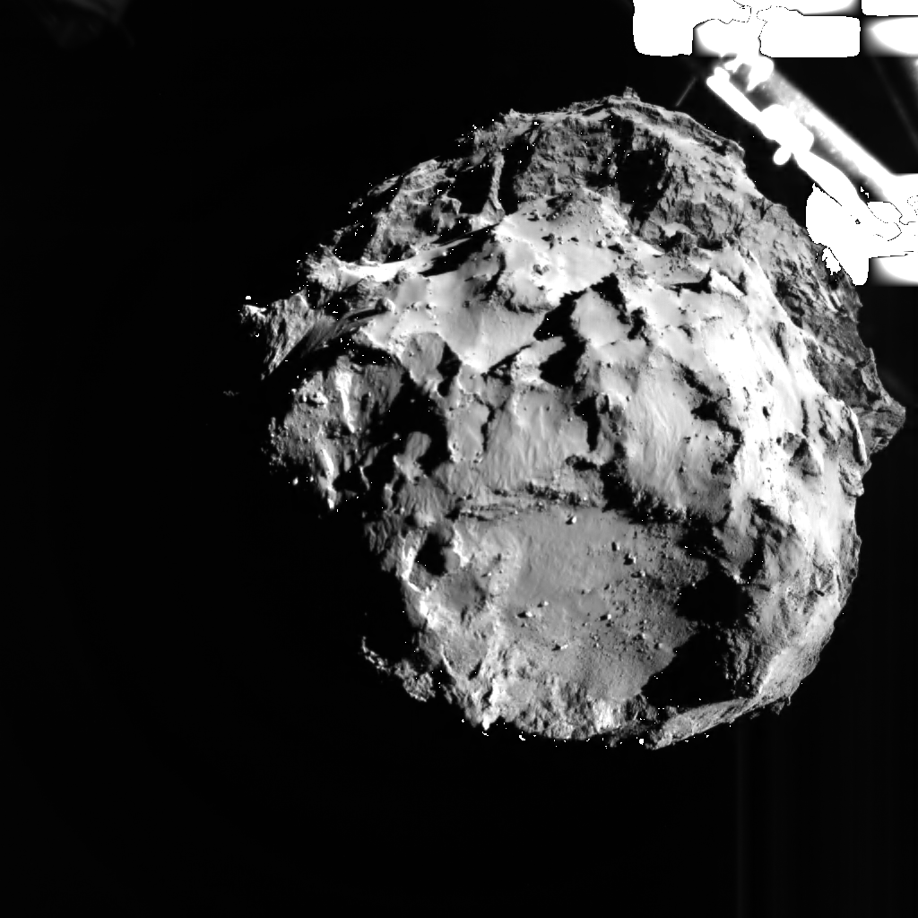
SDL Sequence
From SDL level 3 data
Linear stretch from 3% to 96% brightness range, original size 1024x1024, 9 frame SDL sequence, 0.8s frame delay

Slide 8
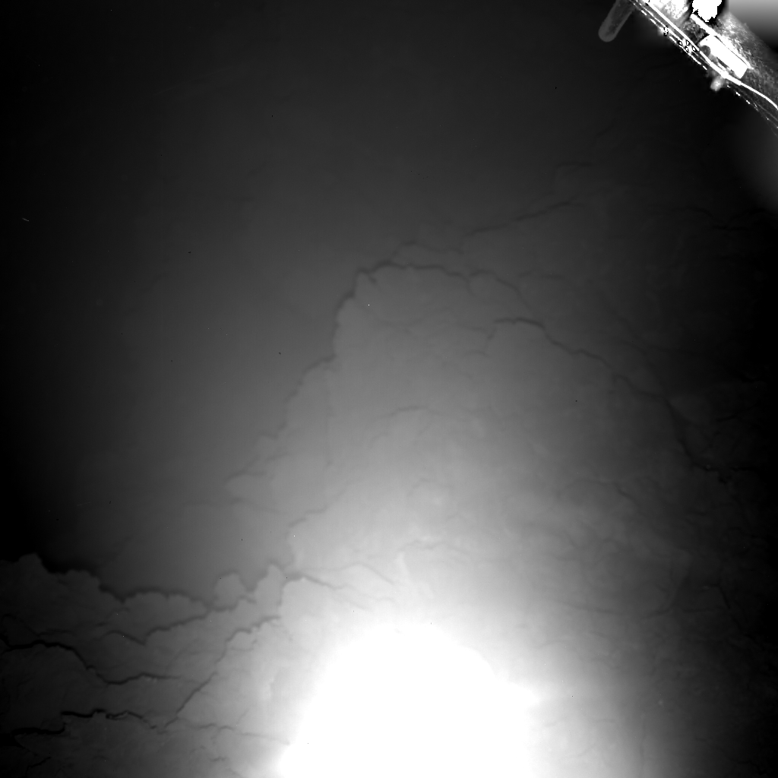
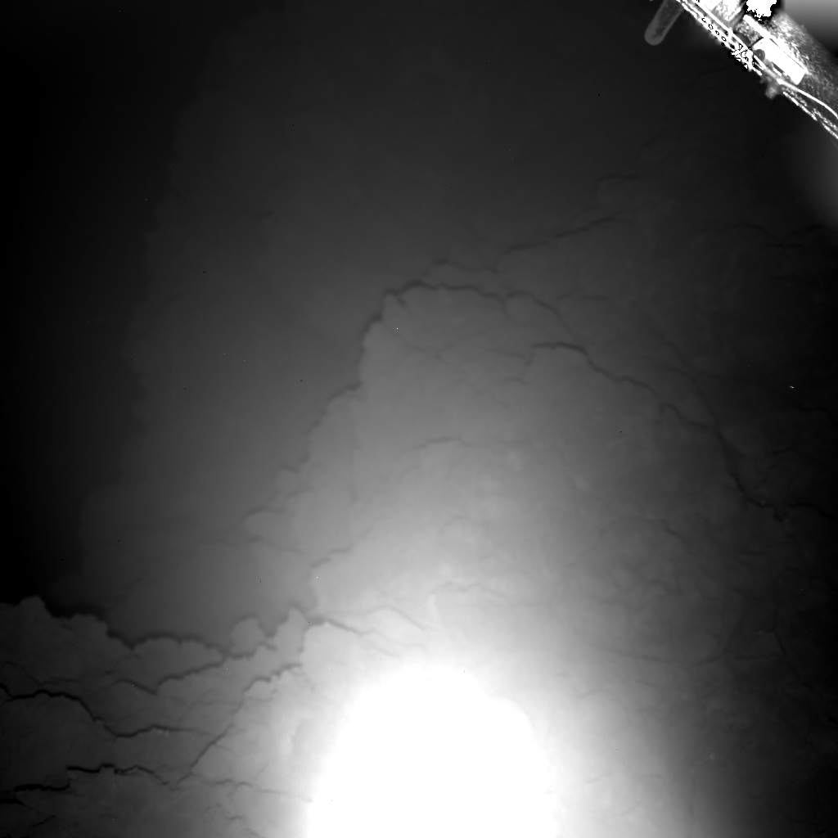
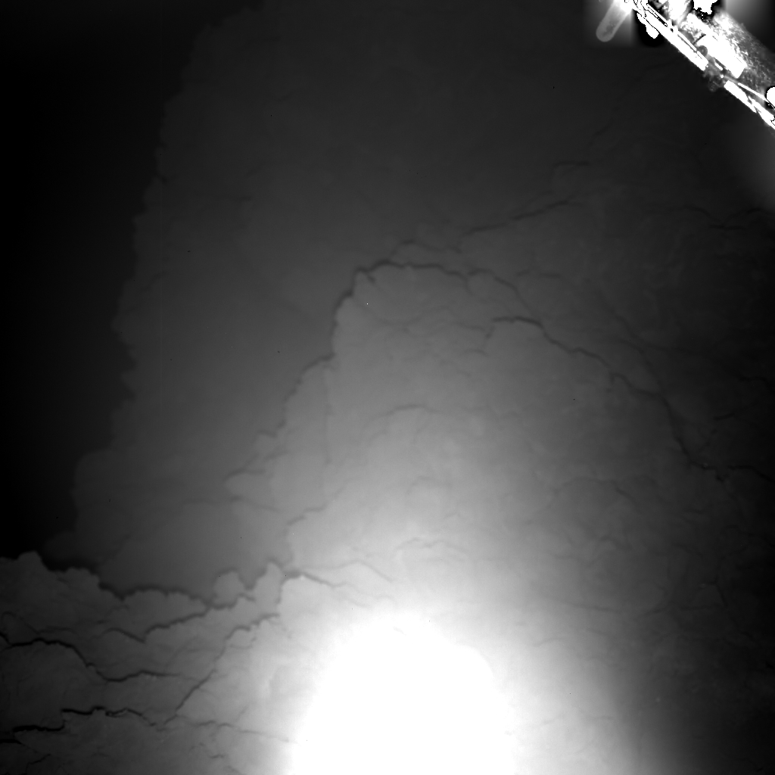
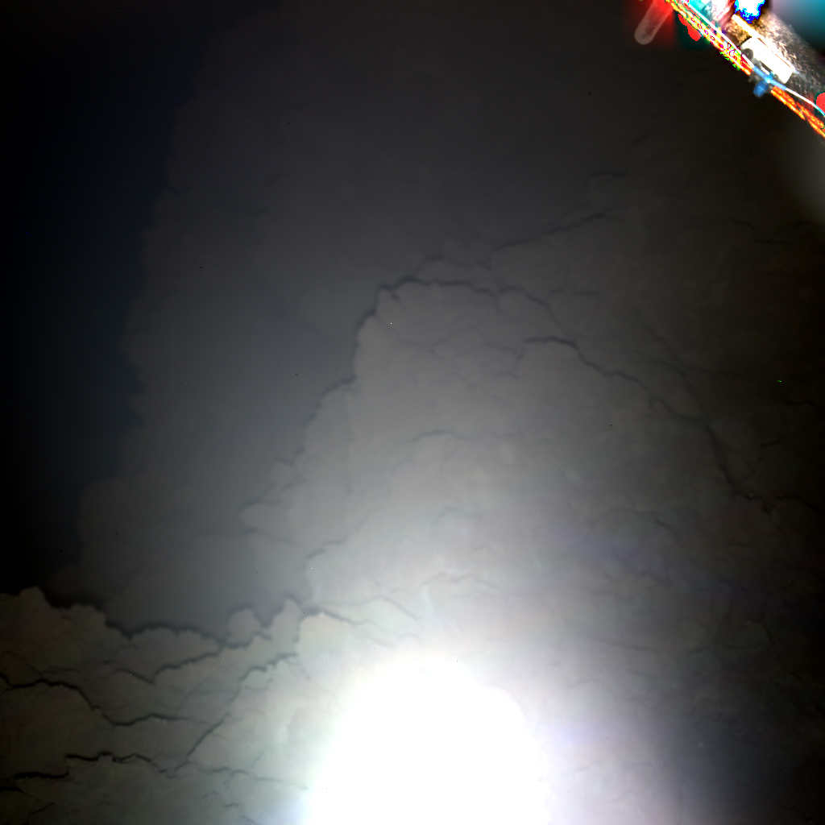
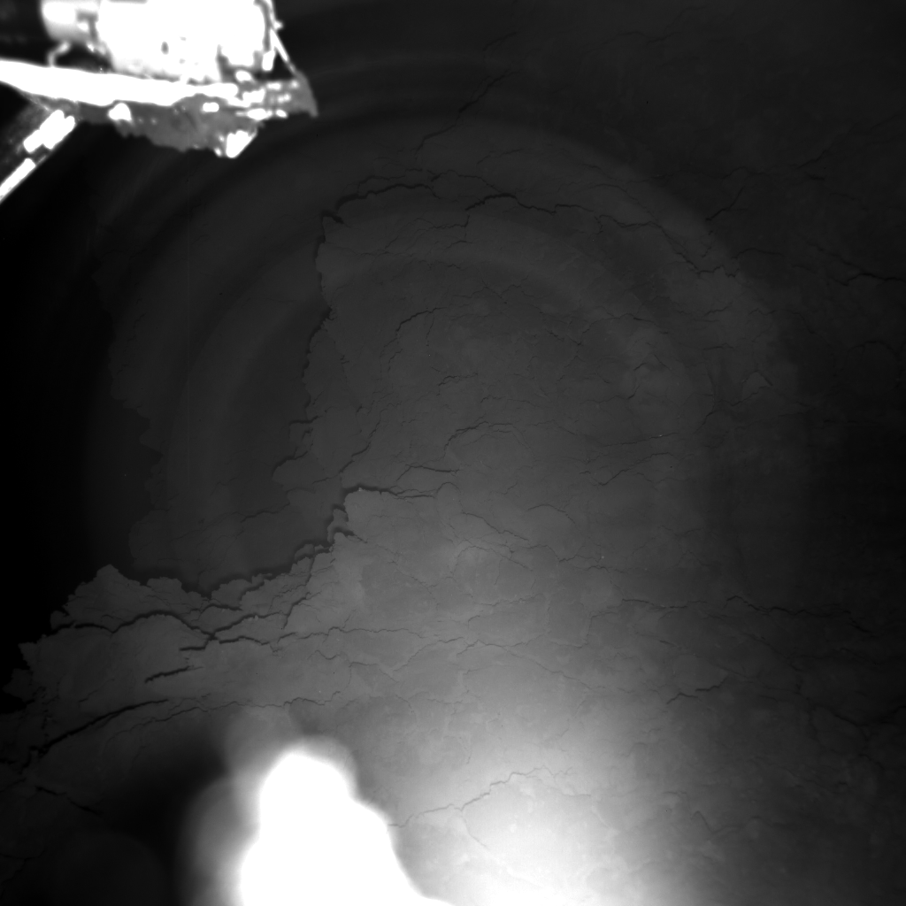
First Science Sequence
Blue
Green
Red
RGB composite
IR
Red

