Slide 1
Rosetta Lander SPM Data Review Comments rl-cal-romap-2-phc-spm-v1.0 rl-cal-romap-3-phc-spm-v1.0 rl-cal-romap-2-fss-spm-v1.0 rl-cal-romap-3-fss-spm-v1.0 rl-cal-romap-2-rbd-spm-v1.0 rl-cal-romap-3-rbd-spm-v1.0
S. Joy

Slide 2
Overview
All of the rl-XXX-romap-X-XXX-spm-v1.0 review volumes share a large number of common files: catalog files, documents, required files (Xxinfo.TXT), etc. rather than repeating comments on those files in this presentation, those comments were provided in Rosetta_Lander_common.pptx
Furthermore, the format files for all of the raw lander mag data are identical so I will discuss them only once
Dataset catalog files
All of these files are extremely sparse, with their only really useful information being the start/stop time and citation descriptions
RID: Update all dataset.cat files to at least describe the data at a high level and allow users to determine if they are usable for science or if another data set should be used instead. Many of the data fills are very sparse (mostly filled with zeros). This should be stated and explained in these catalog descriptions.
It might be helpful to at least direct the user to other more useful files on the volumes like the EACID and calibration description

Slide 3
Catalog Directories
catinfo.txt
mission.cat (fix various typos/misspelled words)
insthost.cat (fix various typos/misspelled words)
person.cat
ref.cat
software.cat
inst.cat
dataset.cat - rl-cal-romap-2-phc-spm-v1.0 (sparse)
dataset.cat - rl-cal-romap-3-phc-spm-v1.0 (sparse)
dataset.cat - rl-cal-romap-2-fss-spm-v1.0 (sparse)
dataset.cat - rl-cal-romap-3-fss-spm-v1.0 (sparse)
dataset.cat - rl-cal-romap-2-rbd-spm-v1.0 (sparse)
dataset.cat - rl-cal-romap-3-rbd-spm-v1.0 (sparse)

Slide 4
Document Directories
Docinfo.txt
eaicd_romap.pdf (.lbl)
rl_romap_logbook.txt (.lbl)
ro-lro-dp-300002-ua.pdf (.lbl)
romap_calibration_desc.txt (.lbl) – deficiencies previously discussed

Slide 5
INDEX files
indxinfo.txt - Add a discussion of the checksum files and their usage (MD5 tools), in particular, that they reference files from the root of the volume and not relative to the INDEX directory where the files are located.
index.tab (lbl)
checksum.tab (lbl)

Slide 6
LABEL
labinfo.txt
romap_rawhk.fmt
romap_spm_elec.fmt
romap_spm_fc.fmt
romap_spm_par_ion_cna.fmt
romap_spm_par_ion_cne.fmt
romap_spm_par_ion_cra.fmt
romap_spm_par_ion_cre.fmt
romap_spm_raw_ion_cn.fmt
romap_spm_raw_ion_cr.fmt

Slide 7
Data sets
rl-cal-romap-2-phc-spm-v1.0
rl-cal-romap-3-phc-spm-v1.0
rl-c-romap-2-fss-spm-v1.0
rl-c-romap-2-rbd-spm-v1.0
rl-c-romap-3-fss-spm-v1.0
rl-c-romap-3-rbd-spm-v1.0
All of the data sets are in a difficult format to work with. None of the tools that I have can easily read, display, or analyze the data as they are currently formatted. Data are stored in simple ASCII tables that have flattened the intrinsically multi-dimensional data.
For this review, data have been validated by visual inspection of the individual ASCII tables. In general, data appear nominal but there could be subtle issues that are missed by inspection
Since the data will require either custom software or reformatting for analysis, I recommend adding browse plots to the archive volumes. This will allow users to verify that their tools are reproducing instrument team results

Slide 8
RL-CAL-ROMAP-2-PHC-SPM-V1.0
Eight types of data files in this data set

Slide 9
Data: RL-CAL-ROMAP-2-PHC-SPM-V1.0
Data files: spme_fs2_*.tab
Specific File: spme_fs2_140416134159.tab
Structure: Time and instrument setting parameters repeat for 32 records. Each
record contains an energy step and an electron counts for that step as described by romap_spm_elec.fmt
Visual Scan: Counts are most zero except for a small (3-5) number of energy steps centered on step 10 or 11.
Appears to be a relatively cold beam of electrons at a fairly constant
energy
Data appear nominal

Slide 10
SC Data: RL-CAL-ROMAP-2-PHC-SPM-V1.0
Data files: spmf_fs2_*.tab
Specific File: spmf_fs2_140416134159.tab
Structure: Time and instrument setting parameters repeat for 16 records. Each
record contains an energy step and the Faraday cup current for that step as described by romap_spm_fc.fmt
Visual Scan: Currents for steps 0-7 are positive and mostly small (<50) except for step 0 that is nearly constant at ~4940 ADC units. Steps 8-15 are negative and rapidly decreasing from ~-1 to ~-580
Data appear fairly regular

Slide 11
SC Data: RL-CAL-ROMAP-2-PHC-SPM-V1.0
Data files: spmp_fs2_*_cna.tab
Specific File: spmp_fs2_140416134159_cna.tab
Structure: Time and instrument setting parameters repeat for 16 records. Each
record contains an elevation angle step and the sum of the counts for the 32 or 64 energy steps as described by romap_spm_par_ion_cna.fmt
Visual Scan: Count sums and overflows for all steps of both modes appear to be mostly zero with a few ones.
Unclear what this means

Slide 12
SC Data: RL-CAL-ROMAP-2-PHC-SPM-V1.0
Data files: spmp_fs2_*_cne.tab
Specific File: spmp_fs2_140416134159_cne.tab
Structure: Time and instrument setting parameters repeat for 32 records. Each
record contains an energy step and the sum of the counts for the 16 elevation angle steps as described by romap_spm_par_ion_cne.fmt
Visual Scan: Count sums and overflows for all steps of both modes appear to be zero
Unclear what this means

Slide 13
SC Data: RL-CAL-ROMAP-2-PHC-SPM-V1.0
Data files: spmp_fs2_*_cra.tab
Specific File: spmp_fs2_140416134159_cra.tab
Structure: Time and instrument setting parameters repeat for 16 records. Each
record contains an elevation angle step and the sum of the currents for the 32 or 64 energy steps as described by romap_spm_par_ion_cra.fmt
Visual Scan: Current sums and overflows for all steps appear to be zero
Unclear what this means

Slide 14
SC Data: RL-CAL-ROMAP-2-PHC-SPM-V1.0
Data files: spmp_fs2_*_cre.tab
Specific File: spmp_fs2_140416134159_cre.tab
Structure: Time and instrument setting parameters repeat for 32 records. Each
record contains an energy step and the sum of the currents for the 16 elevation angle steps as described by romap_spm_par_ion_cre.fmt
Visual Scan: Current sums and overflows for all steps appear to be zero
Unclear what this means

Slide 15
SC Data: RL-CAL-ROMAP-2-PHC-SPM-V1.0
Data files: spmr_fs2_*_cn.tab
Specific File: spmr_fs2_140416141351_cn.tab
Structure: Time and instrument setting parameters repeat for 16 records. Each
record contains an energy step and the counts observed in each of 16 elevation angle steps as described by romap_spm_raw_ion_cn.fmt
Visual Scan: Counts for all steps appear to be zero
Unclear what this means

Slide 16
SC Data: RL-CAL-ROMAP-2-PHC-SPM-V1.0
Data files: spmr_fs2_*_cr.tab
Specific File: spmr_fs2_140416141351_cr.tab
Structure: Time and instrument setting parameters repeat for 16 records. Each
record contains an energy step and the current observed in each of 16 elevation angle steps as described by romap_spm_raw_ion_cn.fmt
Visual Scan: Currents for all steps appear to be zero
Unclear what this means

Slide 17
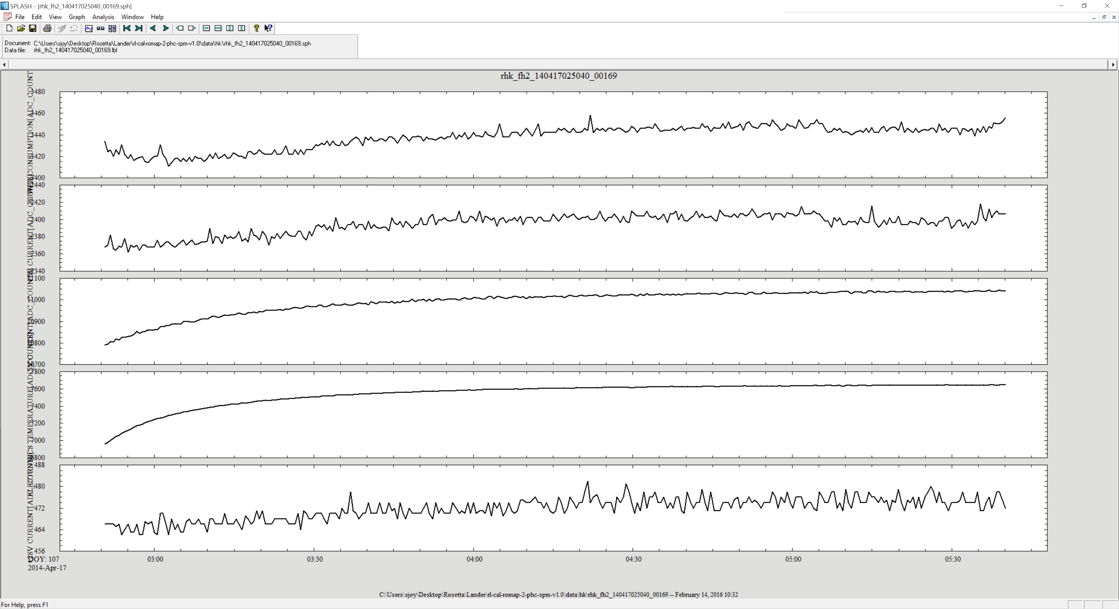
HSK Data: RL-CAL-ROMAP-2-PHC-SPM-V1.0
Plot generated from data file by reading label rhk_fh2_140417025040_00169.lbl
and format file romap_rawhk.fmt (labels valid)

Slide 18
rl-cal-romap-3-phc-spm-v1.0
Files all have the identical structure to those just described in rl-cal-romap-2-phc-spm-v1.0 except that the units have gone from DN (ADC_UNITS) to:
Energy: eV;
Current: µA;
Counts: cm⁻² s^{-1;}
Files all appear nominal, clear evidence of solar winds(cold, low energy beam) is present

Slide 19
Bounce phase data
rl-cal-romap-2-rbd-spm-v1.0
rl-cal-romap-3-rbd-spm-v1.0
Data files have the same structure as previously described.
spmf_fsX_141112155956.tab – Faraday cup currents are nearly constant
spme_fsX_141112155956.tab - Much higher density, hotter, electron distribution than the solar wind data of the PHC mission phase.
spmr_fsX_*_cn.tab – intermittent omni-directional bursts at discrete energies
spmp_fsX_*_cne/cna.tab – both match expectations based on energy (cne) and directional (cna) characteristics of the “cn” files.

Slide 20
First science phase data
rl-cal-romap-2-fss-spm-v1.0
rl-cal-romap-3-fss-spm-v1.0
Data files have the same structure as previously described.
spmf_fs3_*.tab – Faraday cup currents are nearly constant with energy
spme_fs3_*.tab – Very sparse counts with nearly random energies
spmr_fs3_141112173213_cr.tab - Faraday cup currents are nearly constant with both energy and elevation
spmr_fs3_141112173213_cn.tab Very sparse counts with nearly random energies and elevations
spme_fs3_*_cne/cna.tab – both match expectations based on energy (cne) and directional (cna) characteristics of the “cn” files.
spme_fs3_*_cre/cra.tab – both match expectations based on energy (cre) and directional (cra) characteristics of the “cr” files.

Slide 21
Summary
All of the files in each data set are properly described by their labels allowing the user to read and interpret the data
The data set catalog files are very sparse.
The data format is difficult to work with (no off the shelf tools to read/display/analyze). Users will all likely have to develop their own tools to either reformat the data or analyze it as it is.
RIDs
RID: Update all dataset.cat files to at least describe the data at a high level and allow users to determine if they are usable for science or if another data set should be used instead. Many of the data fills are very sparse (mostly filled with zeros). This should be stated and explained in these catalog descriptions.

