Slide 1
SD2
Kevin Walsh
16 Feb, 2016

Slide 2
SD2
The SD2 experiment provides samples collected at different depths to microscopes and evolved gas analysers.
The primary characteristics of SD2 are summarised below:
capable to drill the surface and to collect samples (tens of mm3) at different controllable depth up to 230mm (assuming a clearance between the Lander Balcony and comet surface of 300 mm);
capable to move and distribute the collected samples to the different scientific instruments (visible and I/R microscope, gas volatile analysers);
Three Data sets
Post Hibernation Commision Data: 4/9/2014 – 4/23/2023
Pre Delivery Calibration Science Data: 7/14/2014 – 10/17/2014
First Science Sequence: 11/14/2014 10:43:29 – 22:33:56
Notes:
The post-delivery manoeuvre that has been executed on 12 November 2014
started at 09:14:58.1 UTC and a nominal end time at 09:19:53.7 UTC.
Rosetta was then on a 50 km orbit.
On 13 November at 19:23 UTC Philae started transferring data to
Rosetta. Link was lost at 23:08 UTC on 13 November, 40 minutes before
predicted time.
During this slot was commanded:
- ranging measurements by CONSERT (Lander Search)
- CIVA images
- MUPUS boom deployment and hammering
- APXS deployment and measurement
On 14 November at 9:01, Philae data were received on-board Rosetta and
immediately transmitted to ground, 48 minutes after expected time. The
visibility period finished at 11:47 UTC on 14 November, 50 minutes
earlier than predicted.
During this period was commanded:
- APXS released but measured copper thus revealing that the door had
not opened.
- MUPUS deployment was successful, hammering took place, SESAME
detected it
- Drill activation for sample return to COSAC
- PTOLEMY/COSAC spectra acquisitions
- CIVA image but dark.................................................
- Consert ranging
The fourth and last Philae visibility period started on 14 November at
22:15 UTC ground time. The LAnder bus voltage appeared to decrease
rapidly. On November 15 at 00:07, the link between Orbiter and Lander
broke.
Among the Lander operations carried out during the fourth visibility
period was a rotation of the Lander to increase the illumination of
its solar arrays.
After the planned Touch Down, the Lander did not anchor and bounced.
We estimated that the first TD was:
Time UTC: 15:34:06
Comet-fixed coordinates: [2.129171, -0.961358, 0.498268] km
The NAVCAM image, the NAC image and the first TD as the starting point
gave the following impact point at:
Time UTC: 16:26:23
Comet-fixed coordinates: [2.450, -0.511, -0.242] km
This point has an uncertainty of 7 minutes. The position is also
uncertain.
By using three WAC images, the second TD can be deduced:
Time UTC: 17:31:10
Comet-fixed coordinates: [2.275, 0.249, -0.444] km
Consert Ranging estimated a final landing site at
Comet-fixed coordinates: [2.446, -0.055, -0.360] km
After Touch Down, began the First Science Sequence (FSS) where all
Lander instruments operated on the primary battery. The operations
did not go as planned due to the several TDs but occurred as listed
above. The Long Term Science Phase should have started after the
primary battery died, but the final TD let the Lander in a location
where the illumination condition could not allow battery charging.
Contact was lost on 15 November 2014 at 00:07, ending the FSS, and the
Lander went asleep.

Slide 3
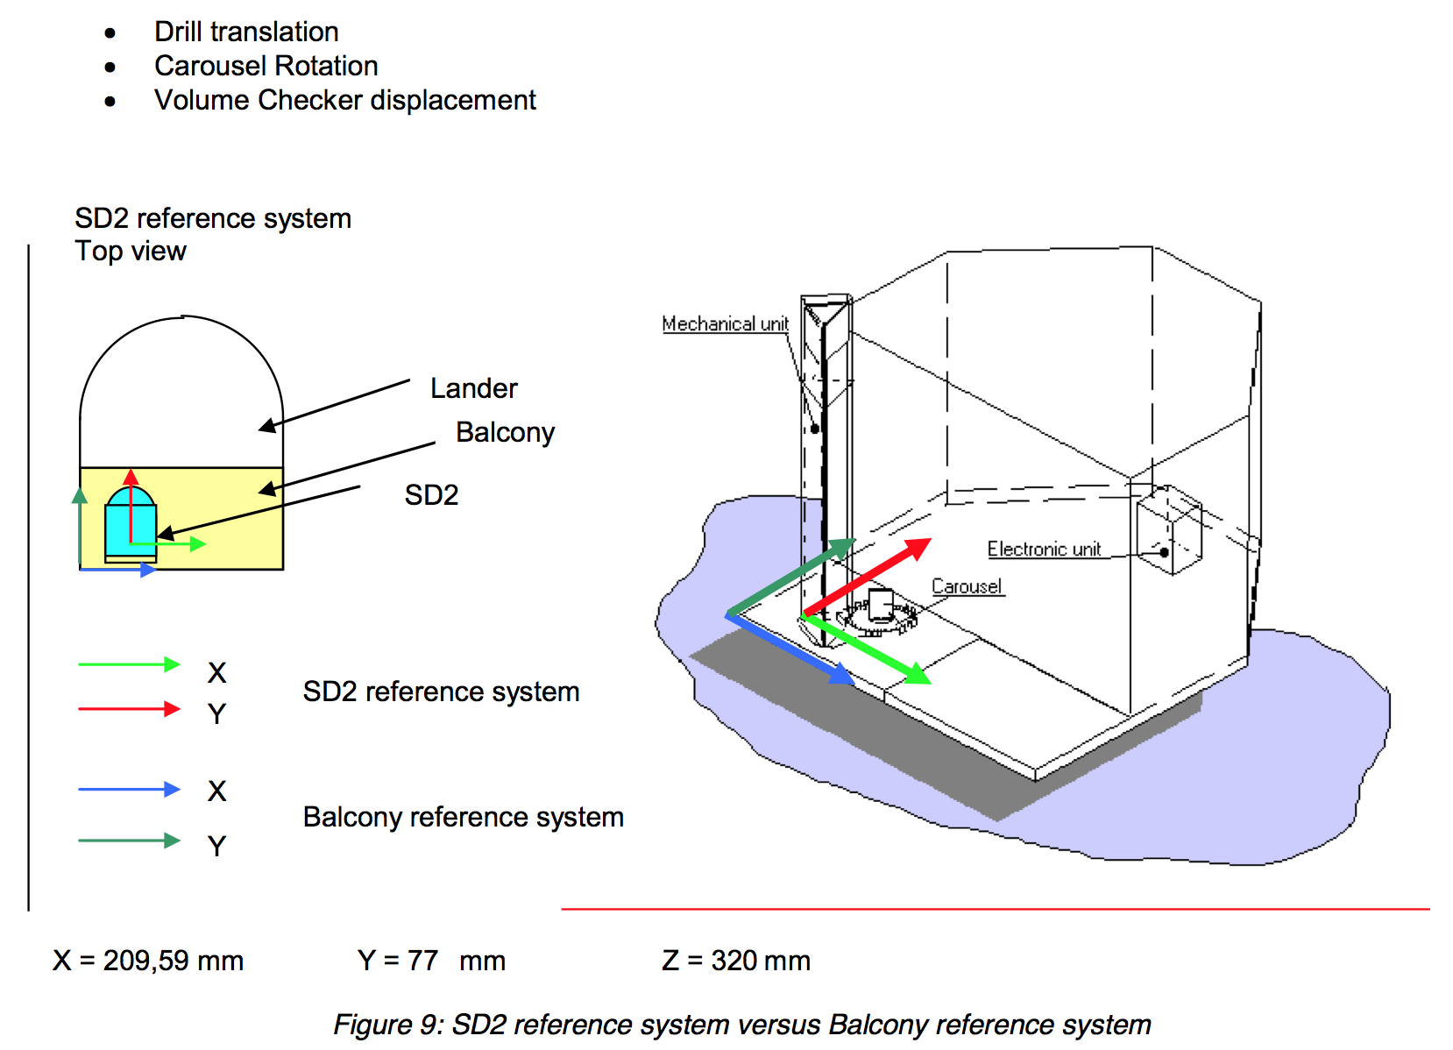

Slide 4
document/timeline_sdl_rbd_fss.png
Notes:
3 parts of PHC data
2 p[arts fort PDSC

Slide 5
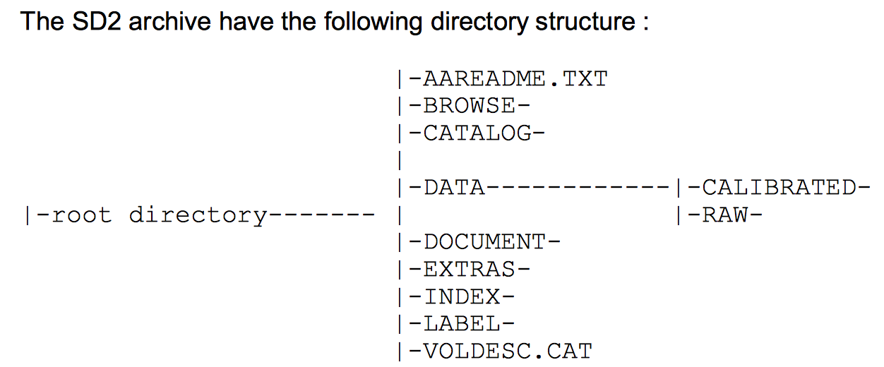
Data set
aareadme.txt
Standard info + contacts all very detailed
dataset.cat
fine
document/
LOTS of .pdfs
_logbook.txt
Timeline .png
txt file minimal, but timeline_sdl_rbd_fss.txt promises a lot (?)

Slide 6
data/ files
sd2_XYZ_date_length
X: G for Ground, F flight
Y: S science, H houskeeping, B for files with mixed
Z: CODMAC: 1 for raw, 3 for calibrated
NOTE: only raw binary or calibrated
label/ Format files
sd2_calibrated_hk.fmt
sd2_calibrated_l1.fmt
raw/ ALL BINARY FILES
sd2_fb2_*.dat (phc)
sd2_fb1_*.dat (pdcs)
sd2_fb1_*.dat (fss)
binary files – telemetry & data
exe provided (more later)
calibrated/
sd2_fs3_*.tab (phc,pdcs,fss)
Science
These are wide data tables 39 cols
sd2_fh3_*.tab (phc,pdcs,fss)
Housekeeping

Slide 7
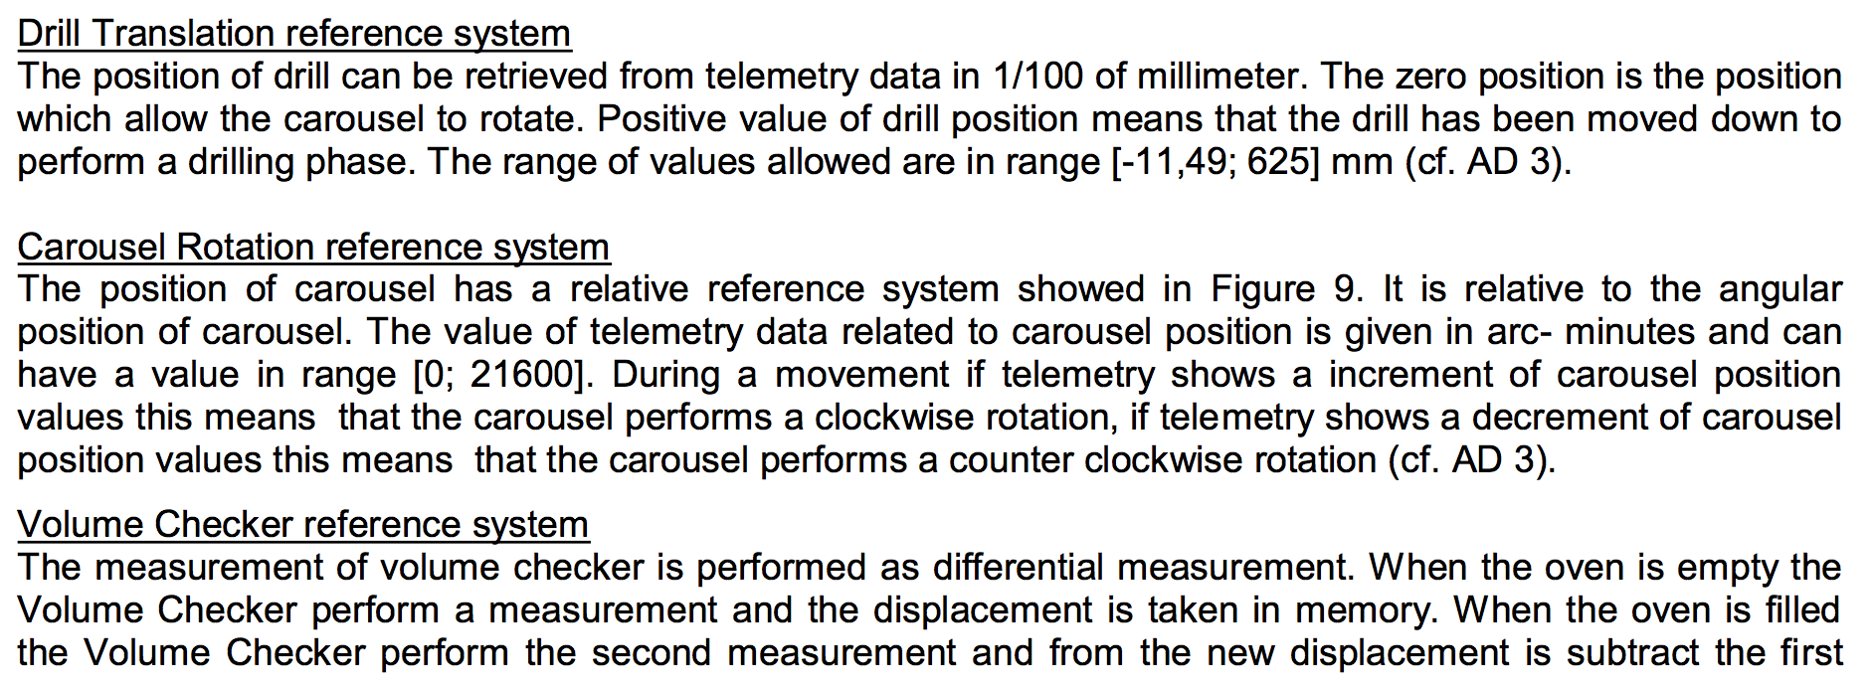
Spot Check

Slide 8
Spot Checks
PME values define the translation of the drill and rotation of carousel
Translation varies in unites similar to mm
-0.08 to 560.29
Rotation
Volume Checker (VCB) measures amount of material deposited in oven
Always 9999.99

Slide 9
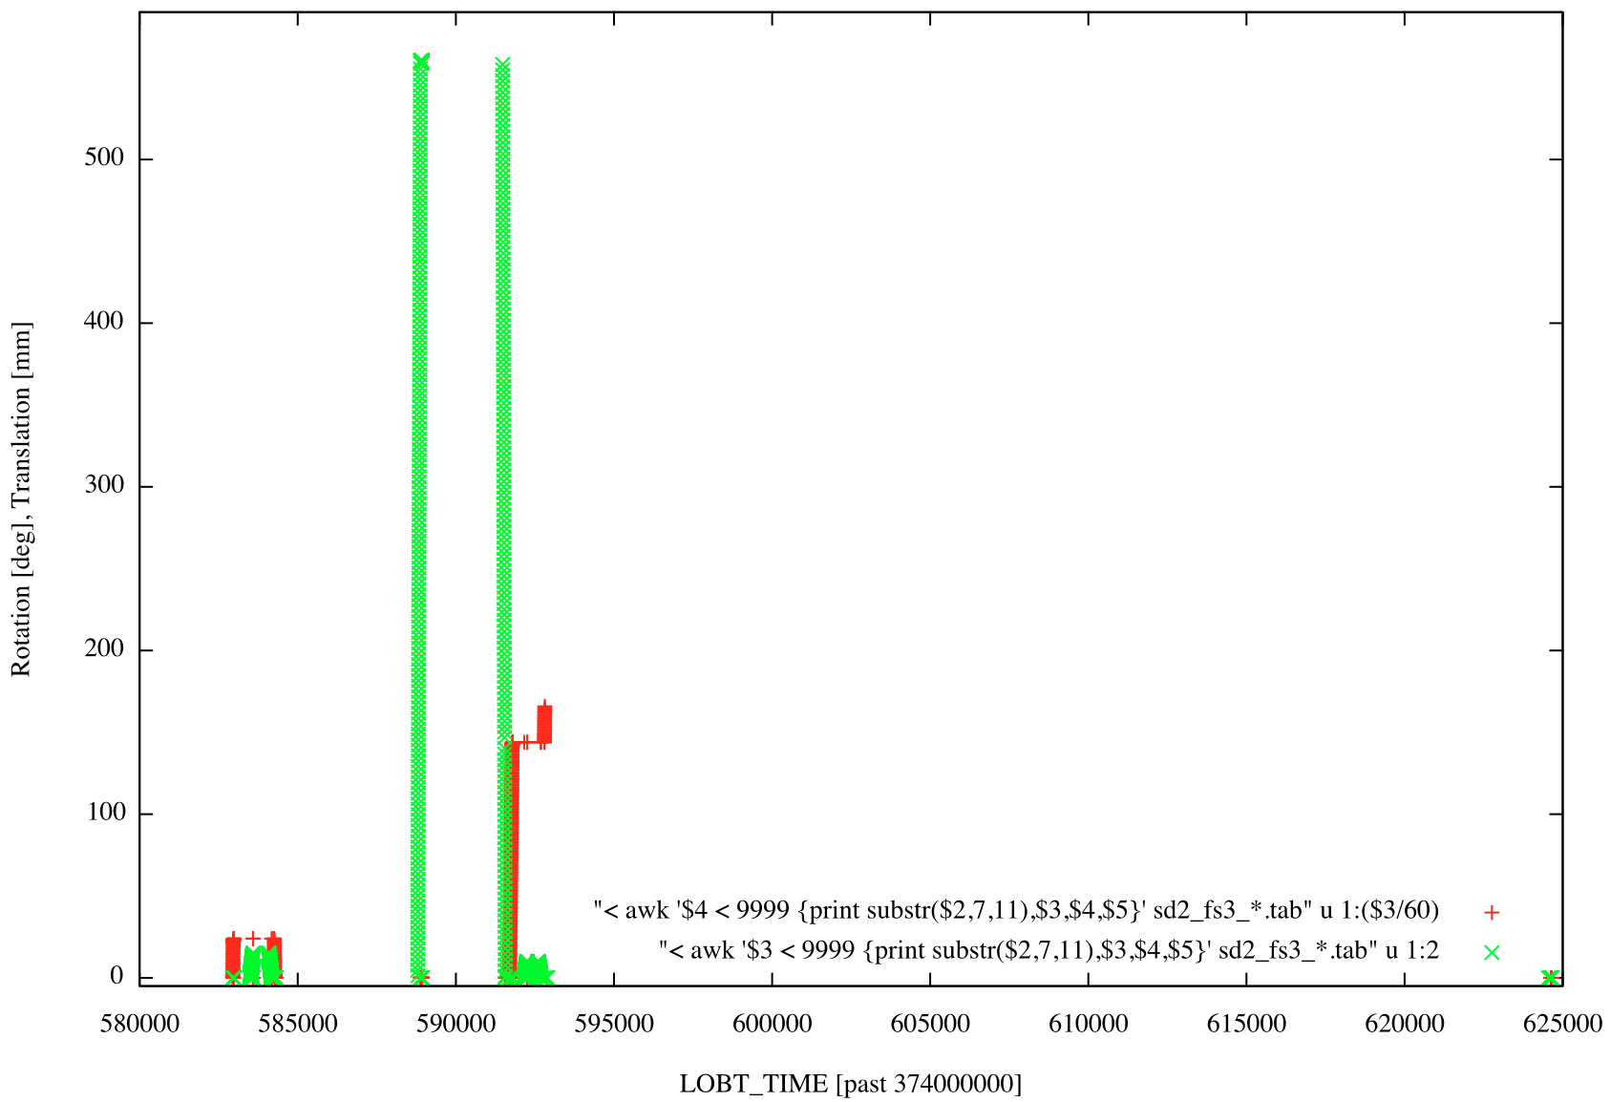

Slide 10
Software for Binary: sd2_egse
Executable included, for Windows 1998 or 2000 machine
.c file also included
NOTHING IN HERE
None of the 3 .dll files are included that are needed for machines without Visual C++
PDF provided with installation and run procedures.
Software reads the raw, binary, data. It does not calibrate them.

Slide 11
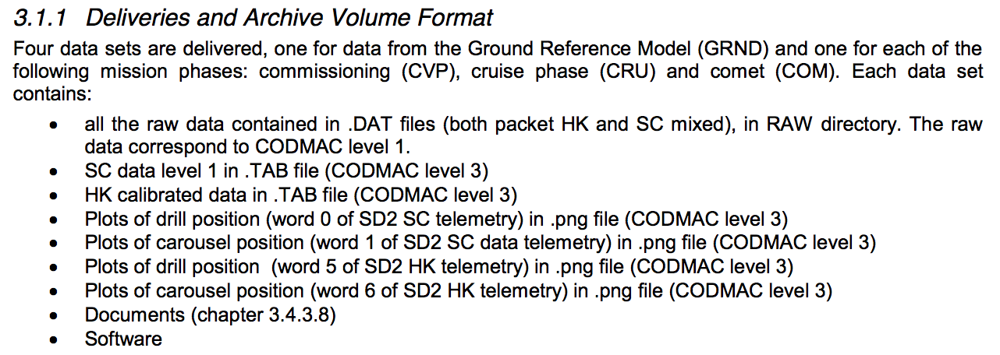
Plots? (eaicd version of deliverables)
From the eaicd_sd2.pdf

Slide 12
Questions/Issues/Concerns
Software for reading raw data does not functionally exist
20 byte line of text – not an actual program
Also, a Windows 2000 program would have been tough
No browse/ directory - listed in Section 3.4.3.4 in the eaicd_sd2.pdf
No plots that are referred to frequently in the eaicd document
PME rotation/translation units for PMEs
PME1: Units listed as “mm” correctly in .fmt file
eaicd suggests that it is 1/100mm
PME2: Unites not listed in .fmt file
eaicd seemingly correctly direct the user to the arc-min scale

