Slide 1
SESAME – PP, CASSE
Kevin Walsh

Slide 2
SESAME
The Surface Electric Sounding and Acoustic Monitoring Experiment (SESAME, Seidensticker et al., 2007) on the lander Philae of the ESA Rosetta Mission. It is the goal of SESAME to contribute to the understanding of the vertical and lateral structure of a cometary surface and the acting processes by conducting in-situ measurements of mechanical, electrical and particle- related properties. SESAME is a complex of three instruments:
The Comet Acoustic Surface Sounding Experiment (CASSE),
The Dust Impact Monitor (DIM) and
The Permittivity Probe (PP).
The analysis of elastic waves that will be generated and recorded by CASSE will allow deducing mechanical parameters as well as the vertical (layered) structure of the cometary surface.
PP will determine the complex permittivity of the surface material beneath Philae, which is a measure for the water ice content, thereby constraining the mass fractions of refractory material and other ices.

Slide 3
File Structure (as described in the eaicd)
Neither 2 or 3
?
?
No Calibration folder in -2 or -3 directories
No Extras/ Geometry/ or Software/ in either.
Don’t find li/ in either the CASSE Level 2 or Level 3 data
Dont find lm/ in PP Level 2 or 3 data
hc/ directory in casse/ where not expected.
?
?
?
?
Notes:
I understand this is likely due to not running in each instrument mode .

Slide 4
CASSE
CASSE will investigate the outermost surface layers of comet 67P/Churyumov-Gerasimenko by transmitting and receiving vibrations in the range from 100 Hz to 10 kHz (audible frequency range). The elastic properties of the cometary surface will be investigated by recording compressional and shear waves.
To guarantee sufficient ground contact the receivers of stacked piezoceramics and triaxial piezoelectric accelerometers are integrated into the lander’s six soles.
The soles thus act as transmitting and receiving antennas. By switching between actuators and accelerometers, an analysis of the surface material and an in-depth sounding for detection of a layered structure or embedded local inhomogeneities are both possible.
Two harpoons fired from Philae shall provide a fixation force of at least 5 N per sole in order to improve the ground contact of the soles and thereby the transmission and reception of vibrations.
Notes:
By measuring the propagation time between feet with triaxial accelerometers, the propagation velocities cp and cs of the acompressional and the shear waves can be derived. These velocities are related to the physical parameters and structural composition of the surface material. Identifying and measuring the thickness of subsurface layers, by detecting echoes from a steep gradient in reflectivity, is of great interest.
Physical parameters related to material properties are the elastic parameters Young’s modulus E and Poisson number v. They are related to the velocities of the longitudinal and transverse elastic waves, described as compressional p- and shear s-waves in seismic terms, and the density  of the material. The elastic parameters can also be expressed by other mechanical parameters such as the compressional modulus and rigidity; these are related to other properties such as tensile strength and microstructure.
The interface between the soles and the cometary surface is mostly unknown. The required contact with the cometary surface strongly depends on the sole design and the final acoustic properties of the feet and landing gear. To cope with the unknown physical conditions on and in the comet, acoustic wave propagation experiments have been made in various materials simulating different cometary conditions. Laboratory studies of regolithic dust and sand, and hardened ice/dust mixtures demonstrated that acoustic sounding could be applied to cometary surfaces.

Slide 5
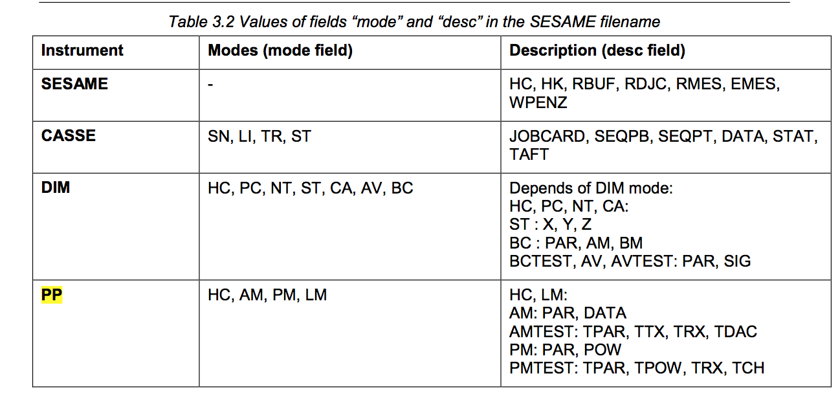
CASSE data
rl-c-sesame-2-sdl-v1.0/
This archive contains edited data (CODMAC level 2) from the SESAME instrument onboard ROSETTA Lander, acquired during the SDL phase.
rl-c-sesame-3-sdl-v1.0/
This archive contains calibrated data (CODMAC level 3) from the SESAME instrument onboard ROSETTA Lander, acquired during the SDL phase.
hc/ – health check (not expected)
Not in page 24/26 eaicd_sesame Table 3.2
Files: _jobc _data _seqp _stat _taft files
sn/ – sounding mode
_jobc
Job parameters
_data
Data from 12 accelerometers
_seqp
Sequence of parameters
Foot temperatures
_stat
Statistics of the channel data (min/max stuff)
_taft
Not present
Supposed to be foot temps – possibly those included in _seqp data
Notes:
hc listed in manual as health check for DIM and PP, but not CASSE

Slide 6
Calibrations: L2 to L3
CASSE
rl-c-sesame-3-sdl-v1.0/document/ses_cas_calibration_desc.asc
“This document describes the calibration of the SESAME-DIM and SESAME-PP data delivered in the SESAME level 3 data sets.
TBD”
What I would want to do:
Convert the channel data from integers in L2 data to the real units (accelerations) in L3 data (or at least know how it was done).
Page 16 of eaicd: “Amplification factors to calculate the signal strength in voltage. Pre-launch Brüel & Kjaer calibration of CASSE accelerometers (transfer from voltage to acceleration)“
Convert the foot temperatures from raw integer data to physical units
(or at least know how it was done)

Slide 7
L2 to L3
_jobc data is identical in L2 and L3. It describes for each job sequence the various transmit/receive settings etc.. I think that this is critical to interpreting this entire data set.
Never found an adequate description of “jobcard” functionality/details. Page 22-27 of lse-sw-fm-3-tc-tm.pdf is close, but not enough.
_seqp
Temperatures are converted between L2 and L3.
No changes in the timing information.
Only information on the meaning of the data is in the .fmt files.
_data
The channels listed in data3.fmt I think correspond to channels described in the job_card_fm3.fmt NOT Explicitly described in the data3.fmt
bit 0: ACC -Y, x-axis
bit 1: ACC -Y, y-axis
bit 2: ACC -Y, z-axis
bit 3: ACC +X, x-axis
bit 4: ACC +X, y-axis
bit 5: ACC +X, z-axis
…….
As previously mentioned, there is no provided algorithm to convert from L2 to L3.
_stat min/max/mean in ADC output formats.

Slide 8
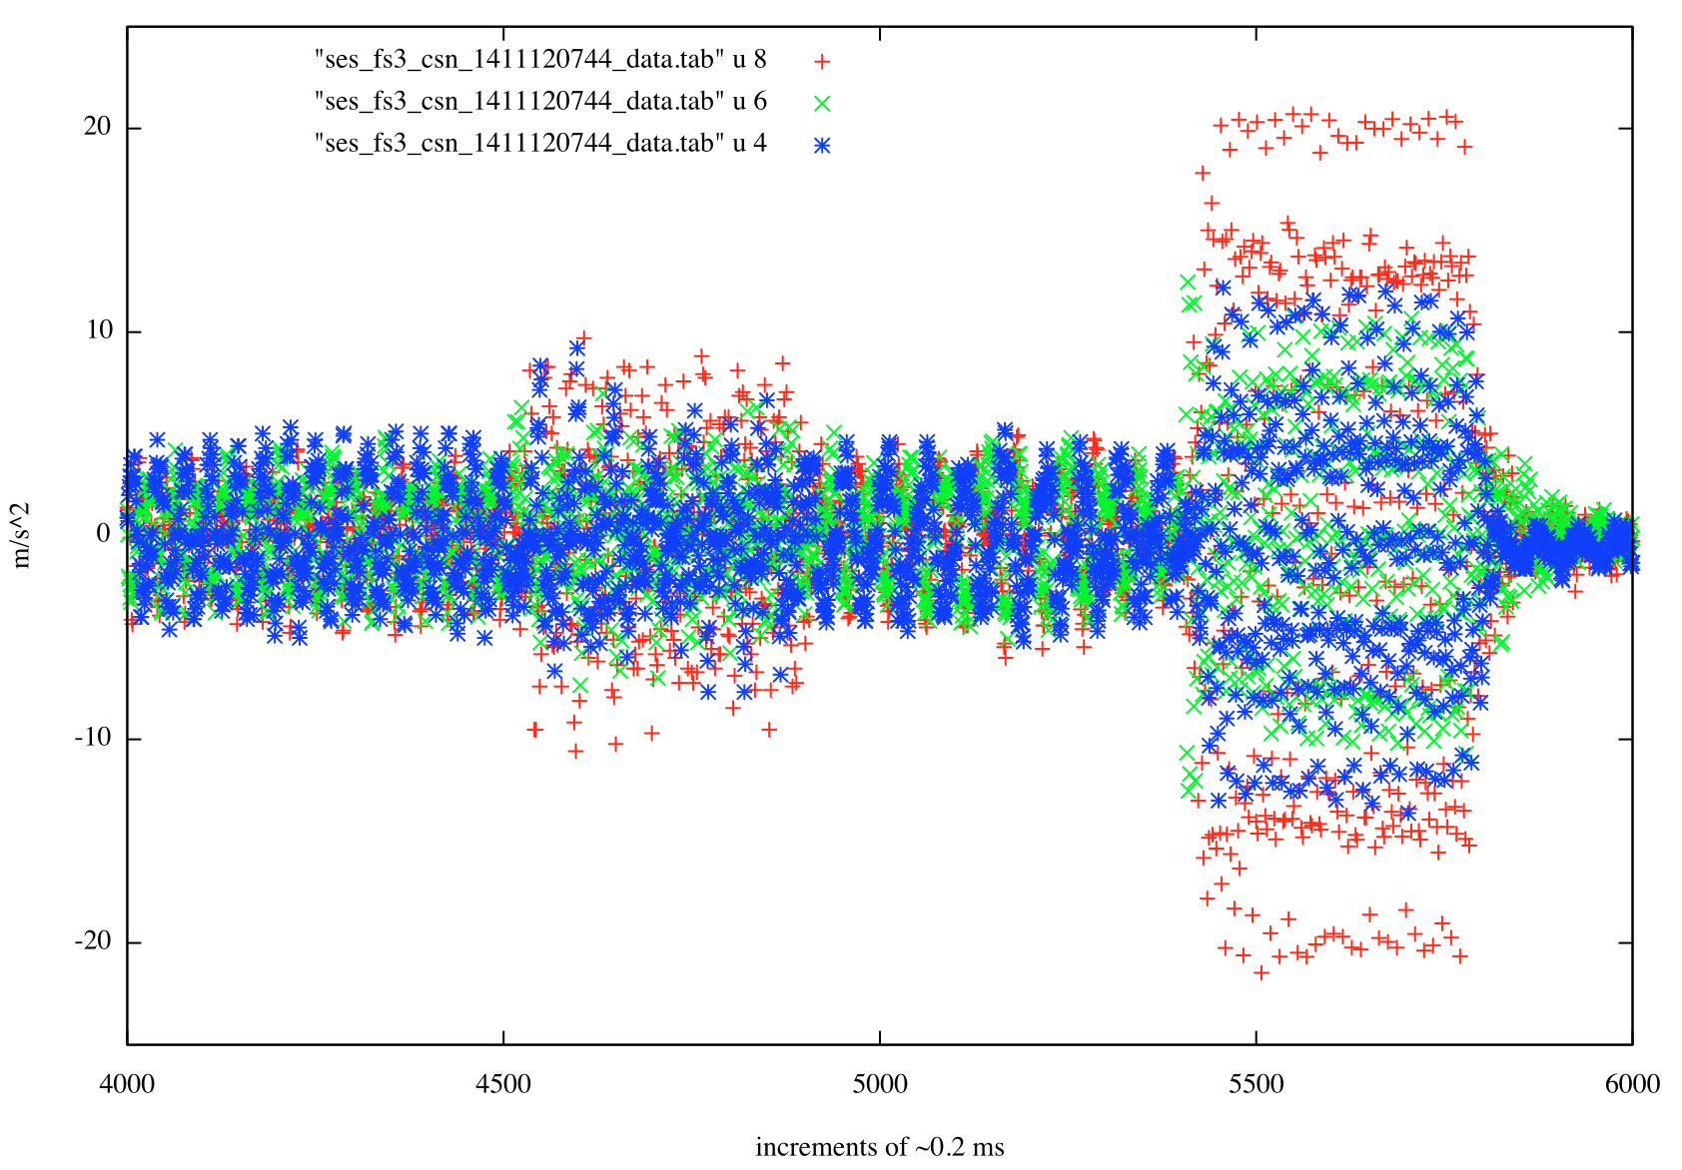
x,y,z accelerations

Slide 9
CASSE: Questions/Issues/Problems
Healthcheck mode hc/ found in folders, but not listed in the eaicd.
No adequate description in eaicd or lse_sw…pdf of many jobcard function parameters
G_GAIN, FIFO_LAG, TL_FACTOR, G_TAR_VAL….
Channel descriptors in _data* format files were not explicit.
No _taft* files in the sn/ folders – only in hc/ folders that were in unexpected locations.
hc - _taft data for example – nothing in section 2.3 “Temperature Measurements” in lse-sw-fm-3-tc-tm.pdf
“TBD” Calibration information for CASSE
No formula for calculating temperatures found in _seqp data
No way to confirm the listed m/s/s units – but suspiciously large for a small body with surface gravity ~10^-3 m/s/s and escape velocity ~ 50cm/s

Slide 10
PP
The PP instrument is mainly a quadrupole detector using two transmitter and two receiver electrodes at any given time in so-called active mode. An AC-voltage, digitally generated by a sequencer inside the common electronics in the frequency range between 10 Hz and 20 kHz and amplitudes up to ±10V, is injected between two transmitter electrodes.
The resulting current can be sampled with up to 180kHz sampling frequency on either of the two electrode’s driver circuits. This current generates an electrical field inside the comet’s surface material, which is picked up by the two receiver electrodes Rx1 and Rx2, placed inside the soles of the +Y and –Y landing gear leg, respectively.
The dataset has both active mode (am) and passive mode (pm) data
Notes:
Receiver
The measured potentials are amplified by preamplifiers, also inside these soles, by a factor of 8 and buffered to drive the long sensor cables into the Lander compartment. The PP electronics generates automatically the differential voltage between both signals, which is subsequently sampled at exactly the same moment as the corresponding current sample.
The resulting 8-bit values are stored in PP’s on memory in alternating order, current values first, followed by the differential potential value. At the end of a measurement with given frequency and amplitude, the SESAME common DPU reads these data into the main memory, sorts them according to type (current or voltage) and places these vectors into the telemetry or use them for further on-board processing.
Transmitter
To achieve different geometries and thereby different penetration depths, three transmitter electrodes are implemented, which can be used in any combination. Tx1 is placed as metal mesh on the inside of the +X landing gear foot sole, Tx2 is implemented as an insulated ring lid to the APX detector, which is in contact with the comet surface once APX is lowered. Tx3 is a flexible mesh foil attached to the MUPUS PEN, lying on the comet surface the moment the PEN is deployed, from the beginning of the insertion process. In case none of the other detectors is deployed, an emergency measurement is possible using only the +X landing gear transmitter Tx1 and as return the grounding of the Lander through the harpoons. The precision of the measurements in this case would be severely reduced. The selection of the transmitter electrode pair is done by electronic switches under software control and are one of the active mode’s configuration parameters.
The AC-signal is generated from a set of up to 256 8-bit values, stored before each measurement into PP’s memory. The value 128 corresponds roughly to 0V, 255 to +10V and 0 to -10V. Using adjustable sequencer timing and a sine wave with different amplitudes as data set, the intended frequency and signal level can be defined. Amplitude control is used to optimize the returned current and potential signals for different material properties to the dynamic range of the digitalization module.
Passive mode
If the transmitter part is not used, the receivers are able to pick up potential variations caused e.g. by plasma waves in the vicinity of the Lander. In PP’s passive mode, the potential difference is sampled with a fixed frequency of 20 kHz. The resulting data of a 1-second measurement can be sent directly via telemetry to ground for analysis. It is envisaged that a later flight software revision analyses the data directly on board and places only a logarithmic 10-bin power spectrum into the telemetry stream instead.
Plasma wave sensor (Langmuir Probe)
An additional sensor wire on top of the DIM sensor cube monitors the electrical field in the vicinity to help interpreting plasma wave like events. Field variations faster than a few Hertz cause a current flow through an integrator of the electronics. Once a minimum total charge is registered, a timer is activated and stopped again when a pre-set total charge is reached. The resulting timer value is transferred as Langmuir Probe value in the housekeeping part of SESAME’s telemetry or as science part during a dedicated measurement. If no signal is detected, the timer stops at its maximum value of hexadecimal

Slide 11
PP- data
RL-C-SESAME-2-SDL-V1.0
This archive contains edited data (CODMAC level 2) from the SESAME instrument onboard ROSETTA Lander, acquired during the SDL phase.
am/
hc/
pm/
rl-c-sesame-3-sdl-v1.0/
This archive contains calibrated data (CODMAC level 3) from the SESAME instrument onboard ROSETTA Lander, acquired during the SDL phase.
am/
hc/
pm/
Notes:
am - PP Active Mode 2 executes a series of active PP measurements. A modified wavelet method is used on-board to analyse the time series of each measurement. All measurement parameters but the electrode configuration are taken from the PP control table or are fixed in the software code. During each measurement, nine waves are transmitted und internally recorded, if the frequency is less than or equal 1560 Hz, else 17 waves. The number of samples per wave is:
pm - PP Passive Mode 2 executes a Langmuir Probe measurement and subsequently one passive measurement. All measuring parameters (integration clock divider, sampling frequency, number of used and skipped samples, number of power spectrum frequency bins) are read from the PP Control Table. The input of one command data word is mandatory, although it is not evaluated on-board.

Slide 12
Data types
Passive mode (pm)
_par (L2)
Sequence Parameters
Integers describing integrating times (LP_INT_CLK_DIV, ADC_CLK_DIV etc.)
_parc (L3)
Sequence Parameters
Integrating sequence now in Seconds
_pow (L2)
Integer codes for frequency bins
“Raw Power” - Integer
_powc (L3)
Frequency bin center (Hz)
Voltage Density (with formula)
_rx (L2)
RX_SAMPLE_NUM, RX_ADC_VALUE in Integers
_rxc (L3)
Milliseconds and Volts
Plasma Wave Sensor (am)
_par (L2)
Seq Params
Includes indications on which transmitter, and which receiver and votlage/phases etc.
_parc (L3)
Parameters greatly distilled to transmitter freq and receiver sampling settings.
_dac (L2)
DAC sample/time Integers
_dacc (L3)
DAC table ms/Volts
_rx (L2)
Receiver time series (Integers&ADCs)
_rxc (L3)
Receiver time series: Time/Potential_differences (ms/Volts)
_tx (L2)
Transmitter time series (Integers&ADCs)
_txc (L3)
Transmitter time series: Time/Current (ms/mA)

Slide 13
Calibrations
In the EAICD – section 2.4.3 lists the following as relevant calibration information for PP.
Calibration functions for digital current consumption in mA
Transmitter currents in mA
Potential values in mV
ses_pp_calibration_desc.asc in documents/ (no calibration/ directory)
“The calibration of SESAME-PP data is divided into 6 different groups:
1) Housekeeping data from PP Healthcheck and SESAME Healthcheck
2) Permittivity measurements using PP's active mode with on-board data processing
3) Plasma wave measurements using PP's passive mode with on-board data processing
4) Permittivity measurements with time series data from PP active test mode data
5) Plasma wave measurements with time series data from PP passive test mode data
6) Plasma wave monitor (LP) data from the additional sensor mounted on the DIM cube”
It looks like the relevant calibration functions are present, including relevant units etc.
KW has not tried to use information in this .asc file to convert values

Slide 14
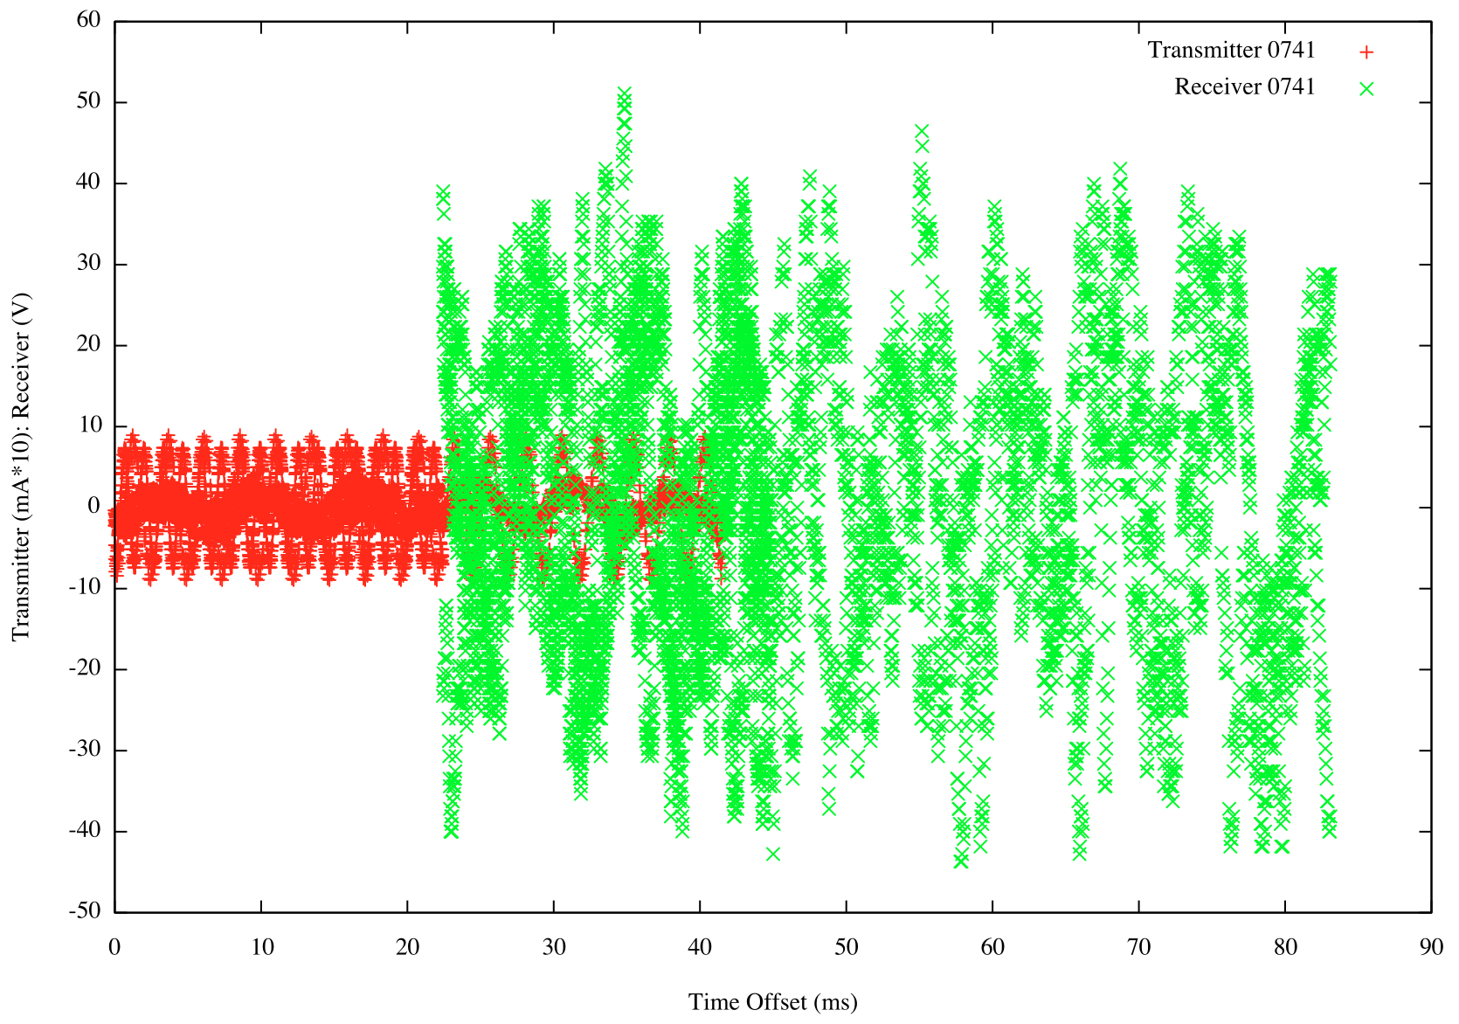

Slide 15
PP:Questions/Issues
The Calibration details are only in documents/
No calibration folder
Not described in the eaicd or the lse-sw…pdf document

