Slide 1
PDS-SBN Review of Pre-lander VIRTIS datasets
M. DiSanti

Slide 2
VIRTIS Overview
M_vis : 0.220-1.046 µm, λ/Δλ = 100-380
M_IR : 0.952-5.059 µm, λ/Δλ = 70-360
H : 1.88 – 5.03 µm, λ/Δλ = 1300-3000,
cross-dispersed (prism + grating);
overlapping λ’s in successive orders

Slide 3
Sample of Data: MTP006 STP011 -M_vis (λ = 0.25 – 1 µm)
Raw data cube
r1 = virtispds(‘v1_00365574167.qub’)
r1.{LABEL STRING Array[152]
QUBE_NAME STRING Array[2] – Raw Data Number (dimensionless)
QUBE_DIM LONG Array[3]
QUBE FLOAT Array[432, 256, 80] – cols, rows, #of frames
SUF_NAME STRING Array[82]
SUF_DIM LONG Array[3]
SUFFIX} UINT Array[82, 5, 80]

Slide 4
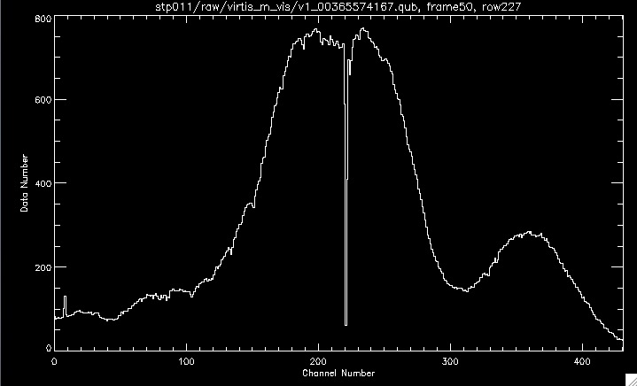
Display sample raw image from QUBE, and extract a spectrum
r1 = virtispds(‘v1_00365574167.qub’)
frame50 = r1.qube(*,*,50)
irdisp, frame50, lo=-160, hi=800 -----------------→
spec50_r227 = frame50(*,227)
xtit=’Channel Number'
ytit=’Data Number’
tit='stp011/raw/virtis_m_vis/v1_00365574167.qub, frame50, row227’
plot,psym=10,xs=1,lam,spec50_r227,xtit=xtit,ytit=ytit,tit=tit

Slide 5
Sample of Data: MTP006 STP011 -M_vis (λ = 0.25 – 1 µm)
Calibrated data cube
v1 = virtispds(‘v1_00365574167.cal’)
v1.{LABEL STRING Array[169]
TABLE FLOAT Array[432, 256, 3] – [cols, rows, (lambda, FWHM, sigma_Radiance)]
QUBE_NAME STRING Array[2] – Radiance (W/m^2/sr/µm)
QUBE_DIM LONG Array[3]
QUBE FLOAT Array[432, 256, 76] – cols, rows, #of frames in the data cube
SUF_NAME STRING Array[3]
SUF_DIM LONG Array[2]
SUFFIX} UINT Array[3, 76]

Slide 6
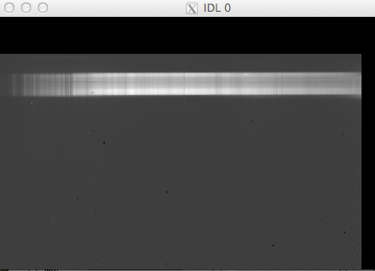
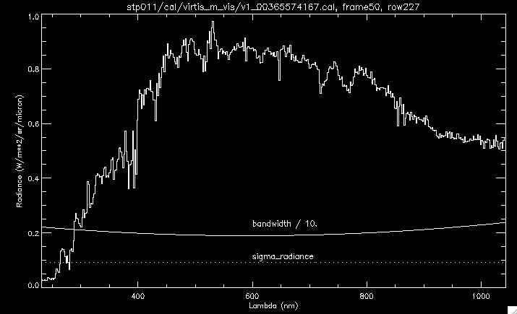
Display a sample calibrated image from QUBE, and extract a spectrum
v1 = virtispds(‘v1_00365574167.cal’)
frame50 = v1.qube(*,*,50)
irdisp, frame50 -----------------------------------→
Extract row 227:
spec50_r227 = frame50(*,227)
lam = v1.table(*,227,0)
bandwidth = v1.table(*,227,1)
sig_radiance = v1.table(*,227,2)
xtit='Lambda (nm)' (spectrum moves down as frame# increases)
ytit='Radiance (W/m**2/sr/micron)’
tit='stp011/cal/virtis_m_vis/v1_00365574167.cal, frame50, row227’
plot,psym=10,xs=1,lam,spec50_r227,xtit=xtit,ytit=ytit,tit=tit
oplot,lam,bw/10.
xyouts,600,0.225,chars=1.1,'bandwidth / 10.' ----------------→
oplot, lines=1,lam,sig_rad
xyouts,600,0.105,chars=1.1,'sigma_radiance’

Slide 7
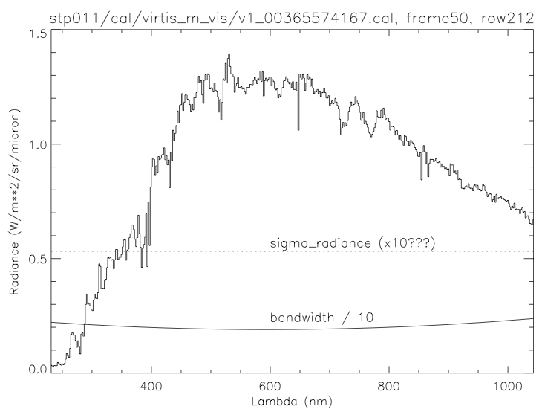
Display a sample calibrated image from QUBE, and extract a spectrum
v1 = virtispds(‘v1_00365574167.cal’)
frame50 = v1.qube(*,*,50)
irdisp, frame50 -----------------------------------→
Next extract row 212:
spec50_r212 = frame50(*,212)
lam = v1.table(*,212,0)
bandwidth = v1.table(*,212,1)
sig_radiance = v1.table(*,212,2)
xtit='Lambda (nm)'
tit='stp011/cal/virtis_m_vis/v1_00365574167.cal, frame50, row212’
ytit='Radiance (W/m**2/sr/micron)’
plot,psym=10,xs=1,lam,spec50_r212,xtit=xtit,ytit=ytit,tit=tit
oplot,lam,bw/10.
xyouts,600,0.225,chars=1.1,'bandwidth / 10.' ----------------→
oplot, lines=1,lam,sig_rad
xyouts,600,0.55,chars=1.1,'sigma_radiance (x10???)’
Possible issue (?): 1σ uncertainty in Radiance (dotted line)
is overestimated (e.g., by a factor of 10?).

Slide 8
MTP006 STP011 -M_ir (λ = 1 – 5 µm)
Calibrated data cube
i1 = virtispds(‘i1_00365574155.cal’)
i1.{LABEL STRING Array[170]
TABLE FLOAT Array[432, 256, 3]
QUBE_NAME STRING Array[2] – Raw Data Number (dimensionless)
QUBE_DIM LONG Array[3]
QUBE FLOAT Array[432, 256, 76] – cols, rows, #of frames
SUF_NAME STRING Array[3]
SUF_DIM LONG Array[2]
SUFFIX} UINT Array[82, 5, 76]

Slide 9
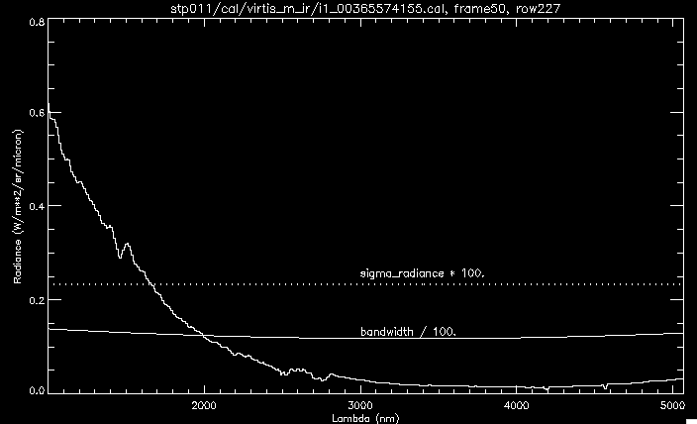
Display a sample calibrated image from QUBE, and extract a spectrum
i1 = virtispds(‘i1_00365574155.cal’)
frame50 = r1.qube(*,*,50)
irdisp, frame50 --------------------------------------→
Extract row 227:
spec50_r227 = frame50(*,227)
lam = r1.table(*,227,0)
bandwidth = r1.table(*,227,1)
sig_radiance = r1.table(*,227,2)
xtit='Lambda (nm)'
ytit='Radiance (W/m**2/sr/micron)’
tit='stp011/cal/virtis_m_vis/i1_00365574155.cal, frame50, row227’
plot,psym=10,xs=1,lam,spec50_r227,xtit=xtit,ytit=ytit,tit=tit
oplot, lam, bw / 100.
xyouts,3000,0.125,chars=1.1,'bandwidth / 100.’ ----------------→
oplot, lines=1, thick=2, lam, sig_rad * 100.
xyouts,3000,0.25,chars=1.1,'sigma_radiance * 100.’

Slide 10
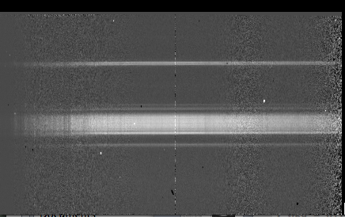
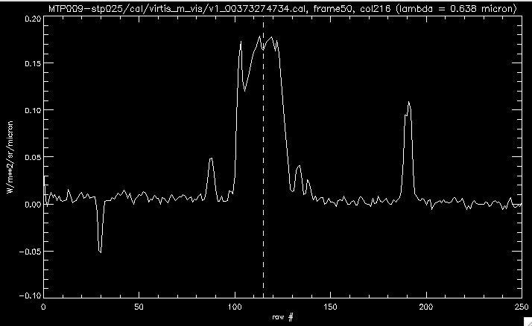
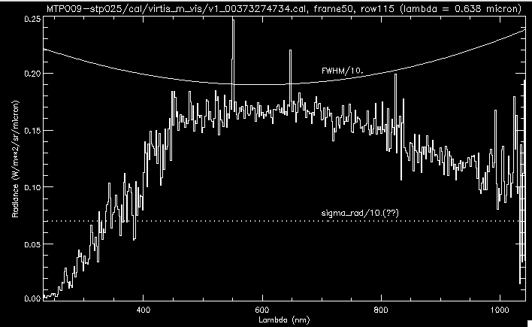
MTP009_stp25_M_vis (cal)
v1_00373274734.cal, frame50 (-0.1,0.25), UT2014-Oct-30

Slide 11
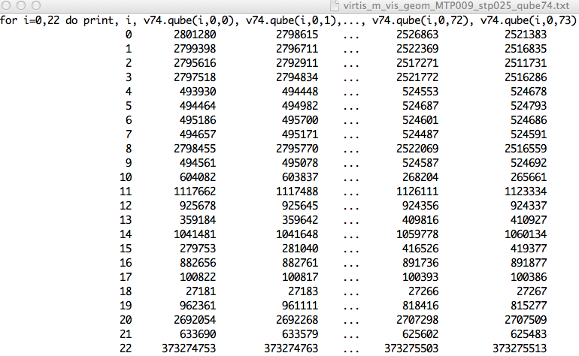
MTP009_stp25_M_vis (geometry/telemetry)
v1_00373274734.geo, UT2014-Oct-30, start = 07:26:45.306, end = 07:39:43.920

Slide 12
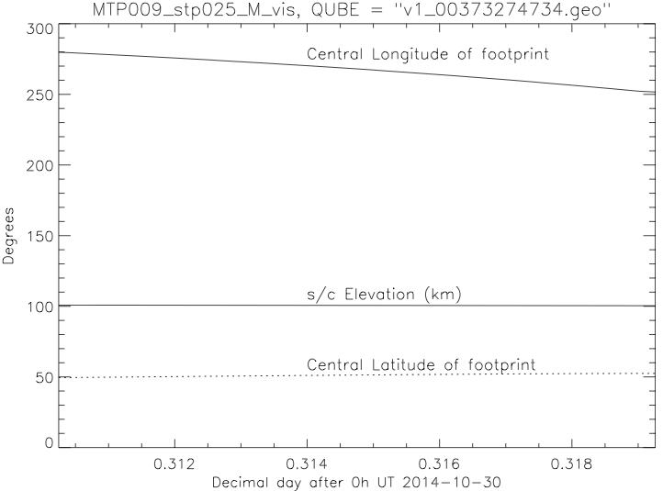
MTP009_stp25_M_vis (geometry/telemetry)
v1_00373274734.geo, UT2014-Oct-30, start = 07:26:45.306, end = 07:39:43.920

Slide 13
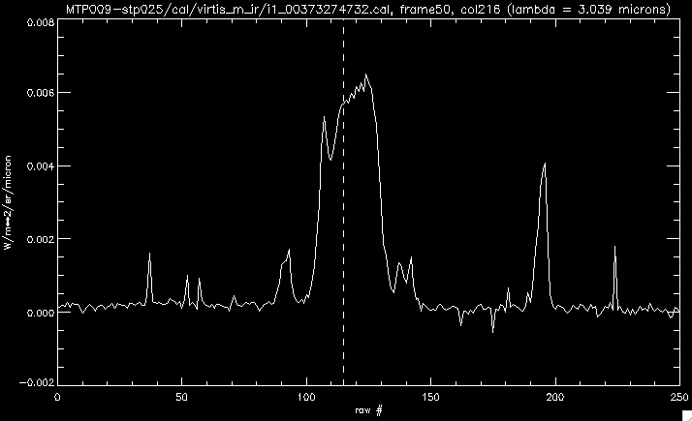
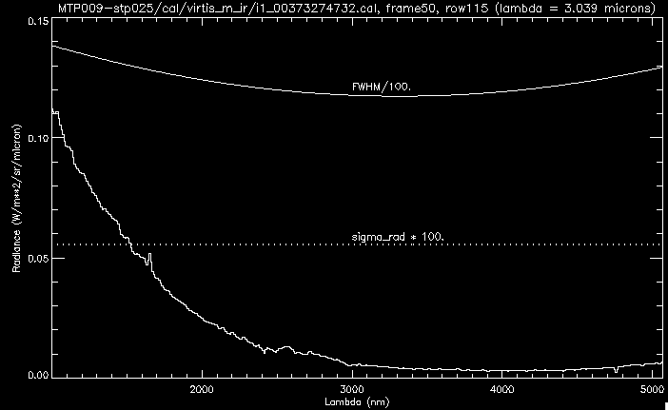
MTP009_stp25_M_ir (cal)
i1_00373274732.cal, frame50 (-0.025,0.05), UT2014-Oct-30

Slide 14
MTP009_stp25_M_ir (geometry/telemetry)
i1_00373274732.geo, UT2014-Oct-30, start = 07:26:43.299, end = 07:39:41.923

Slide 15
MTP009_stp25_M_[vis,IR] (geometry/telemetry)
[v1_00373274734, i1_00373274732].geo, UT2014-Oct-30
vis, ir UT are nearly coincident!

Slide 16
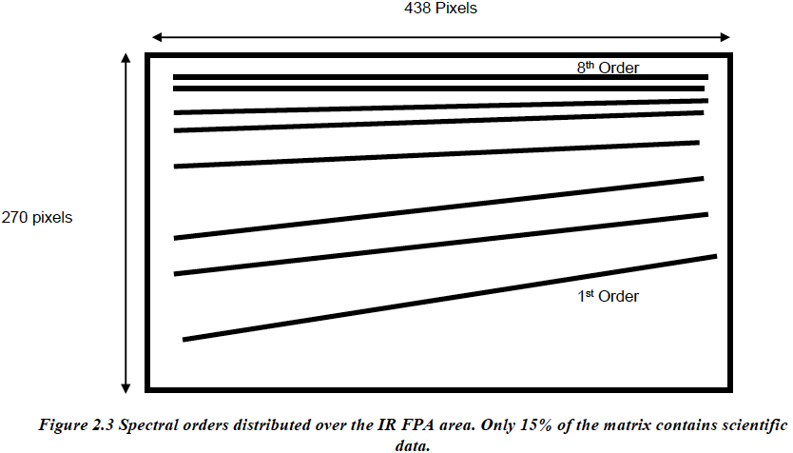
VIRTIS-H layout of orders
Note: Should show “sense” of dispersion (i.e., in which direction does lambda increase? Up/down, left/right?) In other words, where is pixel (1,1)?

Slide 17
Read in a calibrated ‘-H’ file, & display
h1=virtispds('t1_00372813791.cal')
Reading label t1_00372813791.cal
Number of objects found: 6
% VIRTISPDS: File in use: t1_00373272493.cal
** Structure <2209e04>, 9 tags, length=13320760, data length=13320760, refs=1:
LABEL STRING Array[198]
COLUMN_NAMES STRING Array[3]
TABLE FLOAT Array[3, 3456]
QUBE_NAME STRING Array[2]
QUBE_DIM LONG Array[2]
QUBE FLOAT Array[3456, 448]
SUF_NAME STRING Array[3]
SUF_DIM LONG Array[2]
SUFFIX UINT Array[3, 448]
lam =h1.table(0,*) & lam = transpose(lam)
Fwhm =h1.table(1,*) & FWHM = transpose(FWHM)
sig_rad=h1.table(2,*) & sig_rad = transpose(sig_rad)
Noted: lam(0) = 5.0318, and lam(3455) = 1.8712 microns. Is this correct?

Slide 18
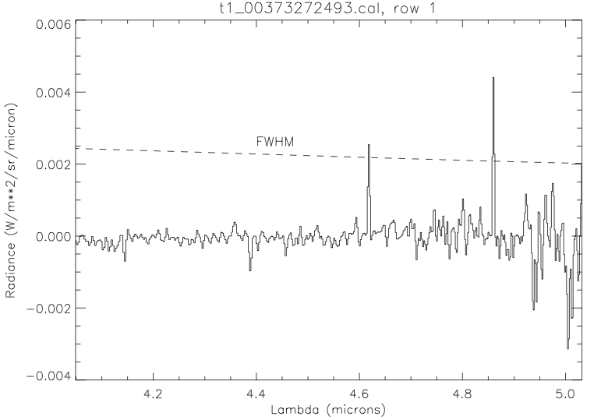
Read in a calibrated ‘-H’ file, & display
Note: sigma_radiance = 0.0 for all spectral channels!

Slide 19
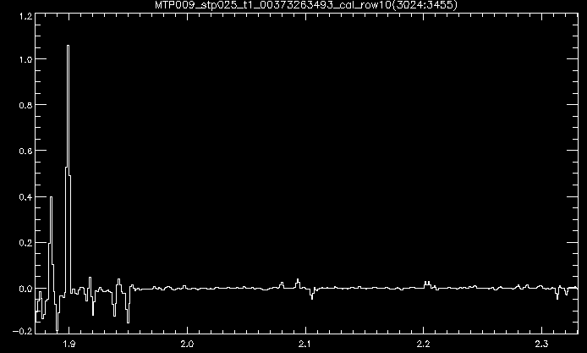
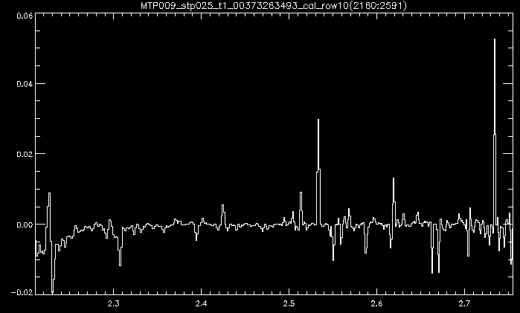
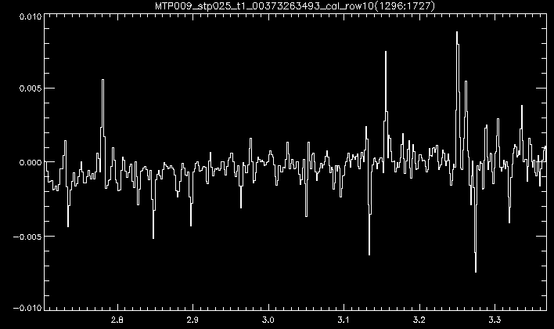
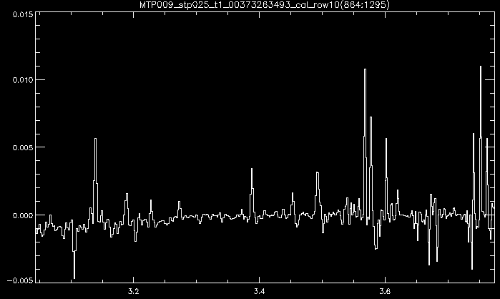
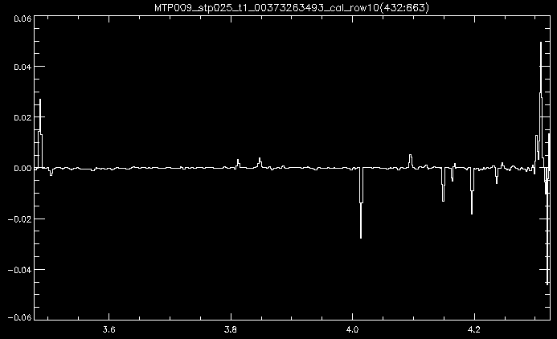
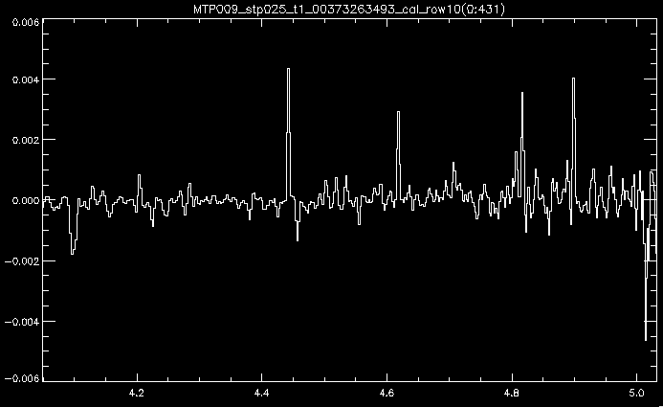

Slide 20
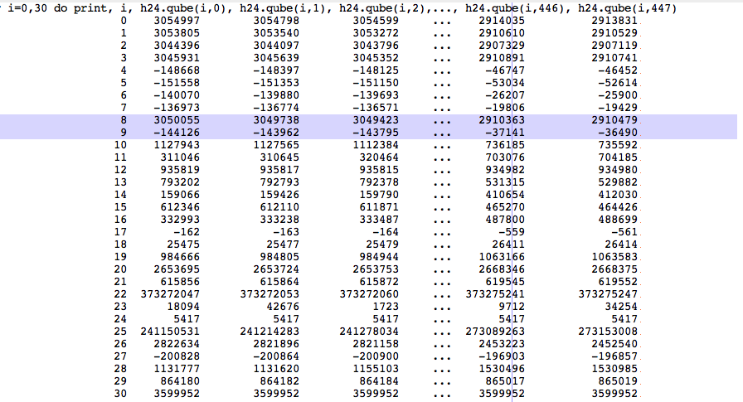
MTP009_stp25_H (geometry/telemetry)
t1_00373272493.geo, UT2014-Oct-30, start = 06:49:24.127, end = 07:35:18.121
?

Slide 21
Notes
All zipped tarfiles unpack to the same name [ro-c-virtis-n-prl-mtp006(9)-v1.0]; n=2 for
Raw data, n=3 for Calibrated data. Not a show stopper, but can be tricky when dealing with multiple stp’s.
IDL software (virtispds) reads in files as described. Array dimensions are as described.
VIRTIS-M frames look reasonable for both vis and ir raw and calibrated data cubes. Lambda calibration looks right, but sigma_radiance and radiance scales are not always consistent. At least based on the “eyeball test.” These need to be checked for consistency.
VIRTIS-H frames are cubes of line spectra (spatially summed). The text file ‘aareadme’ states that “the 2-5 micron spectrum is dispersed in 9 orders on a focal-plane detector array.” However, the QUBE dimensions are [3456, N], where N is the number of line spectra in the file; 3456 spectral channels = 432 spectral channels/order x 8 orders, strung together. This seems to be inconsistent with 9 orders.
Lambda scale runs from maximum to minimum, i.e., lam(0) = 5.0318 µm, lam(3455) = 1.8712 µm. This relates to the sense of the dispersion question for –H data.
What are the ‘drk’ files? Should they be subtracted from corresponding ‘QUBE’ array elements?

