Slide 1
Rosetta – Miro PDS/PSA Review Joint European Session
Bryan Butler
National Radio Astronomy Observatory

Slide 2
MIRO
Despite some shortcomings the data is in pretty good shape, just needs a few fix-ups to get it into PDS-ready form.
Major RIDs:
Documentation on calibration
Artifacts, zero level, and IF offsets/rippling baselines in Level 3 data
Missing data

Slide 3
MIRO – Calibration Documentation
The documentation is not complete enough to reproduce the calibration into Level 3 data (or published data). Note the following at the first of Chapter 9 of the User’s Manual: “This chapter is intended to be a reference for users of MIRO science data. It is being introduced in Version 4.5 of the Users Manual with just a few monographs addressing topics of interest. It is expected to grow rapidly in later versions, and eventually will present a summary of the following topics:
Science data products
Beam pattern
Pointing
Radiometric calibration
Spectral calibration
Spatial calibration ("geolocation”)
Pipeline data processing
Special data processing
Data quality flags.”
Some of this is present, but much is missing; i.e., the “growth” hasn’t happened yet. In principle everything could be reproduced, as there are engineering/ directories under data/ for the Level 2 datasets. But the recipe for calibration is only described in pretty general terms.

Slide 4
MIRO
As an example, given the documentation in the user manual, I think that given a number of source counts D, the antenna temperature of the source is:
Given warm and cold load counts D_{w} and D_{c}, and warm and cold load temperatures T_{w} and T_{c}. But that equation appears nowhere in the documentation. And there are some caveats given about when to use which load, when the sky is used as a load, and there are two temperatures for each load in the housekeeping data and it’s not specified which is used. And, are values interpolated (if so, how)? Nearest neighbor? There are fields in the Level 3 data that help (TYPE and METHOD), but more detail is needed.

Slide 5
MIRO – Level 3 Data Quality
There are artifacts in the data, including jumps in continuum data and IF offsets/baseline ripple in spectroscopic data, that I believe exceed the claimed calibration accuracy of the data (which from catalog/dataset.cat is given as: “CONFIDENCE_LEVEL_NOTE The calibration algorithms used to generate these data are still under development, so the current values must be regarded as preliminary, with uncertainties of order 10%”.

Slide 6
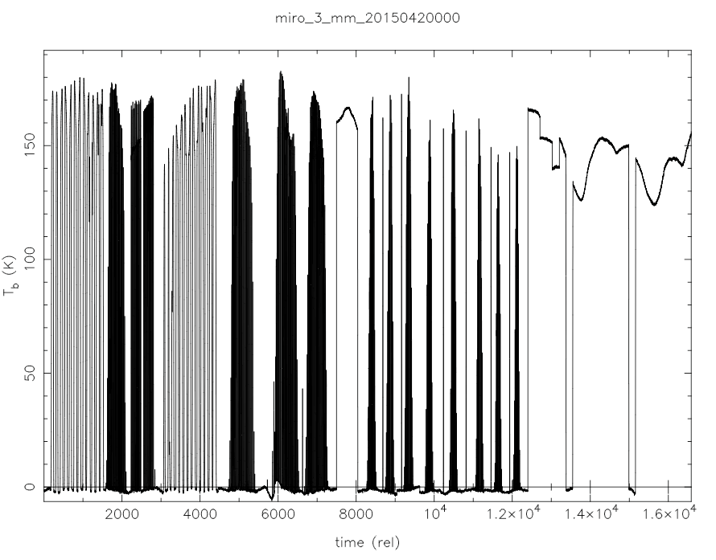
MIRO – Continuum mm – Level 3

Slide 7
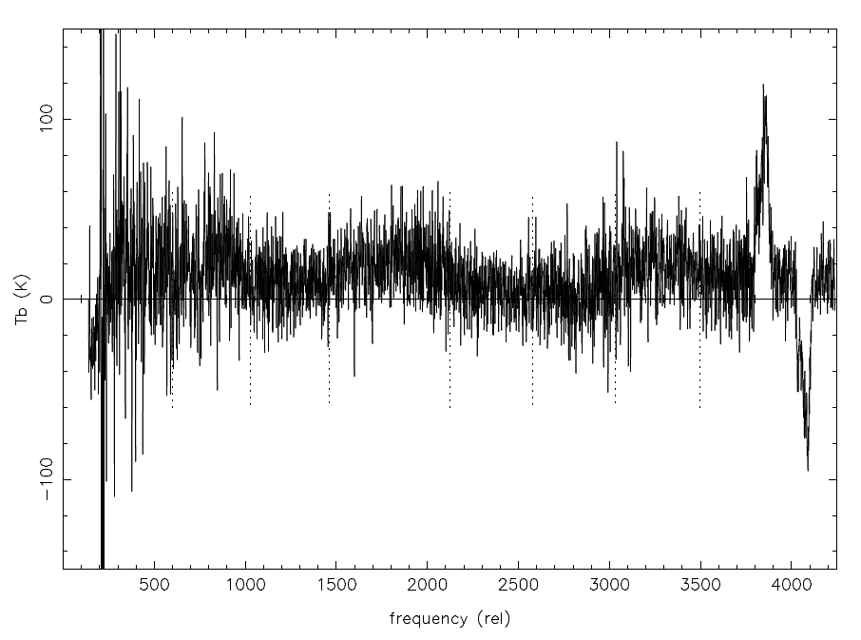
MIRO – CTS (spectra) – Level 3
band edges

Slide 8
MIRO
There is at least one missing data file in the Level 2 and Level 3 continuum datasets from Pre-landing. There should be a miro_3_mm_20142930000.dat file in the ro-c-miro-3-prl-67p-v1.0/data/continuum directory (and similar for _submm_ and for Level 2 for both) covering the timerange 2014-10-23 as published in Choukron et al. 2015, but the files are simply not there. There is a corresponding spectroscopic data file, just no continuum files.

Slide 9
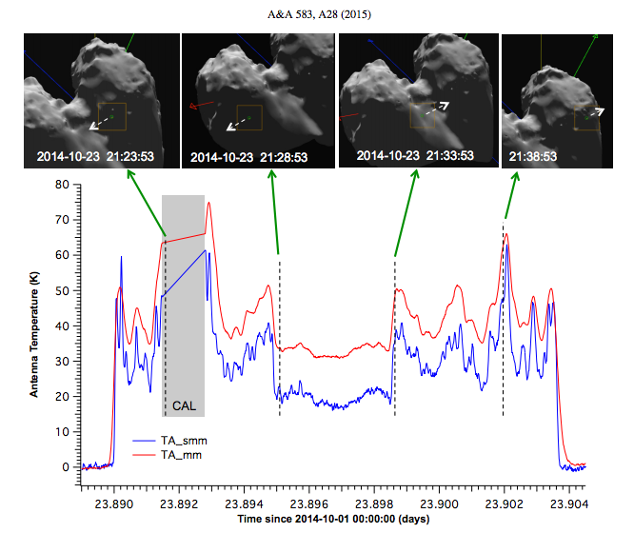
MIRO
Chroukon et al. 2015:
Times: 2014-10-23T21:21:36 to
2014-10-23T21:41:46
In ro-c-miro-3-prl-67p-v1.0/data/continuum
miro_3_mm_20142790000.dat - 2014-10-06T00:00:11 to 2014-10-12T23:59:34
miro_3_mm_20142860000.dat - 2014-10-13T00:01:38 to 2014-10-19T23:59:52
miro_3_mm_20142930000.dat – missing!?
miro_3_mm_20143000000.dat - 2014-10-27T00:00:01 to 2014-11-02T23:00:15
miro_3_mm_20143070000.dat - 2014-11-03T05:32:40 to 2014-11-09T23:59:49

