Slide 1
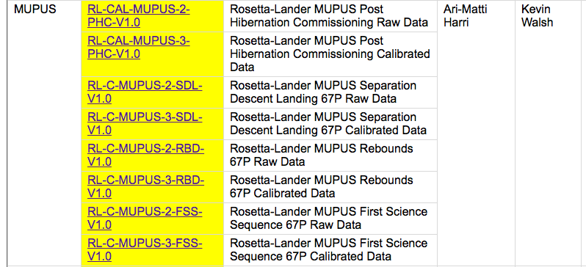
Data

Slide 2
penel map & hammer
penel –
16 temperature sensors down the length of the penetrator + housekeeping/calibration sensors
map -
4 channel infrared radiometer with thermopile detectors and a blackbody calibration unit and the two anchor temp sensors
hammer/
Does the PEN insertion – records hammer strokes

Slide 3
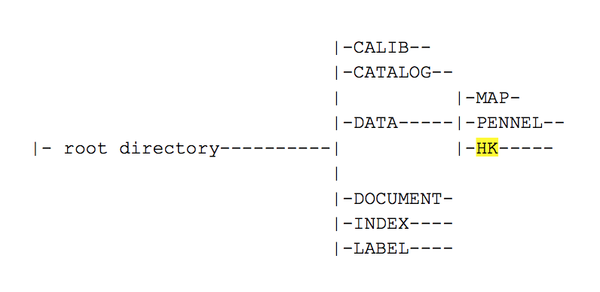
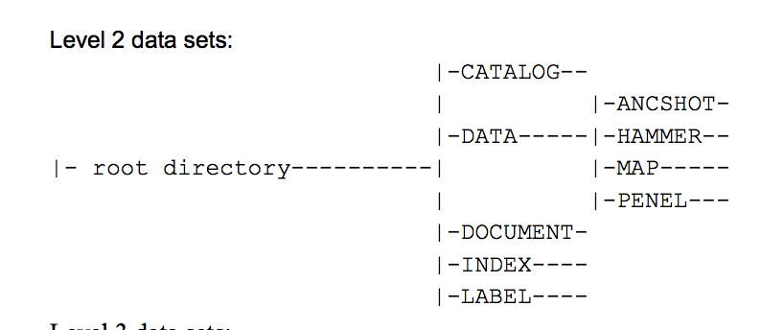
Hibernation Commissioning Raw+Processed
Rosetta-Lander MUPUS Post Hibernation Commissioning Raw Data
RL-CAL-MUPUS-2-PHC-V1.0
Data is Hex values of raw measured voltage
data/
map/
penel/
Rosetta-Lander MUPUS Post Hibernation Commissioning Calibrated Data
RL-CAL-MUPUS-3-PHC-V1.0
Data is decimal, converted values of raw voltage
data/
map/
penel/
hk/
Notes:
~2Hr chunks of data for Penel in calibrated in April 2014, 14th 16th 21st and 23rd
MUPUS On Board Time represented as a
32-bit integer (in hexadecimal format)
with 1 millisecond resolution.
It counts the time since the MUPUS boot and
overruns after 49.7 days (2^32 milliseconds)
MAP.FMT - Calibrated SC data before PEN deployment (Level 2 SONC)
PEN.FMT - Calibrated SC data after PEN deployment (Level 2 SONC)
MAP.FMT - Calibrated SC data before PEN deployment (Level 2 SONC)
PEN.FMT - Calibrated SC data after PEN deployment (Level 2 SONC)
The Calib directory further contains the file "Tau_FM.txt" which provides
the 4 filter transmission curves and infrared absorber emittance as
a function of wavelength.
This auxiliary data is required to derive brightness temperatures from digital
values.

Slide 4
Separation Descent Landing (SDL), Rebounds (RBD) and First Science (FSS) Raw+Calibrated
SDL
Only TM data
7 hour dataset
RBD
Only TM mapper data
2 hours of data
FSS
Hammer (1 table)
Map (5 tables)
Penel (2 tables)
Hammer in Raw but not Calibrated
Nothing in calib/ directories
Nothing in MUPUS manual to calibrate/interpret Hammer data

Slide 5
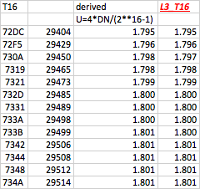
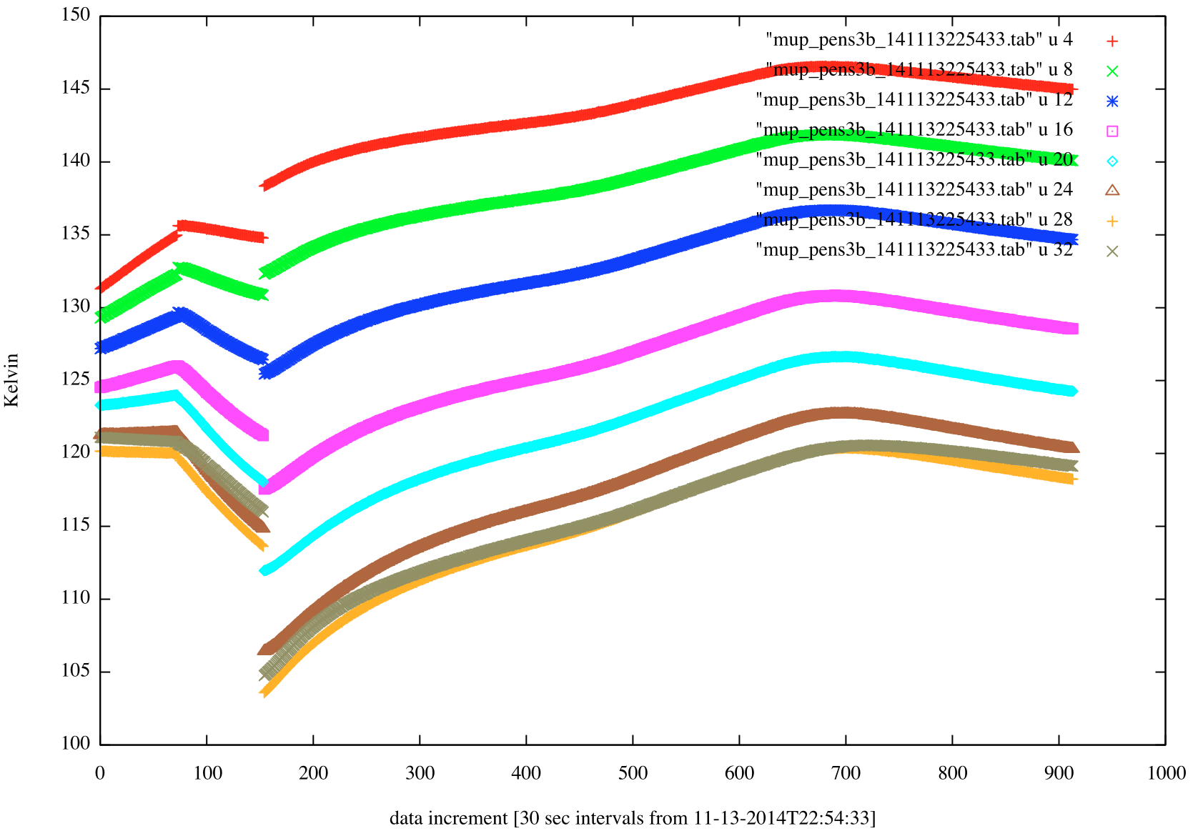
Spot Checks for map & penel
Converting raw to measured voltage
Hex to Decimal
Formula from MUPUS User Manual page 100
U=DN*4/(2^16-1)
Derived voltage compared to Calibrated data is good
Followed calibration description (page 100/101) using table in calib/ directory
Quickly got ballpark temps
Calibrated Temperatures look reasonable
Figure shows Penetrator sensor calibrated temps (FSS)

Slide 6
RIDs
Typos in section 10.1 of MUPUS User Manual
Eq(2) R_{il} should be R_{i,l}
Eq(3) is awkward with no space between formula and indices…
T₀ is updated in the calib/ directory from the value listed in the Manual
Typos is section 10.2 of MUPUS User Manual
References to Eq 1 should be Eq 6
TM calibration steps – 5. incorrect Table Reference (51 should be 52 on page 104)
(I think) typo in step 5. of TM calibration steps – I think Ucal should be Uth,i . I think.
Hammer/ in Raw (rl-c-mupus-2-fss-v1.0/) but not Calibrated (rl-c-mupus-3-fss-v1.0/) for FSS
Nothing in calib/ directories in rl-c-mupus-3-fss-v1.0/ relating to hammer/
Nothing in MUPUS manual to calibrate/interpret hammer data

