Slide 1
Rosetta Orbiter RPCICA Archive Comments ro-c-rpcica-2-esc1-raw-v1.0 ro-c-rpcica-2-prl-raw-v1.0 ro-c-rpcica-3-esc1-calib-v1.0
S. Joy

Slide 2
Catalog Files
dataset.cat - ro-c-rpcica-2-esc1-raw-v1.0 – sparse,
RID: file describes binning of the data in mass but this does not appear to be the case, at least not in all of the L2 files. Description should state that these are raw data in data numbers and explain why so many of the values are either zero or single digit numbers.
dataset.cat - ro-c-rpcica-2-prl-raw-v1.0 – sparse.
RID: file describes binning of the data in mass but this does not appear to be the case, at least not in all of the L2 files. Description should state that these are raw data in data numbers Description should state that these are raw data in data numbers and explain why so many of the values are either zero or single digit numbers.
dataset.cat - ro-c-rpcica-3-esc1-raw-v1.0 – sparse,
RID: description should state that these are calibrated data in units of “flux” and explain why so many of the values are zero.

Slide 3
Document
docinfo.txt (all volumes)
ica_eacid Subdirectory
ica_eaicd.pdf (.lbl, .asc, .doc) ok
ica_l2_to_l3_eacid (.lbl)
RID: Document should provide a concrete example starting with a specific data file, walking through the lookup of the appropriate calibration tables and values
Software Subdirectory
Various MATLAB programs to initialize, read, and plot the ICA data described by the PDS labels as ASCII documents
Softinfo.txt – RID: Please add a statement providing the version of MATLAB used to produce the code, another indicating that the software is unsupported, and lastly, add a brief statement of how to use the programs provided.

Slide 4
Data: ro-c-rpcica-2-XXXX-raw-v1.0
For each hour that contains data, there are 3 data files plus labels for each
Data - rpcica141130t00_000_96l2.tab (.lbl) - 10-75 MB each
Values are likely to be correct, difficult to compare to browse plots provided
2048 records per time step (16x4x16 azimuth x elevation x mass)
RID: Data appear to be binned in elevation angle. If this was done on the ground, then this is not L2 data. This appears to be a mistake in this particular file. Other files that were spot checked did not appear to have binning in elevation angle.
HSK - rpcica141130t00_000_hk.tab (.lbl)
Geom - rpcica141130t00_000_geom.tab (.lbl)
Spacecraft position, velocity, altitude, etc.
RID: Geometry information in the labels and data files have too many significant digits
RID: Provide SPICE kernel set used to produce files in label
All files are simple ASCII tables
Nearly every record contains value of 00000 for the counts in all 96 channels.
RID: Data are nearly all zero with occasional single digit numbers. This should be described and explained in the dataset.cat. Browse plots seem to show more data content and variability.
Data are difficult to work with because of their size in this format but no changes are proposed at this time
Browse plots suggest that there may be some issues in the separation of the solar wind (light) and water group (heavy) particles.

Slide 5
Data: ro-c-rpcica-3-esc1-raw-v1.0
For each hour that contains data, there is a data file and label
Data - rpcica141128t05_000_96l3.tab (.lbl) - 60-75 MB each
512 records per time step 16x16x2 (azimuth x elevation x mass)
L2 data were different 16x4x16 (azimuth x elevation x mass)
Values are likely to be correct, difficult to compare to raw data for same time period
Browse plots would be nice (plots on raw volumes might be more appropriate here
RID: Geometry information in the labels have too many significant digits
RID: Data are binned in mass
All files are simple ASCII tables
Nearly every record contains value of 0.000E+00 for the counts in all 96 channels.
RID: Explain the abundance of zero values in the data files and why it is so difficult to correlate the data files with the browse plots
Data are difficult to work with because of their size in this format but no changes are proposed at this time

Slide 6
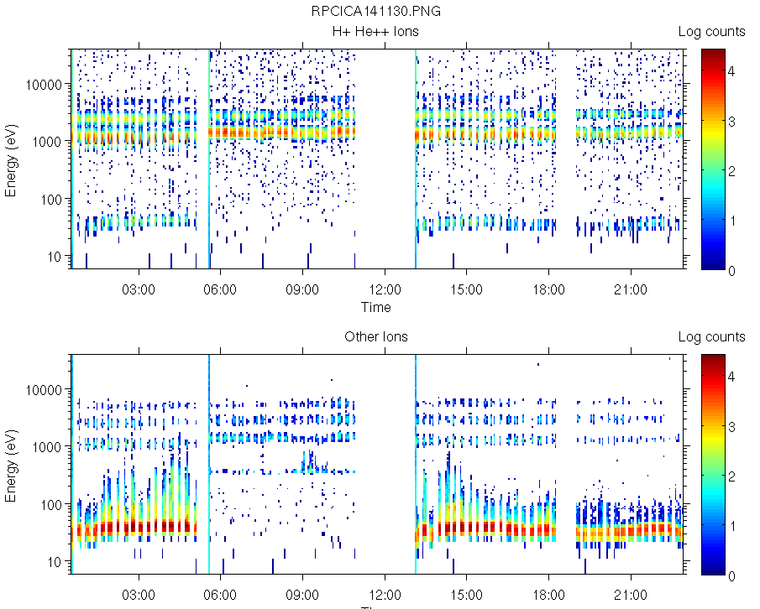
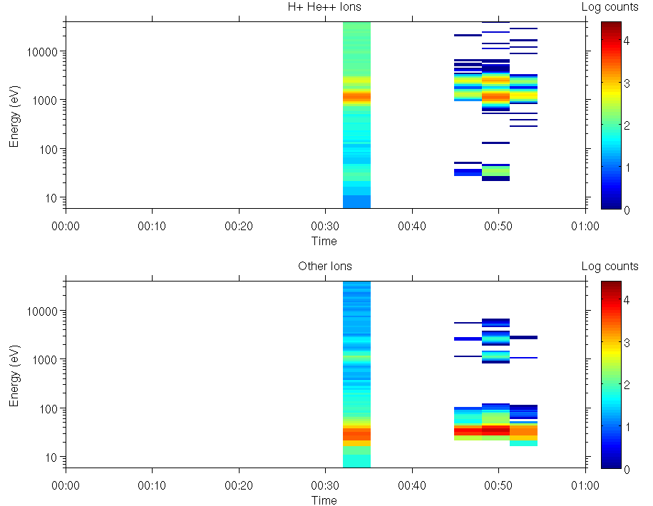
Browse: ro-c-rpcica-2-XXXX-raw-v1.0
Browinfo.txt – present, not useful.
Plots appear to be calibrated data, not the raw data that are on the volume making it difficult to compare the two
RID: Please include a description of how the plots were generated from the data files (sum over azimuth and elevation angles and convert energy step to eV?)
Plots include full day and each hour of the day that contain data
Full day
Hour 0 - 1

Slide 7
Summary
The data contain a very large number of zeros with only a small number of single digit numbers. This is inconsistent with my expectations given the richness of the browse plots.
RIDs:
All: data set catalog file descriptions should be updated to include discussion of precessing level, units, and the sparseness of the data.
All: Provide information in the calinfo.txt that describes the differences between files of similar name rather than just a list of file names (add naming conventions for each file type).
L2 volumes: browinfo.txt should include description of how the plots were created (angular binning?, apply calibration?, etc.)
ro-c-rpcica-3-esc1-calib-v1.0: Provide concrete example of how to produce an L3 file from one of the files on the L2 volume including which calibration table to apply based on the contents of the L2 data values in the ica_l2_to_l3_eacid document.
ro-c-rpcica-2-esc1-calib-v1.0: file rpcica141130t00_000_96l2.tab appears to be incompatible with the rest of the data set (binned in elevation angle).
ro-c-rpcica-2-XXXX-calib-v1.0: Update the *geom.lbl files to specify the set of kernels used to produce the geometry data i.e.SPICE_FILE_NAME = {“file1”, “file2”, … “fileN”} and provide geometry data to the right number of significant digits.
ro-c-rpcica-2-XXXX-calib-v1.0: Update the *geom.tab files to have an appropriate number of significant digits in the data columns.

