Slide 1
Rosetta Radio Science Investigations (RSI) Comet Data Review Summary
Dick Simpson
18 February 2016
V2.0

Slide 2
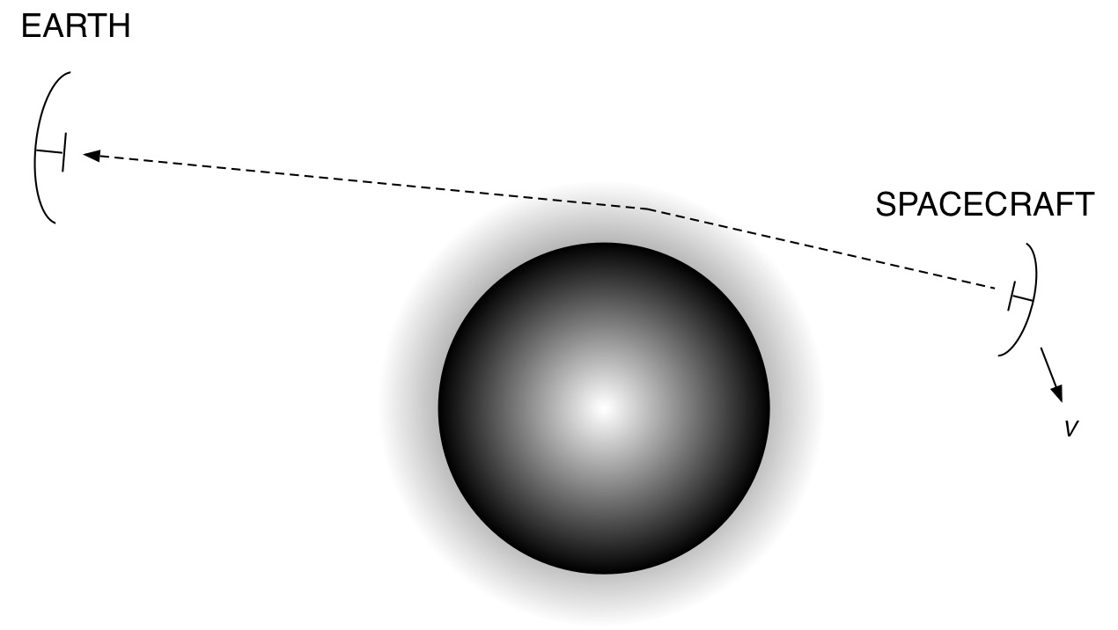
RSI Measurements — Rosetta Mission
INTERIOR/GRAVITY
COMA/PARTICLES
SURFACE/BSR
SOLAR CONJUNCTION
COMMISSIONING
Perturbations in received radio signals on Earth enable several science investigations.
Two Commissioning data sets (2014-03-30 and 2014-04-13) were available for review.

Slide 3
Conclusions
Two data sets (out of more than 500 collected) are not representative in terms of instrumentation used, timing, or science attempted during the post-Hibernation to early Escort phases of the mission.
Data sets reviewed are from ‘COM’ activities, which are not described in any documentation. Specifically, the objectives, achievements, and failings of these two tests are not specified.
The 2014 Ops Log lists only one non-COM activity in 2014; there should have been many GRV activities. Six bistatic radar (BSR) observations are not listed.

Slide 4
Conclusions
There are no Level 2 AGC data in either data set.
Very little documentation has been updated in the last 5 years. For example:
The RSI User’s Guide has not been updated since 2006
There is no Ops Log for 2010 (Lutetia)
There is no mention of Malargue (new ESA ground station used for several RSI activities in 2014).
Spurious references to archaic data formats (ODRs from JPL), MEX and VEX procedures, and contributions to RSI from Stanford clutter many files (e.g., AAREADME.TXT and DATASET.CAT).

Slide 5
Conclusions
DATASET.CAT lists HGA patterns as a DSN product. In fact, HGA patterns would be an ESA product for Rosetta and valuable for BSR; but there are no HGA patterns in either data set.
A high percentage of labels for data products have incorrect values for FILE_RECORDS, RECORD_BYTES, etc.
The collection of files in DOCUMENT needs to be scrubbed for relevance and currency; then DOCINFO.TXT needs to be updated. Other document lists (such as in AAREADME.TXT) then need to be made consistent.

