Slide 1
SD2
The SD2 experiment provides samples collected at different depths to microscopes and evolved gas analysers.
The primary characteristics of SD2 are summarised below:
capable to drill the surface and to collect samples (tens of mm3) at different controllable depth up to 230mm (assuming a clearance between the Lander Balcony and comet surface of 300 mm);
capable to move and distribute the collected samples to the different scientific instruments (visible and I/R microscope, gas volatile analysers);
Three Data sets
Post Hibernation Commision Data: 4/9/2014 – 4/23/2023
Pre Delivery Calibration Science Data: 7/14/2014 – 10/17/2014
First Science Sequence: 11/14/2014 10:43:29 – 22:33:56
Notes:
The post-delivery manoeuvre that has been executed on 12 November 2014
started at 09:14:58.1 UTC and a nominal end time at 09:19:53.7 UTC.
Rosetta was then on a 50 km orbit.
On 13 November at 19:23 UTC Philae started transferring data to
Rosetta. Link was lost at 23:08 UTC on 13 November, 40 minutes before
predicted time.
During this slot was commanded:
- ranging measurements by CONSERT (Lander Search)
- CIVA images
- MUPUS boom deployment and hammering
- APXS deployment and measurement
On 14 November at 9:01, Philae data were received on-board Rosetta and
immediately transmitted to ground, 48 minutes after expected time. The
visibility period finished at 11:47 UTC on 14 November, 50 minutes
earlier than predicted.
During this period was commanded:
- APXS released but measured copper thus revealing that the door had
not opened.
- MUPUS deployment was successful, hammering took place, SESAME
detected it
- Drill activation for sample return to COSAC
- PTOLEMY/COSAC spectra acquisitions
- CIVA image but dark.................................................
- Consert ranging
The fourth and last Philae visibility period started on 14 November at
22:15 UTC ground time. The LAnder bus voltage appeared to decrease
rapidly. On November 15 at 00:07, the link between Orbiter and Lander
broke.
Among the Lander operations carried out during the fourth visibility
period was a rotation of the Lander to increase the illumination of
its solar arrays.
After the planned Touch Down, the Lander did not anchor and bounced.
We estimated that the first TD was:
Time UTC: 15:34:06
Comet-fixed coordinates: [2.129171, -0.961358, 0.498268] km
The NAVCAM image, the NAC image and the first TD as the starting point
gave the following impact point at:
Time UTC: 16:26:23
Comet-fixed coordinates: [2.450, -0.511, -0.242] km
This point has an uncertainty of 7 minutes. The position is also
uncertain.
By using three WAC images, the second TD can be deduced:
Time UTC: 17:31:10
Comet-fixed coordinates: [2.275, 0.249, -0.444] km
Consert Ranging estimated a final landing site at
Comet-fixed coordinates: [2.446, -0.055, -0.360] km
After Touch Down, began the First Science Sequence (FSS) where all
Lander instruments operated on the primary battery. The operations
did not go as planned due to the several TDs but occurred as listed
above. The Long Term Science Phase should have started after the
primary battery died, but the final TD let the Lander in a location
where the illumination condition could not allow battery charging.
Contact was lost on 15 November 2014 at 00:07, ending the FSS, and the
Lander went asleep.

Slide 2
data/ files
sd2_XYZ_date_length
X: G for Ground, F flight
Y: S science, H houskeeping, B for files with mixed
Z: CODMAC: 1 for raw, 3 for calibrated
NOTE: only raw binary or calibrated
label/ Format files
sd2_calibrated_hk.fmt
sd2_calibrated_l1.fmt
raw/ ALL BINARY FILES
sd2_fb1_*.dat (phc)
sd2_fb1_*.dat (pdcs)
sd2_fb1_*.dat (fss)
binary files – telemetry & data
exe provided (does not work)
calibrated/
sd2_fs3_*.tab (phc, pdcs, fss)
Science data
These are wide data tables 39 cols
sd2_fh3_*.tab (phc, pdcs, fss)
Housekeeping data

Slide 3
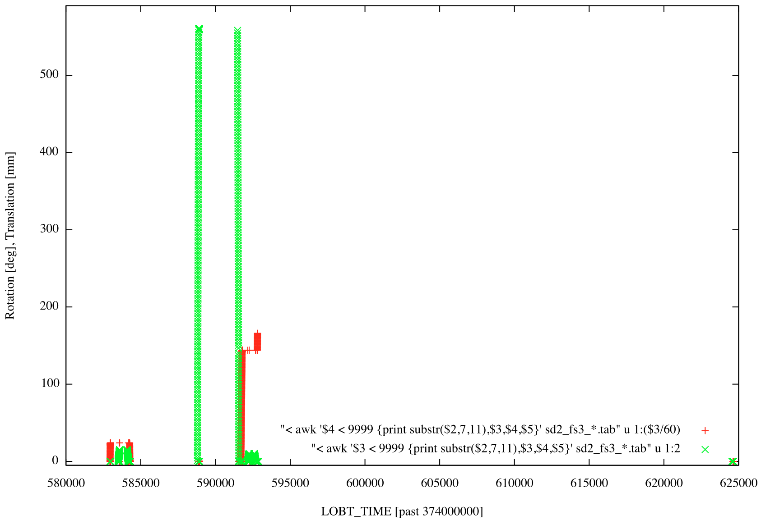
Spot Check
PME values define the translation of the drill and rotation of carousel
Translation varies in units of mm
-0.08 to 560.29
Rotation given in arc-min
0 to ~180 deg
Volume Checker (VCB) measures amount of material deposited in oven
Always 9999.99

Slide 4
RIDs
No structural description of the raw data.
The raw data needs to be accessible by a standard PDS tool with adequate descriptions of the Data Structure.
Software for reading raw data does not functionally exist.
No browse/ directory - listed in Section 3.4.3.4 in the eaicd_sd2.pdf
No plots that are referred to frequently in the eaicd document

