Slide 1
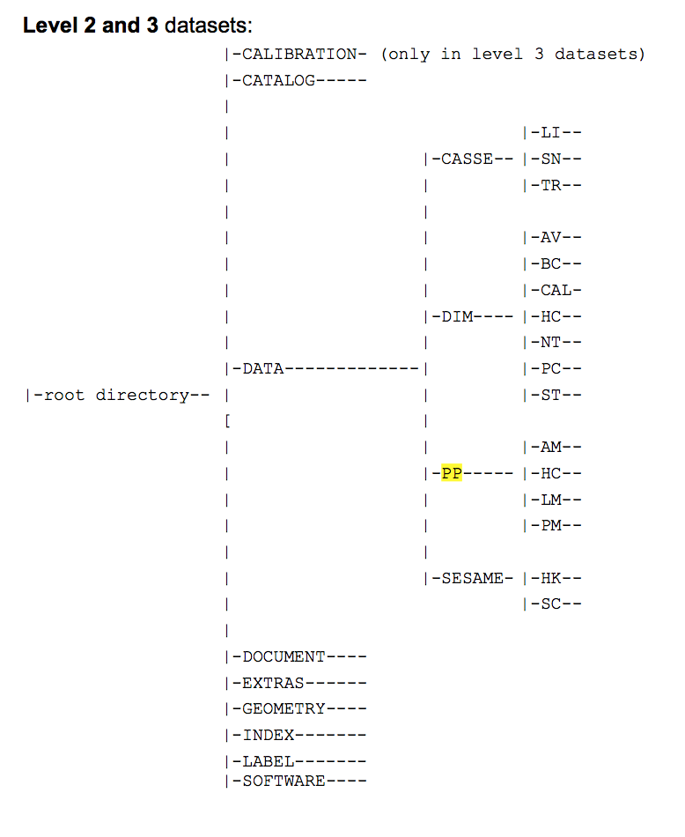
File Structure (as described in the eaicd)
Neither 2 or 3
?
?
No Calibration folder in -2 or -3 directories
No Extras/ Geometry/ or Software/ in either.
Don’t find li/ in either the CASSE Level 2 or Level 3 data
Dont find lm/ in PP Level 2 or 3 data
hc/ directory in casse/ where not expected.
?
?
?
?
Notes:
I understand this is likely due to not running in each instrument mode .

Slide 2
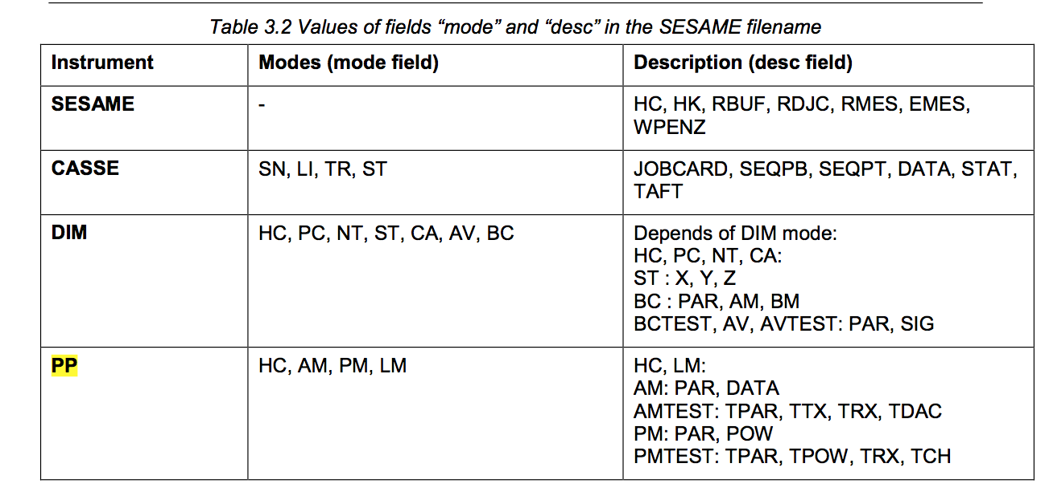
SESAME-CASSE data
rl-c-sesame-2-sdl-v1.0/
This archive contains edited data (CODMAC level 2) from the SESAME instrument onboard ROSETTA Lander, acquired during the SDL phase.
rl-c-sesame-3-sdl-v1.0/
This archive contains calibrated data (CODMAC level 3) from the SESAME instrument onboard ROSETTA Lander, acquired during the SDL phase.
hc/ – health check (not expected)
Not in page 24/26 eaicd_sesame Table 3.2
Files: _jobc _data _seqp _stat _taft files
sn/ – sounding mode
_jobc
Job parameters (L2 identical to L3
_data (L2 converted to phys. units in L3)
Data from 12 accelerometers
_seqp (L2 converted to phys. units in L3)
Sequence of parameters
Foot temperatures
_stat (L2 identical to L3)
Statistics of the channel data (min/max stuff)
_taft
Not present
Supposed to be foot temps
Notes:
hc listed in manual as health check for DIM and PP, but not CASSE

Slide 3
Calibrations: L2 to L3
CASSE
rl-c-sesame-3-sdl-v1.0/document/ses_cas_calibration_desc.asc
“This document describes the calibration of the SESAME-DIM and SESAME-PP data delivered in the SESAME level 3 data sets.
TBD”
No direction to do the following:
Convert the channel data from integers in L2 data to the real units (accelerations) in L3 data (or at least know how it was done).
Page 16 of eaicd: “Amplification factors to calculate the signal strength in voltage. Pre-launch Brüel & Kjaer calibration of CASSE accelerometers (transfer from voltage to acceleration)“
Convert the foot temperatures from raw integer data to physical units
(or at least know how it was done)

Slide 4
SESAME-CASSE: RIDs
Insufficient Calibration information for SESAME-CASSE:
“TBD” Calibration information for CASSE in rl-c-sesame-3-sdl-v1.0/document/ses_cas_calibration_desc.asc
No formula for calculating temperatures found in _seqp data
Directory structure does not match Figure 3.3 in eaicd documentation.
Healthcheck mode hc/ found in CASEE/ folders, but not listed in the eaicd.
No calibration/ extras/ geometry/ PP/LM/ CASSE/LI or CASSE/TR/
Insufficient documentation of operational parameters
No adequate description in eaicd or lse_sw…pdf of many jobcard function parameters
G_GAIN, FIFO_LAG, TL_FACTOR, G_TAR_VAL….
Channel descriptors in _data* format files were not explicit.
No _taft* files in the sn/ folders – only in hc/ folders that were in unexpected locations.
hc - _taft data for example – nothing in section 2.3 “Temperature Measurements” in lse-sw-fm-3-tc-tm.pdf

Slide 5
PP- data
RL-C-SESAME-2-SDL-V1.0
This archive contains edited data (CODMAC level 2) from the SESAME instrument onboard ROSETTA Lander, acquired during the SDL phase.
am/
hc/
pm/
rl-c-sesame-3-sdl-v1.0/
This archive contains calibrated data (CODMAC level 3) from the SESAME instrument onboard ROSETTA Lander, acquired during the SDL phase.
am/
hc/
pm/
Notes:
am - PP Active Mode 2 executes a series of active PP measurements. A modified wavelet method is used on-board to analyse the time series of each measurement. All measurement parameters but the electrode configuration are taken from the PP control table or are fixed in the software code. During each measurement, nine waves are transmitted und internally recorded, if the frequency is less than or equal 1560 Hz, else 17 waves. The number of samples per wave is:
pm - PP Passive Mode 2 executes a Langmuir Probe measurement and subsequently one passive measurement. All measuring parameters (integration clock divider, sampling frequency, number of used and skipped samples, number of power spectrum frequency bins) are read from the PP Control Table. The input of one command data word is mandatory, although it is not evaluated on-board.

Slide 6
Data types
Passive mode (pm)
_par (L2)
Sequence Parameters
Integers describing integrating times (LP_INT_CLK_DIV, ADC_CLK_DIV etc.)
_parc (L3)
Sequence Parameters
Integrating sequence now in Seconds
_pow (L2)
Integer codes for frequency bins
“Raw Power” - Integer
_powc (L3)
Frequency bin center (Hz)
Voltage Density (with formula)
_rx (L2)
RX_SAMPLE_NUM, RX_ADC_VALUE in Integers
_rxc (L3)
Milliseconds and Volts
Plasma Wave Sensor (am)
_par (L2)
Seq Params
Includes indications on which transmitter, and which receiver and votlage/phases etc.
_parc (L3)
Parameters greatly distilled to transmitter freq and receiver sampling settings.
_dac (L2)
DAC sample/time Integers
_dacc (L3)
DAC table ms/Volts
_rx (L2)
Receiver time series (Integers&ADCs)
_rxc (L3)
Receiver time series: Time/Potential_differences (ms/Volts)
_tx (L2)
Transmitter time series (Integers&ADCs)
_txc (L3)
Transmitter time series: Time/Current (ms/mA)

Slide 7
Calibrations
In the EAICD – section 2.4.3 lists the following as relevant calibration information for PP.
Calibration functions for digital current consumption in mA
Transmitter currents in mA
Potential values in mV
ses_pp_calibration_desc.asc in documents/ (no calibration/ directory)
“The calibration of SESAME-PP data is divided into 6 different groups:
1) Housekeeping data from PP Healthcheck and SESAME Healthcheck
2) Permittivity measurements using PP's active mode with on-board data processing
3) Plasma wave measurements using PP's passive mode with on-board data processing
4) Permittivity measurements with time series data from PP active test mode data
5) Plasma wave measurements with time series data from PP passive test mode data
6) Plasma wave monitor (LP) data from the additional sensor mounted on the DIM cube”
It looks like the relevant calibration functions are present, including relevant units etc.

Slide 8
PP:Questions/Issues
The Calibration details are only in documents/
No calibration folder
Not described in the eaicd or the lse-sw…pdf document

