Slide 1
PDS Data Review New Horizons LORRI and MVIC
Tony Farnham
May 19, 2016

Slide 2
LORRI Instrument
Narrow angle, panchromatic camera
0.29 degree square FOV
high resolution (5 microradian/pixel)
1024x1024 pixel CCD detector
Operates in 1x1 or 4x4 on-chip binning modes
Raw data format
FITS files with 3 extensions
Primary image, Data Histogram, 34 pixel housekeeping
Calibrated data format
FITS files with 3 extensions
Primary image, Error estimate image, Quality flag image

Slide 3
General Comments – LORRI, MVIC
Overall, both data sets are in great shape
Well documented with lots of description and information available
Data are in good shape
Read with IDL FITS readers, PDSREAD
Includes extensions
All 4 data sets are similar & somewhat parallel In processing, etc
Many files in common, or very similar
Address the common files first, then split into specific data sets

Slide 4
General comments – LORRI, MVIC
Repetition of files and information has benefits and problems
Simplifies dataset creation, but
Sometimes makes the information vague, where a long-term archive should be more specific: e.g., the AAREADME.TXT file…
has directory tree with branches that don’t exist in all datasets
Would be more valuable if the file reflected the structure of the dataset where it is contained.
gives long generic discussion of CODMAC levels
Simply providing information about the level of the specific dataset would make it shorter and clearer
Often the same information appears in multiple places
Not always appropriate
Makes some files longer than necessary
Risks having different versions if one is edited and the other is not (e.g. ICD information)

Slide 5
AAREADME.TXT – LORRI, MVIC
Same in all 4 datasets, with instrument names changed.
Very long, detailed file, with a lot of material that seems out of place.
I see this as a relatively brief description of what is available in the dataset, with pointers to where to find more details.
From the file: “Extensive preparation is necessary to properly understand and interpret the data in this data set. Although some detail is provided here, this file is only intended as an introduction to and starting point for this data set; refer to the Required Reading section below for further guidance.”
Fewer details forces the user to go to the relevant documents that they should be looking at anyway!

Slide 6
AAREADME.TXT – LORRI, MVIC
May be my personal preference, but I would suggest editing it down
Details could be relocated to the specific labels, catalog files or documents where they are relevant.
Potential separate documents for the details (point to from AAREADME):
Information about specific documents (most already exist in DOCINFO.TXT)
File formats and suggested software
Data label overview
Discussion of processing levels (already exists)
Some of the details may also be more appropriate in the label for a specific document
e.g., discussion of ICD, which currently is not contained in that label

Slide 7
AAREADME.TXT – LORRI, MVIC
Typos, etc.
“The filename prefix may provides additional information about the instrument detector.”
“The following URLs were current as of 2007 when the early New ??? occasionally, and given the availability of search engines, no attempt will be made to update this information throughout the mission.”
Is the DOCUMENT/AAREADME_BU.TXT file really necessary?
Simply a copy of the file in the parent directory

Slide 8
DATASET.CAT – LORRI, MVIC
“some sequences may have failed to execute due to spacecraft events (e.g. safing) and there will be observations associated with those sequences.”
Is this correct?
Not clear if observations are not obtained, or if they are obtained with bad pointing, etc.
More detail would be useful.
Is it straightforward to determine what sequences were not obtained, simply by comparing to the index table.
Is it possible to get a list of known “interruptions” that might have affected the data sequences, just as a basic guide (e.g. a table of times when observations might have been affected)?
TARGET_NAME uncertainties
It is annoying that the targets are questionable, but it sounds like the team did what they could to lead the user to the answer and provide a warning that there are issues involved.

Slide 9
NH.CAT – LORRI, MVIC
Some of the mission descriptions are still written in future tense, with predicted distances, etc. These could be updated with more meaningful information.
“Pluto and Charon will first appear as unresolved bright dots, but the planet and its moon appear larger as the encounter date approaches. About three months from the closest approach … the cameras on the spacecraft can make the first maps.”
“the spacecraft comes as close as … when the spacecraft is closest to Pluto … it will take close-up pictures ...”
“as of early 2016, no extension to the mission has been approved.”
Is this still true? Update discussion?

Slide 10
DOCINFO.TXT – LORRI, MVIC
Several places throughout the text
SSR papers are referenced to 2007, but should be 2008
Also in REF.CAT and AAREADME.TXT (where some are correct)
May be an issue with how they were ingested in to the PDS, but need to make them consistent
e.g., 2 references to CHENGETALXXXX in REF.CAT
Somewhere in this document (maybe in the tree diagram) it would be useful to note:
The LORRI_SSR paper is CHENGETAL2008 (LORRI)
The PAYLOAD_SSR paper is WEAVERETAL2008 (LORRI, MVIC)
The RALPH_SSR paper is REUTERETAL2008 (MVIC)

Slide 11
Documents
Information in the NH_MISSION_TRAJECTORY.TAB file ends before the dataset start date

Slide 12
LORRI - RAW and CAL

Slide 13
LORRI – RAW and CAL
IntroDoc
Found it to be a good overview with a lot of detail that helped in getting into the dataset.
Line 1: is "[instrument]" supposed to be replaced by LORRI?
4th paragraph: “!25-30 microradians” what is “!”?
Directory and filenames Paragraph
It would be useful to point to the DATASET.CAT file for definitions of the APID, etc
Filename definition includes a version number after the "eng" or "sci” identifier, but none of the files contains this version number and it is not mentioned in any other documentation

Slide 14
LORRI – RAW and CAL
DATASET.CAT: “The common data product is a 2-D image of brightnesses that is, or can be, calibrated to radiance.”
For LORRI, this should probably be “… can be calibrated to radiance or irradiance”

Slide 15
CALIB – LORRI – RAW and CAL
Are calibration files necessary in the LORRI raw dataset?
File CALINFO.TXT
Update or remove the comment “Filenames of calibration file used in data calibration will be included in PDS labels produced after the 2014-01 peer review.”
Neither the Hot Pixel Maps nor the Dead Pixel Maps have any flagged pixels.
Is this the case? Are these just placeholders?
From DATASET.CAT: For calibrated window objects, pixels outside the window are zero in raw, and pass through calibration. Why can’t the quality map be used to produce a mask that can reset the bad pixels back to zero?
In radiance calibration: Need to provide coefficients/guidance/suggestions on how to calibrate small moons, etc.

Slide 16
CALIB – LORRI - CAL
Is it stated anywhere how well the smear removal is supposed to work? I see streaks in the data still (about 1% level).

Slide 17
RESPONSIVITY – LORRI - RAW and CAL
Responsivity – Discussion of the conversion equation and plot in the SSR paper points out an error.
This is noted in various places in the documentation, but they say Fig 9 is wrong when it looks like it’s actually Eq 3 that is wrong .
Assuming units are (DN/s/pixel)/(W/cm^2/sr)
CALIB/LORRI_RESPONSIVITY:
Need to remove “/nm” from “(DN/s/pixel)/(W/cm^2/sr/nm)
Note should say that Eq 3 from CHENGETAL2008 is wrong
DOCUMENT/LORRI_SSR.LBL
Note should say that Eq 3 from CHENGETAL2008 is wrong
Also, "monocrhomatic" should be "monochromatic”
DOCUMENT/DOCINFO.TXT
Note should say that Eq 3 from CHENGETAL2008 is wrong
CATALOG/DATASET.CAT (Calibrated dataset)
Note should say that Eq 3 from CHENGETAL2008 is wrong
Other locations?

Slide 18
LORRI Calibrated Data
Calibration is “do it yourself”
Apply the relevant calibration coefficient to get absolute radiance, etc.
For calibrated window objects, pixels outside the window are zero in raw, and pass through calibration.
Can the quality map be used to produce a mask that can reset the unused pixels back to zero?
Discussed in IntroDoc and DATASET.CAT
IntroDoc also states that the first 34 pixels are flagged as missing in the quality map, but I never saw that information anywhere in the other documents. Should be included somewhere.

Slide 19
LORRI Data Files
Lots of geometric information in the FITS header, but little in the PDS Labels
Would be useful to add pointing to the labels
Data in common generally agree well
Estimated pixel positions don’t
APPROX_TARGET_LINE / SAMPLE vs TARGFOV00
Some position vectors in PDS label are inverse of those in FITS header
Fine if they are not lt & abberation corrected, but PDS label says they are corrected
Geometry should be lt & abberation corrected
SPICE discussed later…

Slide 20
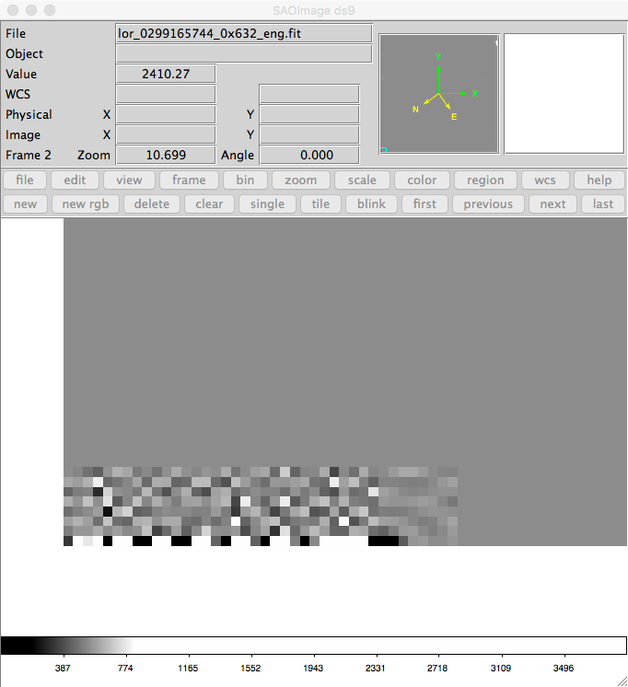
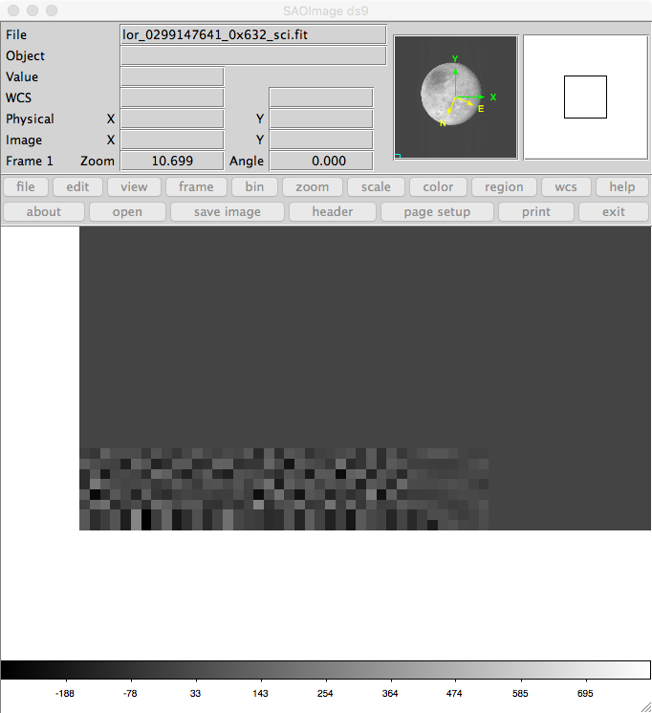
LORRI Data Files – RAW and CAL
Bottom Left Corner (noted by Xiaoduan Zou)
Block of unusual pixels visible in high S/N data (~40 columns, 8 rows)
Present in both raw and Calibrated data
Document what is going on?

Slide 21
LORRI SPICE Check
Comparison of my SPICE calculations vs header/label data are generally good
Some kernels are different, so values are not exact
My calculations suggest there is a mix of positions calculated with and without light time corrections
For geometry listed in PDS labels (defined as light time corrected):
s/c – target position is best matched with “lt+s”
s/c – Sun position is best matched with no correction (incorrect)
Target – Sun position best matched with “lt+s”
s/c – Earth position best matched with “lt+s
For FITS headers,
target-s/c is given as the inverse of s/c-target (incorrect)
Earth – s/c is given as the inverse of s/c-target (incorrect)

Slide 22
LORRI SPICE Check
Solar phase angle in the PDS label should be checked
Example: LOR_0299124574_0X632_SCI.LBL
Gives a phase angle (Sun-Pluto-s/c) for Pluto of 69.463 deg
I compute 16.09 deg
Image suggests ~16 deg is correct

Slide 23
MVIC - RAW and CAL

Slide 24
MVIC – RAW and CAL
IntroDoc
Found it to be a good overview with a lot of detail that helped in getting into the dataset.
Finding the data paragraph
Filename definition includes a version number after the "eng" or "sci” identifier, but in this case it notes that only some data sets contain this entry.
MVIC.CAT
As with LORRI, the SSR paper references (Reuter et al) need updating from 2007 to 2008 (make sure they are consistent)
CALINFO.TXT
"Supreceded" should be "Superceded” or “Superseded”

Slide 25
CALIB – MVIC – RAW and CAL
Are calibration files necessary in the MVIC raw dataset?
Calibration is “do-it-yourself”
Apply the relevant calibration coefficient to get absolute radiance, etc.
Need to provide coefficients/guidance/suggestions on how to calibrate small moons, etc.
PDS labels don’t contain the calibration coefficients
Need to be added
FITS headers contain the coefficients, but they are string format
Would be easier if they were floating point (eliminates a step)

Slide 26
MVIC Data Files – RAW and CAL
Able to read the data with both PDSREAD and IDL FITS readers
Includes extensions, etc.
Able to manipulate and calibrate the data

Slide 27
MVIC Data Files – RAW and CAL
Lots of geometric information in the FITS header, but little in the PDS labels
Would be useful to add pointing to the labels
Data in common generally agree well
Comparison of my SPICE calculations vs header data are generally good
Some kernels are different, so not exact
Some differences, probably due to my implementation of MVIC
Various twist angles are inconsistent
Haven’t tracked down the problems yet
SPICE Note: position vectors are often reversed (sc/Earth vs Earth/sc) but they are negatives in this case. Suggests there is no light travel time included.
However, my calculations agree very closely and I am using the “lt+s” corrections.

Slide 28
MVIC SPICE Check
Comparison of my SPICE calculations vs header data are generally good
Some kernels are different, so not exact
Some differences – all related to clock angle calculations
Most likely due to my implementation of MVIC
Haven’t tracked down the problems yet
Using LORRI as a proxy and the images as a guide, I think the clock angle values in the FITS header
Same comments about the vectors as were given in the LORRI Review (some w lt+s, others without, and FITS having inverted values)
Phase angle in the label again appears to be incorrect

Slide 29
MVIC SPICE Check
My calculations suggest there is a mix of positions calculated with and without light time corrections
For geometry listed in PDS labels (defined as light time corrected):
s/c – target position is best matched with “lt+s”
s/c – Sun position is best matched with no correction (incorrect)
Target – Sun position best matched with “lt+s”
s/c – Earth position best matched with “lt+s
For FITS headers,
target-s/c is given as the inverse of s/c-target (incorrect)
Earth – s/c is given as the inverse of s/c-target (incorrect)
Phase angle in the label again appears to be incorrect

