Slide 1
New Horizons Alice PDS-SBN Review
Lori Feaga
May 19, 2016

Slide 2
NH Alice Data
Overall – in good shape

Slide 3
Data Set Inconsistencies
aareadme.txt – (and aareadme_bu.txt files in both Level 2 & 3) incomplete thought and sentence in the Suggested FITS & PDS Software section
voldesc.cat – (Level 2), which includes a calib directory, should include calibration information in its DESCRIPTION
Spectrograph vs. spectrometer terminology!

Slide 4
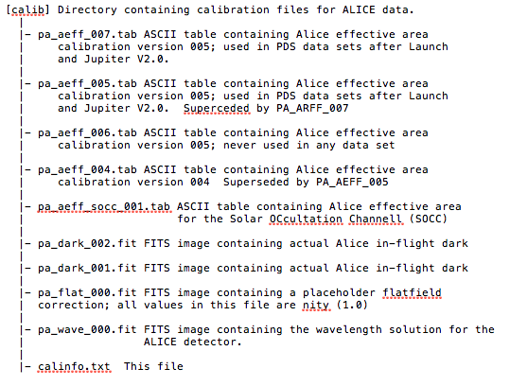
calinfo.txt (Levels 2 & 3)

Slide 5
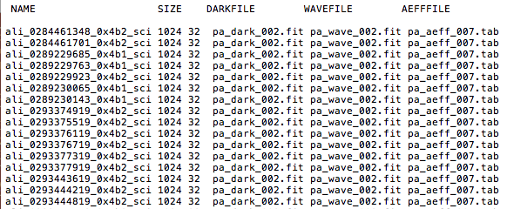
Calibration Files Used in Pipeline (for a subset of data)

Slide 6
Data Set Typos
See Lori Feaga’s submitted .txt file with full listing of typos

Slide 7
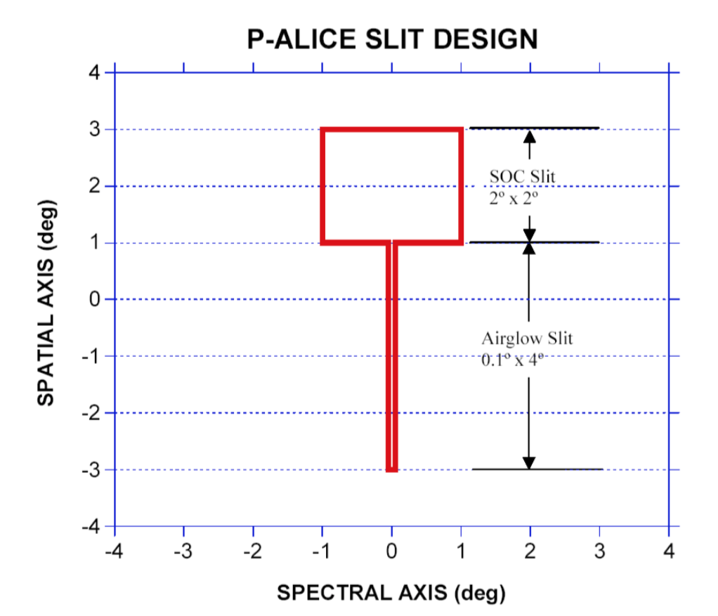
Alice Slit Shape
Solar
Occultation
Channel
Row 25 (zero indexed)
Row 19 (zero indexed)
Row 18 (zero indexed)
Row 6 (zero indexed)

Slide 8
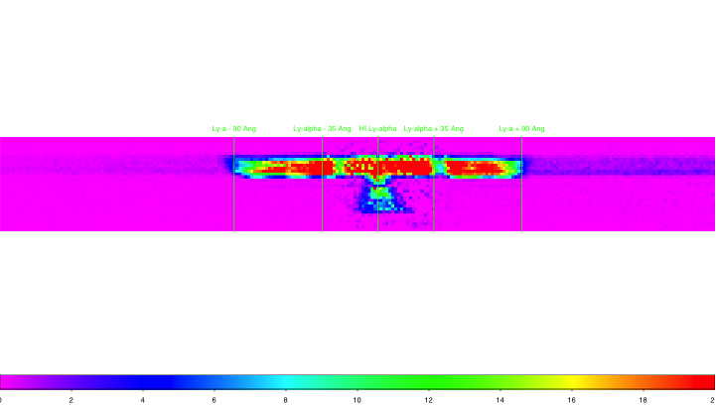
Lollipop “fuzz”
To reduce sensitivity at the bright HI Lyman-α emissions at 1215 Å, a 70 Å band of the photocathodes were not coated with KBr or CsI. However, in the 2°x2° box portion of the slit, the HI Lyman-α spreads out beyond the uncoated portion of the detector an additional ~110 Å. So, for ~90 Å [(70 + 110 )/2] on either side of the coated photocathodes, there is contamination from HI Lyman-α that has been dubbed the lollipop fuzz.
λ ➔
Wording in the dataset.cat:
“However, in the 2x2 degree box portion of the aperture designed to capture the Sun during occultations, the H Lya spreads out beyond the uncoated 70-Angstrom band over another ~110 Angstroms of photocathode-coated, more sensitive detector on either side.”

Slide 9
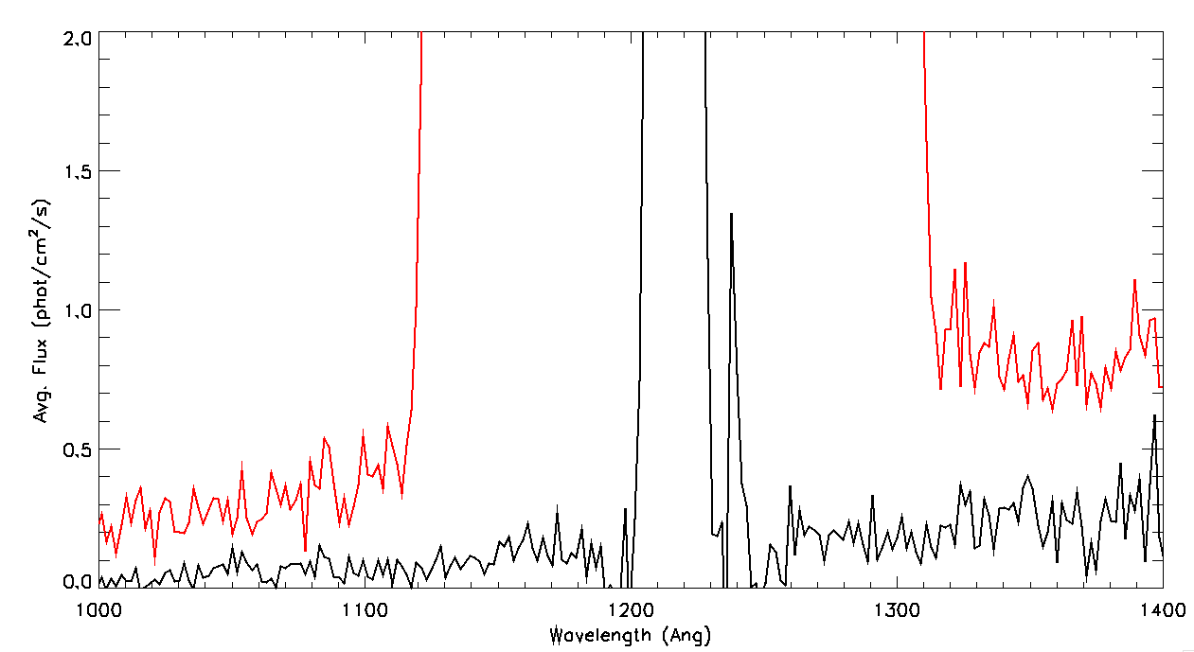
Lollipop Fuzz ~180 Å Wide Verified Spectrally

Slide 10
Basic Data Analysis

Slide 11
Checked data with NASAVIEW, SAOImage ds9, IDL ReadPDS
could display data with labels as expected

Slide 12
SPICE Geometry Check
Sunward Pointing (2015-06-16T16:41:38)
PDS label shows Sun to target distance of 0 km ✓
.fit file header agrees with SPICE for sub-S/C lat and long on Sun (5°,33°) ✓
Pluto Pointing (2015-07-13T06:41:40)
PDS label agrees with SPICE for S/C to target distance of 1444727 km ✓
.fit file header agrees with SPICE for boresight RA & dec, sub-S/C lat and long, etc. ✓

Slide 13
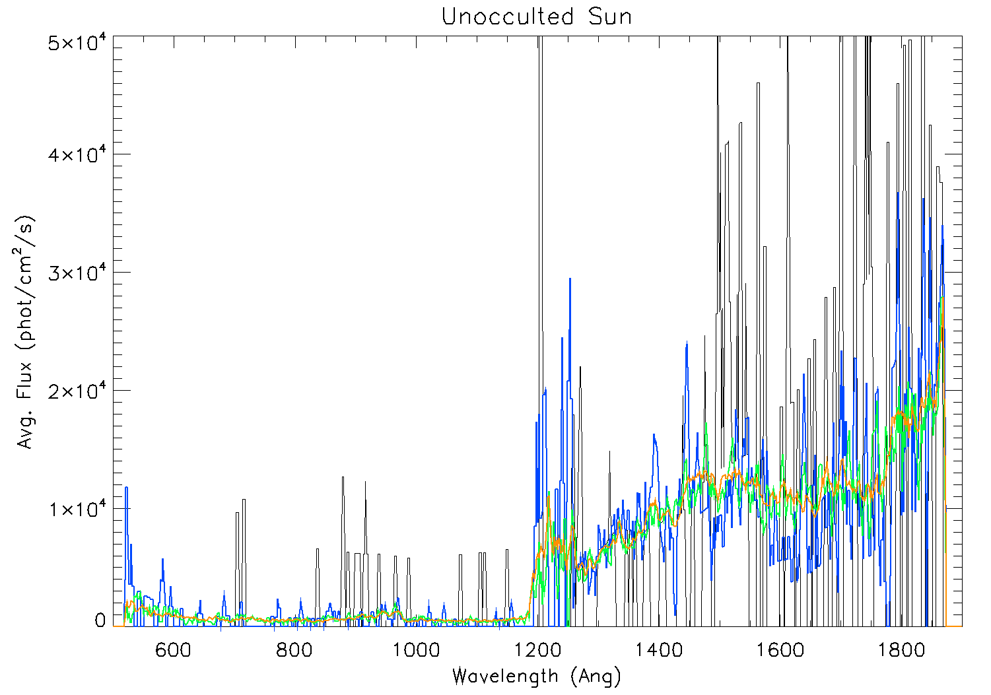
Increase in SNR w/ Exposure Time
1 sec
10 sec
100 sec
1000 sec

Slide 14
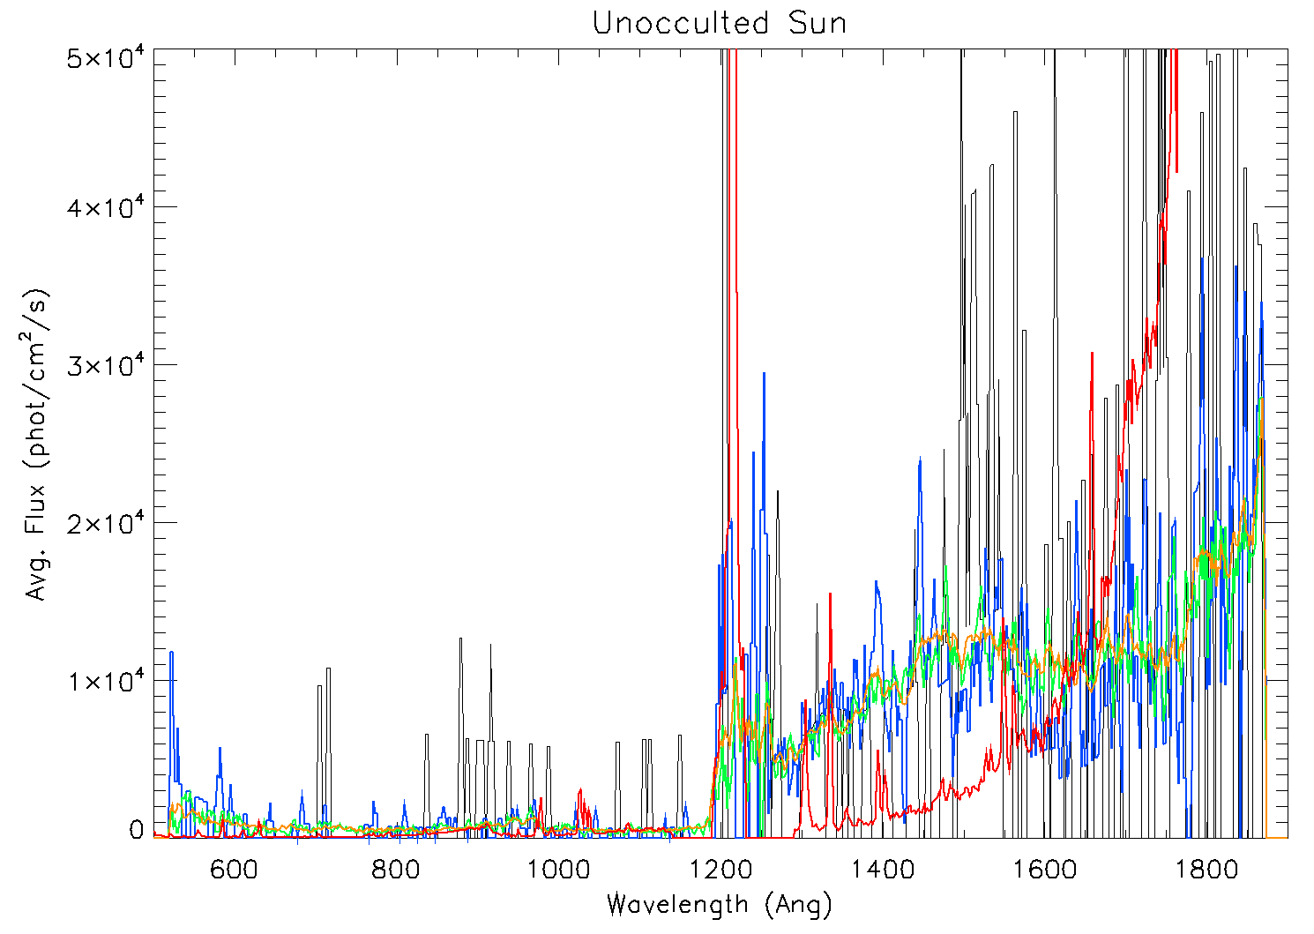
Scaled Sun Overplotted
Sun doesn’t match the spectra –
but should only be in one pixel,
so Sun not in the narrow slit

Slide 15
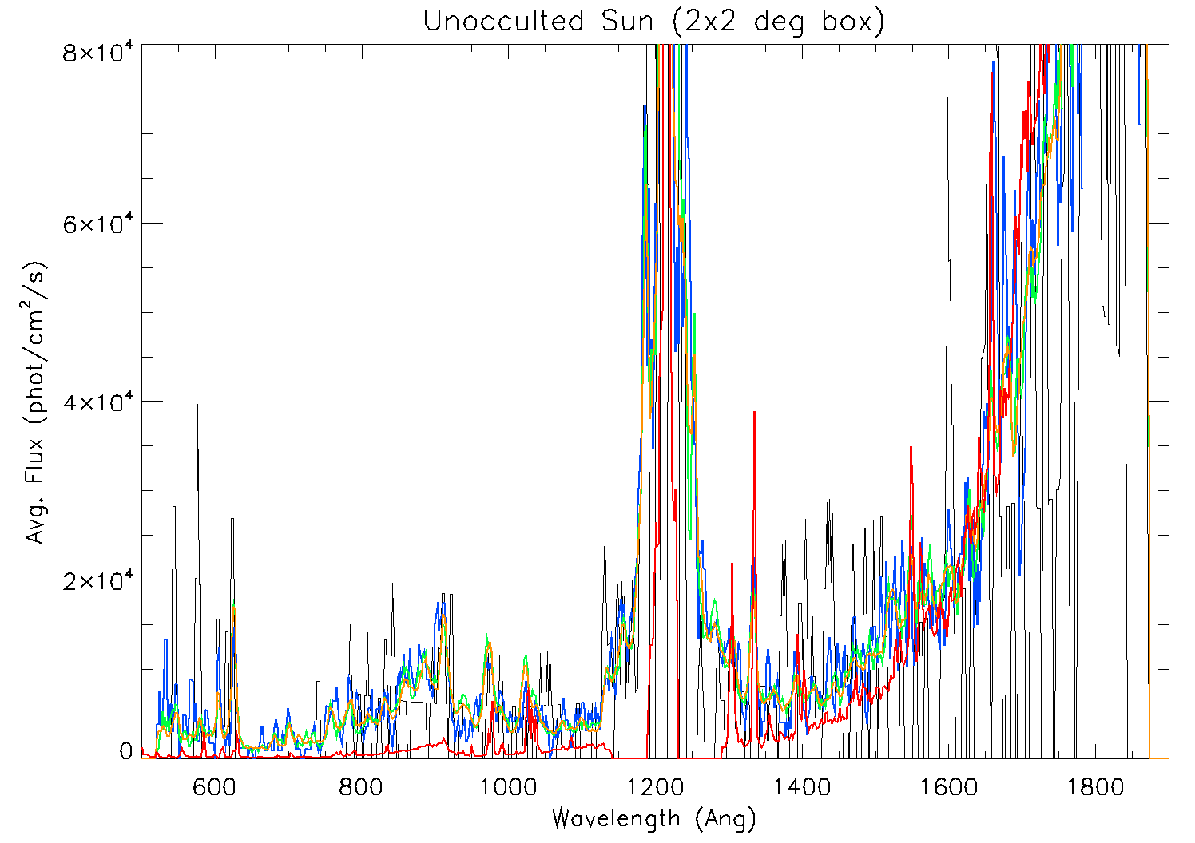
Scaled Sun Overplotted
Sun matches the spectra –
Sun in the wide slit (SOC)

Slide 16
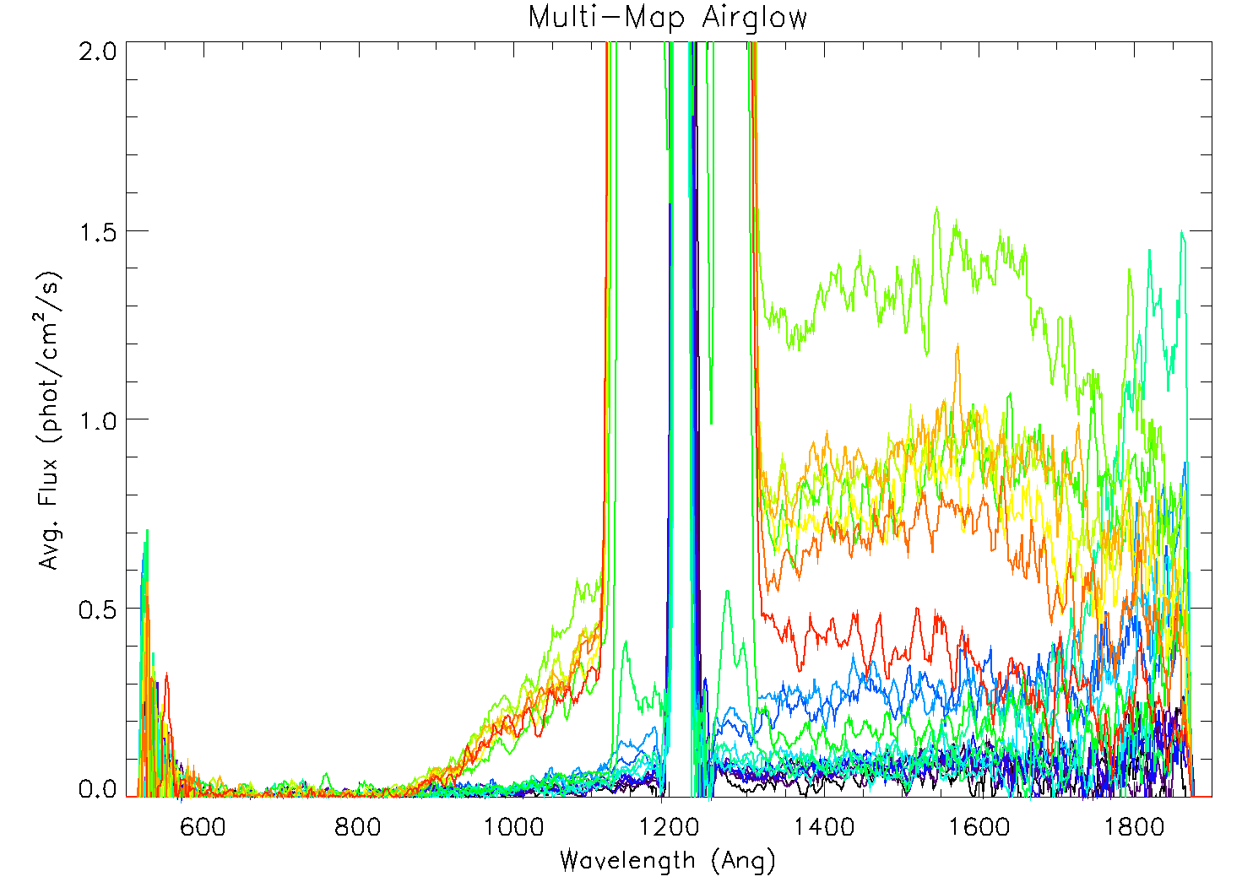
Pluto

Slide 17
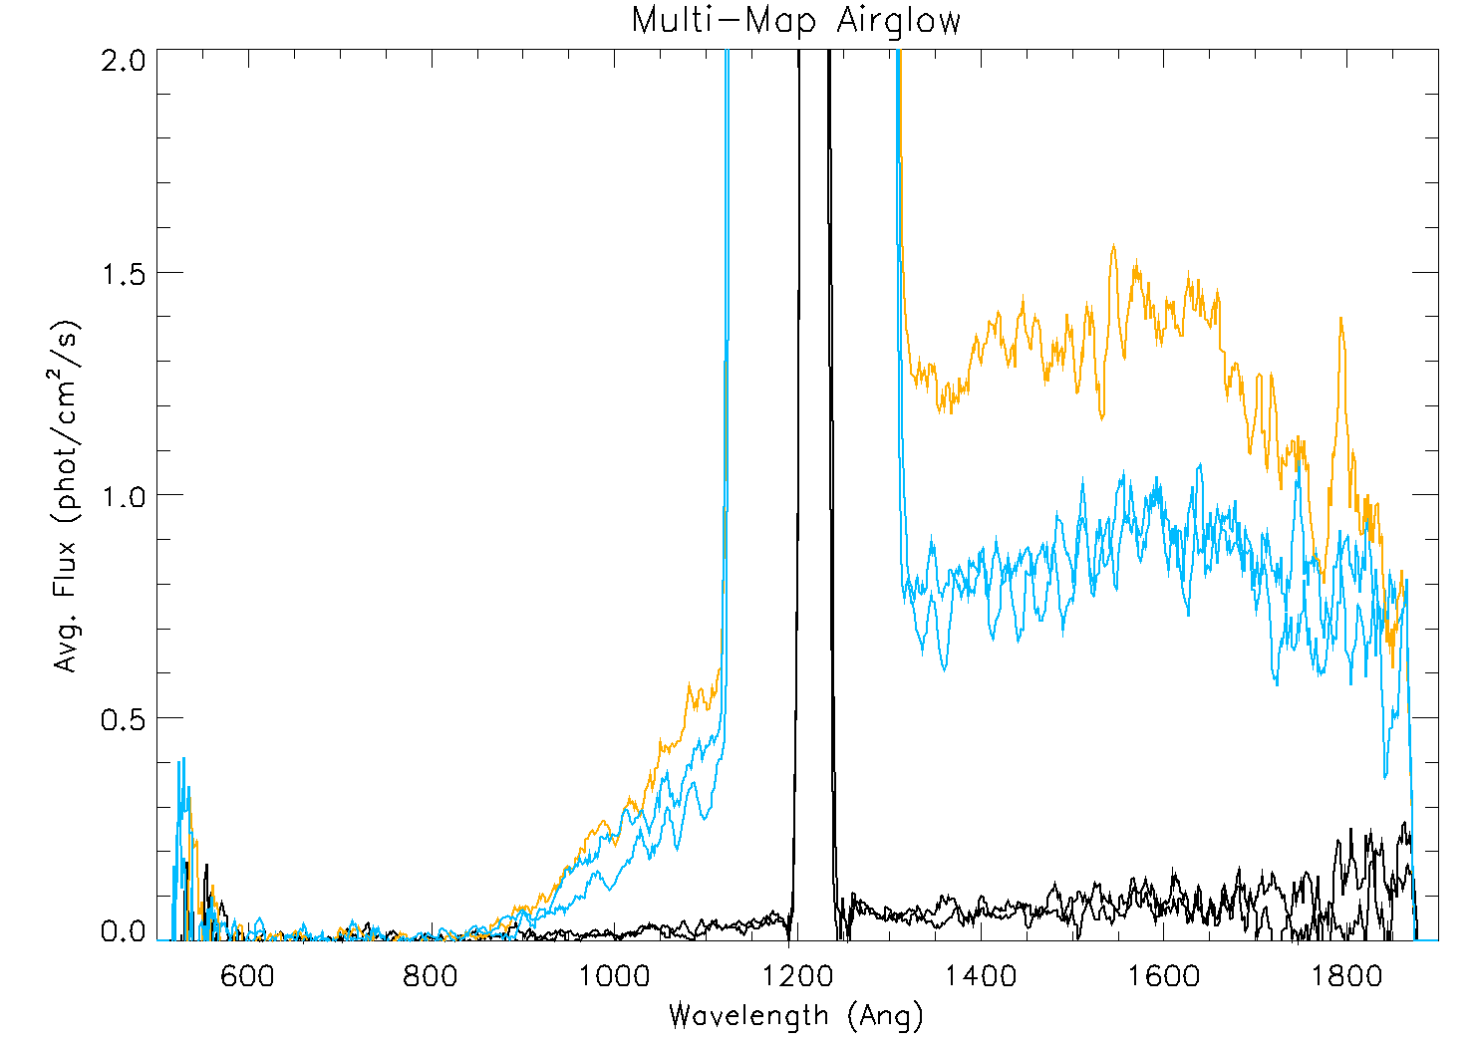
Pluto
Rows 7,8
Rows 19,21
Row 20

Slide 18
The End

