Slide 1
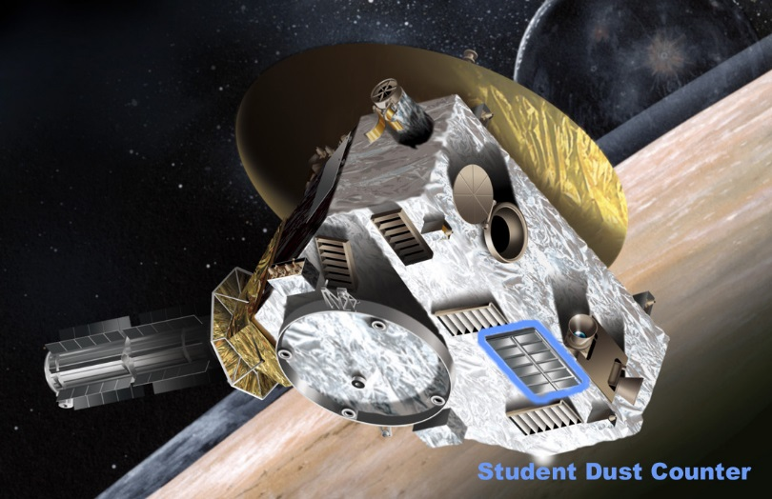
PDS Data Review
New Horizons Pluto Encounter
Student Dust Counter
May 19, 2016
Jim Gaier
NASA Glenn Research Center

Slide 2
Documentation
No issues with the documentation except:
NHSC.cat
Spacecraft sketches do not show position of SDC nor is its position described in the document
SOC to Instrument Pipeline ICD
P115, 13.2.1, 2) the unused channel should be 10 not 11 (which on higher level data products becomes 11)
P121, 13.4.4, 1) Calibrated Data - Only 9 columns are defined but there are 10 columns. “j. Impact Velocity” should be added

Slide 3
Calibration Data (last calibrated 5-13-2013?)
Downloaded calibration matrices through Browse
Plotted DNavg, SIG
DNavg data look reasonable
Temperature effects more pronounced at high counts
0 counts = 65535 and decreases with increased signal strength
Threshold (#7) set at 20,225 (45,310 or first 30 data points on charts)
SIG data look reasonable
Relative deviation (σ/DNavg) ranges 1% – 12%
Higher counts, higher relative deviation
Temp effects on relative deviation pronounced at high counts
Range 4% to 12%

Slide 4
Raw Data
Only used NASAView through Browse
Looked at data around Pluto encounter (PE)
Time Stamp issue?
Identical times often the same for same channel
(2,3) (5,6) (7,8) (11,12) (13,14) ….3917 (way before PE)
(2,3) (5,6) (8,9) (10,11) (12,13) (14,15) for ….8021 (before PE)
(2,3) (7,8) (11,12) (14,15) ….8022 (during PE)
(1,2) (3,4,5) (6,7) (8,9,10) (11,12) (13,14,15) ….8033 (after PE)
No clear hits (DNavg >> Threshold)
Before PE: 1 with magnitude 2% above threshold
During PE: 4 with magnitude (0.03 – 0.6% above threshold)
After PE: none above threshold
SDC not aligned in ram direction during Pluto Encounter
“Hits” not evenly distributed among active channels

Slide 5
Calibrated Data
Only used NASAView through Browse
Looked at data around Pluto encounter (PE)
Time Stamp duplications were propagated
No recorded hits
Mass = 0 for all DNavg (before, during, and after PE)
One mass > 0 datum at lowest possible in (way before PE) data

