Slide 1
LEISA
PDS review
19-May-2016

Slide 2
Documentation
The Ralph instrument SSR paper (Reuter et al.) described in aareadme.txt may be outdated
document/ralph_ssr.pdf
Perhaps use a more recent version; e.g.,
https://arxiv.org/ftp/arxiv/papers/0709/0709.4281.pdf
File
document/codmac_level_definitions.pdf
describes the NASA Level 1B (Resampled L4) as irreversibly transformed measured values. I assume these are derived from the calibrated L3? Please note the source.
Is document/leisa_window_pluto.* referenced in the introductory material? I could not find one. Minor typo “wwindows” in leisa_window_pluto.lbl.
Ralph FOV definitions in aareadme are useful. Files in catalog directory (leisa.cat and nhsc.cat) have good ASCII drawings that relate the array scan direction in the context of the spacecraft frame. However, consider including a brief discussion on how the spacecradt frame definitions in these drawings relate to the figures in ralph_ssr.pdf and payload_ssr.pdf (see next two pages). This will facilitate understanding the reference frames and push broom direction.
Minor typo “lossles” in catalog/leisa.cat.
WHY TWO identical aareadme.txt files (document/aareadme_bu.txt)? Was this intended?

Slide 3
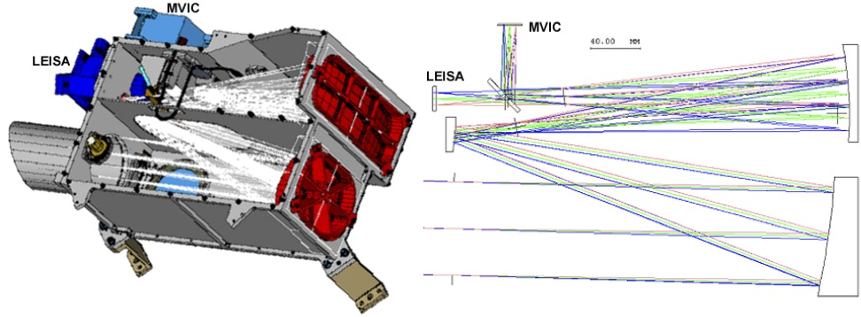
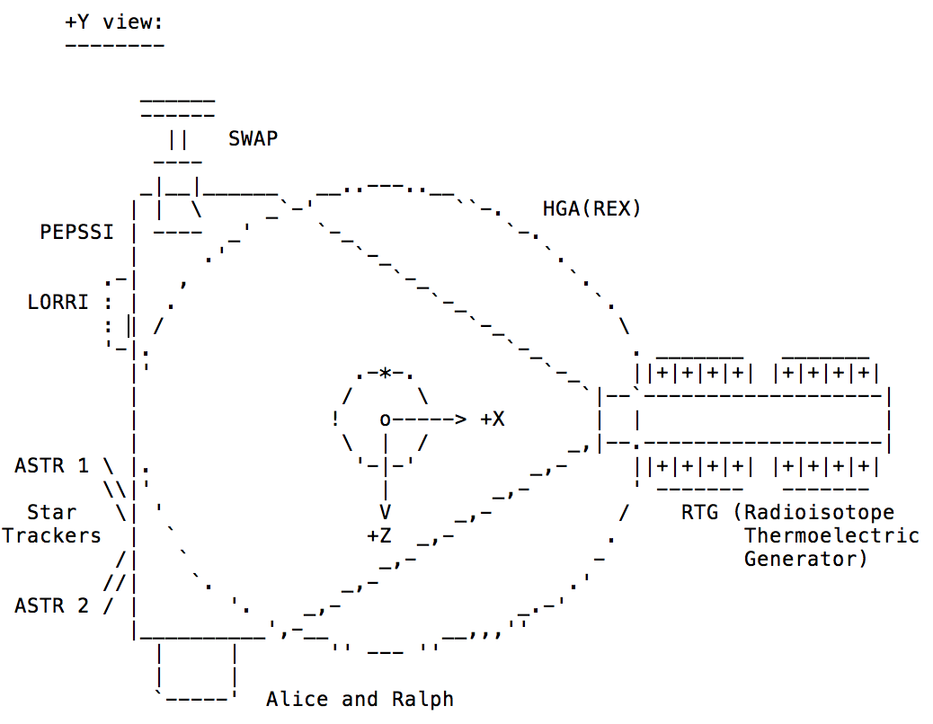
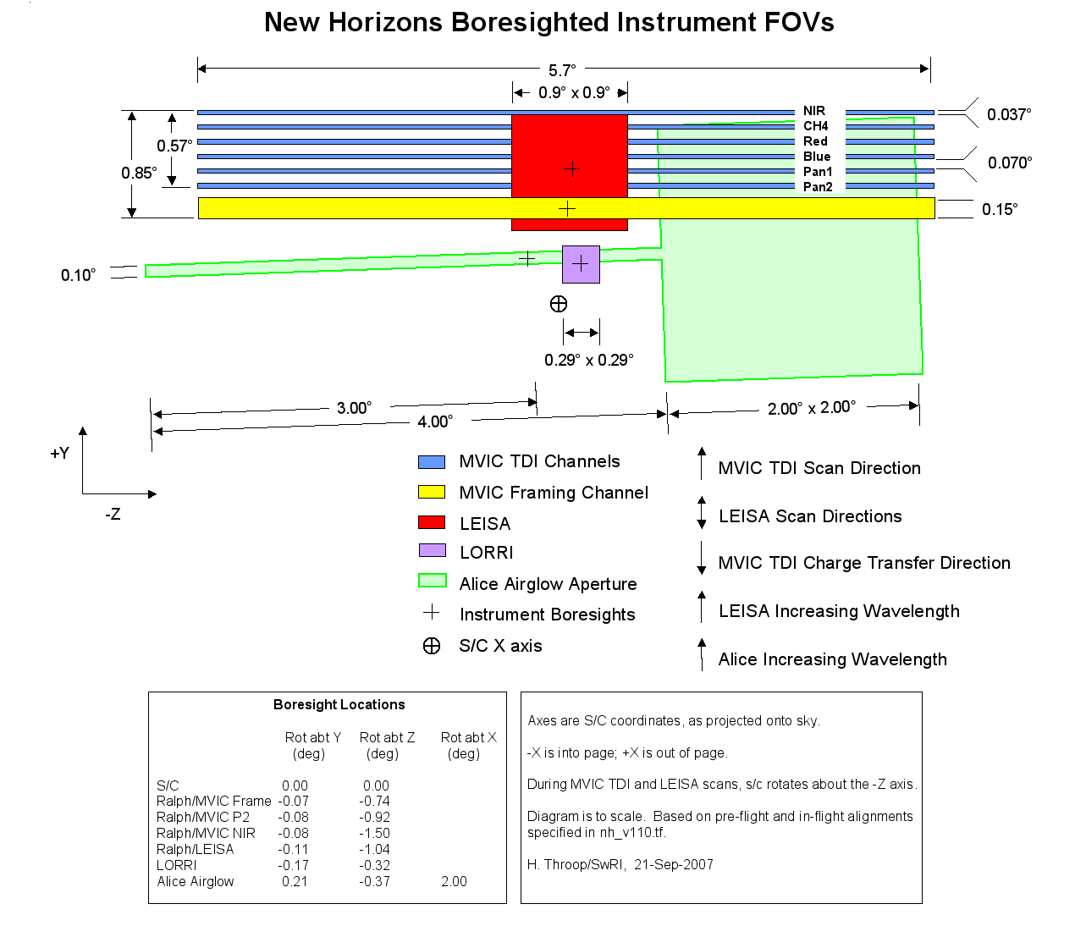
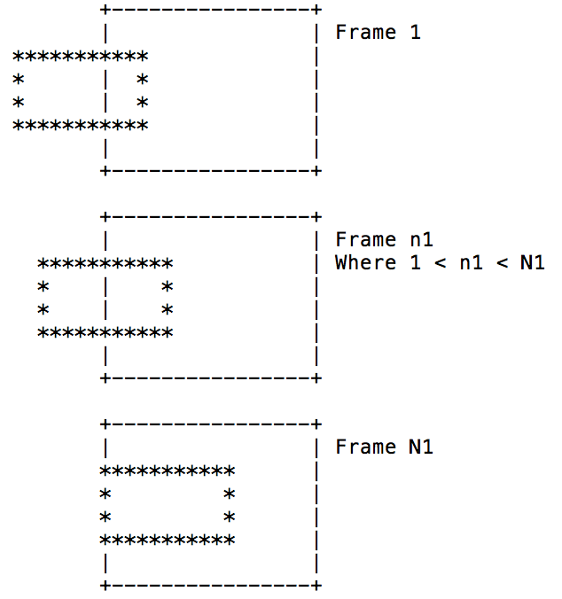
~/document/ralph_ssr.pdf
–X?
~/document/payload_ssr.pdf
~/catalog/nhsc.cat
~/catalog/nh.cat

Slide 4
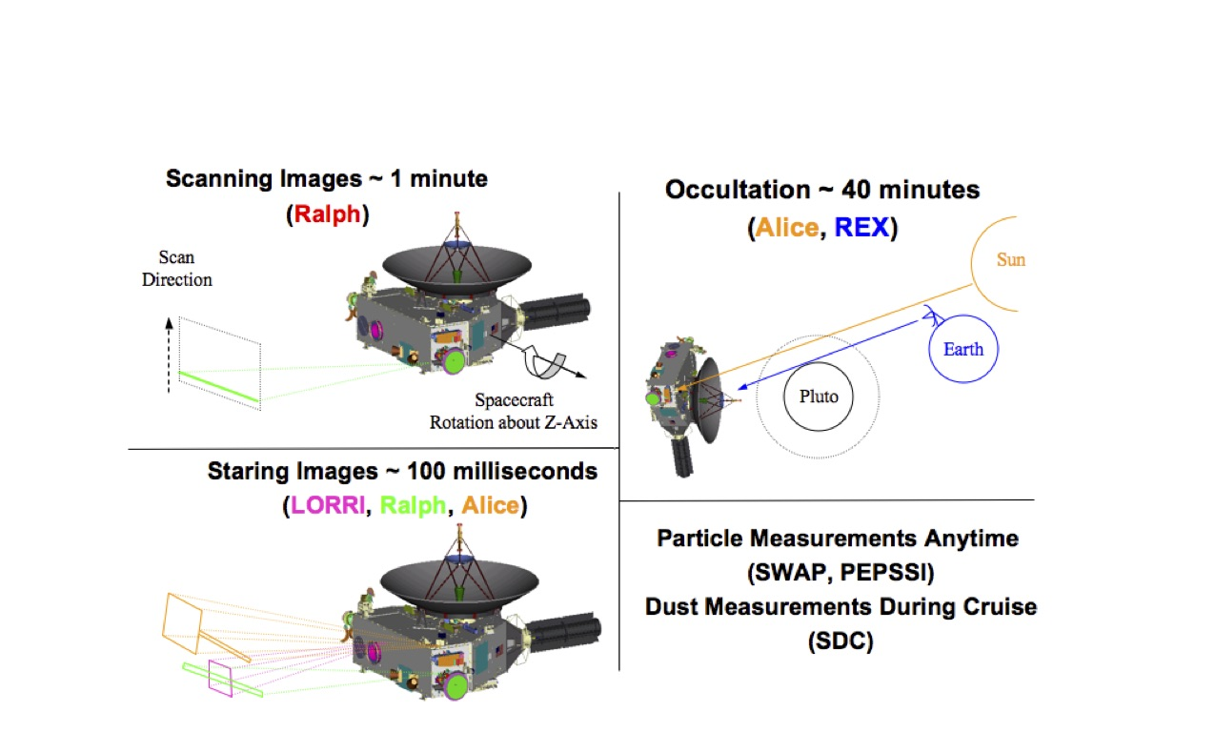
~/document/payload_ssr.pdf

Slide 5

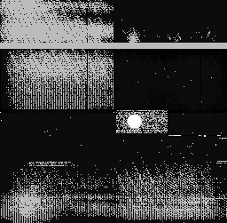
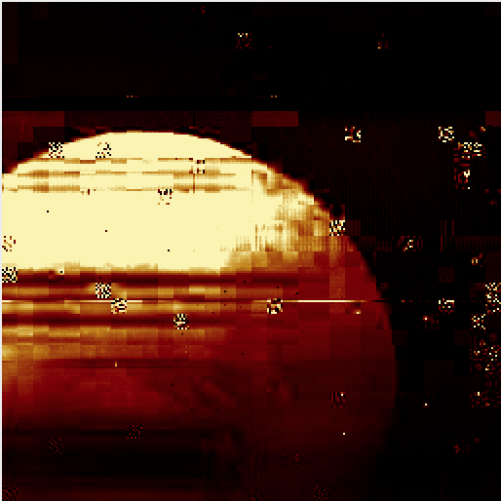


Data quality
Where are the BAD PIXEL VALUES defined?
What about the Jupiter encounter data & Pluto post-encounter? Perhaps add a note to anticipate these in a future PDS release?
The FITS data can be read with IDL (readfits), QFitsView, NIH/Image, GraphicConverter etc (OSX and Linux). Quick looks were easiest with QFitsView.
Windowing was paticularly useful in quick scans to identify appropriate frames –
especially in finding Charon!
TARGET_CENTER_DISTANCE = 152003.15 <km>
Verified that with the appropriate stretch, the target is seen as it passes throught the window.
Left: ~/nh-p-leisa-3-pluto-v1.0/data/20150714_029916/lsb_0299169338_0x53e_sci.fit
Spot check of ephemeris
~/nh-p-leisa-3-pluto-v1.0/data/20150712_029899/lsb_0298995539_0x53c_sci.lbl (right)
TARGET_CENTER_DISTANCE = 2547089.1 <km>
SC_TARGET_POSITION_VECTOR = (14971.796 <km>, -2466566.2 <km>, -635208.66 <km> )
SOLAR_DISTANCE = 4.9228360e+09 <km>
JPL/Horizons gives below values. The range and spacecraft and heliocentric ranges match.
2015-Jul-12 08:00 4.922834558E+09 1.0621094 2.5722797241E+06 -13.7836607
2015-Jul-12 09:00 4.922838381E+09 1.0621121 2.5226584928E+06 -13.7836514
The data set appears to be well prepared and presented.

Slide 6
Notes on file catalog/nh.cat
Contains appropriate information.
Post-Launch Checkout:
Checkout phase is <12 months, but
"The first 13 months (through 2007-01-19) include spacecraft and instrument checkouts"
--> is it 12 months or 13 months
Mission Phase Stop Time
Pluto Cruise:
Mission Phase Stop Time - 2015-01-15
is the same as Mission Phase Start Time of
Pluto-Charon Encounter
Mission Phase Start Time - 2015-01-15
I guess these overlaps are OK (as per aaReadme).
These can be ignored

Slide 7
Notes on file catalog/nhsc.cat
For completeness, suggest to add wavelength range for MVIC and LEISA in the first paragraph for RALPH.
RALPH/LEISA operates at infrared wavelengths, and its etalon (a WEDGED filter.......
> Check statement
more than 4 billion miles from Earth → >4.9 billion km from Sun
Change unit to km.
Measured Parameters
Radiance. ----> Units?

Slide 8
dataset.cat
low (1.225-2.5 micron) spectral resolution segments.
---> 1.25
During the Pluto mission phase starting in January, 2015
----> Pluto-Charon Encounter?
Add sub-phases (AP1,AP2,AP3) to nh.cat file? Are these DP1,DP2,DP3?

Slide 9
Data header/extensions
When reading ext=1, the header does not contain array type (wavelength) & units. OK?
Window coordinates in header look OK.
SPCT SCX, SCY, SCZ are at defaults
Blank data nh-p-leisa-3-pluto-v1.0/data/20150703_029827/lsb_0298270709_0x53c_sci.fit
These can be ignored

Slide 10
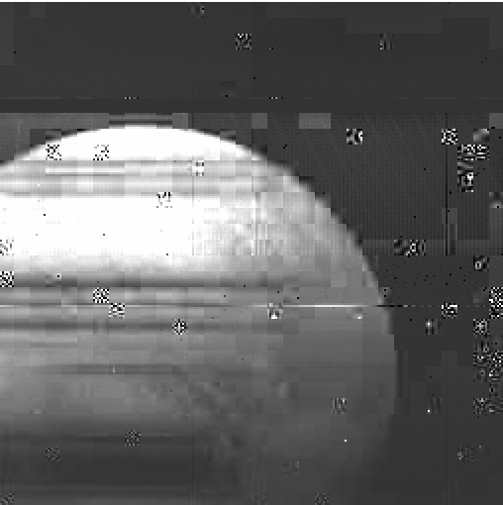
Sanity check on data
~/nh-p-leisa-3-pluto-v1.0/data/20150714_029916/lsb_0299169338_0x53e_sci.fit
Target – Pluto (closest encounter)
Take a slice in wavelength
~/nh-p-leisa-3-pluto-v1.0/data/20150714_029916/lsb_0299169338_0x53c_sci.fit
Target – Pluto
Target missed
My mistake
Ignore comments
~/nh-p-leisa-3-pluto-v1.0/data/20150714_029917/lsb_0299171308_0x53c_sci.fit
Target – Charon
Seems like the target was missed

