Slide 1
NH MVIC Dataset Review
Jian-Yang Li
Planetary Science Institute
May 19, 2016, UMD

Slide 2
Dataset Overview
NH-P-MVIC-2/3-PLUTO-V1.0
Raw and calibrated MVIC imaging data from NH during approach from 2015-03-03 to 2015-07-14
MVIC is a multi-color imaging instrument
One panchromatic framing camera (MPF)
Two panchromatic TDI (MP1, MP2)
Four filtered TDI (MC0 – MC3) with red, blue, NIR, and CH4 filtes
All detectors 5024 (24 columns of overscan) wide
MPF 128 lines
TDI detectors 32 lines
The science goal during this time period is to obtain color images of Pluto, Charon, and Nix to monitor temporal variations

Slide 3
Review Overview
Excellent dataset
Comprehensive information included
Complete and clearly written documentation
Some problems are identified, mostly minor

Slide 4
Catalog Files
dataset.cat in level-3 data
Calibration section, the last paragraph is potentially confusing
All other catalog files read well

Slide 5
Documentation
nh_mission_trajectory.tab contains the trajectory of the whole mission, nh_trajectory.tab covers the first half of 2007 (Jupiter phase). Suggest to remove the latter
No documentation for FITS header keywords found
No documentation for the columns of housekeeping data table contained in each raw images (to follow up)
soc_inst_icd.pdf (next slide):
page 54, table 10-2, 10-3: Data format not consistent with the specifications in these two tables
page 66, 10.3.4: The unit for resolved and unresolved sources are reversed
page 67, 10.3.6: Information outdated, and conflict with 10.3.13

Slide 6
soc_inst_icd.pdf
page 54, table 10-2, 10-3: Data format not consistent with the specifications in these two tables
028769/mc0_0287692247_0x536_eng.fit:
HOUSEKEEPING table 75 columns
WINDOW_MISMATCHES table 10 columns

Slide 7
soc_inst_icd.pdf
page 66, 10.3.4: The unit for resolved and unresolved sources are reversed

Slide 8
soc_inst_icd.pdf
page 67, 10.3.6: Information outdated, and conflict with 10.3.13

Slide 9
Calibration
Based on the ICD document, different objects have different calibration constants (due to their different color/spectra), but which one is used if multiple objects (e.g., Pluto and Charon) are in the same frame?
calib/ directory is included in level-2 dataset. Is it needed?
I did not verify calibration from raw images to calibrated images

Slide 10
Data
Both datasets contain the same number of images with names and directories corresponding to each other
PDS labels:
Include exposure time and additional information, such as more geometry information, calibration constants used, etc., in PDS labels?
The UNIT in PDS labels for calibrated data is wrong: “DATA NUMBER”
The TARGET keywords in images in 20150303/ have values “---” in FITS headers, and “N/A” in PDS labels (both raw and cal datasets). Is this legal?
FITS headers do not have keyword BUNIT
Long documentation in PDS label file for the FITS extension WINDOW_MISMATCHES table for windowed observations, but need a pointer somewhere in dataset level documents to tell users the location of this description

Slide 11
Images
All images loaded and displayed well
Directions are all defined
Display direction from readpds and DS9 are consistent
No problems identified

Slide 12
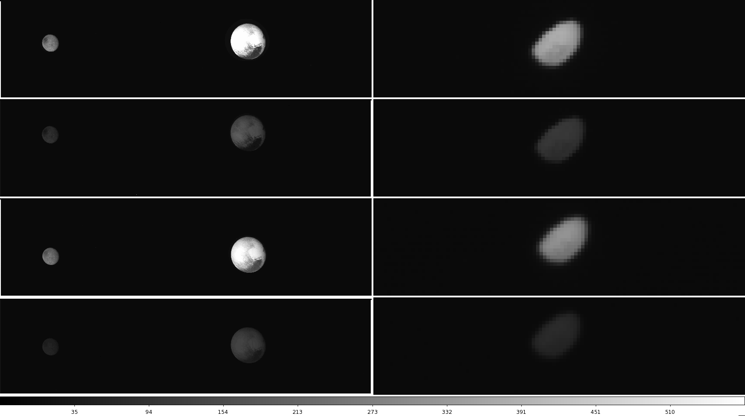
Examples
Color images taken on 2015-07-14

Slide 13
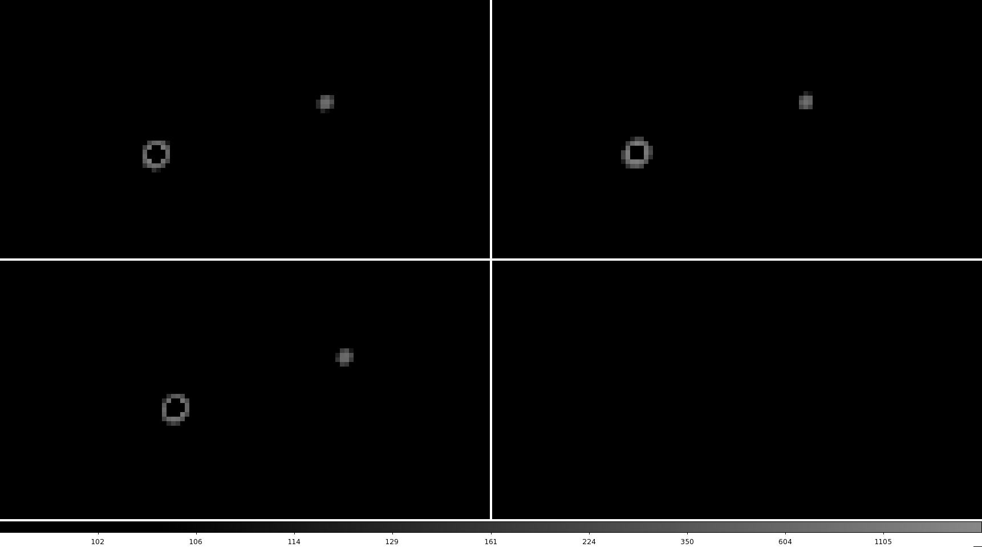
Examples
Panchormatic framing camera images (MPF) taken on 2015-06-23

