Slide 1
New Horizons LEISA PDS Review

Slide 2
NH LEISA Data
Overall – Looks good.
Documentation
Generally thorough
Missing a number of definitions for acronyms
Handful of typos noted

Slide 3
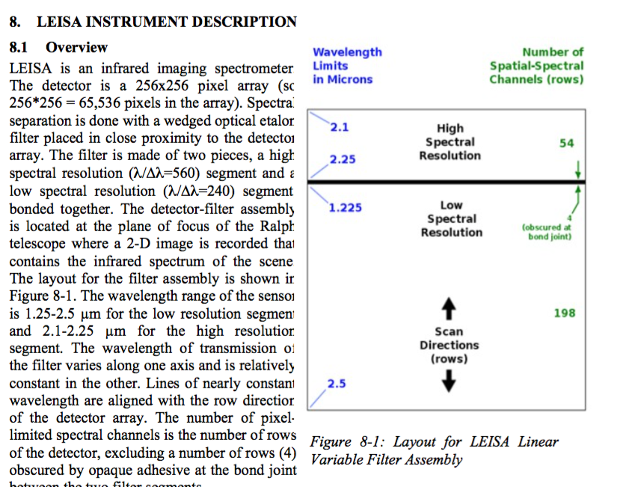
LEISA Data Overview

Slide 4
Data
Checked data with SAOimage DS9, Qfitsview, and IDL.
Could read and display data with labels as expected

Slide 5
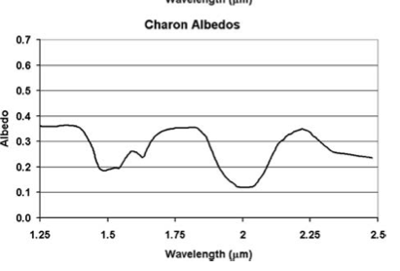
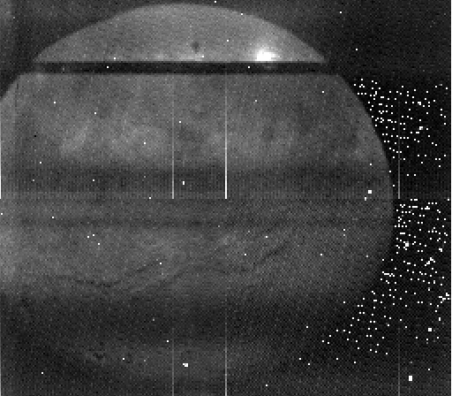
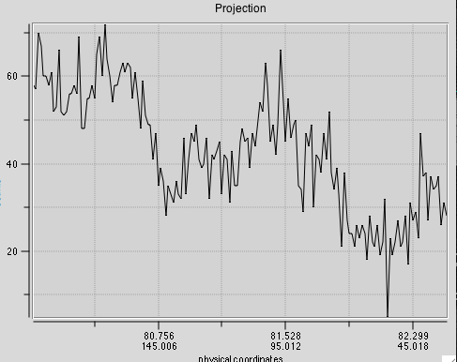
Charon
H2O Features
Charon as seen in: DATA/20150714_029917/LSB_0299175509_0X53C_ENG

Slide 6
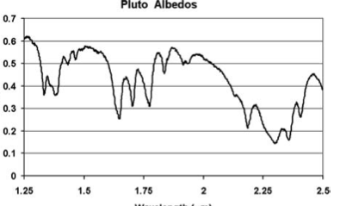
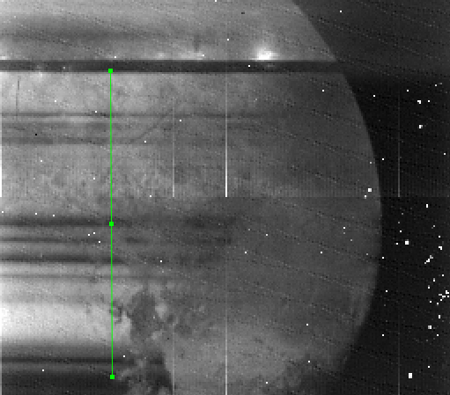
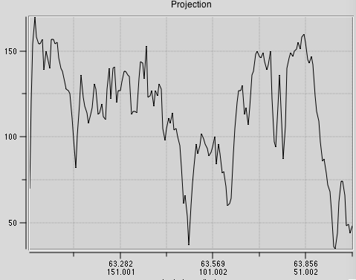
Pluto
lsb_0299172889_0x53c_eng.fit

Slide 7
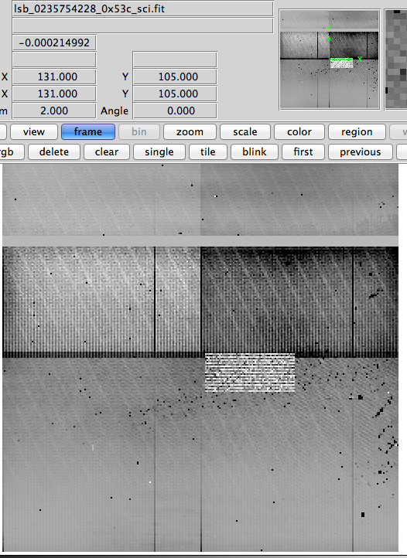
PlutoCruise – Encounter Rehearsal

Slide 8
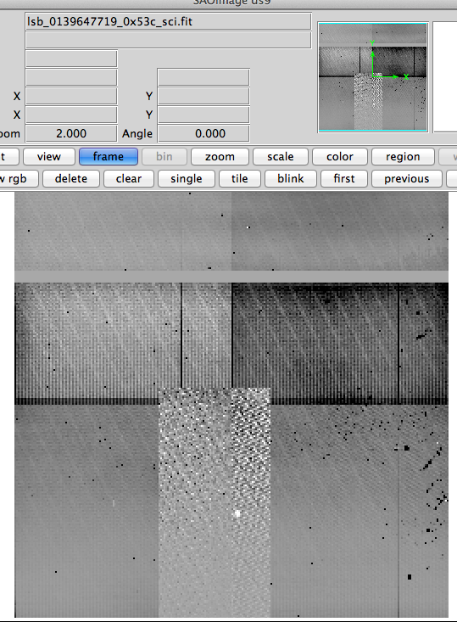
PlutoCruise Vega Obs
Vega is identified
Window height appears incorrect in lbl file
Realized encounter stores windowing summary in file “leisa_window_pluto.csv” Should this be provided for plutocruise phase?

Slide 9
Documentation and Labels
Catalog/
introdoc.pdf
line 1: "[instrument]" appears that it should be filled in with the appropriate instrument.
line 2: typo "here tfor"
Directory section line 4 typo: " SuBtracted”. line 5: EDR and RDR acronyms not defined.
Data File contents acronyms EDU, ICD not defined.
nh.cat
"Mission phases and sub-phases in data products" uses sub-phases that are not defined "ACO#" "AP#" "DP#"
nhsc.cat
I prefer for wavelength ranges of instruments to be provided rather than just the general "visible" and "infrared" description.
leisa.cat
Some acronyms not defined: FOV, MVIC TDI channels, IFOV, LVF, SSR1, CDH1 (likely more)
line 257: "The LEISA ApIDs, the algorithm, and whether the data are stored on SSR1 by CDH1 or on SSR2 by CDH 1 are shown in the following table:” I assume they mean "SSR2 by CDH2" according to the table that follows this line.
dataset.cat
starting at line 47: “- Uranus with MVIC at phase angles not available from Earth “ (and Neptune next line) → what phase angles?
line 55 - what is SIA? (it is defined in line 76)
acronyms: CODMAC

Slide 10
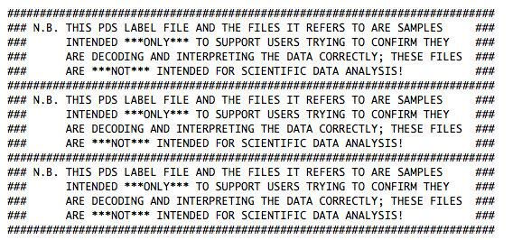
Documentation and Labels
document/docinfo.txt
line 51: 3) SOC Instrument Interface Control Document (aka the 'ICD') → 1) and 2) provide the file name, it would be best to use the file name when possible. In this case: soc_inst_icd.pdf. Same applies for reference 4) on line 76
line 29 of leisa_window_pluto.lbl - actual phase name wasn't inserted below.
spacecraft during the
$(phaseUC)s
mission phase.
document/stis_solar.lbl
line 44: type "specturm" should be "spectrum" : Multiply by a target's geometric albedo specturm, and divide by r (AU;
document/samples/leisa_samples.lbl
lines 71-80 are repetitive: (note this is true for all lbl files in the document/samples folder for all four LEISA datasets

Slide 11
Documentation and Labels
Calib/ and index/ look fine. No issues noted.
Data/ typo noted in lbl files
"Ephemeris time and quaternion fo each frame"

