Slide 1
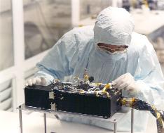
P-Alice PDS Data Review Cruise & Pluto Encounter phases
Cesare Grava

Slide 2
Characteristics of P-Alice
520-1870 Angstroms (though only 780 columns are active, starting from 130th)
Spectral dispersion: 1.832 Å/pixel
Lollipop-shaped slit: 0.1x4.0° for the AirGlow Channel (AGC) + 2.0x2.0° for the Solar Occultation Channel (SOCC)
Two modes of operation:
Pixel list mode: preserves time information
Histogram: 2D histogram of previous
You can create a histogram from pixel list but not vice versa
Very similar to the LRO/LAMP UV spectrograph I work with.

Slide 3
Objectives of P-Alice
To determine or constrain:
The mixing ratios of N2, CO, CH4 and noble gases;
The vertical density and temperature structure (e.g., gradient) of the upper atmosphere;
The atmospheric haze optical depth;
The atmospheric escape rate and escape regime;
The brightness of airglow emissions from Pluto’s atmosphere

Slide 4
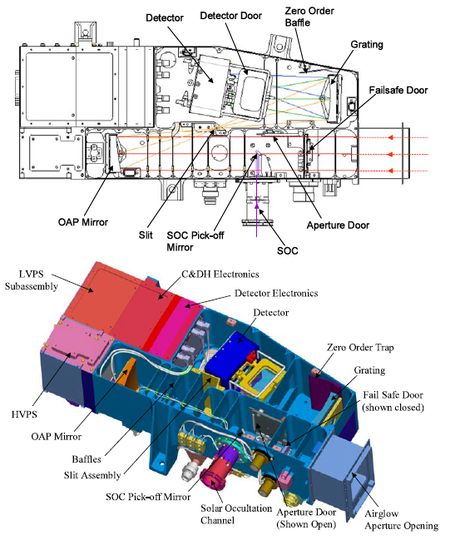

Slide 5
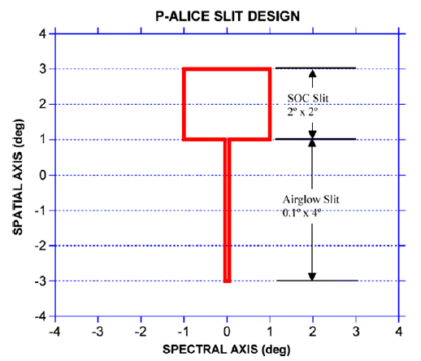

Slide 6
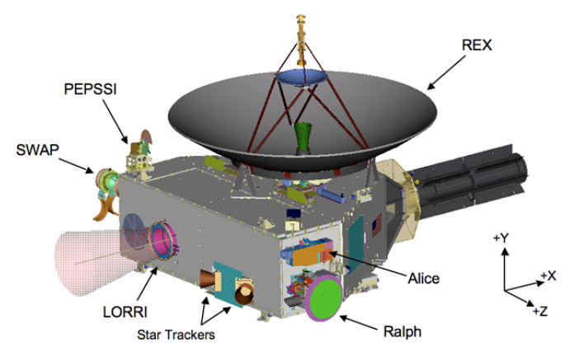

Slide 7
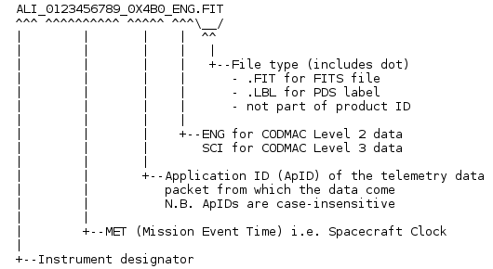
Datasets Reviewed
nh-p-alice-2-pluto-v2.0
nh-p-alice-3-pluto-v2.0
nh-x-alice-2-plutocruise-v2.0
nh-x-alice-3-plutocruise-v2.0
Naming convention:

Slide 8
Document\, including samples\ & aaa_generic_readme\ subdirectories
Docinfo.txt, which explains what’s in here and recommends the following 3 files;
nh_obs_geom.pdf (redundant), which has 3 figures from Payload_ssr.pdf (plus one number in figure 2)
Payload_ssr.pdf (it is basically the Weaver et al. 2008 SSR paper), which includes figures from nh_obs_geom.pdf and additional references;
Soc_inst_icd.pdf: the link to the FITS is broken! Units: photons/cm2/s
The 2 SSR paper(s) + lunineetal1995.pdf: ok
Seq_alice_pluto(cruise).tab: Missing CoccEgress. (I found the time in Sup. Mat. of Gladstone et al. 2016 Science…)
Nh_mission_trajectory.tab: not understood why s/c and dust particle, but file is ok.
Aareadme_bu.txt: Backup copy of top-level AAREADME.TXT
Quat_axyz_instr_to_j2k.asc: OK
Codmac_level_definitions.pdf: link is not working
nh_fov.png: ok
Nh_met2utc.tab: converts MET to date (neat, but wouldn’t it be better if they included a routine?)
Nh_trajectory.tab: not explained! What is that?
nh_alice_v200_ti.txt : not referenced in docinfo.txt
Samples\ & aaa_generic_readme\ directories: ok

Slide 9
Index\
Slimindx.tab is very useful to know the target of each file! This has to be used after you checked in Seq_alice_pluto(cruise).tab the type of sequence you want (i.e. Pluto airglow, Pluto occultation, Charon occultation, etc.)
Checksum.tab: MD5 checksums for each file on this volume
Indxinfo.txt: explains what’s in here
Index.tab: location of each data file on this volume

Slide 10
Catalog\
Alice.cat: describes the instrument and its 2 operating modes and explains the PHDs;
Catinfo.txt : explains the files contained here
Ref.cat: references
Nh.cat: explains the mission goals and phases
Nhsc.cat: explains the s/c (I read just Alice section)
Dataset.cat: phases (sequences) of the mission (AP1, NEP, DP1, etc.), caveat on TARGET ID, etc.; it points to one file in Document\ which is missing;

Slide 11
Calib\
Calinfo.txt: explains what’s in here
All other files I’ve tested them (latest versions)
Problem with aeff_socc: why does it have a different “sampling” than the airglow aeff?

Slide 12
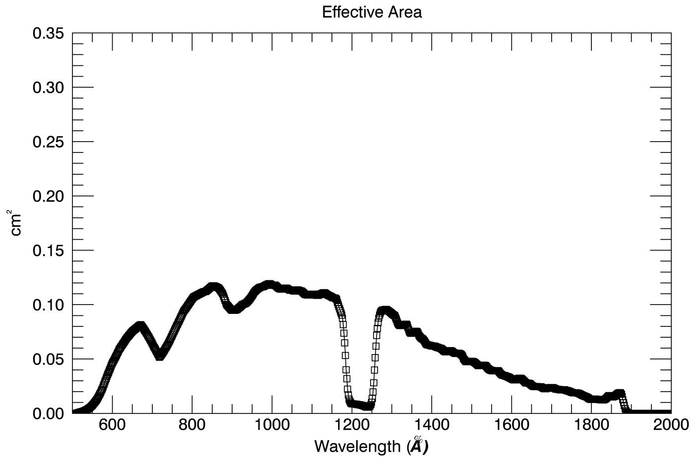
Calib\
Effective area airglow (pa_aeff_007.tab):
Good: slightly more sensitive than what reported in fig. 21 (top) of Stern et al. 2008

Slide 13
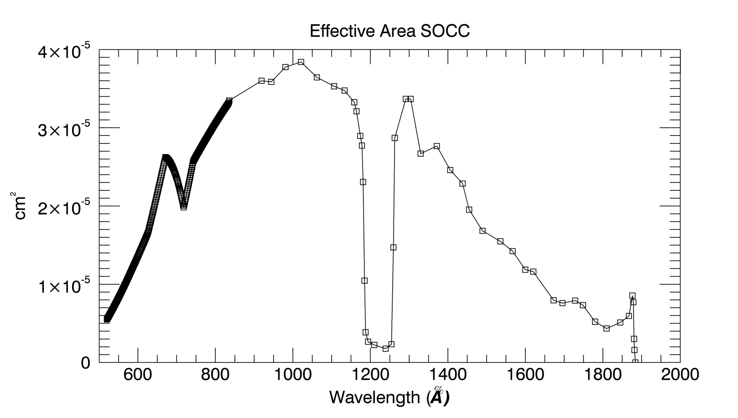
Calib\
Effective area SOCC (pa_aeff_007_socc.tab):
Resolution is not sampled as the Aeff (every ~1.8 Å). Instead, it is sampled every 1.0 Angstrom until ~836 Å
Afterwards, it is defined every ~30-40 Å
Why?

Slide 14
Calib\
nh-p-alice-3-pluto-v2.0\calib\pa_dark_002.fit
Dark: ~3 hrs integration time; mean ~0.004 counts/sec

Slide 15
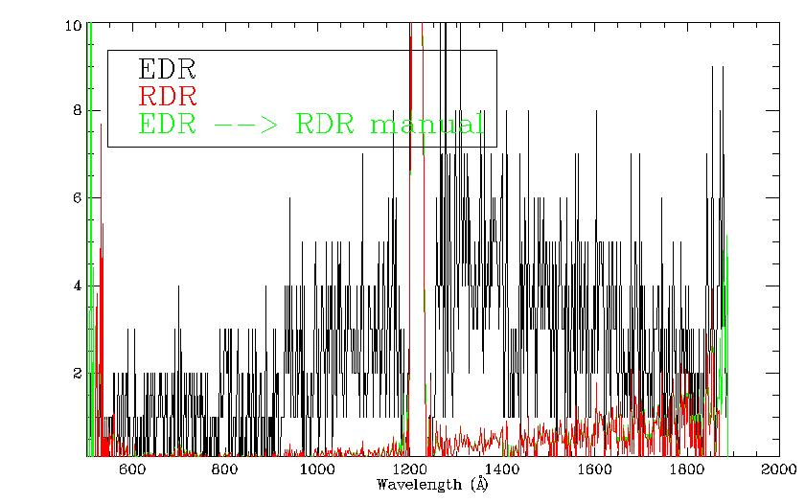
Data\
nh-p-alice-3-pluto-v2.0\data\20150714_029921\ali_0299219555_0x4b2_sci.fit
SAPNAME: P_LORRI_ALICE_DEP_2_AH
SAPDESC: Alice Ride-Along
VISITDSC: Alice Airglow, 12x 150sec
DATE = 2015-07-14T22:39:20.876
APERTURE = AIRGLOW
TARGET = PLUTO
Possible to reconstruct the RDR from ENG file: good

Slide 16
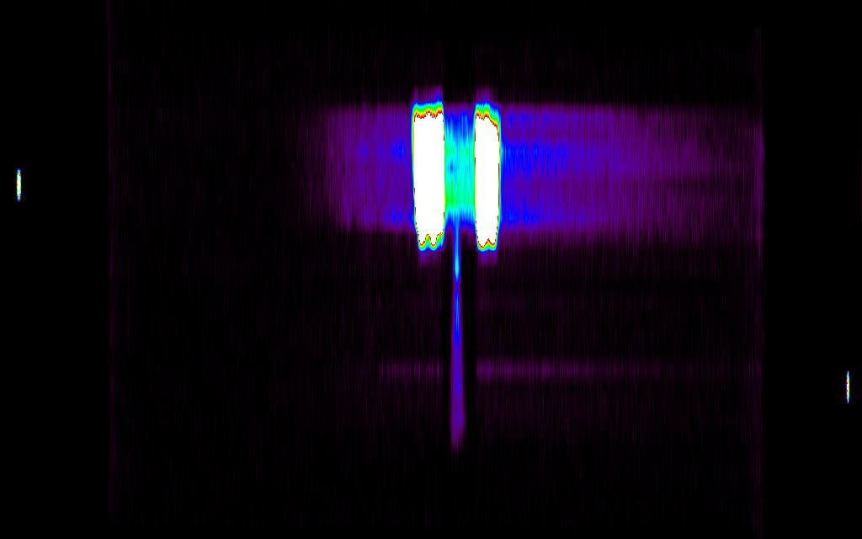
Data\
nh-p-alice-3-pluto-v2.0\data\20150718_029950\ali_0299509700_0x4b2_sci.fit
SAPNAME: P_AIRGLOW_DEP_A_3
SAPDESC: Alice 45m airglow observation of Pluto+Charon (histogram)
VISITNAM: P_Airglow_Dep_A_3
VISITDSC: Alice Airglow, 9x 300sec
DATE = 2015-07-18T07:13:50.880
Lollipop-shaped fuzz is SOCC aperture

Slide 17
Rummaging through the headers
type of observation (histogram/pixel list)
EPHEMERIS
SUB-PHASE
START & STOP TIMES
EXPOSURE TIME
S/C POSITION WRT SUN
DARK FRAME USED
EFFECTIVE AREA USED
FLAT FIELD, BIAS
TARGET NAME
All looked good

Slide 18
Evaluation Tools
Laptop Lenovo Thinkpad:
Virtual Machine Oracle Fedora 17x86_64
Windows 7
IDL 8.4
Readpds v4.8
Astron library

Slide 19
RIDs

Slide 20
RID 101
RID Classification: Major
Location: Calib/
Dataset: ALL
Title: effective area file for SOCC.
Description: the effective area file, and its wavelength solution, have different sampling.
Recommended Solution: adopt same sampling as the airglow channel

Slide 21
RID 102
RID Classification: Major
Location: Document
Dataset: ALL
Title: missing CoccEgress info.
Description: The Charon occultation egress sequence is missing from the files Seq_alice_pluto(cruise).tab
Recommended Solution: insert details of Charon occultation egress

Slide 22
RID 103
RID Classification: Major
Location: Document
Dataset: ALL
Title: files not referenced.
Description: the files nh_trajectory.tab and nh_alice_v200_ti.txt are never referenced
Recommended Solution: in docinfo.txt, explain purpose of nh_trajectory.tab and nh_alice_v200_ti.txt

Slide 23
RID 104
RID Classification: Major
Location: Catalog/
Dataset: ALL
Title: missing file described in dataset.cat
Description: in dataset.cat it’s written: “a table has been provided in the DOCUMENT/ area with XY (two-dimensional) positions of each inferred target in the primary data products”. No such a table exists…
Recommended Solution: add such file or delete reference to that file

Slide 24
RID 105
RID Classification: Minor
Location: Documents/
Dataset: ALL
Title: bad URLs
Description: the links in Soc_inst_icd.pdf (page 10 of pdf, on FITS format) and Codmac_level_definitions.pdf are not working
Recommended Solution: replace with working URL.

Slide 25
RID 106
RID Classification: Minor
Location: Documents/
Dataset: ALL
Title: redundant PDF file
Description: nh_obs_geom.pdf duplicates payload_ssr.pdf, except for one figure.
Recommended Solution: remove file?

Slide 28
RID 107
RID Classification: Minor
Location: Document\
Dataset: ALL
Title: missing files with steradians and conversion in Rayleighs
Description: There’s no mention of P-Alice solid angle ☹ In R-Alice there were two files, in Document\: 1) alice_data_to_rayleighs.asc, which explained the conversion between photons/cm2/s and Rayleighs; 2) the file with the solid angle for each pixel of the detetor, needed to do such conversion
Recommended Solution: add those two files

Slide 29
Review Conclusions
Data are ready to be released after some RIDs are addressed
RIDs: 4 major, 3 minor

Slide 30
END

