Slide 1
NH MVIC Dataset Review
nh-p-mvic-2/3-pluto-v2.0
nh-x-mvic-2/3-plutocruise-v1.0
Jian-Yang Li
Planetary Science Institute
Dec 5, 2016, UMD

Slide 2
Dataset Overview
nh-p-mvic-2/3-pluto-v2.0
Updated from v1.0 of the same dataset
New data included:
Departure sequence downlinked through the end of Jan 2016 (vs. Jul 2015 in v1.0)
KBO 2014 JR1 observations
Low-res Pluto ring search taken on Nov 2015
nh-x-mvic-2/3-plutocruise-v1.0
Annual checkout data from cruise phase between 2007-09-18 and 2014-07-23
Various calibration and test observations
MVIC is a multi-color imaging instrument
One panchromatic framing camera (MPF)
Two panchromatic TDI (MP1, MP2)
Four filtered TDI (MC0 – MC3) with red, blue, NIR, and CH4 filtes
All detectors 5024 (24 columns of overscan) wide
MPF 128 lines
TDI detectors 32 lines

Slide 3
Overall Assessment
Excellent datasets as in previous review in May 2016
dataset.cat files and document/ directory contain all information or pointers necessary to understand and use the data
Calculation of target ranges and phase angles consistent with values in PDS labels
Some problems in the ICD doc as identified previously still persist

Slide 4
nh-p-mvic-2/3-pluto-v2.0
Compare with the corresponding dataset.cat files in the v1.0 datasets, the changes include:
Updated STOP_TIME
Descriptions of new data included
List of new observation sequence added
Updated descriptions about ApIDs, TARGET_NAME=N/A, data quality, and abstract
No mentioning about 2014 JR1 data in the abstract

Slide 5
Changes from v1.0
30 new directories contain 146 new images
14 new images in the previously existing subdirectories
All common files are exactly the same for level-2 datasets
Four images are different in level-3 dataset:
20150303_028769/mp1_0287692367_0x530_eng.fit
20150303_028769/mp1_0287694167_0x530_eng.fit
20150303_028769/mp2_0287692487_0x530_eng.fit
20150303_028769/mp2_0287694287_0x530_eng.fit
Only minor difference in one column near the edge of the detector, no concerns

Slide 6
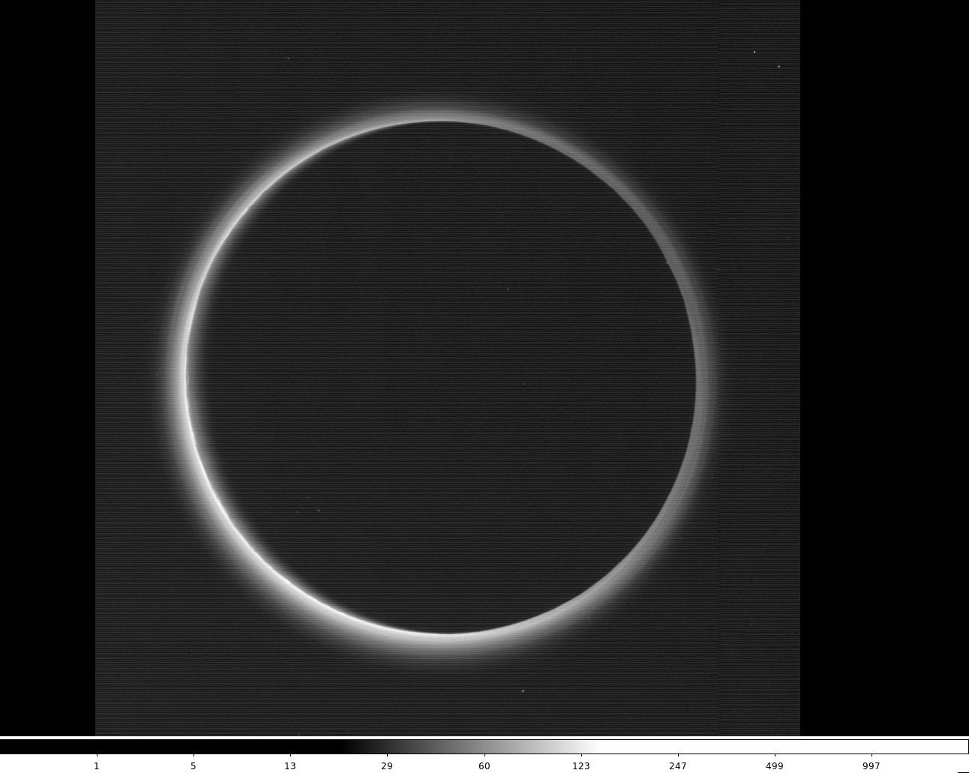
Example of a new image: mc2_0299193157_0x536_eng

Slide 7
nh-x-mvic-2/3-plutocruise-v1.0
Does it contain all Pluto cruise data, or just those already downlinked? (Are we expecting more cruise data to come?)

Slide 8
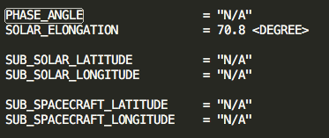
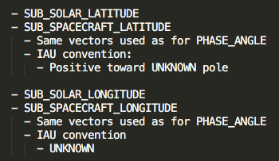
Image Label
It’s useful to have a NOTE in label to explain the geometric parameters.
However, when TARGET_NAME = “N/A”:
Some geometric parameters are undefined, but the way they are explained in the NOTE section is potentially confusing
Example from mc0_0052459368_0x536_eng.lbl

Slide 9
Documentation
A few problems persistent from the previous review:
nh_mission_trajectory.tab contains the trajectory of the whole mission, nh_trajectory.tab covers the first half of 2007 (Jupiter phase). Suggest to remove the latter
No documentation for the columns of housekeeping data table contained in each raw images
soc_inst_icd.pdf (next slide):
page 54, table 10-2, 10-3: Data format not consistent with the specifications in these two tables
page 66, 10.3.4: The unit for resolved and unresolved sources are reversed
page 67, 10.3.6: Information outdated, and conflict with 10.3.13

Slide 10
soc_inst_icd.pdf
page 54, table 10-2, 10-3: Data format not consistent with the specifications in these two tables
028769/mc0_0287692247_0x536_eng.fit:
HOUSEKEEPING table 75 columns
WINDOW_MISMATCHES table 10 columns

Slide 11
soc_inst_icd.pdf
page 67, 10.3.6: Information outdated, and conflict with 10.3.13

