Slide 1
SDC PDS Review Pluto Data: January 2015 to January 2016
A. R. Poppe
U.C. Berkeley
December 5, 2016

Slide 2
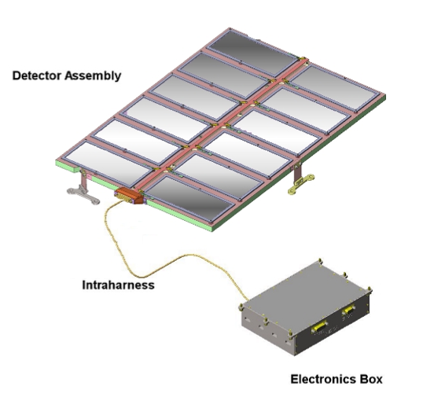
SDC Instrument
SDC instrument:
- 14 detectors: 12 science (with 1 defunct), 2 reference
- electronics box for signal processing, telemetry/commands

Slide 3
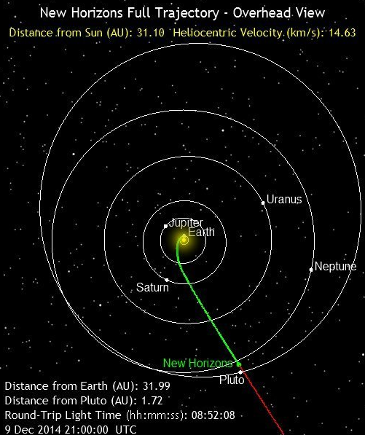
Previous & Current Releases
Three main data periods previously released by SDC:
Launch: March 2006 – Dec 2006, mainly testing and checkout of instrument
Jupiter: Dec 2006 – June 2007, small chunk of data taken post-Jupiter fly-by (note SDC was not on during close approach of Jupiter)
Pluto-cruise: June 2007 – July 2014, main period of scientific data collection by SDC between the orbits of Jupiter and Pluto
Current dataset:
Pluto Encounter: Jan 2015 – Jan 2016, Pluto approach, encounter, post-encounter
SDC launch, jupiter, and cruise datasets cover 1/2006 to 7/2014, Earth to approximately the orbit of Neptune

Slide 4
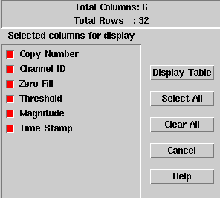
SDC Raw Data
Includes SDC raw scientific data, SDC housekeeping (engineering telemetry), New Horizons spacecraft housekeeping (0x004, 0x00D, 0x00A), and New Horizons thruster firing fata
The SDC raw scientific data includes channel (detector) number, data threshold, data magnitude, and time stamp

Slide 5
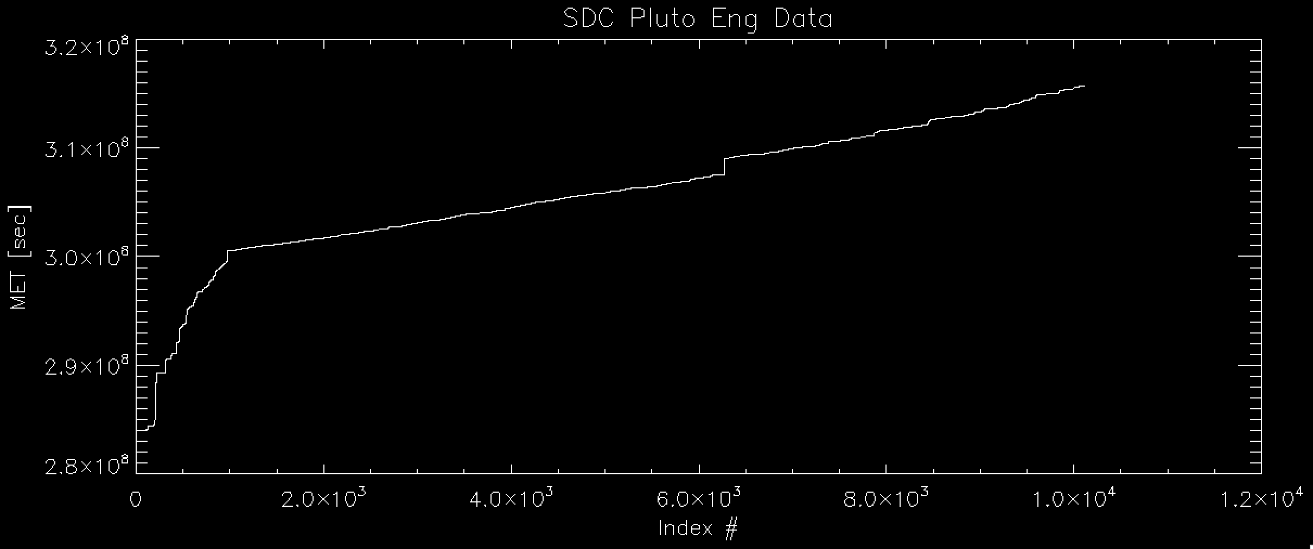
SDC Raw Data
Plot of Mission Elapsed Time vs entry looks good
Total number of events: 10,118
Time period covers: Jan 17, 2015 – Jan 23, 2016
- note: this is about 6 months longer than the data reviewed at the May ‘16 meeting

Slide 6
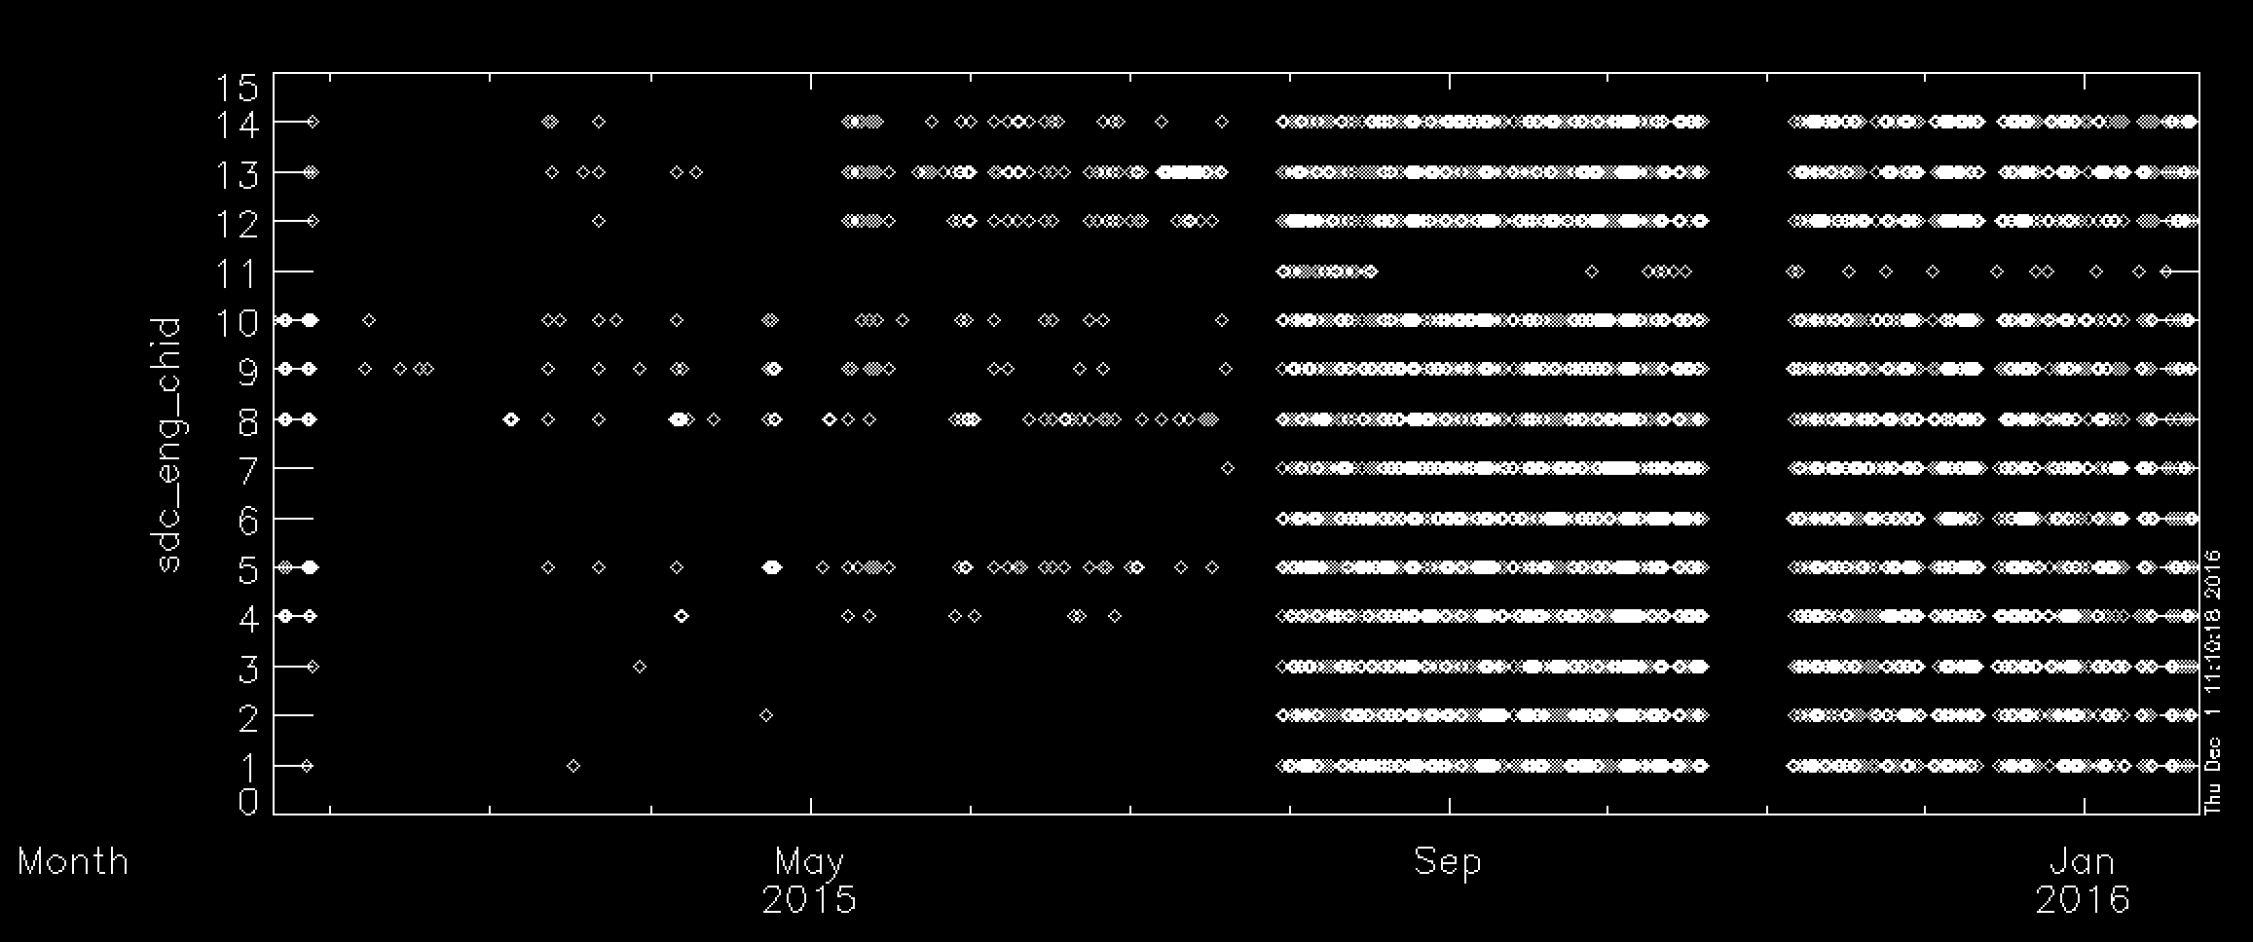
SDC Raw Data
Channel ID# versus Time looks good
Total number of events: 10,118
Time period covers: Jan 17, 2015 – Jan 23, 2016
- note: this is about 6 months longer than the data reviewed at the May ‘16 meeting

Slide 7
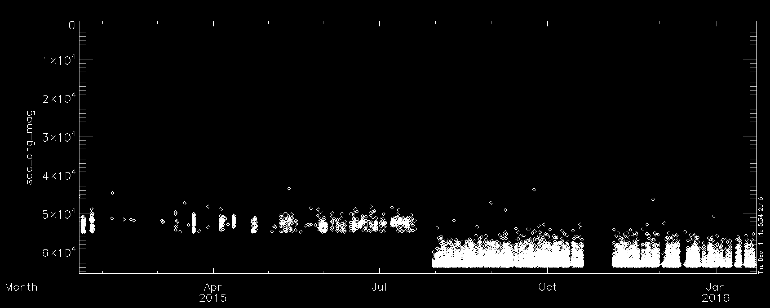
SDC Raw Data
Magnitude versus Time looks good – note threshold change post Pluto encounter
Total number of events: 10,118
Time period covers: Jan 17, 2015 – Jan 23, 2016
- note: this is about 6 months longer than the data reviewed at the May ‘16 meeting

Slide 8
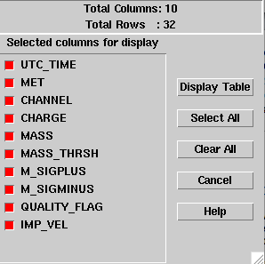
SDC Calibrated Data
Includes SDC calibrated scientific data
The SDC calibrated scientific data includes time, channel, charge, mass, mass threshold, error bars, quality flag, and theoretical SDC-dust relative impact velocity

Slide 9
SDC Calibrated Data - ERROR
These two files are incorrectly formatted:
nh-p-sdc-3-pluto-v2.0/data/20160119_031574/sdc_0315748362_0x700_sci.fit
nh-p-sdc-3-pluto-v2.0/data/20160121_031574/sdc_0315748363_0x700_sci.fit
For some reason, these two files have different dimensions (9 cols) than the properly-formatted SDC science files (10 cols)…
This is the FITS header for a correctly formatted level 3 file:

Slide 10
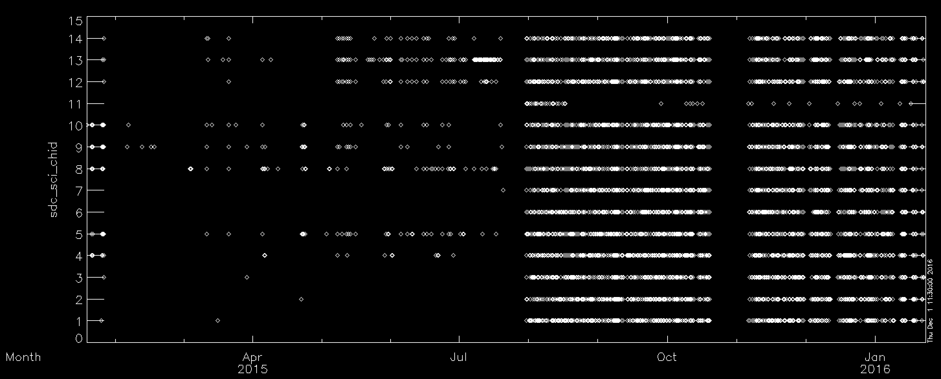
SDC Calibrated Data
Plot of Mission Elapsed Time vs entry looks good
Again, note failure of Channel 11 (described in documentation)
Significantly increased count rate post-Pluto encounter… due to a return to nominal, lower thresholds

Slide 11
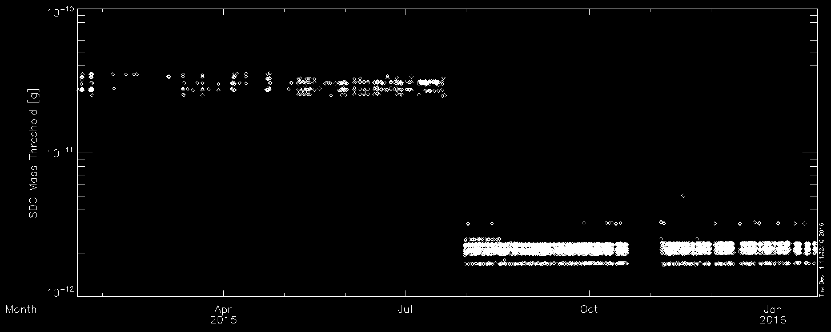
SDC Calibrated Data
SDC minimum thresholds were dropped by about 1 order-of-magnitude post Pluto encounter
This leads to a greater number of events.

Slide 12
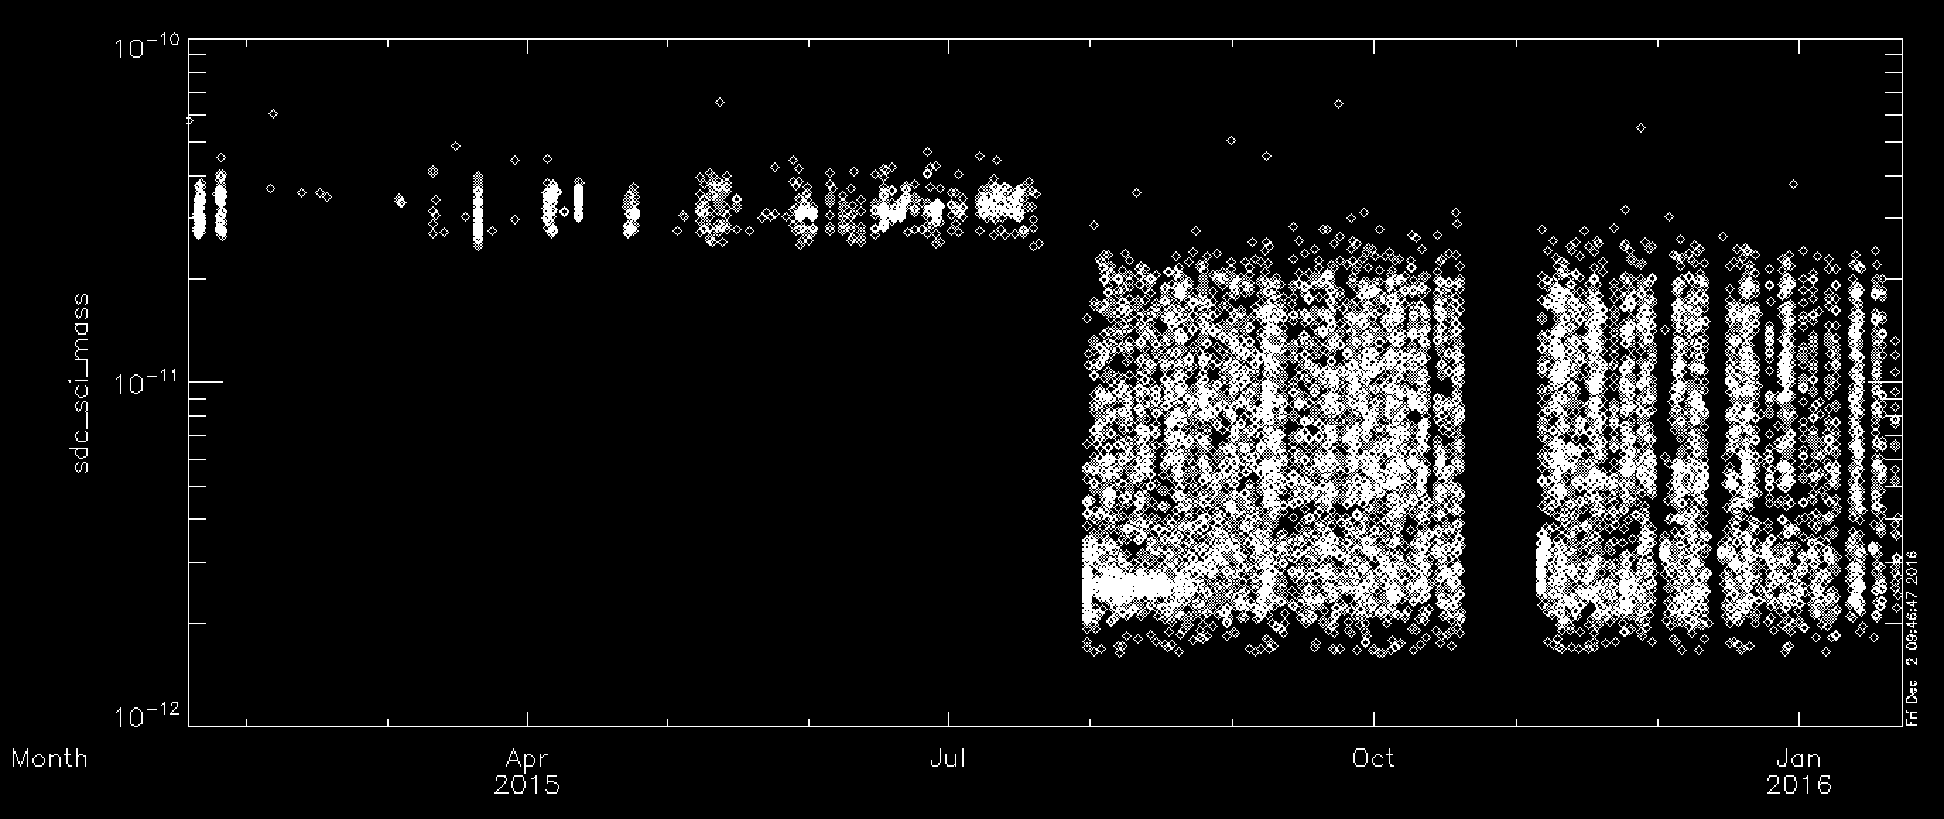
SDC Calibrated Data
SDC minimum thresholds were dropped by about 1 order-of-magnitude post Pluto encounter
This leads to a greater number of events.

Slide 13
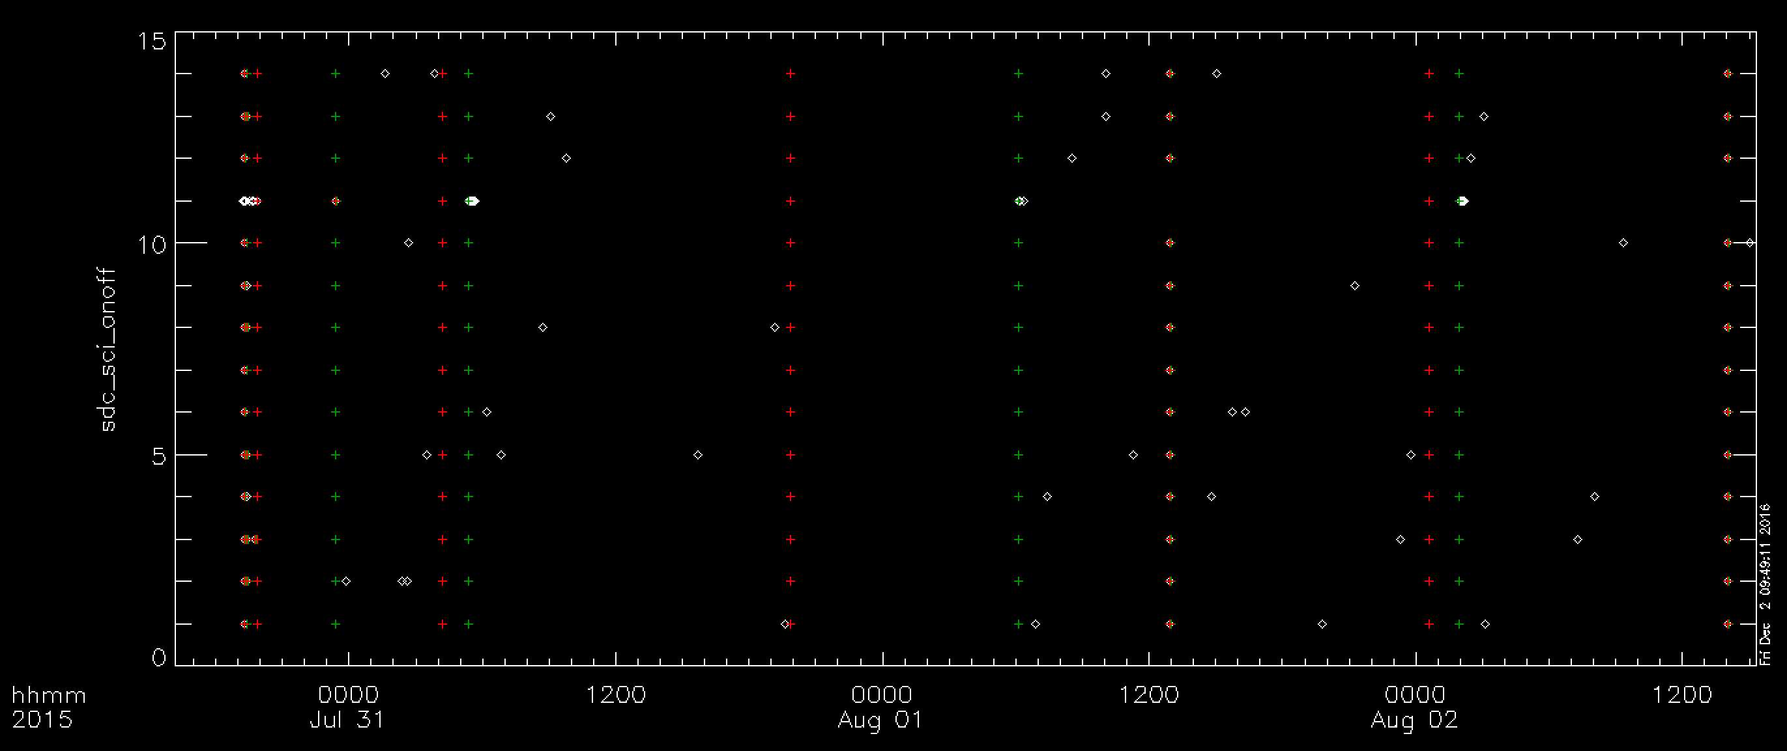
SDC Calibrated Data: On/Off
Incorrect on/off table for SDC has been successfully resolved from May 2016 review

Slide 14
Textual Edits: nh-p-sdc-[2,3]-pluto-v2
Aareadme.txt:
Under “Whom to contact…”: Mihaly’s name is mis-spelled, and is duplicated two lines in a row
Dataset.cat, Data Set Overview,1st paragraph:
“New Horizon” -> “New Horizons”
Dataset.cat, Data Set Overview,3rd paragraph:
“...limit is lower than earlier in the mission...”
Document/docinfo.txt:
LUNINEETAL1995.PDF: “background” is mis-spelled
Document/nh_mission_trajectory.lbl:
DESCRIPTION: “instrument” mis-spelled
Data/*/*.lbl:
Under “QUALITY_FLAG” description, “initials” is mis-spelled

Slide 15
Misc questions - nh-p-sdc-[2,3]-pluto-v2:
document/sdc_seq_pluto.tab
There’s only entry here… is this correct?
Differs, for example, from the plutocruise dataset, which has several sequences listed

Slide 16
Completeness:
Each time period (launch, jupiter, cruise, pluto) has a complete set of files and documentation
Adequate completeness of each data record (i.e., one dust hit)
Intelligibility:
Documentation is adequate and straightforward
SDC data are intelligibly formatted through FITS files, both raw and calibrated
Metadata are straightforward through ASCII implementation
Interpretability:
Given the relatively simple nature of SDC operations, the data are straightforwardly interpretable; no issues noted here
Only one major lien:
Need to correct two files in the nh-p-sdc-3-pluto-v2.0 dataset

