Slide 1
New Horizons PDS Review REX Filter and Radiometry
Frank Centinello
NOAA Aircraft Operations Center
Lakeland, FL
( frank.centinello@noaa.gov , frank.cent@gmail.com )
19 June 2017

Slide 2
Overview
I have no prior experience with the FIT data format.
Documentation was generally sufficient and well-organized.
No additional documentation is needed.
FIT files were first opened with the fv and hera applications.
Just opening a subset of files, and looking at some of the FIT contents.
ALL FIT files were successfully read using the fdump application of the FTOOLS/HEASoft package.
All *packetized* FIT Filter and Radiometry calibrated and pre-calibrated data were plotted. Only the packetized files were selected due to post-2007 anomalies associated with compression referenced in .
Calibration attempts from v2.0 ENG raw data to v1.0 SCI were successful for Filter In-Phase and Quadrature.
Differences between my calibrated values and those in the v1.0 SCI FITs were <1.0e-5 – 1.0-6 mV
… but slightly more instruction (or documentation) might be needed for calibrating the Radiometry data.

Slide 3
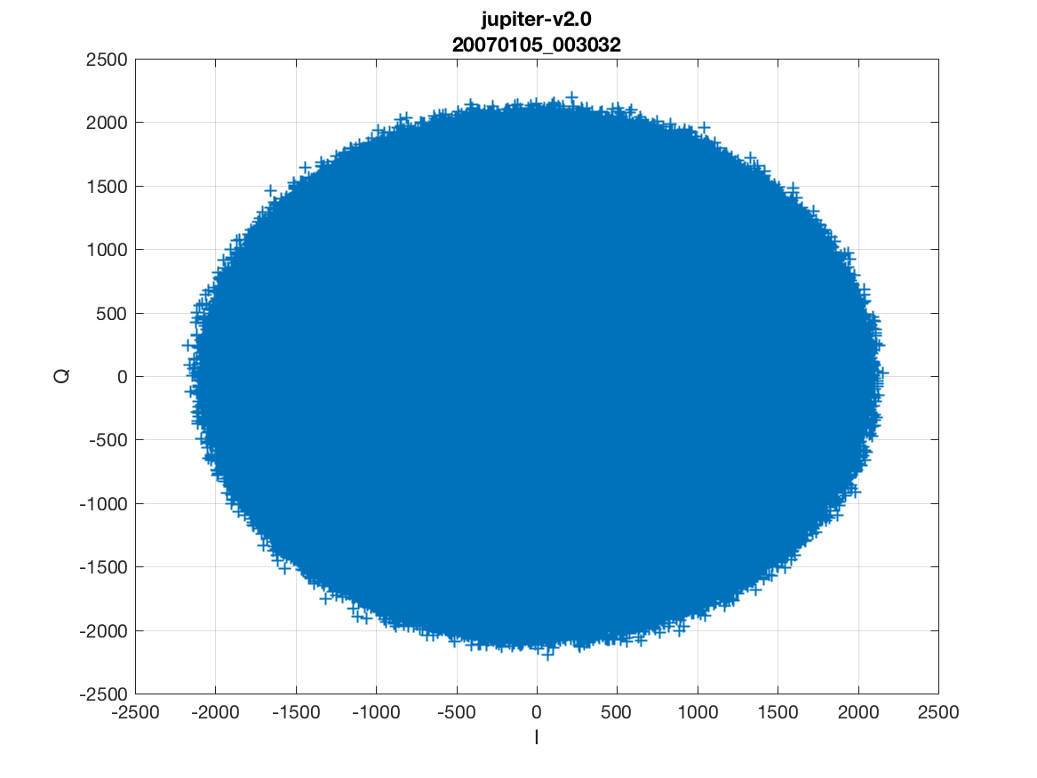
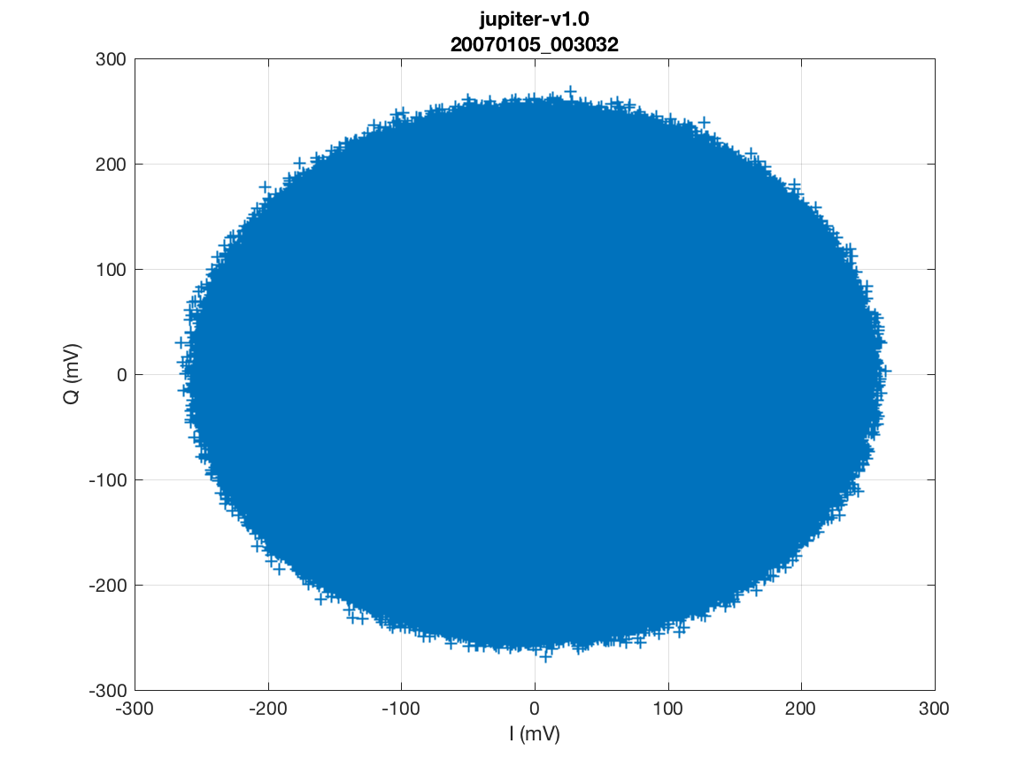
IQ Filter Data
I and Q values were plotted for all folders. Plots show all I and Q values in the folder for Jupiter 20070105_003032 – so all the I and Q values for all the METs contained in that time. This was done for all packetized FIT files.
Uncalibrated I and Q
Calibrated I and Q

Slide 4
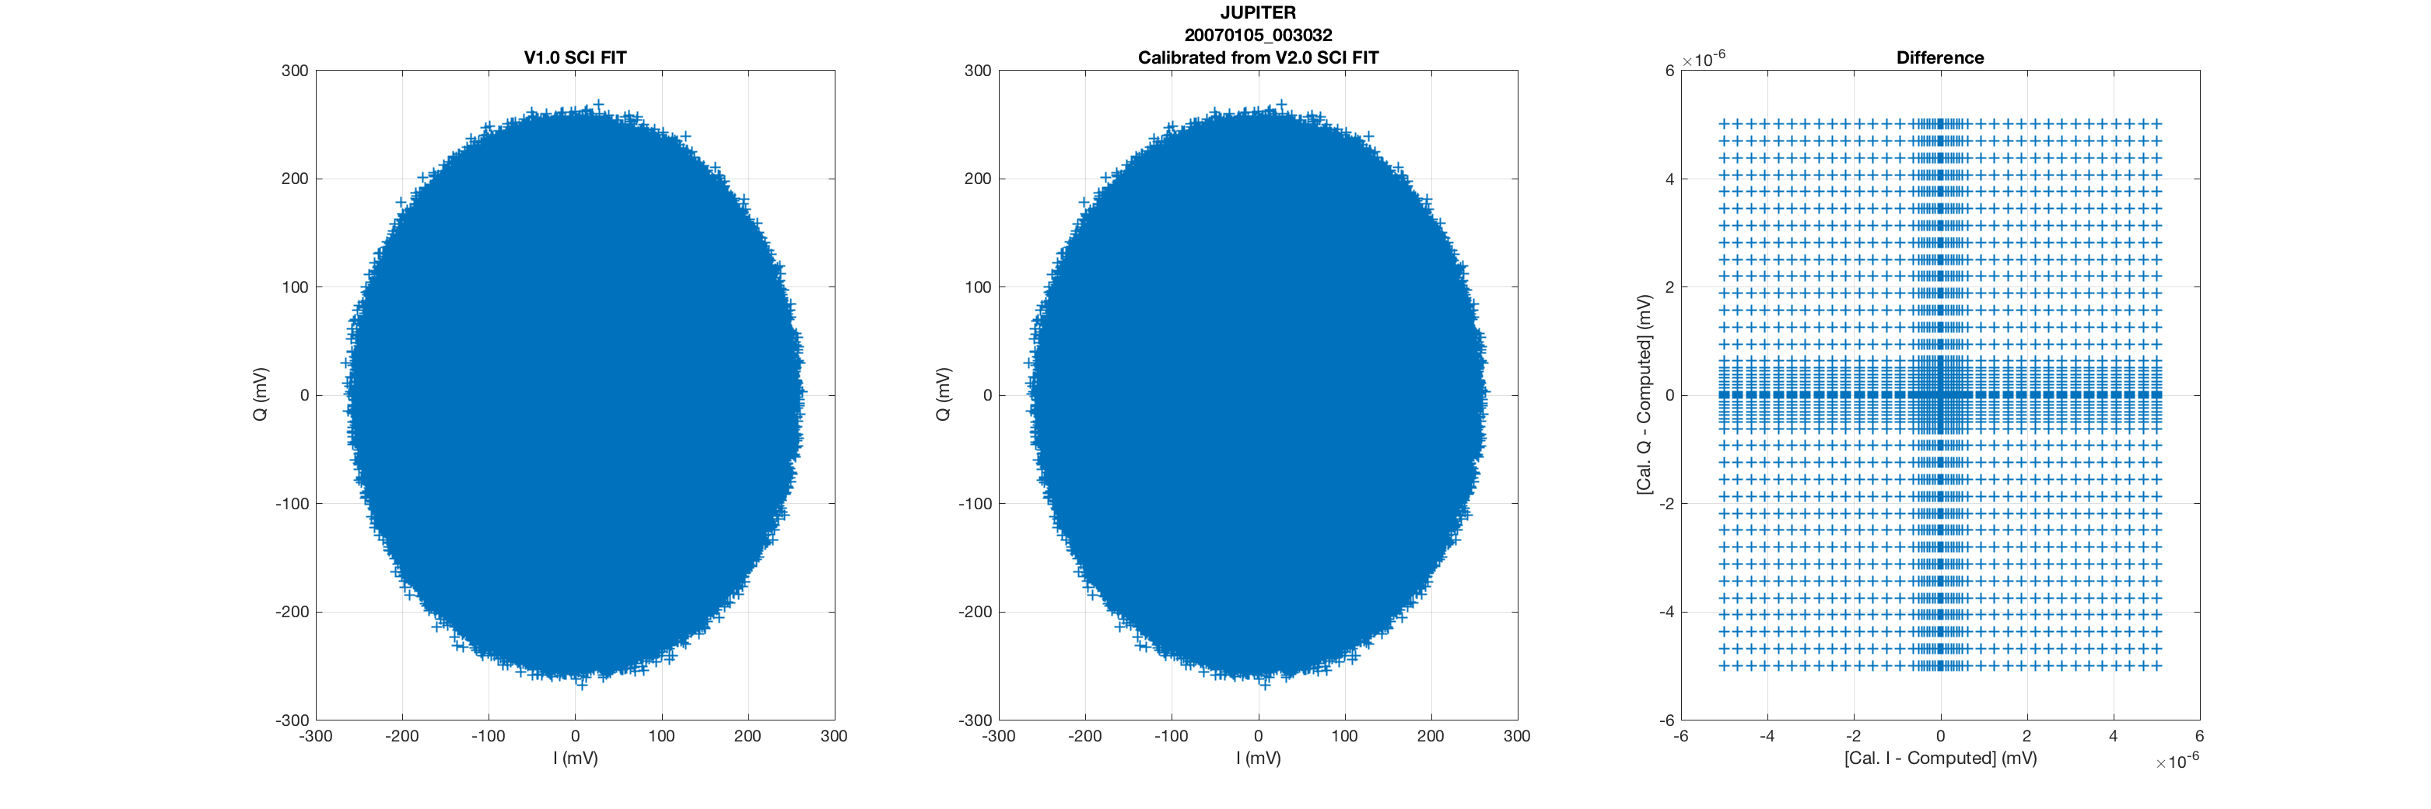
IQ Filter Data Calibration
The left plot contains the calibrated data from a V1.0 SCI FIT file.
The center plot is data calibrated from a V2.0 ENG FIT file using the description in the ICD, Section 12.
The right plot is the difference between the right plt and the center plot.
This was done for all packetized FIT files.
Differences were <1.0e-6 to 1.0e-5 mV.

Slide 5
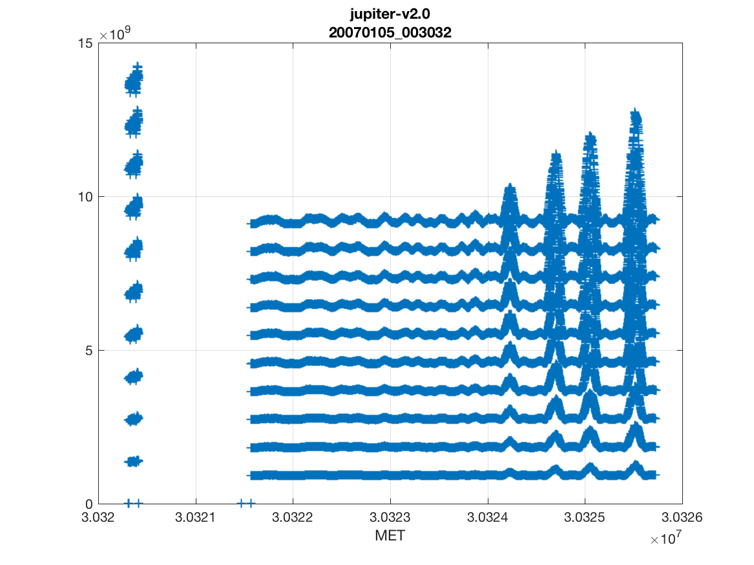
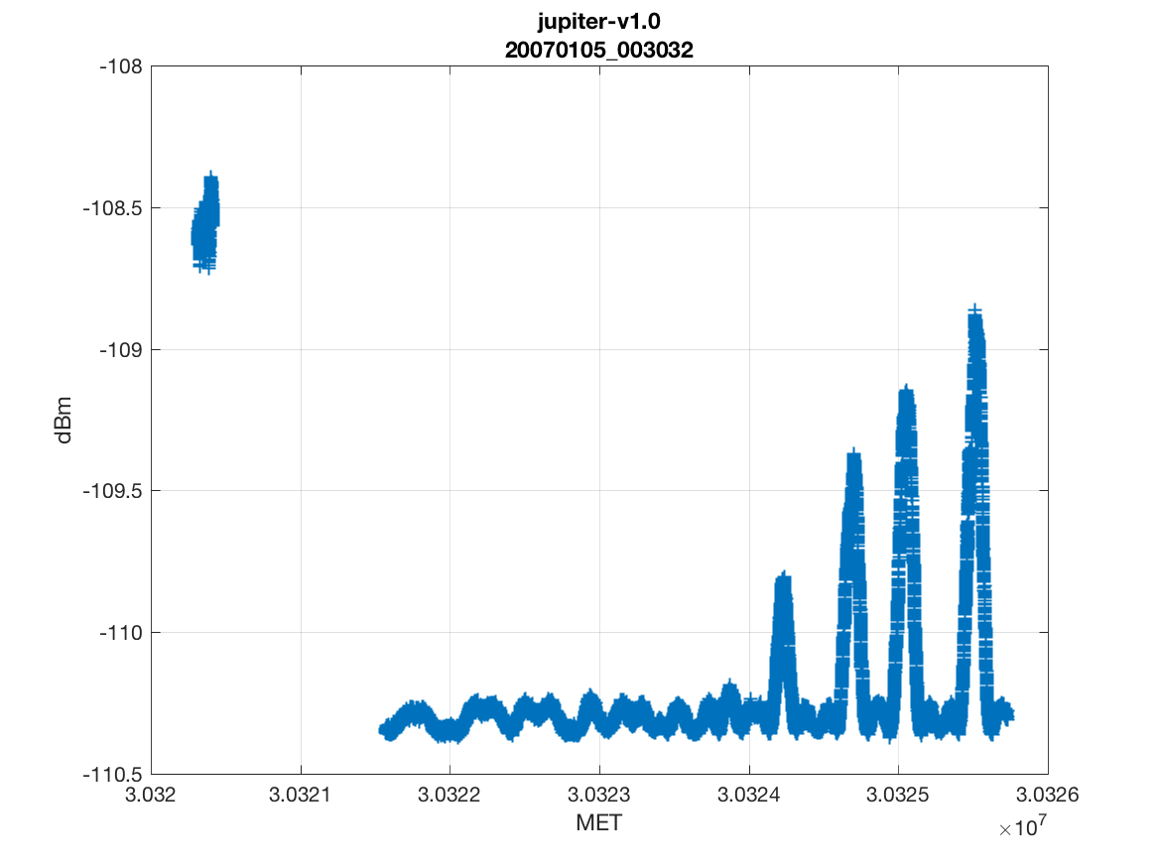
Radiometry Data
Radiometry values were plotted for all folders, in the same way as with the Filter data. These plots contain the data from all the FIT files in the JUPITER 20070105_003032 folder. These plots were made from the *packetized* data in all folders from all mission phases.
Uncalibrated Radiometry Data
Calibrated Radiometry Data

Slide 6
Radiometry Calibration
Calibration of Radiometry Data was attempted, but unsuccessful. For example, in the file:
../nh-j-rex-2-jupiter-v2.0/data/20070105_003031/rex_0030311311_0x7b3_eng.fit
The filename appears to indicate this is a Side B file (given the *b3* string), but when AGC gain was queried from the REX_AGCGAINA.CSV, it seems as though Side A was in use.
I was NOT able to reconstruct the V1.0 calibrated values from the V2.0 values using Section 12 of the ICD, or other supporting documents.
dBm = Rbase + 10*log10(RAW(ii)*4.5e6) + dBstep*(AGC-AGCoffset) + Ro;
Where: Rbase=-178 dB, dBstep=0.475,
AGC = 152? 157? (from *.CSV files ) - or - 163 as reported in the label
SIDE A: AGCoffset = 167, Ro = -100.19 dB
SIDE B: AGCoffset = 163, Ro = -103.7 dB

Slide 7
Radiometry Calibration (continued)
In the file: ../nh-p-rex-2-pluto-v2.0/data/20160712_033067/rex_0330673806_0x7b3_eng.fit
Radiometer Time Tag
1 28872151477 2540
2 2891185939 2541
3 5781432499 2542
4 8666813569 2543
In the V1.0 SCI FIT file:
1 -1.1056308E+02 2.6009601E+02 0
2 -1.1055711E+02 2.6019839E+02 0
3 -1.1055853E+02 2.6030081E+02 0
4 -1.1056584E+02 2.6040320E+02 0

Slide 8
Radiometry Calibration (continued)
In the file: ../nh-p-rex-2-pluto-v2.0/data/20160712_033067/rex_0330673806_0x7b3_eng.fit
Index | V1.0 SCI | V2.0 ENG | Reconstruction
1 | -1.1056308E+02 | 28872151477 | -1.105630833e+02
2 | -1.1055711E+02 | 2891185939 | -1.205571146e+02
3 | -1.1055853E+02 | 5781432499 | -1.175475202e+02
4 | -1.1056584E+02 | 8666813569 | -1.157892803e+02
5 | -1.1055772E+02 | 11557599801 | -1.145391983e+02
6 | -1.1056535E+02 | 14443313375 | -1.135712065e+02
7 | -1.1055474E+02 | 17336078737 | -1.127783661e+02
8 | -1.1055918E+02 | 20225888238 | -1.121087988e+02
9 | -1.1055001E+02 | 23121808316 | -1.115276568e+02
10 | -1.1056624E+02 | 26006925997 | -1.110169846e+02
Side B values used for AGCoffset and Ro.
163 was used for AGC.
Only the first value matches the V1.0 SCI FIT value.

Slide 9
Conclusions & Recommendations
Documentation was sufficient to begin examination of FIT format data.
All FIT files were read successfully. I and Q, as well as radiometry data were read from packetized FIT files, and plotted. I can share those with the team if they’d like to see them.
Calibrated I and Q values were calculated using the instructions in the ICD with all raw I and Q values from *eng*fit files. Differences between my calibration and those in the V1.0 SCI files were <1.0e-5 mV. Plots of all of these differences can be made available as well.
Calibrated radiometry data were not able to be recovered using the ICD and supporting documentation, though this may simply be user error, or indicate a need for additional clarification in documentation.

